Slide 1
Bismark Data Processing Method
Caihong Xia
01-22-2021

Slide 2
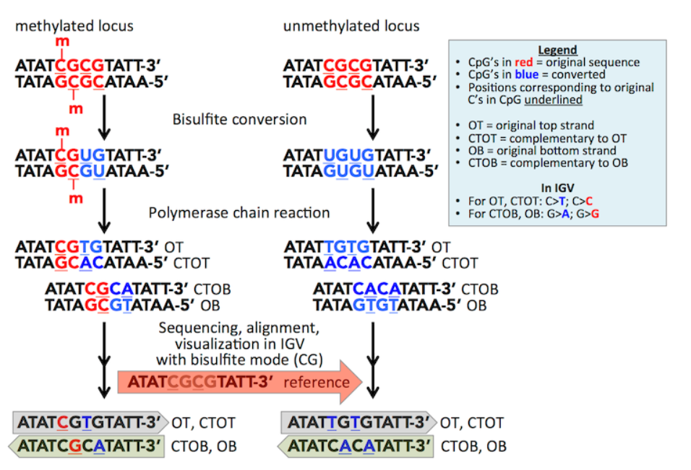
Whole Genome Bisulfite Sequencing (WGBS)

Slide 3
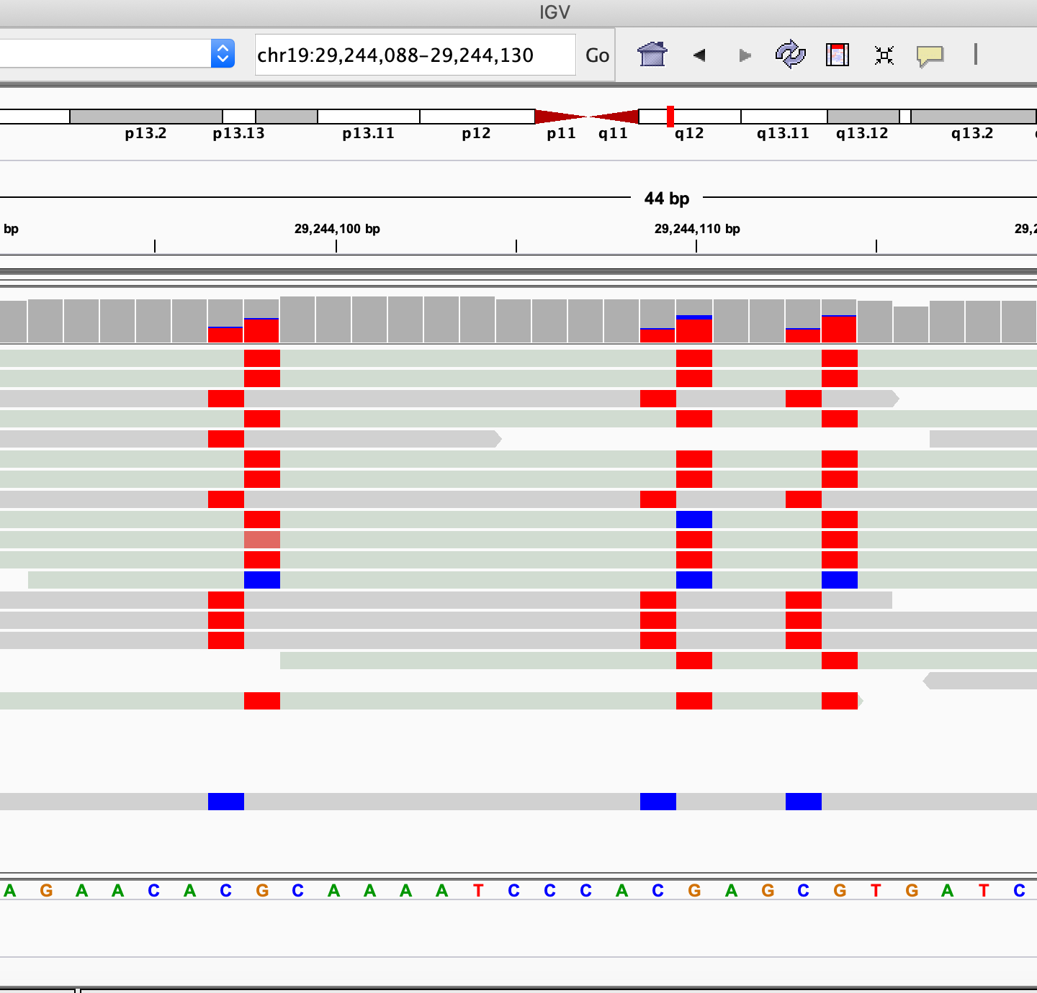
Visualization with Integrative Genomics Viewer (IGV)
Example to Count methylation reads:
Per-Cytocine metrics:
At C (read from OT + CTOT strand, shaded with gray):
# Met (red): 5
# Un-met (blue) : 1
# Coverage: 5+1=6
At G (read from OB + CTOB strand, shaded with sage):
# Met (red): 9
# Un-met (blue): 2
# Coverage: 9+2=11
Per-CpG metrics:
# Met (red): 5+9=14
# Un-met (blue): 1+2=3
# Coverage: 14+3=17
# Methylation rate: 14/17=0.82

Slide 4
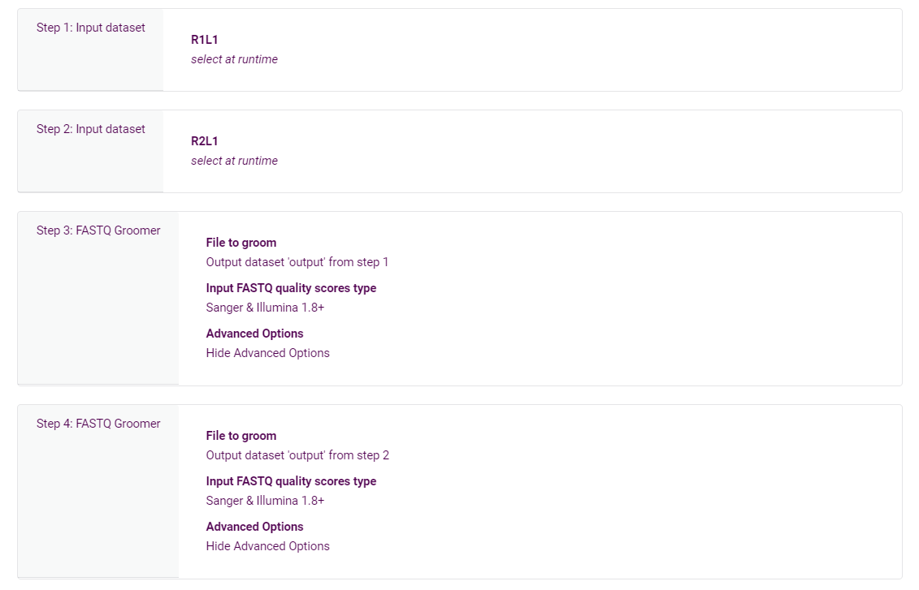
From .FASTQ to .bam files
usegalaxy.eu

Slide 5
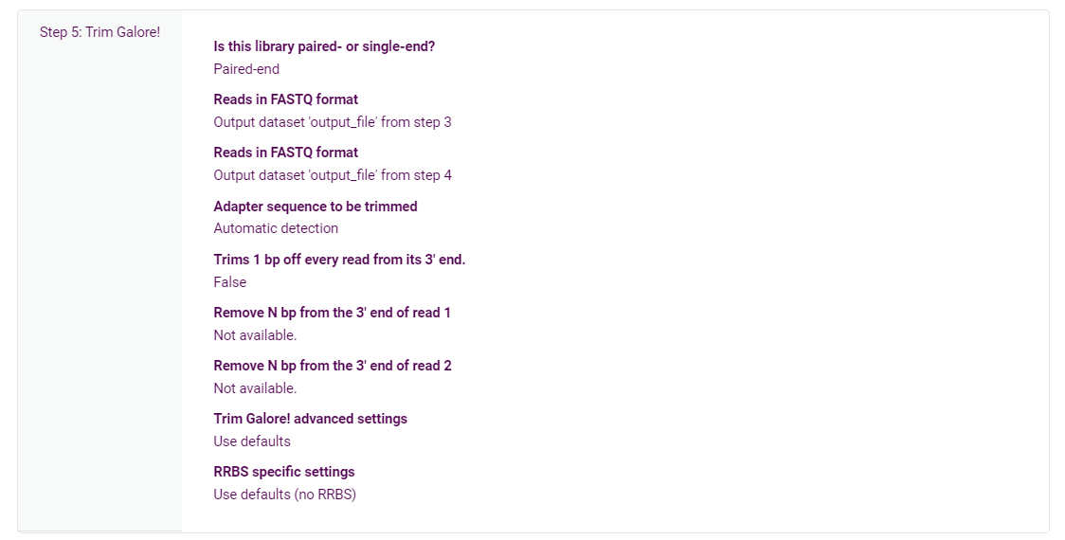
From .FASTQ to .bam files
usegalaxy.eu

Slide 6
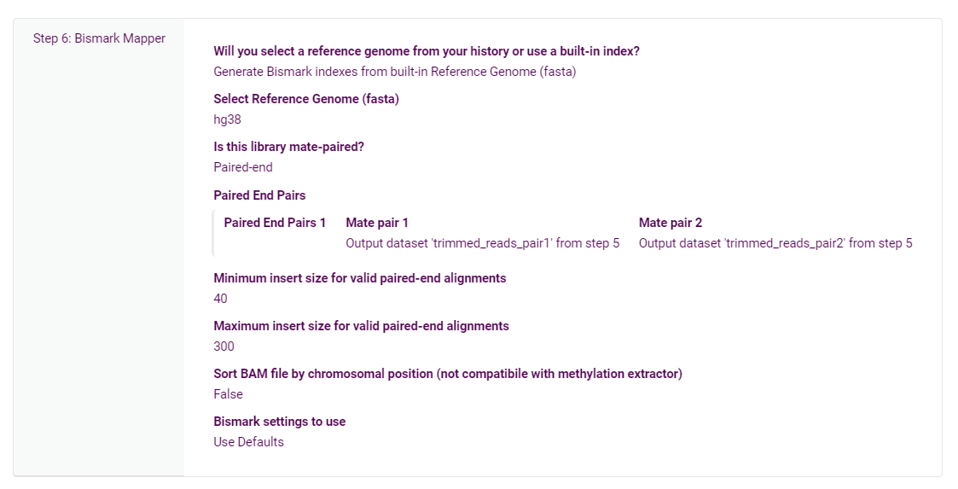
usegalaxy.eu
From .FASTQ to .bam files

Slide 7
From .bam to .bed files
https://www.bioinformatics.babraham.ac.uk/projects/bismark/
For sample 1, I have sequencing results from 4 different runs:
AS1L1.bam AS1L2.bam BS1L1.bam BS1L2.bam
Step 1. Merge and deduplicate
nohup deduplicate_bismark --bam -p --multiple AS1L1.bam AS1L2.bam BS1L1.bam BS1L2.bam &
Step 2. Remove non-converted reads
nohup filter_non_conversion -p AS1L1.multiple.deduplicated.bam —-threshold 1 &
Step 3. Output coverage & strand specific methylation info
nohup bismark_methylation_extractor --gzip --bedGraph --parallel 20 AS1L1.multiple.deduplicated.nonCG_filtered.bam &
Your will get 10+ output from step 3. Use the following 3 in R to make .bed file:
AS1L1.multiple.deduplicated.bismark.cov.gz
CpG_OB_AS1L1.multiple.deduplicated.txt.gz
CpG_OT_AS1L1.multiple.deduplicated.txt.gz
Step 4. Make CpG-metric bed files in R
SampleBismarkMakeData.rmd (attached in email)

Slide 8
From .bam to .bed files: work on HPC
The merge and filter non-converstion step don't support multithreading, but the methylation extraction step does. So I did these steps separately.
Step 1. Run MergeFilter.sh (assuming you have 6 samples):
sbatch --array=1-6 MergeFilter.sh
Step 2. Run extractmet.sh:
sbatch --array=1-6 extractmet.sh
The two shell scripts were attached in email.

Slide 9
Subset .bam files to view with IGV
# subset
samtools view -H file.bam > header
samtools view file.bam | grep chr19 > chr19_only.sam
cat header chr19_only.sam | samtools view -bS - > chr19.bam
# remove duplicate
deduplicate_bismark --bam -p chr19.bam
# sort and index
samtools sort chr19.deduplicated.bam -o chr19.sorted.bam
samtools index chr19.sorted.bam chr19.sorted.bam.bai
# put .bam and .bai files in the same folder and visualize with IGV

Slide 10
Make UCSC bigwig files
Preparation:
Download binary utilities:
http://hgdownload.cse.ucsc.edu/admin/exe/
chmod +x ./bedGraphToBigWig
chmod +x ./fetchChromSizes
chmod +x ./liftOver
./fetchChromSizes hg38 > hg38.chromsizes
# hg38 to hg19 conversion
./liftOver file.bed hg19ToHg38.over.chain.gz file_hg38.bed file_unlifted.bed

Slide 11
Make UCSC bigwig files
# view your data
head -10 wg_s1a.bed
# make beta.bw
cut -f1-4 wg_s1a.bed > wg_s1beta.bed
sort -k1,1 -k2,2n wg_s1beta.bed > wg_s1beta_sorted.bed
./bedGraphToBigWig wg_s1beta_sorted.bed hg38.chromsizes wg_s1abeta.bw
# make coverage.bw
cut -f1-3,5 wg_s1a.bed > wg_s1coverage.bed
sort -k1,1 -k2,2n wg_s1coverage.bed > wg_s1coverage_sorted.bed
./bedGraphToBigWig wg_s1coverage_sorted.bed hg38.chromsizes wg_s1acoverage.bw
# make pwd.bw
sort -k1,1 -k2,2n wgdf12npwd.bed > wgdf12npwd_sorted.bed
./bedGraphToBigWig wgdf12npwd_sorted.bed hg38.chromsizes wgdf12npwd.bw

Slide 12
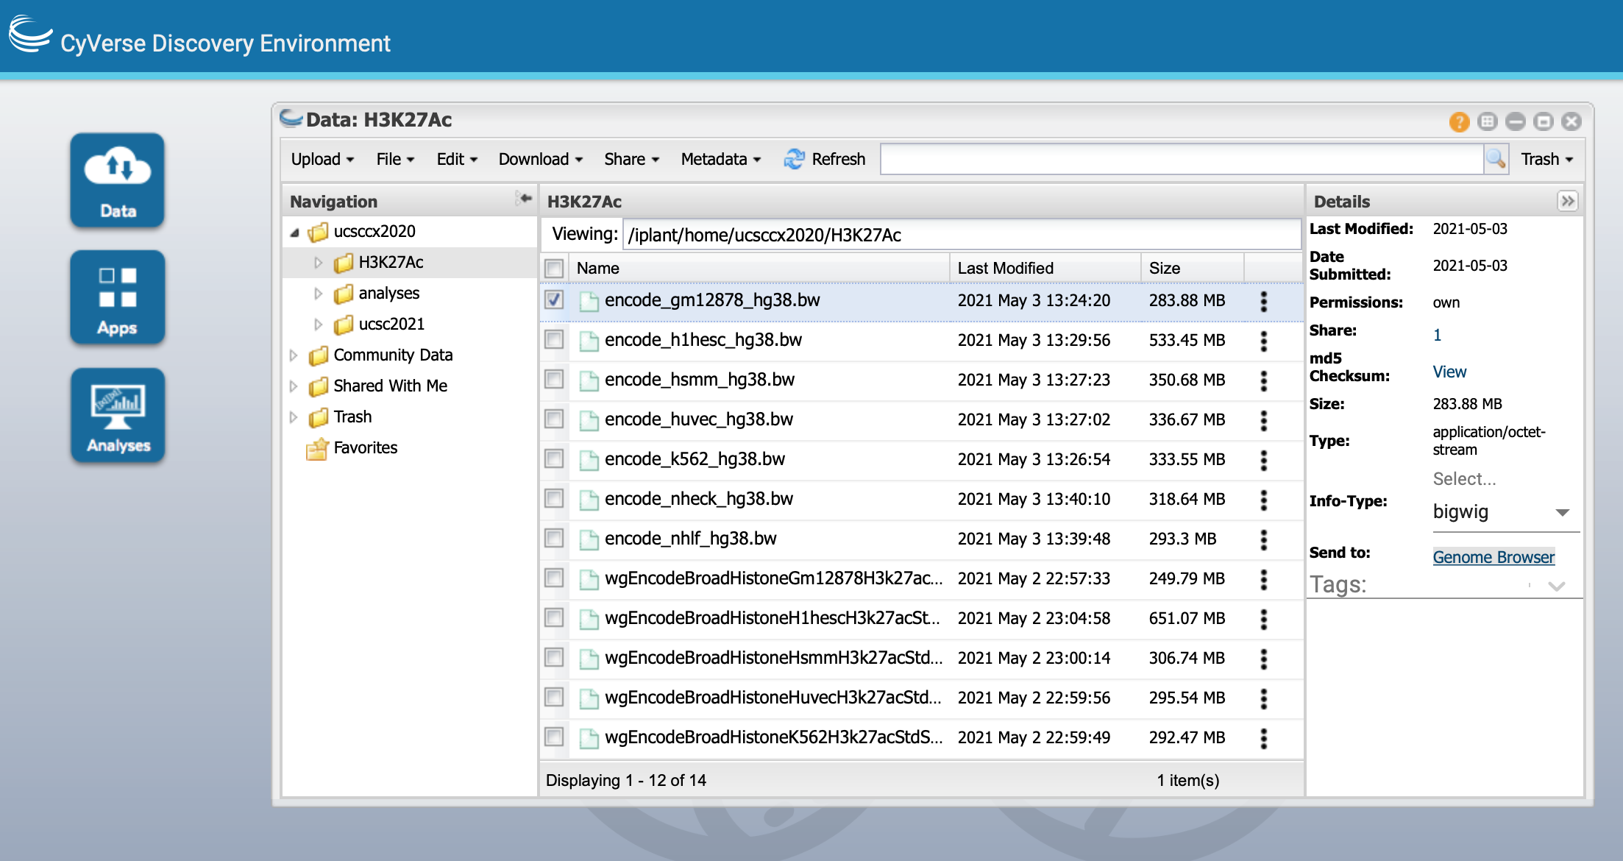
Upload .bw files to cyverse.org
Create your own free account, use this CDE to upload files. Remember to define the type as bigwig and send to Genome Browser for each file.

Slide 13
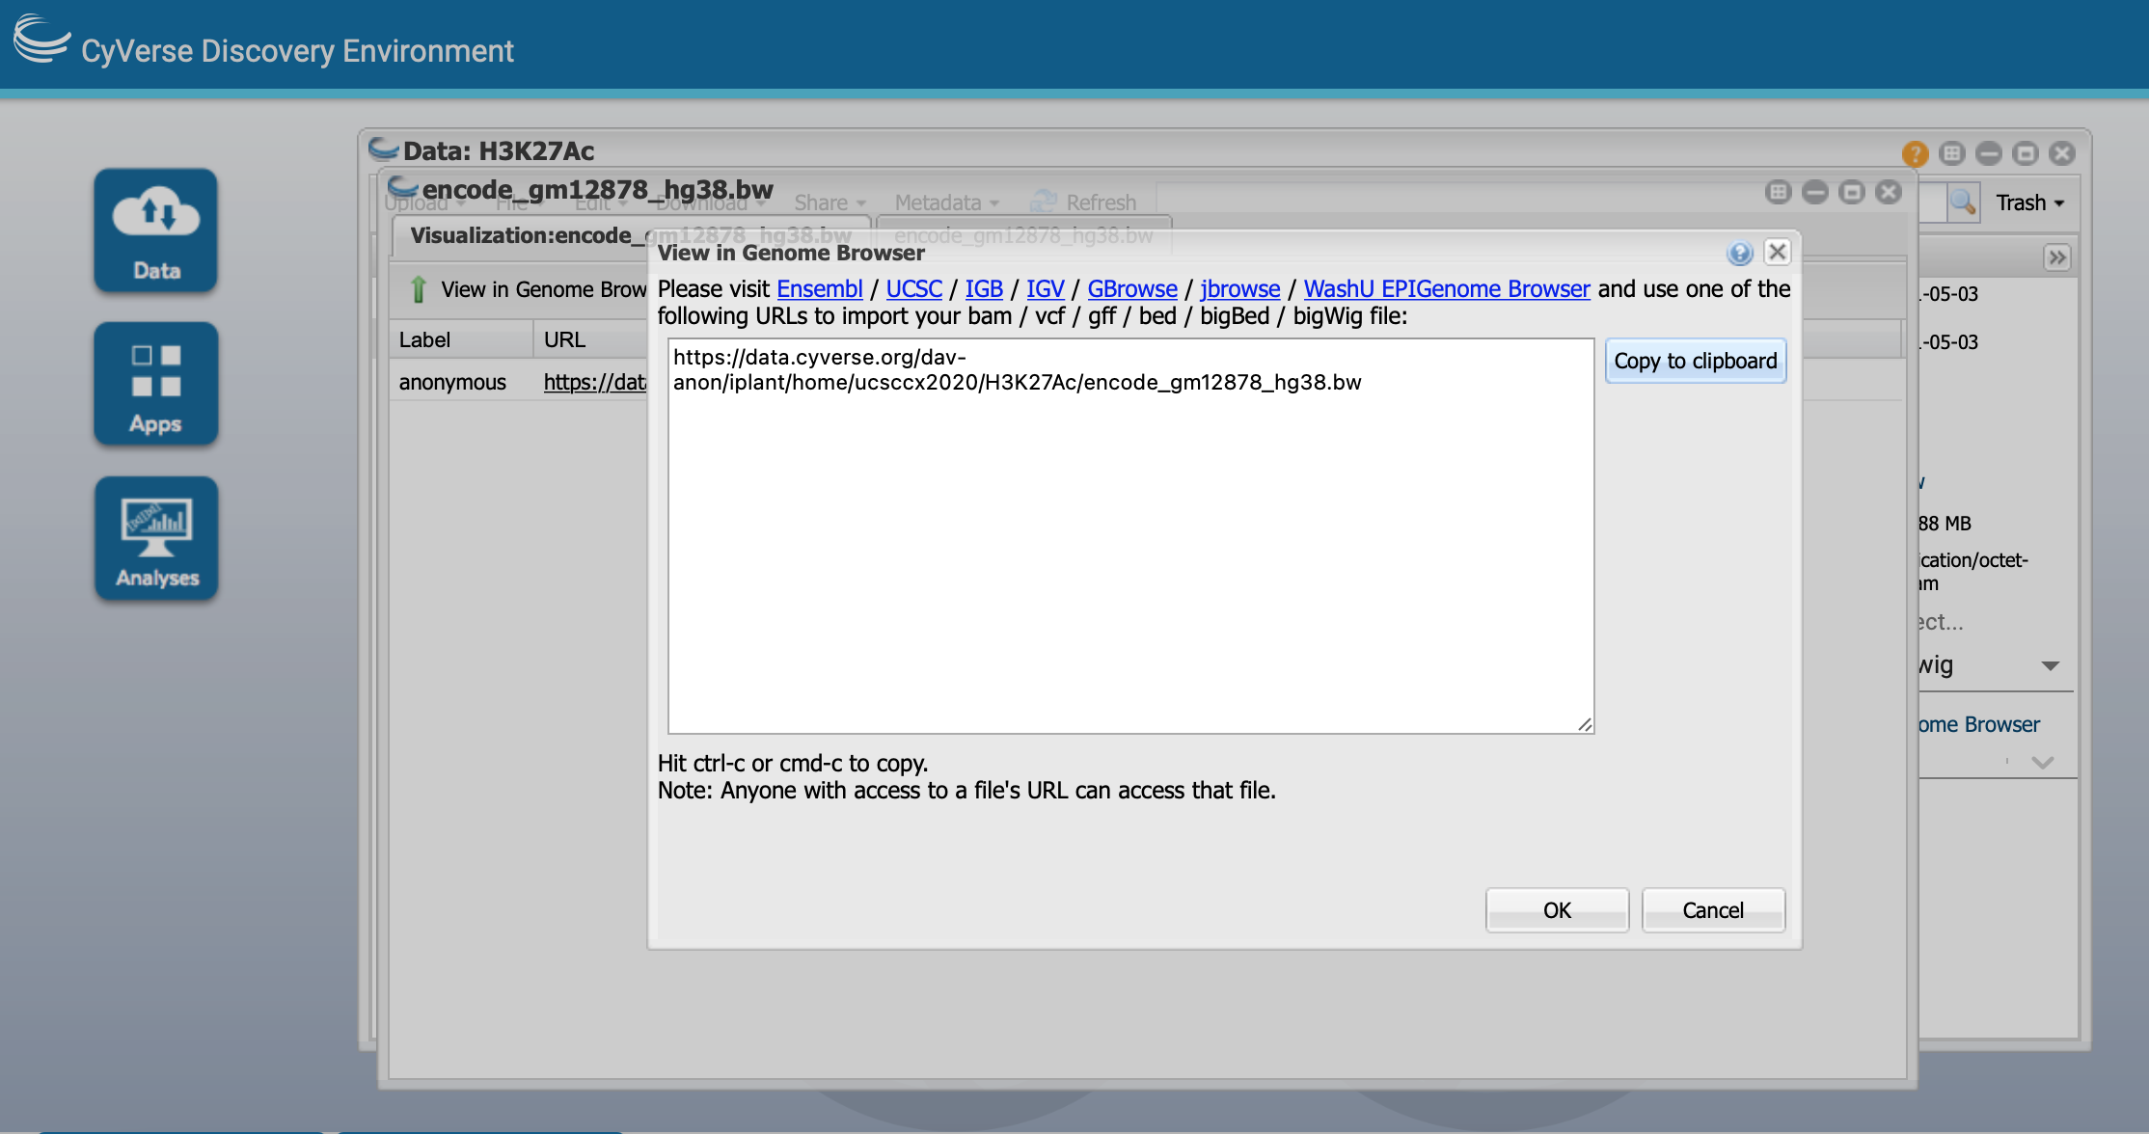
Upload .bw files to cyverse.org
After sending to Genome Browser, you can find the unique link for each file. This step has to be repeated for every single file. Otherwise, the link is not valid.

Slide 14
Make wgN1vsN2caller.txt which contains the following:
# N1-N2
browser position chr12:77324692-77325024
track type=bigWig name=“N1-N2-pwd” description=“N1-N2-pwd” bigDataUrl=https://data.cyverse.org/dav-anon/iplant/home/ucsccx2020/wgdf14pwd.bw
track type=bigWig name=“N1-beta” description=“Normal1-beta” bigDataUrl=https://data.cyverse.org/dav-anon/iplant/home/ucsccx2020/wg_s1beta.bw
track type=bigWig name=“N1-coverage” description=“Normal1-converage” bigDataUrl=https://data.cyverse.org/dav-anon/iplant/home/ucsccx2020/wg_s1coverage.bw
track type=bigWig name=“N2-beta” description=“Normal2-beta” bigDataUrl=https://data.cyverse.org/dav-anon/iplant/home/ucsccx2020/wg_s4beta.bw
track type=bigWig name=“N2-coverage” description=“Normal2-coverage” bigDataUrl=https://data.cyverse.org/dav-anon/iplant/home/ucsccx2020/wg_s4coverage.bw

Slide 15
Upload wgN1vsN2caller.txt to your github account, change the red font to your own file path
https://genome.ucsc.edu/cgi-bin/hgTracks?db=hg38&hgct_customText=http://raw.githubusercontent.com/caihongx/ucscdemo/master/wgN1vsN2caller.txt

