Slide 1


Project Manager: Victoria Donelson
Technical Lead: Sierra Cockerill
Quality Assurance: Bryan Silinski

Slide 2
The initial problem…
No other useful apps for UNCW campus
UNCW information scattered around website
Bus route website is inconvenient
“Interactive” campus map is difficult to use, especially on mobile
Google Maps walking directions are typically inaccurate

Slide 3
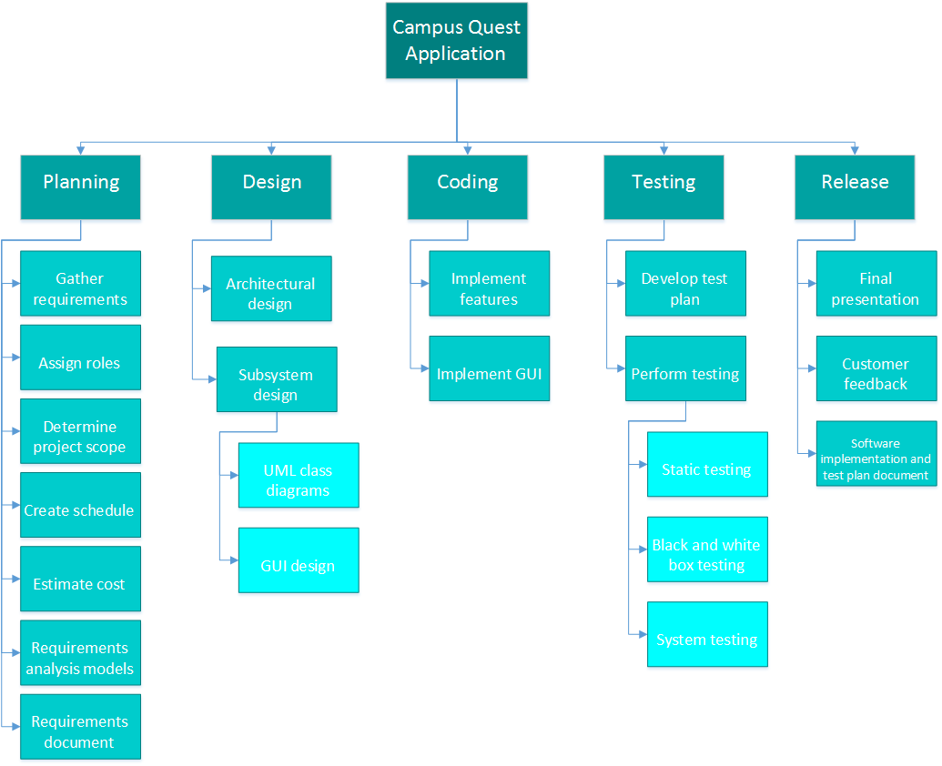
Work breakdown

Slide 4
Responsibility Matrix
Task | Sierra Cockerill | Victoria Donelson | Bryan Silinski
Project Manager |  | X
Quality Assurance Lead |  |  | X
Technical Lead | X
Project Objective | X
Project Scope | X
Success Criteria | X
Collaboration with Stakeholders | X
Work Breakdown |  | X
Project Resources |  | X
Responsibility Matrix |  | X
GANTT Chart |  | X
PERT Chart |  | X
Cost Estimation |  | X
Risk Plan |  | X
Project Monitoring |  | X
Control Mechanisms |  | X
Major Software Functions |  |  | X
Use Case Diagrams |  |  | X
Use Case Descriptions |  |  | X
Activity Diagrams |  |  | X
Sequence Diagrams |  |  | X
Requirements Class Models |  |  | X
Prototype Description | X
Data Dictionary |  |  | X
Limitations and Constraints |  |  | X
Non-functional Requirements |  |  | X
Problems Encountered | X
Bibliography | X
Software Design | X | X | X
Implementation | X | X | X
Testing | X | X | X

Slide 5
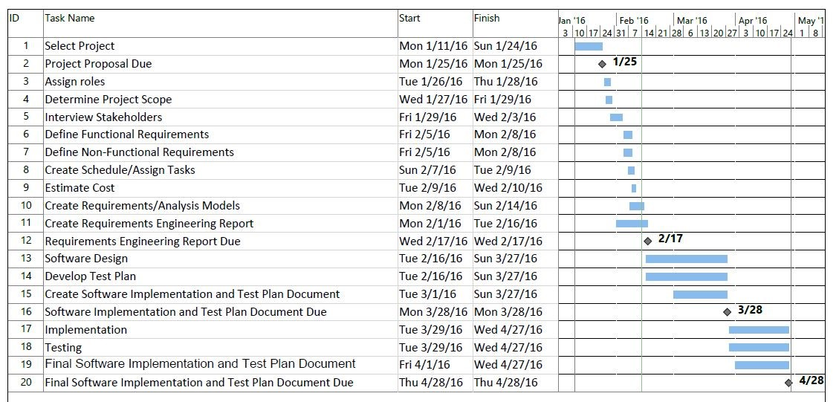
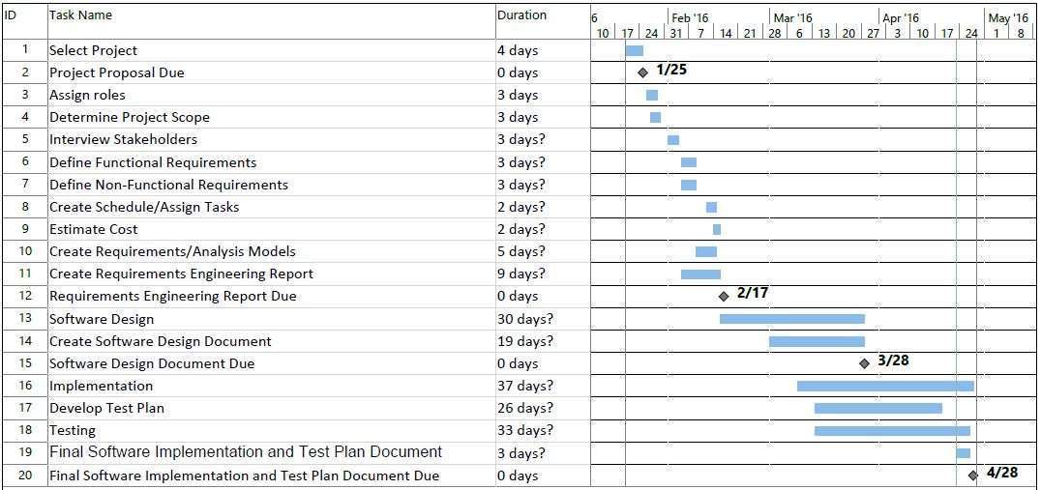
Original Gantt Chart
Final Gantt Chart

Slide 6
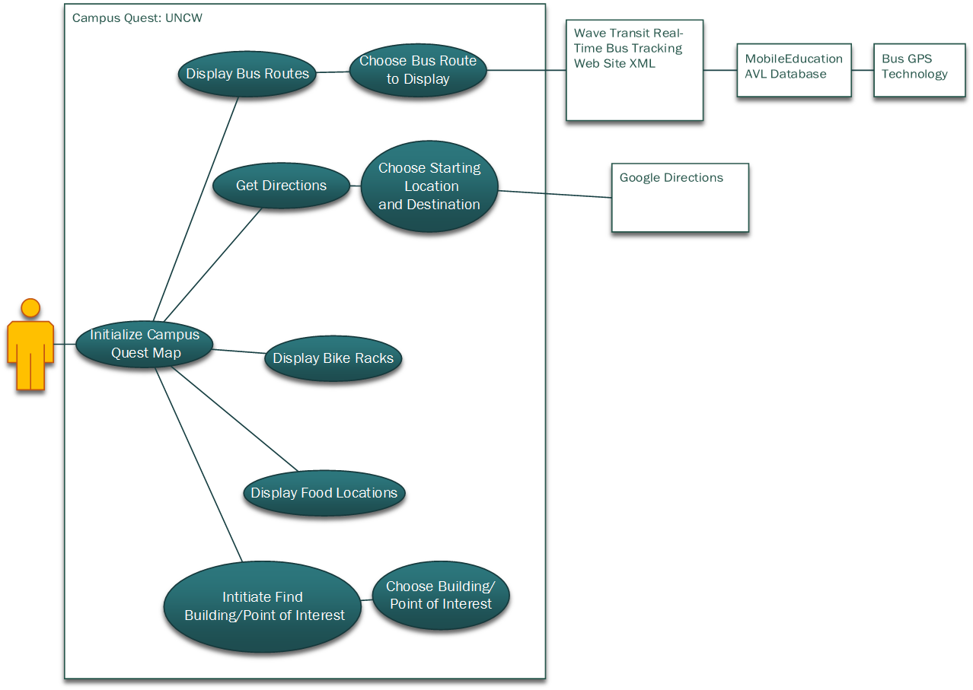
Use Case Diagram

Slide 7
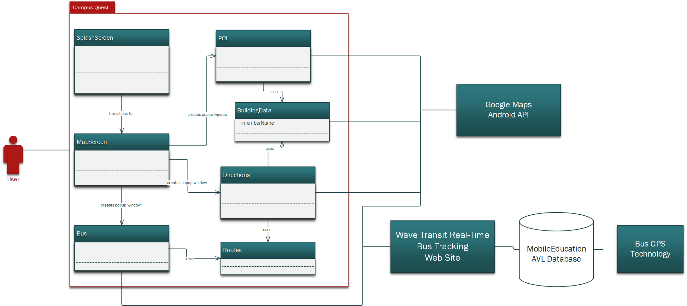
Architectural Design

Slide 8
UML Class Models

Slide 9
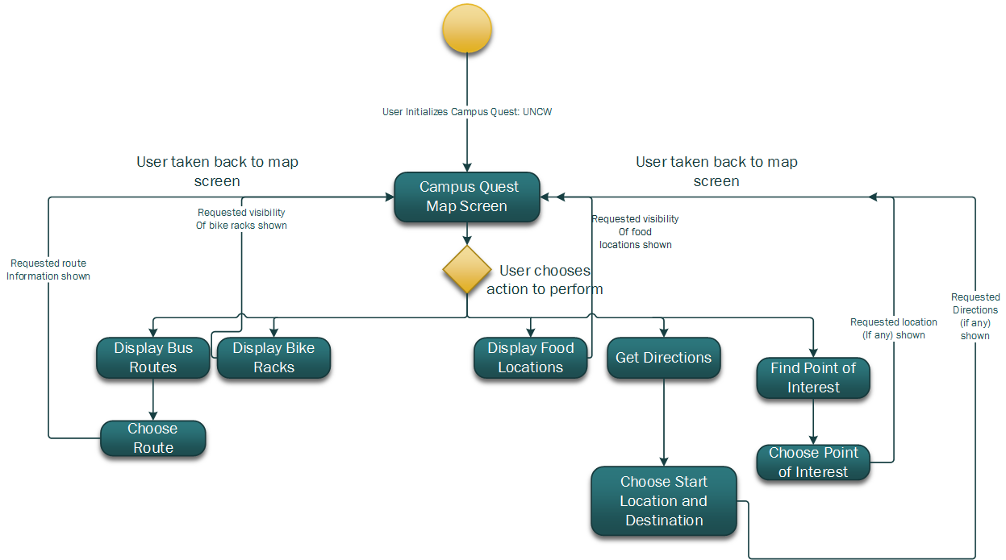
Activity Diagram

Slide 10
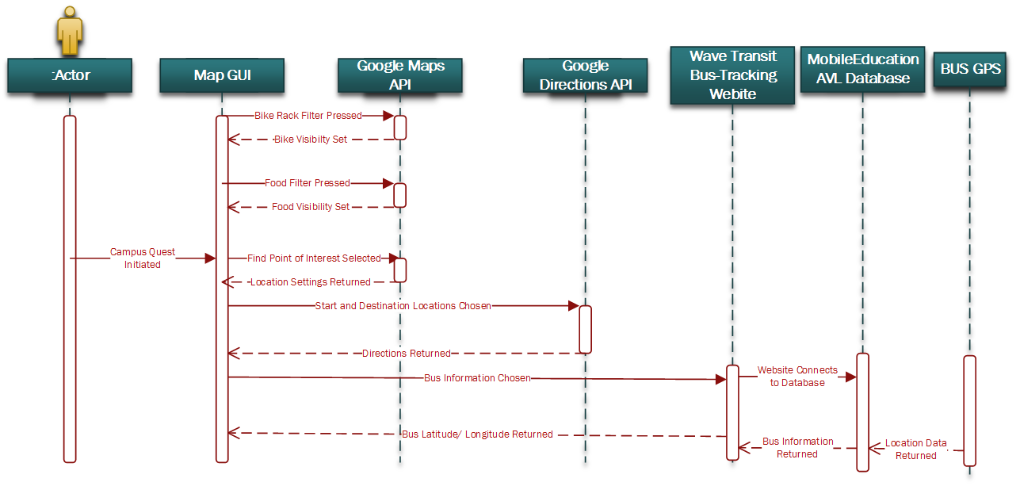
Sequence Diagram

Slide 11
Effort Expended
Lines of code: Total = 1,824
  Java: 854
  XML: 380
  Text data: 590
9 Java classes, 7 text files, 7 XML layout files, 58 images/icons
17 methods
222 lines of comments!

Slide 12
Testing
Testing method: Validation
Repeated test phases after each major function was finished
Interesting bugs we had to fix:
  Directions led through the pond
  Could not get directions multiple times in a row

Slide 13
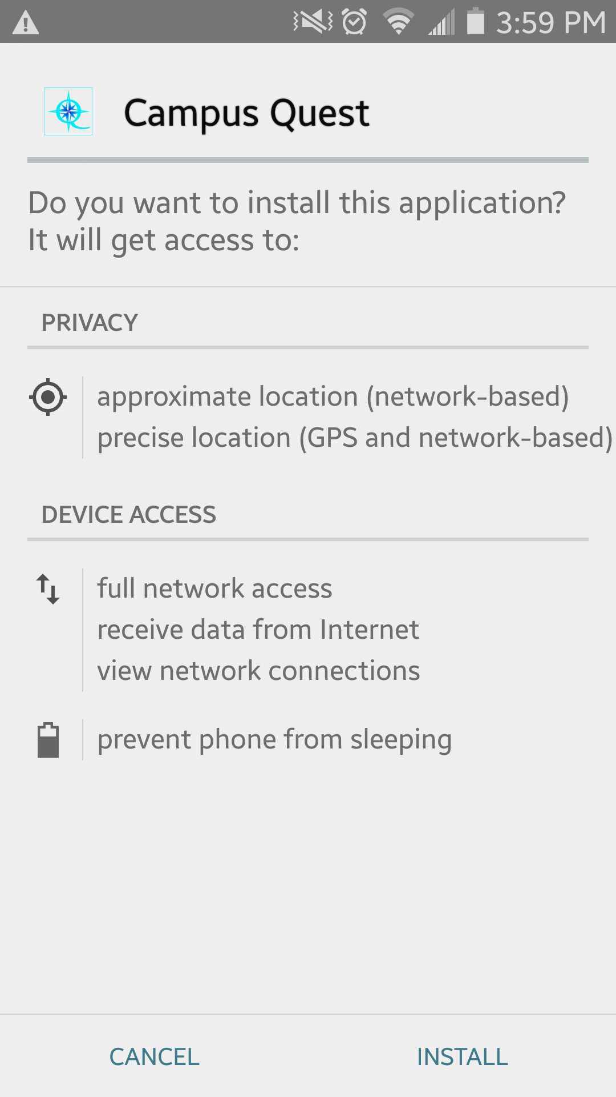
Professional, Legal, Ethical Issues
Warns about privacy/location and device access
Did not ask permission to use WAVE bus tracking resources
Not storing login details or user information

Slide 14
Lessons Learned
Made several changes to improve code efficiency
Value of reliable team members
Using new tools – Android Studio and Google Maps API
Structured planning and testing process

