Slide 1

AMITY UNIVERSITY RAJASTHAN
DESIGN, ANALYSE AND FABRICATE
CHASSIS FOR AN ALL TERRAIN VEHICLE
Submitted by:
Somveer Singh
B.tech (M&AE) 8th sem
A20405413092
Submitted to :
Mr. Amit Sharma

Slide 2
CONTENT:
1. Introduction
2. Material selection
3. Design Parameters
4. Software designing
5. Analysis
6. Fabricating the prototype
7. Fabricating the steel chassis

Slide 3


1. INTRODUCTION :
What is SAE BAJA?
-Static Events
-Dynamic Events
Objective of the project
What is a chassis?

Slide 4
2. MATERIAL SELECTION:
Available materials :
AISI 4130 ,
AISI 1018 ,
AISI 1020 ,
AISI 1026
Material | Modulus of elasticity (ksi) | Yield strength (ksi) | Elongation at break
AISI 1018 | 29,700 | 53.7 | 15%
AISI 1020 | 29,700 | 42.7 | 36%
AISI 1026 | 29,700 | 60.12 | 15%
AISI 4130 | 29,700 | 63.1 | 25.50
Yield Strength affects the bending strength of a material
bending strength is not only affected by cross sectional moment of inertia but also by radius of material
AISI 4130 having maximum yield strength will allow the usage of large diameter tubing with smaller wall thickness
4130 Chromoly is more ductile than other materials so it will deform more before its ultimate failure

Slide 5
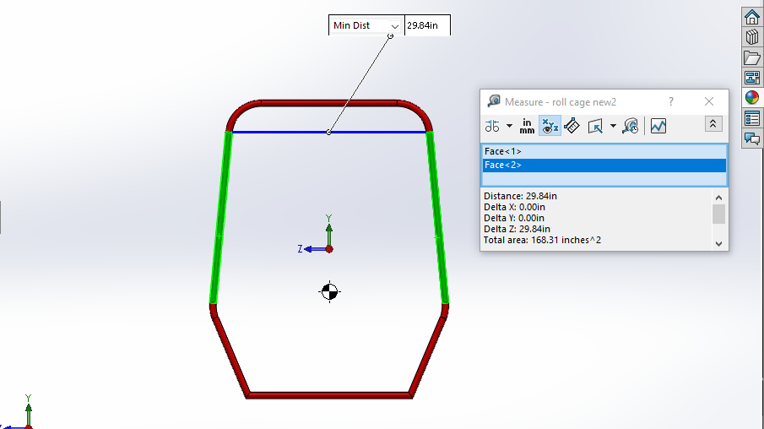
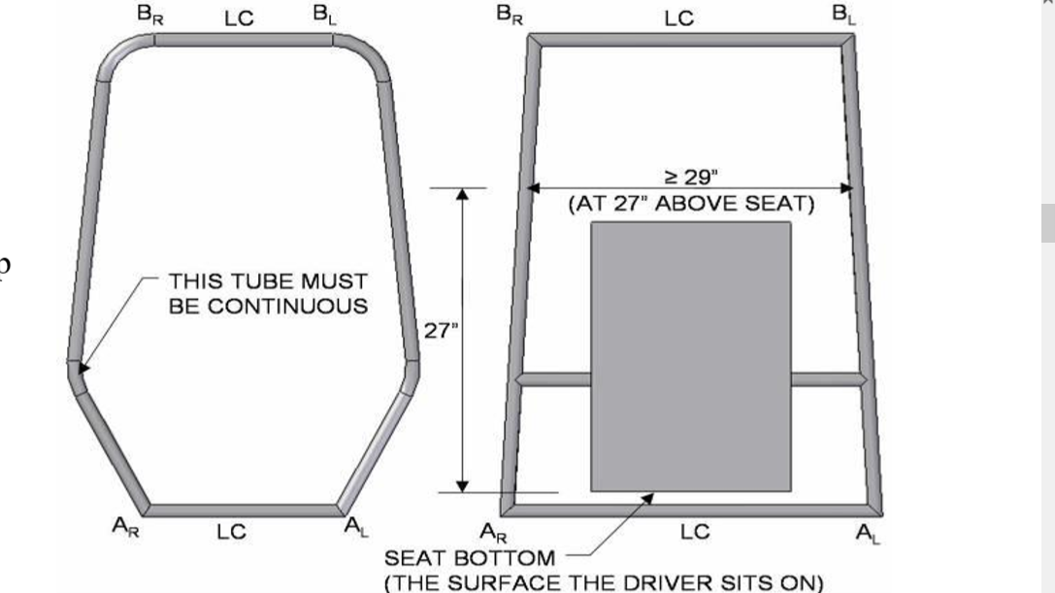
3. DESIGN PARAMETERS:
According to the rules stated in the rule book , some of the primary members are listed below :
3.1. Rear Roll Hoop (RRH)

Slide 6
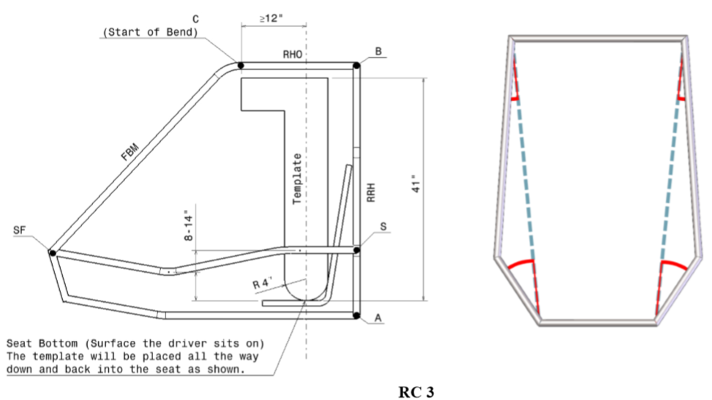
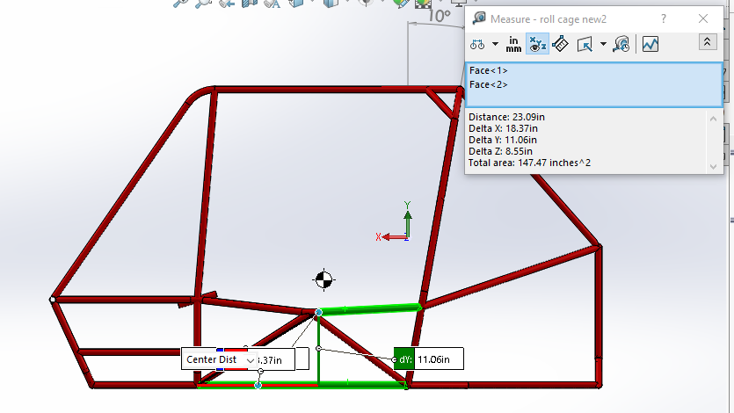
3.2 Roll Hoop Overhead Members (RHO)

Slide 7
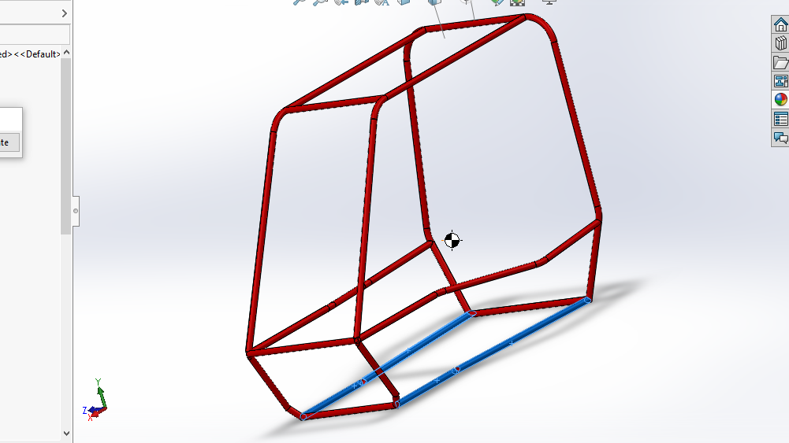
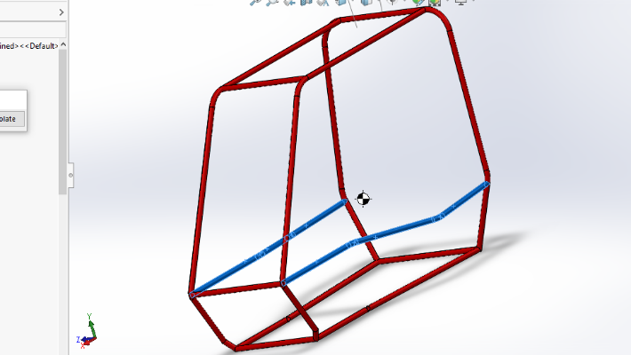
3.3 Lower Frame Side Members (LFS)
3.4 Side Impact Members (SIM)

Slide 8
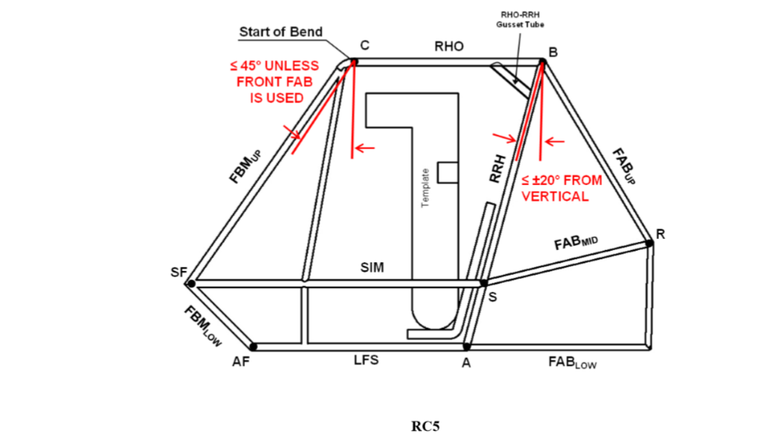
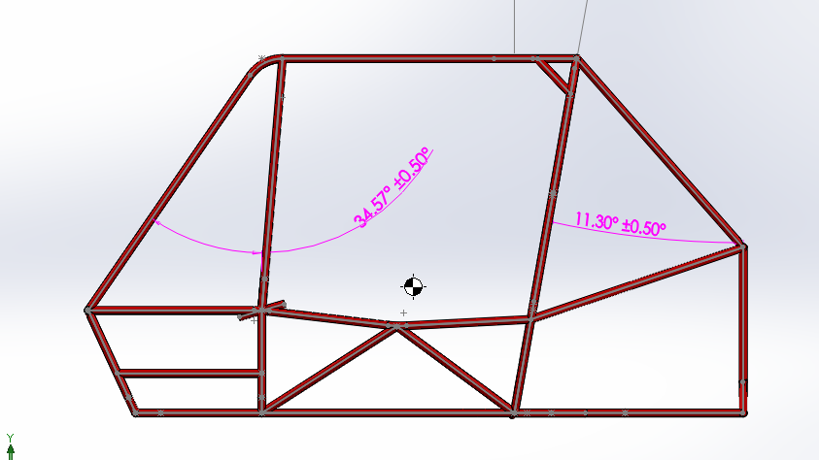
3.5 Front Bracing Members (FBM)

Slide 9
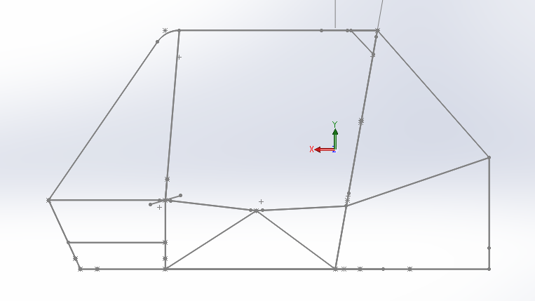
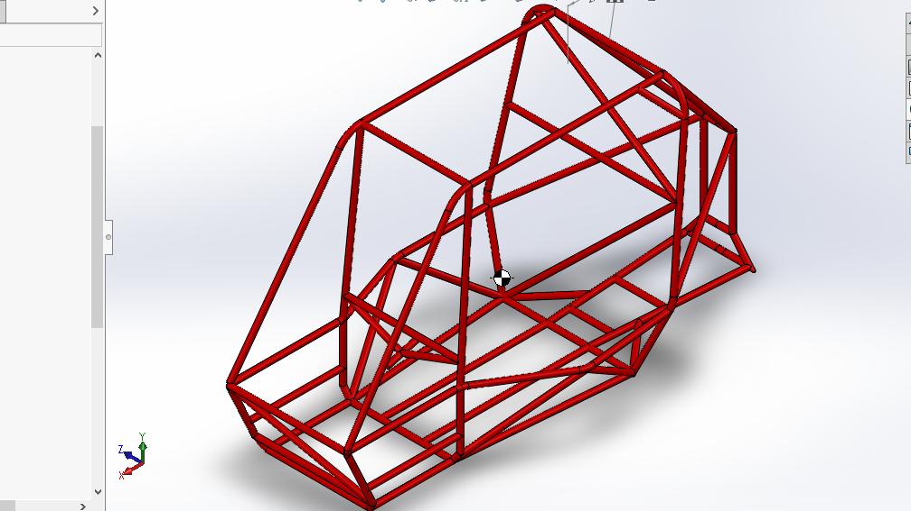
4. SOFTWARE DESIGNING:
4.1 chassis design on solidworks

Slide 10
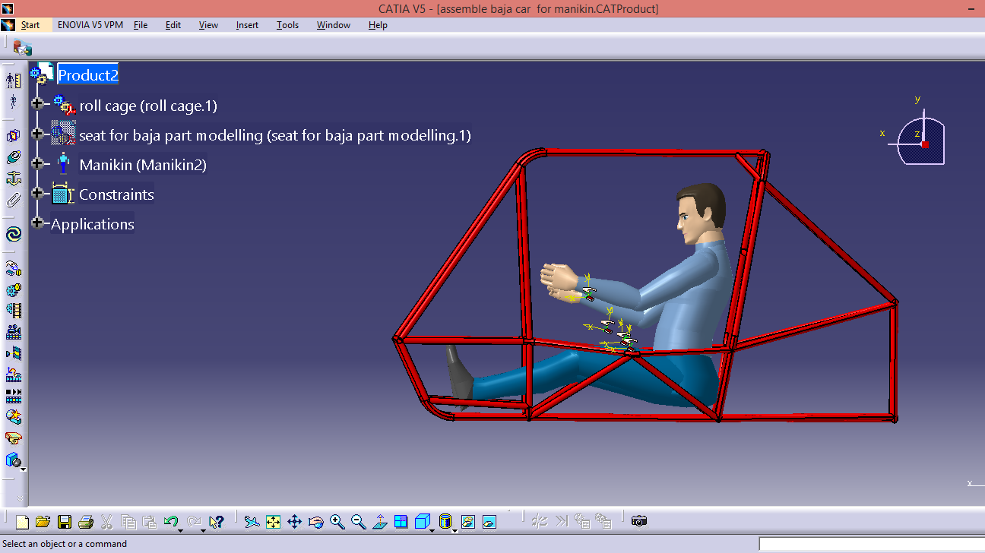
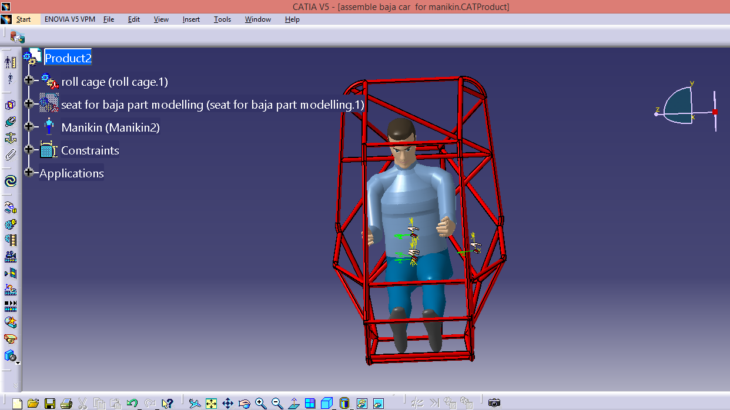
4.2 Ergonomy and clearances check on CATIA V5.0

Slide 11
5. ANALYSIS
Analysis was done on ANSYS software
Analysis is done to check whether the chassis can withstand collision at high speed
Main aim is to check the stresses and displacement produced in the chassis at the time of collision
During analysis a force is applied in the opposite direction of motion and all the suspension points are constrained
The forces which were impacted on the roll cage were decelerations of 4g and it is calculated as follows:-
Assume gravitational force = 9.8 m/s2 ≈ 10 m/s2
g = mass of the vehicle × gravitational force acting on the vehicle
= 350 × 10
= 3500 N
Therefore, 4g = 14000 N

Slide 12
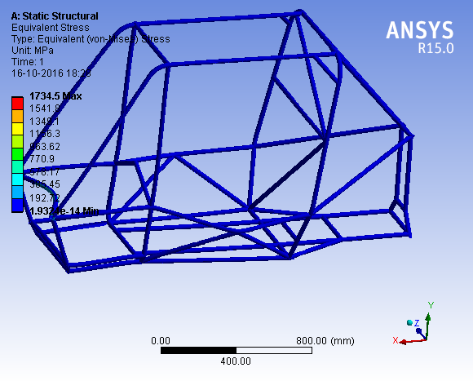
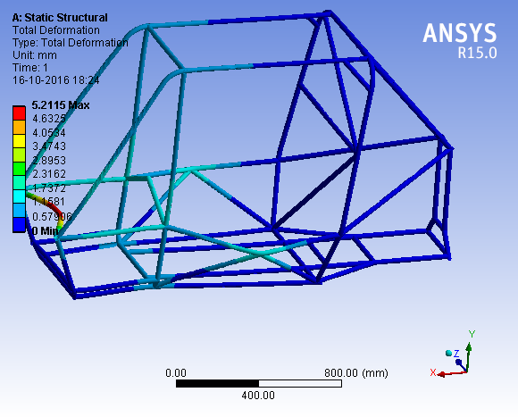
5.1 Front Impact analysis

Slide 13
6. FABRICATING THE PROTOTYPE
PVC pipes of 1:1 ratio to the actual chassis is fabricated to check for any design errors.
Components used in prototype chassis: PVC pipes, packing tape, steel wires for strength.
Firstly the different planes of the chassis were drawn on the chart for accurate profiling of the tubes.
Packaging tape and wire were used to give the prototype some strength.

Slide 14
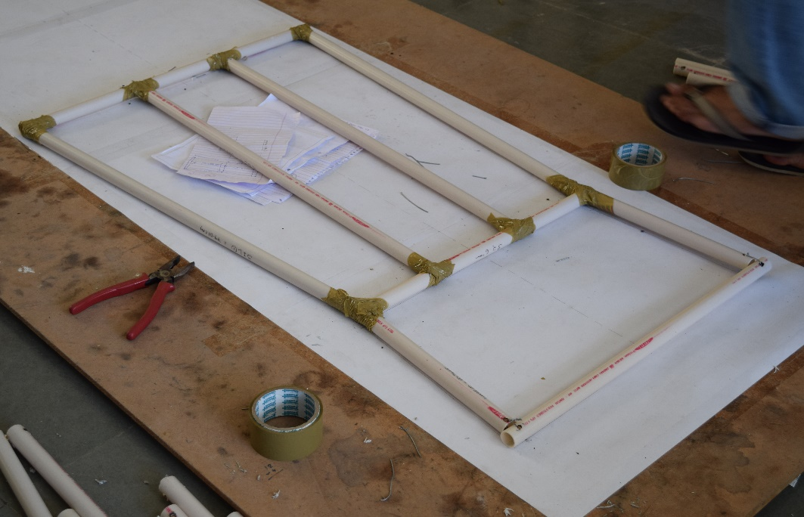
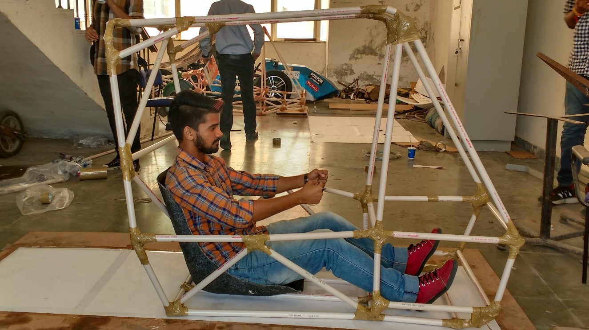
6.1 Progress of the prototype

Slide 15
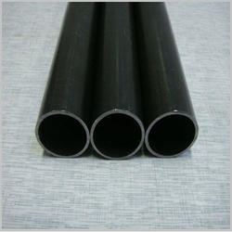
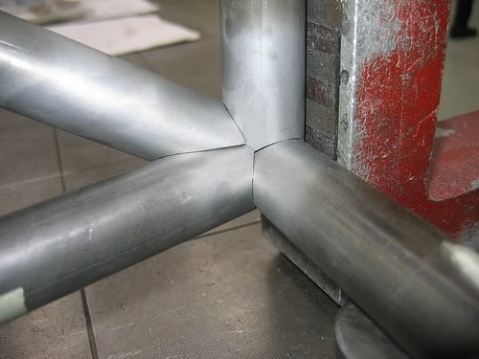
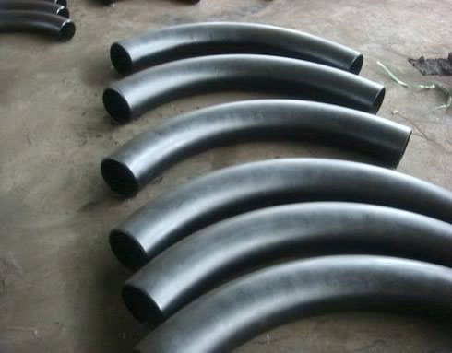
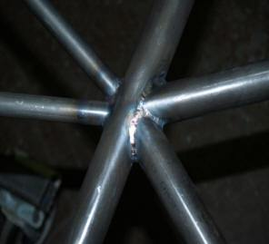
7. FABRICATING THE STEEL CHASSIS
With some slight modification after checking the prototype, the fabrication of steel chassis was started.
The fabrication process of steel chassis includes :
-cutting of pipes
-profiling of the pipes
-bending of pipes
-arc welding
-MIG welding

Slide 16
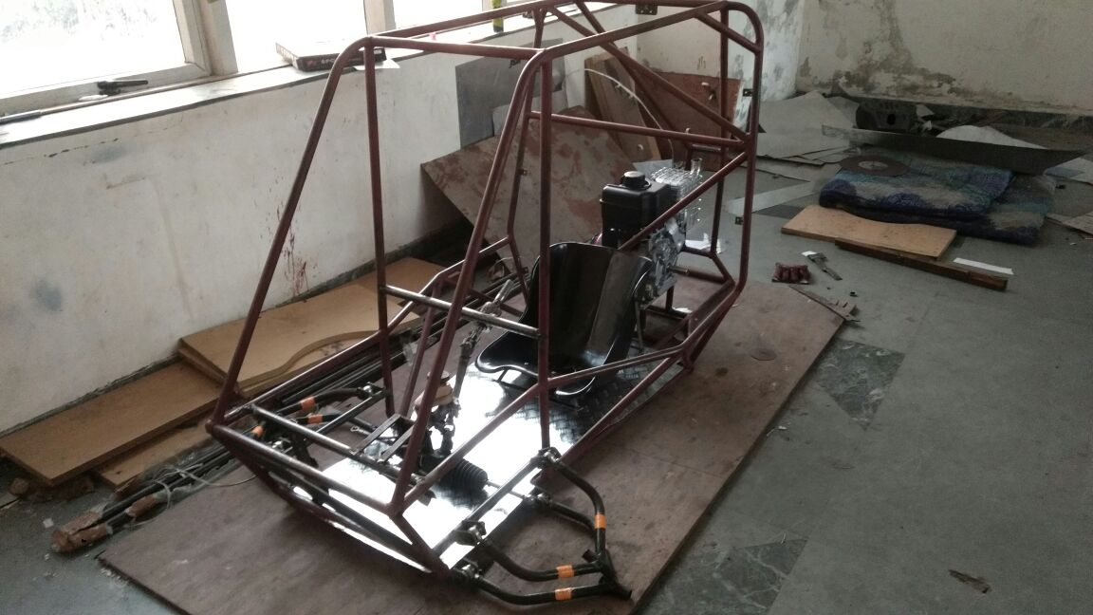
7.1 Final chassis

Slide 17
THANK
YOU

