Slide 1

Uber Supply-Demand Gap Study
Silambarasan Melapudi Kannappan

Slide 2




Uber Supply-Demand Gap Study
Objectives - To address the problem Uber is facing - driver cancellation and non-availability of cars leading to loss of potential revenue
Exploratory Data Analysis is conducted and data provided was cleaned up.
A study of Uber Supply – Demand Gap was conducted using Python, pandas and seaborn libraries.

Slide 3
Business Objectives
To identify the root cause of the problem (i.e. cancellation and non-availability of cars)
To present to the root cause(s) and possible hypotheses of the problem(s)
Present solution to improve the situation and meet the supply - demand

Slide 4
Instructional Methods
Hypothesis is conducted based on the below attributes
There are six attributes associated with each request made by a customer:
Request id: A unique identifier of the request
Time of request: The date and time at which the customer made the trip request
Drop-off time: The drop-off date and time, in case the trip was completed
Pick-up point: The point from which the request was made
Driver id: The unique identification number of the driver
Status of the request: The final status of the trip, can be either completed, canceled by the driver or no cars are available
Data Cleaning and Manipulation
Data cleaning is performed using python data frames and a structured approach.
Data Analysis
Data Analysis is performed to understand the business and the supply Vs demand of taxis/cars required at City/Airport during peak hours.
Recommendations
Recommendations are provided based on the hypothesis.

Slide 5
Instructional Methods – Data Cleaning and Manipulation
Data cleaning was performed to identify the number of NA/Null values in each column.
Data type was corrected for timestamp columns
New columns were produced from timestamp such as hours, minutes, date, day etc.
A new column was created with name as "Time of Day"
Time of Day was divided into 5 time of day namely:
Early Morning 24 to 5AM
Morning Peak hours 5-10AM
Day time 10-17PM
Evening Peak hours 17-22PM
Late evening 22-24AM

Slide 6
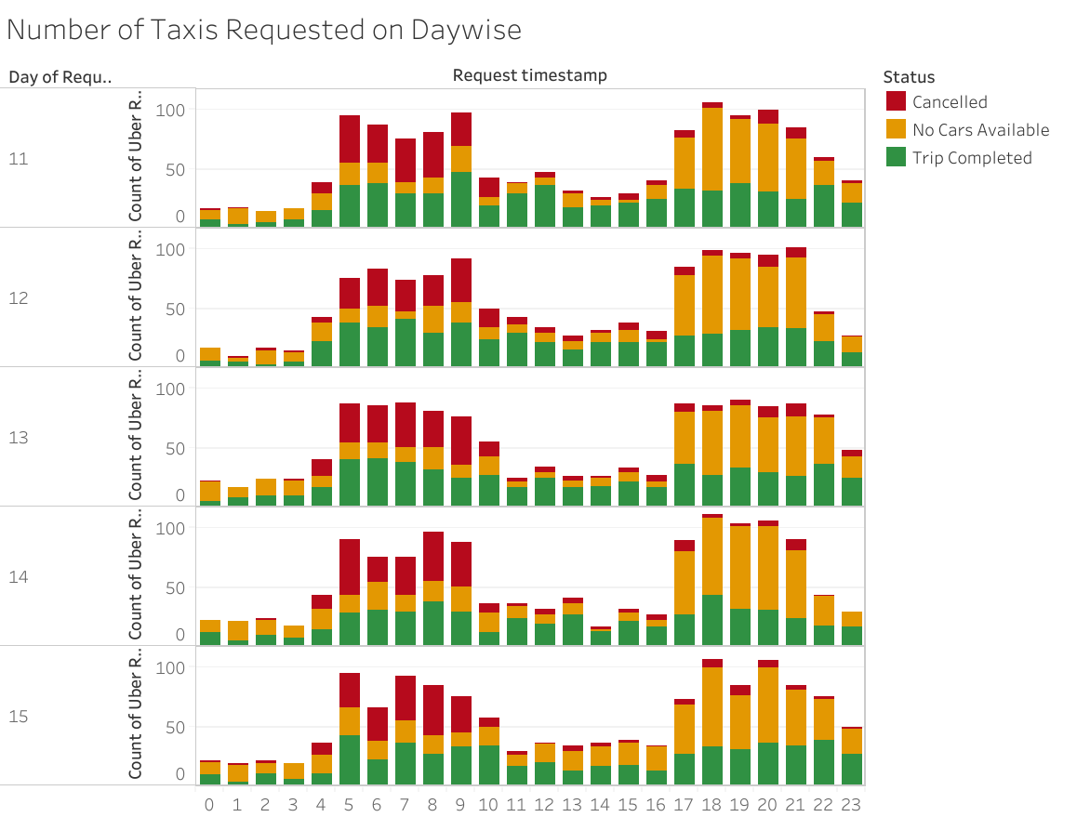
Hypothesis using plots – Analyzing the Trend For Each Day
The Pattern of request looks pretty much common on different days, there are more number of request during Morning and Evening Peak hours.

Slide 7
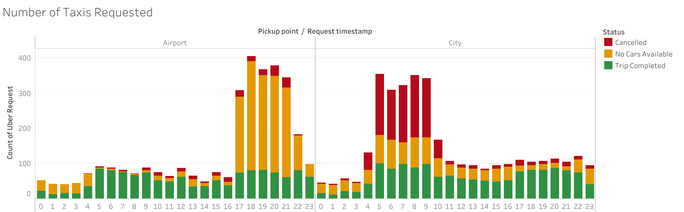
Hypothesis using plots – Analyzing the Trend For Each Day
Since the pattern of request looks common, the request for all day can be aggregated
Conclusion:
Number of trips in the morning seems to be higher from the city
Number of trips from the evening seems to be higher from the airport

Slide 8
Hypothesis using plots – Analyzing the Trend
Binning the time to 5 Homogenous categories
Time | Category
12 am to 5 am | Early Morning
5 am to 10 am | Morning Peak Hours
10 am to 5 pm | Day time
5 pm to 9 pm | Evening Peak Hours
9 pm to 12 am | Late Evening

Slide 9
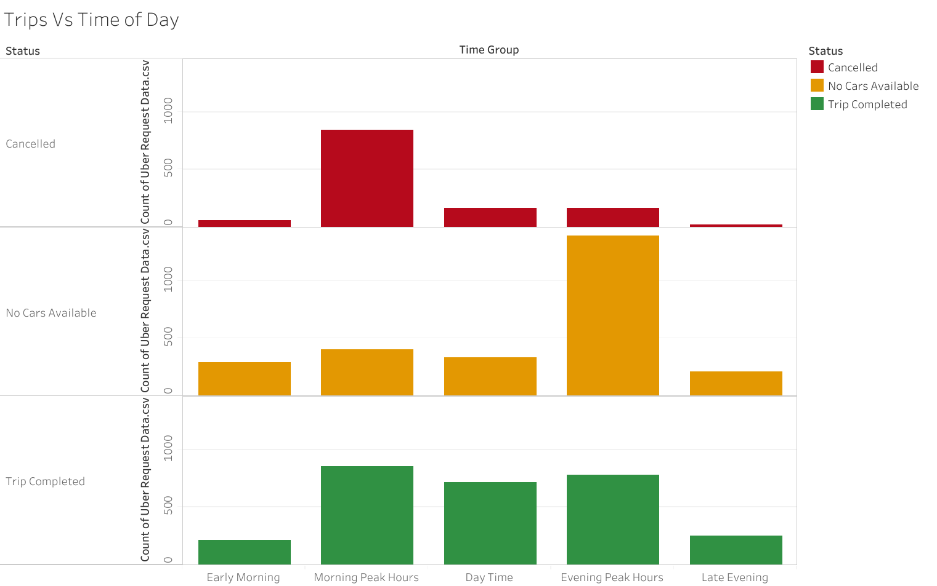
Hypothesis using plots – Analyzing the Trend
Problem Uber is facing -
Plot shows cancelled are more in the morning peak hours
Taxis/cars not available in evening peak hours

Slide 10
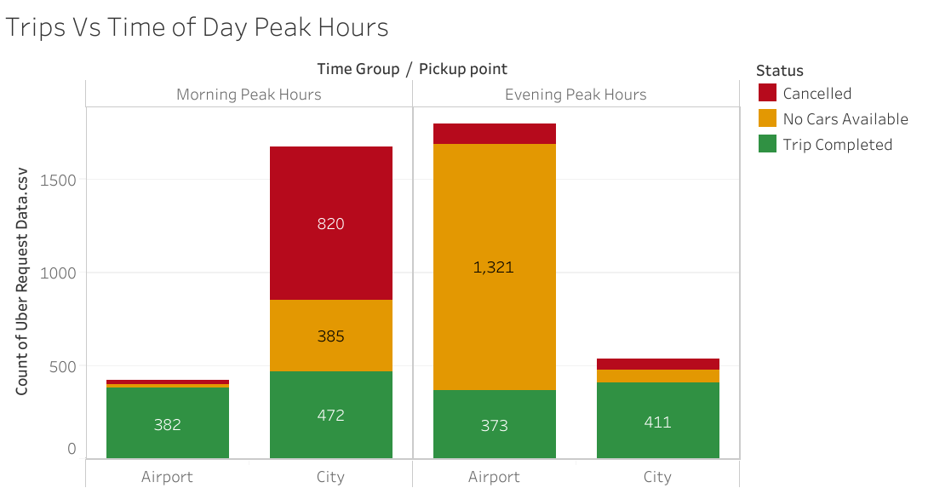
Hypothesis using plots – Analyzing the Trend
Problem Uber is facing -
Number of taxis required at city to meet the demand is 472+385+820= 1677 supply is about 1:3.
Number of taxis required at Airport is 373+1321+106=1800 supply is about 1:3

Slide 11
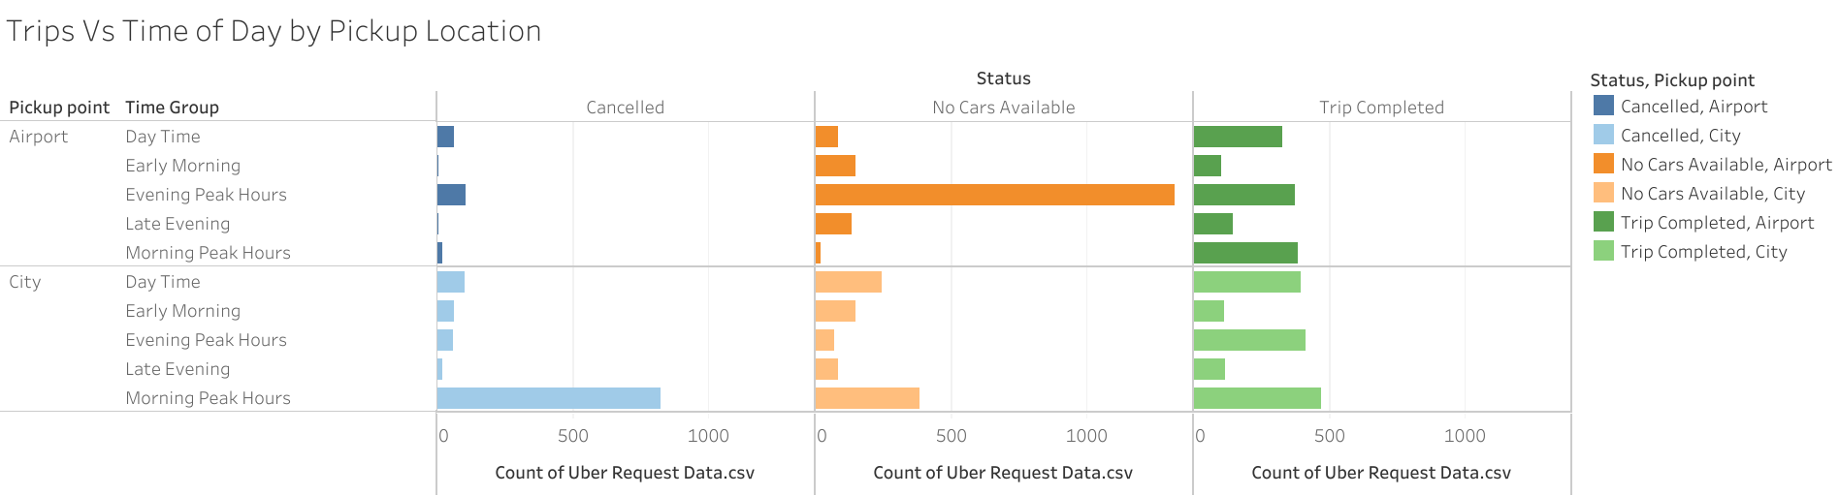
Hypothesis using plots – Analyzing the Trend

Slide 12
Hypothesis using plots – Recommendations
For the trips in the morning, drivers can be incentivized to make those trips.
They could be given a bonus for each trip they complete from the city to the airport in the morning peak hours. This will ensure that less number of trips are cancelled.
Uber can pay for the gas mileage of drivers to come back to the city without a ride.
Uber can increase the demand at the airport to reduce idle time - by adding a marketing and price cut to customers.
For the evening, since the number of drivers is less, some of the ways are:
Drivers can again be given a bonus to complete a trip from the airport in the evening. This will ensure that the supply increases at the airport.
Uber can also pay drivers to come without a passenger to the airport
Another innovative way can be to pool the rides of passengers so that lesser number of cars can serve more passengers.

Slide 13
Questions?

