Slide 1
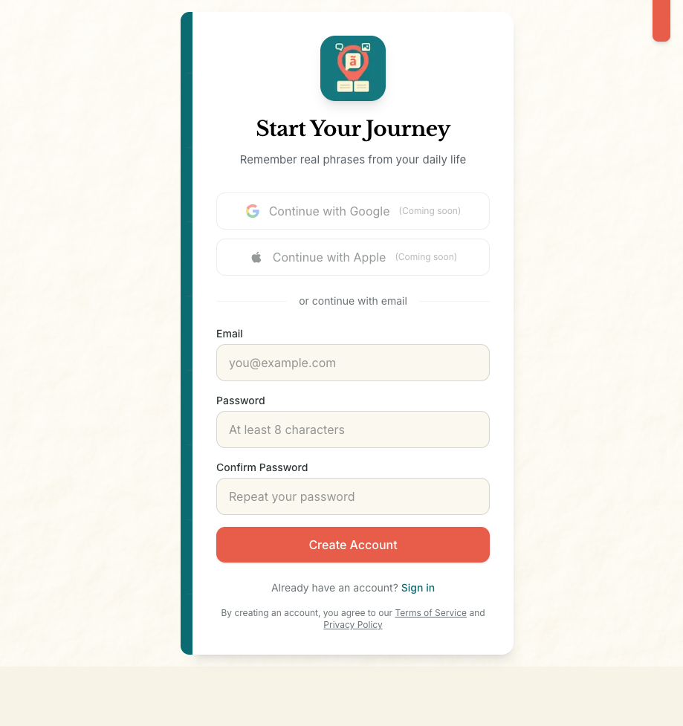
Welcome to LLYLI
Learn the Language You Live In
Key Points:
Simple email/password sign-up
Account stores everything securely
Progress synced to the cloud
Notes:
Welcome to LLYLI - Learn the Language You Live In. This app helps you remember real phrases from your daily life. Getting started is simple - just create an account with your email. Your account keeps all your phrases and progress safe in the cloud, so you can access them from any device.

Slide 2
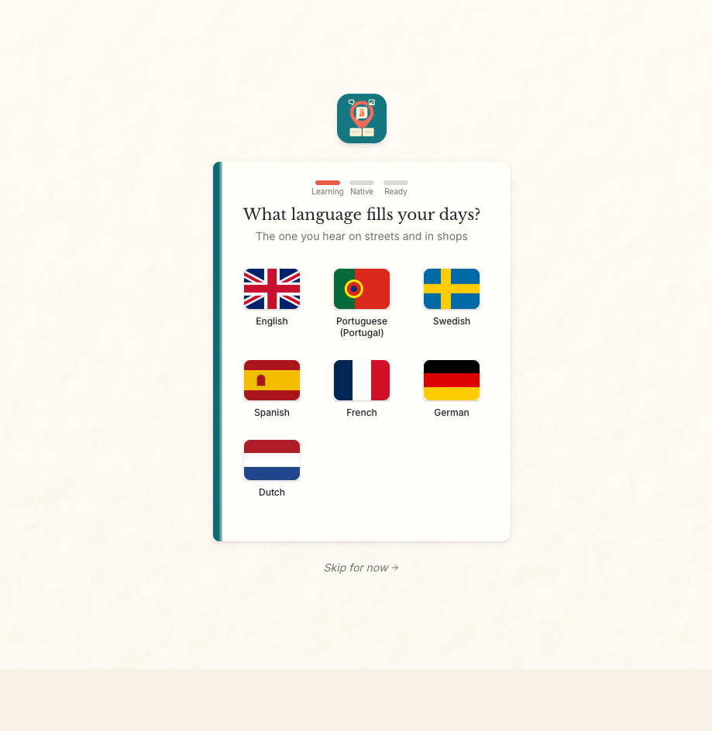
Choose Your Target Language
What language fills your days?
Key Points:
Select the language you're immersed in
Supports: English, Portuguese, Swedish, Spanish, French, German, Dutch
Visual flag selection for easy recognition
Notes:
First, tell us what language fills your days - the one you hear on streets, in shops, on signs. This is the language you want to learn.

Slide 3
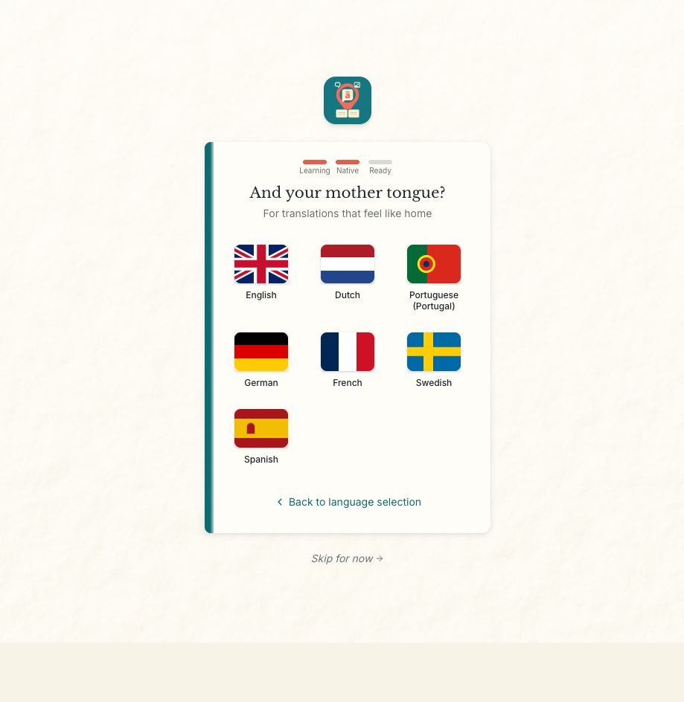
Set Your Native Language
For translations that feel like home
Key Points:
Translations appear in your native language
Creates your personal learning direction
Example: English → Portuguese
Notes:
Next, select your mother tongue. LLYLI will translate everything into this language, so explanations feel like home.

Slide 4
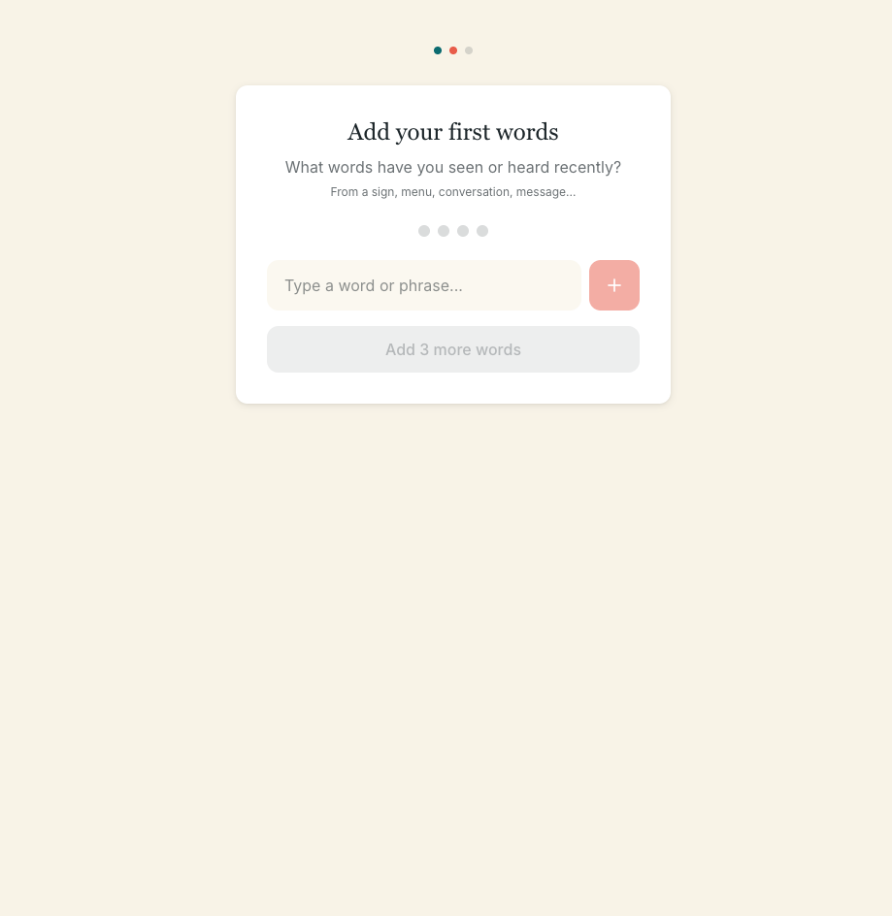
Add Your First Words
Capture phrases you've encountered
Key Points:
Type any word or phrase you've encountered
Minimum 3 words to proceed
Teaches you how to use the capture feature
Notes:
Now add some words you've already encountered. Seen something on a sign? Heard a phrase at a café? Type it in! The app asks for just 3 words to get started.

Slide 5
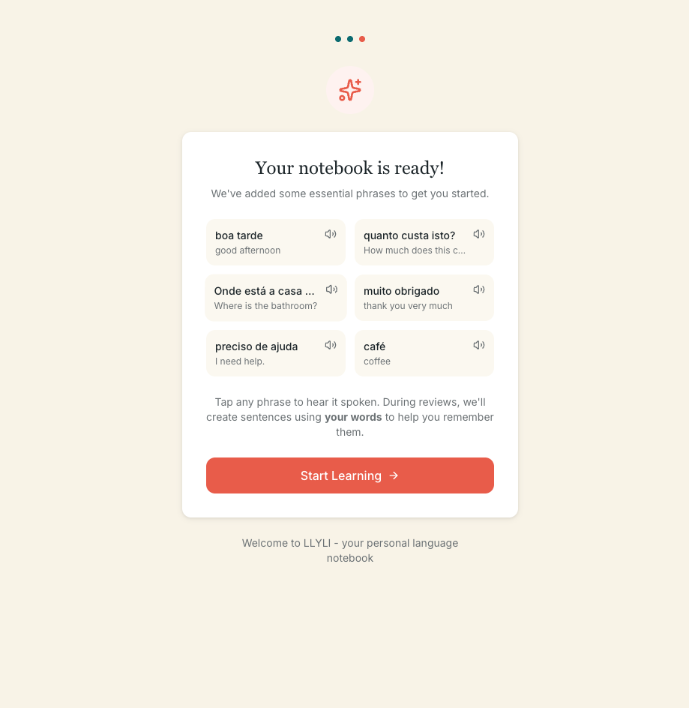
Your Notebook is Ready
Essential phrases to get you started
Key Points:
Starter phrases pre-loaded
Audio playback for pronunciation
Personalized sentence generation
Notes:
Your personal notebook is ready! We've added some essential phrases to help you get started. Tap any phrase to hear it spoken by a native speaker. During reviews, the app will create sentences using YOUR words to help you remember them in context.

Slide 6
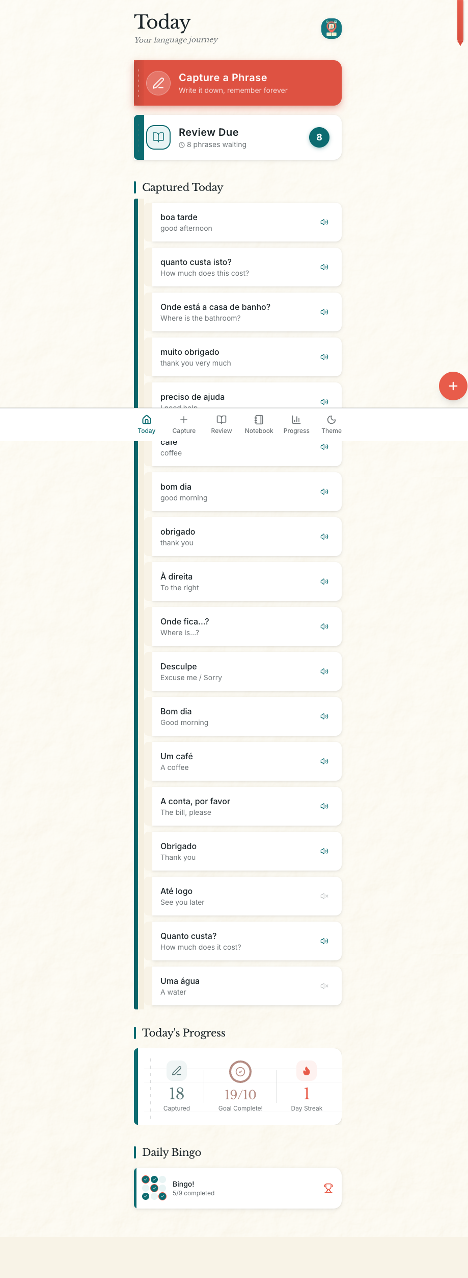
Your Daily Dashboard
Everything at a glance
Key Points:
Quick access to capture and review
Shows phrases captured today
Progress tracking (captured, goal, streak)
Daily Bingo for gamification
Notes:
This is your daily home screen. At a glance, you can see what you captured today, how many phrases are due for review, and your daily progress. The "Capture a Phrase" button is always prominently available.

Slide 7
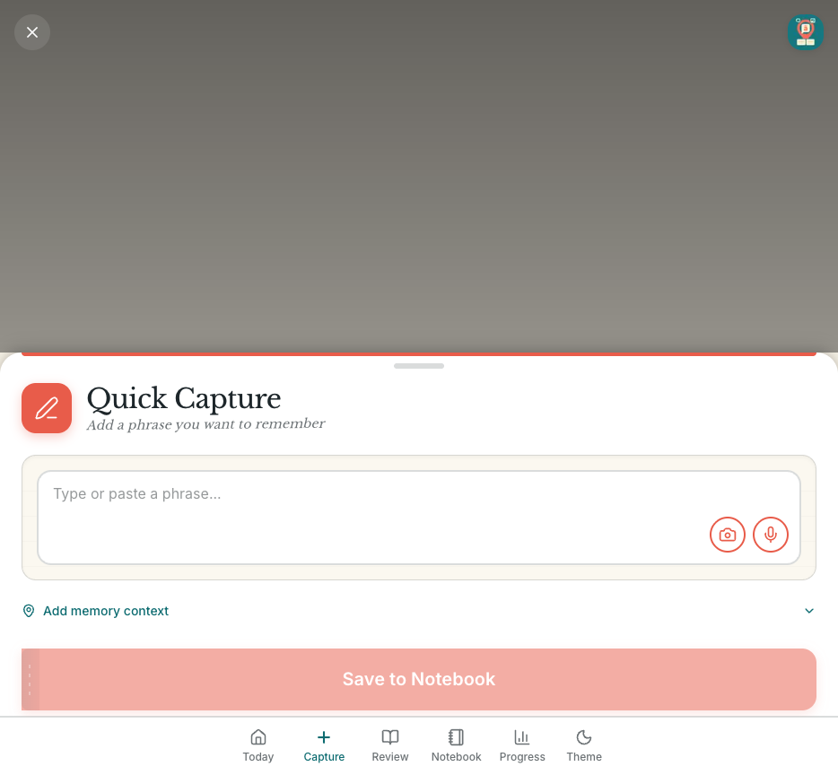
Capturing Phrases
Turn real-life encounters into learning
Key Points:
Type or paste any phrase
Auto-translation and categorization
Native speaker audio generation
Add memory context (where you heard it)
Notes:
Whenever you encounter a new word or phrase, tap Capture. Type it in - it can be something you saw on a menu, heard in conversation, or read on a sign. The app automatically translates it, categorizes it, and generates native speaker audio.

Slide 8
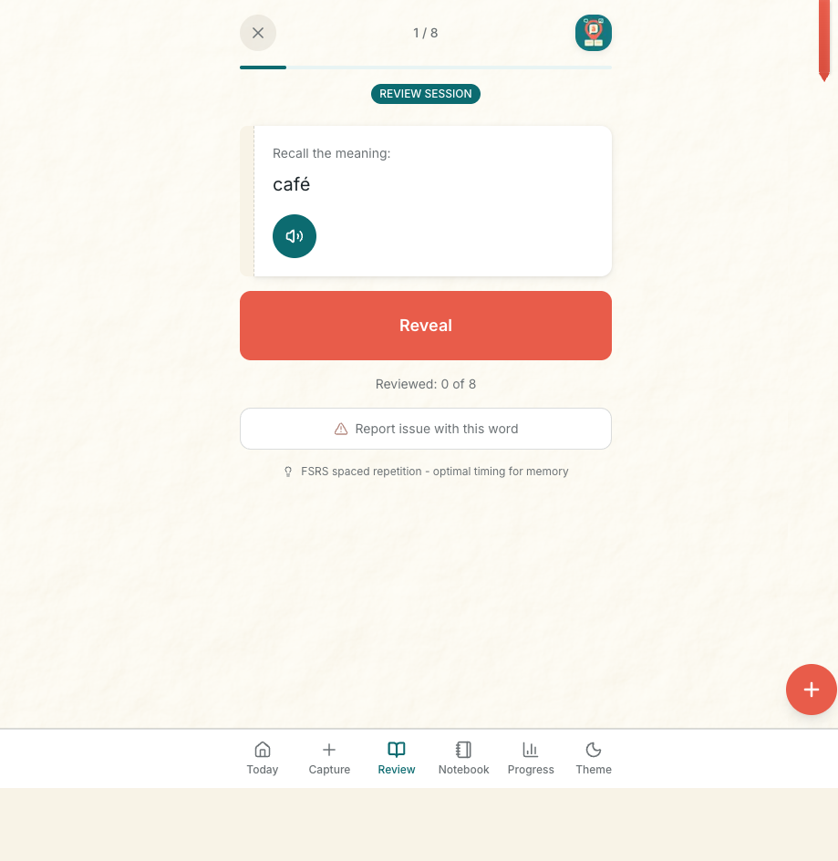
Review: The Question
Recall the meaning
Key Points:
Shows progress (1 of 8)
Audio playback available
Simple "Reveal" interaction
FSRS algorithm schedules optimal times
Notes:
When phrases are due for review, tap "Review Due" to start a session. You'll see the phrase and hear the audio. Try to recall the meaning before revealing the answer.

Slide 9
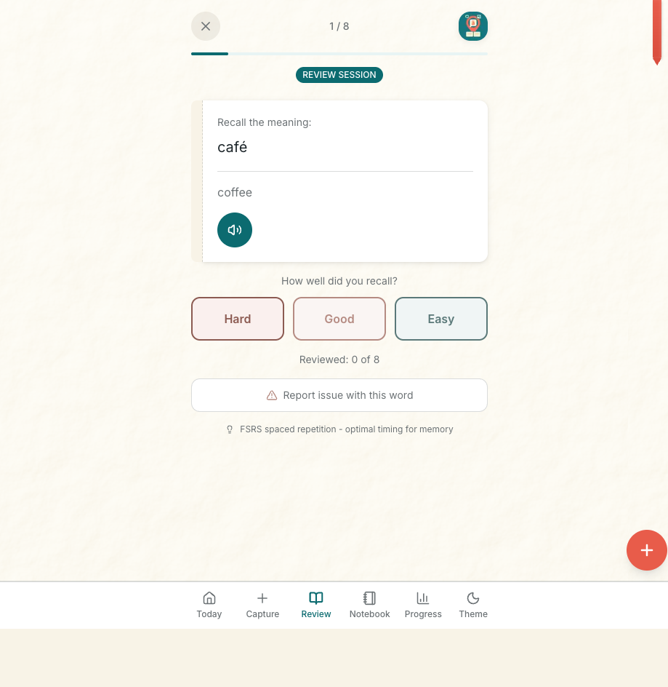
Review: The Answer
Rate your recall
Key Points:
Three simple recall ratings
FSRS-4.5 algorithm optimizes timing
"3 correct recalls" rule for mastery
Report button for issues
Notes:
After revealing the answer, rate how well you remembered: Hard, Good, or Easy. This feedback trains the spaced repetition algorithm to show you phrases at exactly the right time - not too soon, not too late.

Slide 10
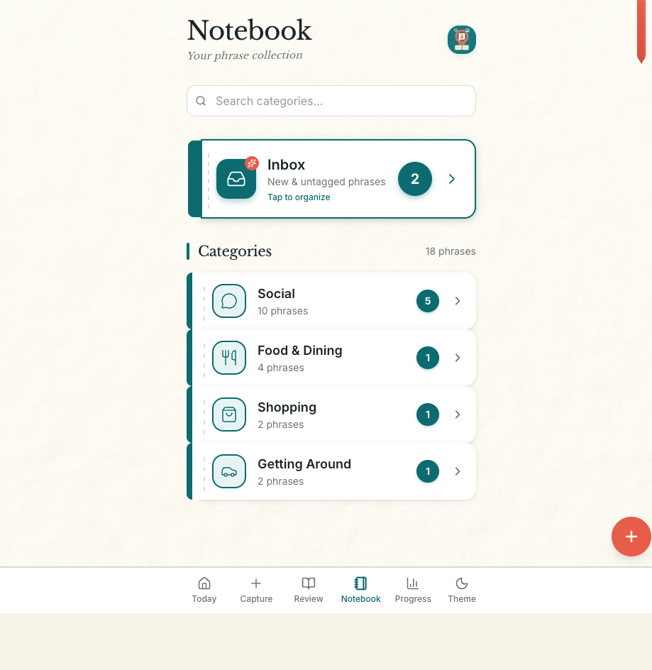
Your Notebook
Organized phrase collection
Key Points:
Inbox for organization
8 automatic categories
Search functionality
Due indicators per category
Notes:
Your Notebook organizes all your phrases by category. See your Inbox for new untagged phrases, or browse by category - Social, Food & Dining, Shopping, Getting Around. The numbers show how many phrases are due for review in each category.

Slide 11
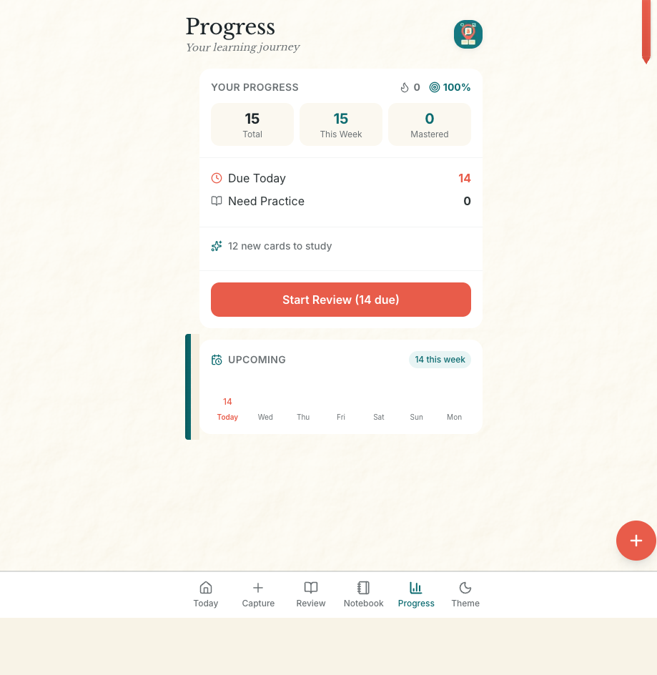
Track Your Progress
Your learning journey visualized
Key Points:
Total/weekly/mastered counts
Due today and need practice indicators
Weekly forecast calendar
Quick access to start review
Notes:
The Progress page shows your learning journey at a glance. See your total phrases, this week's activity, and how many you've mastered. The upcoming calendar shows when reviews are scheduled throughout the week.

Slide 12
Daily Usage
Your routine with LLYLI
Key Points:
Morning: Review due phrases
Daytime: Capture new encounters
Evening: Check progress
Consistency is key
Notes:
Here's your daily routine with LLYLI:
Morning: Check the Today screen. See what's due for review. Do a quick 5-minute review session.
Throughout the day: When you encounter a new word - at a café, in a meeting, on a sign - capture it immediately. Takes 5 seconds.
Evening: Check your progress, review any new due items, browse your notebook.
The key is consistency: capture real phrases from YOUR life, review them at the right time, and watch your vocabulary grow naturally.

Slide 13
The LLYLI Promise
What makes us different
Key Points:
Real phrases from your life
Native speaker audio
FSRS spaced repetition
Cloud-synced and secure
Notes:
LLYLI offers: Real Phrases - learn words you actually encounter, not textbook vocabulary. Native Audio - hear every phrase spoken correctly. Smart Timing - FSRS algorithm ensures optimal review scheduling. Context Memory - remember where you heard each phrase. Progress Tracking - watch your mastery grow over time. Secure & Synced - your vocabulary is safe in the cloud.

