Slide 1
K-Nearest Neighbor

Slide 2
Different Learning Methods
Eager Learning
  Explicit description of target function on the whole training set
Instance-based Learning
  Learning=storing all training instances
  Classification=assigning target function to a new instance
  Referred to as “Lazy” learning

Slide 3

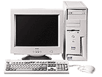
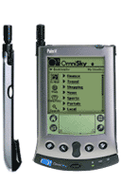



Different Learning Methods
Eager Learning
Instance-based Learning
Any random movement
=>It’s a mouse
Its very similar
to a
Desktop!!
I saw a mouse!

Slide 4
Instance-based Learning
K-Nearest Neighbor Algorithm
Weighted Regression
Case-based reasoning

Slide 5
KNN algorithm is one of the simplest classification algorithm
non-parametric
  it does not make any assumptions on the underlying data distribution
lazy learning algorithm.
  there is no explicit training phase or it is very minimal.
  also means that the training phase is pretty fast .
  Lack of generalization means that KNN keeps all the training data.
Its purpose is to use a database in which the data points are separated into several classes to predict the classification of a new sample point.

Slide 6
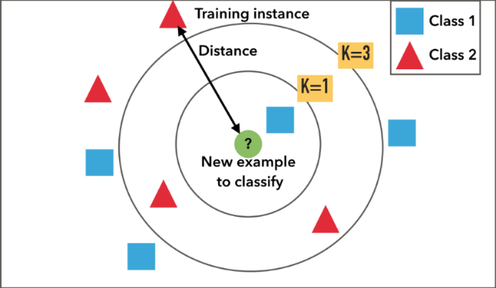
KNN Algorithm is based on feature similarity
How closely out-of-sample features resemble our training set determines how we classify a given data point

Slide 7
1-Nearest Neighbor

Slide 8
3-Nearest Neighbor

Slide 9
Classification steps
Training phase: a model is constructed from the training instances.
  classification algorithm finds relationships between predictors and targets
  relationships are summarised in a model
Testing phase: test the model on a test sample whose class labels are known but not used for training the model
Usage phase: use the model for classification on new data whose class labels are unknown

Slide 10
K-Nearest Neighbor
Features
  All instances correspond to points in an n-dimensional Euclidean space
  Classification is delayed till a new instance arrives
  Classification done by comparing feature vectors of the different points
  Target function may be discrete or real-valued

Slide 11
K-Nearest Neighbor
An arbitrary instance is represented by (a₁(x), a₂(x), a₃(x),.., a_{n}(x))
  a_{i}(x) denotes features
Euclidean distance between two instances
d(x_{i}, x_{j})=sqrt (sum for r=1 to n (a_{r}(x_{i}) - a_{r}(x_{j}))²)
Continuous valued target function
  mean value of the k nearest training examples

Slide 12
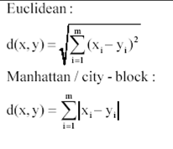
K-nearest neighbours uses the local neighborhood to obtain a prediction
The K memorized examples more similar to the one that is being classified are retrieved
A distance function is needed to compare the examples similarity
This means that if we change the distance function, we change how examples are classified

Slide 13
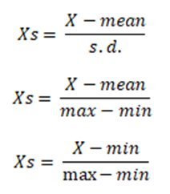
If the ranges of the features differ, feaures with bigger values will dominate decision
In general feature values are normalized prior to distance calculation

Slide 14
Voronoi Diagram
Decision surface formed by the training examples

Slide 15
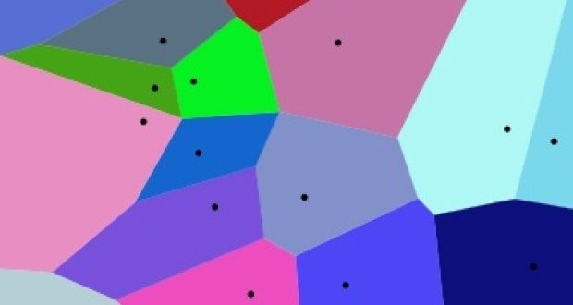
Voronoi diagram
We frequently need to find the nearest hospital, surgery or supermarket.
A map divided into cells, each cell covering the region closest to a particular centre, can assist us in our quest.

Slide 16
Distance-Weighted Nearest Neighbor Algorithm
Assign weights to the neighbors based on their ‘distance’ from the query point
  Weight ‘may’ be inverse square of the distances
All training points may influence a particular instance
  Shepard’s method

Slide 17
Remarks
+Highly effective inductive inference method for noisy training data and complex target functions
+Target function for a whole space may be described as a combination of less complex local approximations
+Learning is very simple
- Classification is time consuming

Slide 18
Remarks
- Curse of Dimensionality

Slide 19
Remarks
- Curse of Dimensionality

Slide 20
Remarks
- Curse of Dimensionality

Slide 21
Remarks
Efficient memory indexing
  To retrieve the stored training examples (kd-tree)

