Slide 1

Identity Anonymization on Graphs
Kundan Singh [S4723435]

Slide 2
Background
IBM Research paper by Liu & Terzi
Privacy concern on Individual Network data
specific graph-anonymization problem

Slide 3
Why K-Degree anonymization?
Only removing Identity of nodes doesn’t always guarantee Privacy
Adversaries can infer the identity of the nodes by solving a set of restricted isomorphism problems based on the uniqueness of small random subgraphs embedded in network.
Structure or basic degree of nodes can help to reveal identities of individuals.
structural similarity of the nodes in the graph determines the extent to which an individual in the network can be distinguished from others.

Slide 4
The Problem
To Create K-degree anonymized Graph Ga:
Given a graph G and an integer k,
Modify Graph G via a set of edge-addition or deletion
Every node v has the same degree with at least k-1 other nodes.
additional requirement that the minimum number of such edge-modifications is made:
Preserve the utility of the original graph, while at the same time satisfy the degree-anonymity constraint

Slide 5
Problem Definition
Given a graph G(V,E) and an integer k :
find a k-degree anonymous graph Gb(V, Eb) with Eb \ E = E such that Ga(G, Gb ) is minimized.
V is a set of nodes and E the set of edges in G and dG to denote the degree sequence of G
Ga(G, Gb ): graph-anonymization cost

Slide 6
Problem solving Approach
Two Step approach :
Degree Anonymization
Given the degree sequence d of the original input graph G(V,E), the algorithms output a k-anonymous degree sequence db such that the degree anonymization cost Da is minimized
Graph Construction
Given the original graph G(V,E) and the desired k-anonymous degree sequence db output by the DP (or Greedy) algorithm, we construct a k-degree anonymous graph Gb(V, Eb) with Eb \ E = E and degree sequence dGb with dGb = db.

Slide 7
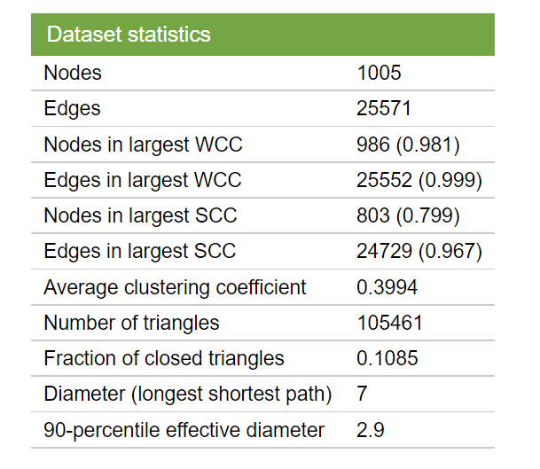
Dataset
This network represents the "core" of the email-EuAll network, which also contains links between members of the institution and people outside of the institution.
https://snap.stanford.edu/data/email-Eu-core.html

Slide 8
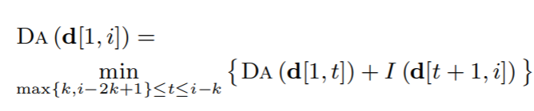
Degree Anonymization
Dynamic Programming algorithm
Greedy algorithm
Input : sorted degree sequence d of graph G
Anonymization cost C is calculated
To improve speed O(n2) → O(nk)
Any group >= 2k-1 can broken into two subgroups with equal or lower overall degree-anonymization cost.
considering t’s in the range max{k,i-2k+1}
recursion

Slide 9
Graph Construction
Construct Graph algorithm
Relaxed Graph algorithm
Greedy Swap algorithm
Priority algorithm
Input: degree sequence d of length n
Check realizable:
if sum is odd: Halt and return “No”
While true:
if d(i) < 0 then Halt and return “No”
if sequence d are all zeros : Halt and return G(V,E)
Pick a random node v with d(v) > 0
Set d(v)=0
iterate over degree-sorted vertices
add edges that for both available or not available the original graph as well

Slide 10
Evaluation & comparison
Anonymization cost
anonymization cost is very close to the Baseline cost also , the degree sequences that are solutions to the Degree Anonymization
Clustering coefficient
CC is almost equal of the original graph. Both negligible increments and decrements are observed.
Average Path length
anonymization process decreases the average path length of the output graph since new connections are added.
Edge Intersection
around 56% of edge intersection is obtained since we added the edge present in the original graph while graph construction.

Slide 11
Extension
SIMULTANEOUS EDGE ADDITIONS AND DELETIONS
algorithm implicitly allows for both edge-additions and edge-deletions.

Slide 12
Conclusion
Difficult to model capability of attacker
Any topological structure of the graph can be potentially used to derive private information
Difficult to measure utility of graph
Not aware of any effective metrics to quantify the information loss incurred by the changes of its nodes and edges.

Slide 13

THANK YOU

