Slide 1
Introduction to Servlet

Slide 2
Agenda
Introduction to web server
What are Servlets
Advantage of Servlets
Servlet Container
Servlet Architecture
Servlet Life Cycle
Servlet Interfaces
web.xml
ServletContext & ServletConfig
HttpServletRequest & HttpServletResponse & HttpSession
Forward and Redirect in servlet
Servlet filtering and chaining

Slide 3
Introduction to web server
A Web Server is a Computer or Combination of computers, which is connected through internet or intranet to serve the clients requests, coming from their web browser.
The client request to the server through protocol such as FTP, HTTP, SMTP etc for their own specific use.
Different web server handles different request.
It has unique IP address and domain name which identifies that machine on the network.
Consider an example:
A user type in a URL (e.g. www.google.com) in browser (a client), and get a web page to read. Here server gets the request from client and sends a web page to client.

Slide 4
What are Servlets
Servlet is a technology i.e. used to create web application.
Servlet is an API that provides many interfaces and classes including documentations.
Servlet is an interface that must be implemented for creating any servlet.
Servlet is a web component that is deployed on the server to create dynamic web page.
Its define in javax.servlet package.
init(), service(), and destroy()- Three essential methods for the life cycle of a servlet

Slide 5
Advantages of Servlets
Performance is significantly better.
Servlets execute within the address space of a Web server. It is not necessary to create a separate process to handle each client request.
Servlets are platform-independent.
Servlets are trusted.
It can communicate with applets, databases, or other software via the sockets and RMI mechanisms.

Slide 6
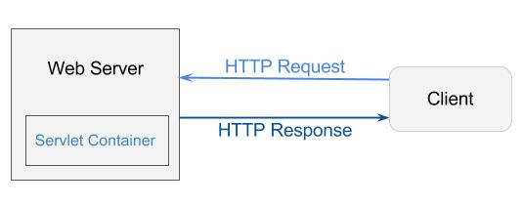
Servlet Container
Its an essential part of web server to interact with servlet.
User can read web pages based on the input through this.
Servlet container is using Java to dynamically generate the web page on the server side.

Slide 7
Web server & Servlet Container
Web server receives HTTP request.
Forwards the request to servlet container.
Servlet is dynamically retrieved and loaded into the address space of the container.
Invokes init() method for initialization(called only once when servlet is loaded)
Invokes the service() method of servlet which read data in the request and formulate a response. Servlet remains in a container to process other HTTP request.
Web server return the dynamically generated results.

Slide 8
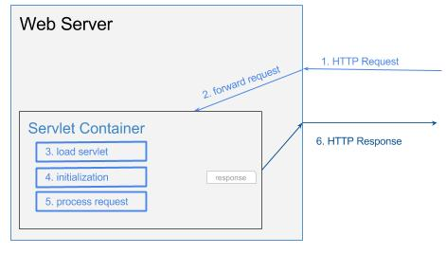
Web server & Servlet Container

Slide 9
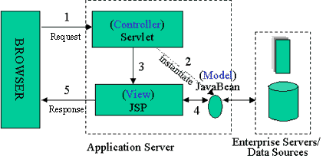
Servlets Architecture

Slide 10
Servlet Life Cycle
Steps in servlet life cycle:
Load servlet class
Create servlet instance
Call init(ServletConfig config) method(execute only once)
Call service(ServletRequest req,ServletResponse res)throws ServletException,IOException method.
Call destroy() method.

Slide 11
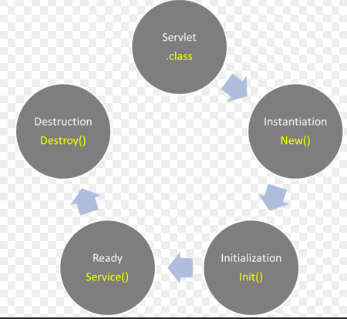
Servlet Life Cycle

Slide 12
Servlet Life Cycle
init(ServletConfig config):
  The container will creates the object of the servlet and executes the init() method.
  If we use ‘load-on-start-up‘ tag in the web.xml then, our servlet will be loaded and init() method will be executed at the time when server starts.
  Database connection opening, one time object creation can be written in this method as this method executes only once.

Slide 13
Servlet Life Cycle
service(ServletRequest req,ServletResponse res):
  Whenever we send the request to the servlet, every time this service() method will be executed.
  This service() method internally calls doGet() or doPost() methods in HttpServlet
Destroy():
  This method is called before servlet is removed from the container.

Slide 14
Servlet Interfaces
The javax.servlet package contains interfaces and classes that are used by the servlet or web container.
These are not specific to any protocol.
javax.servlet.Servlet is one of pre-defined top most interface, which is containing life cycle methods[init(), service(), destroy()]
Servlet interface provides common behaviour to all the servlets.

Slide 15
Servlet Interfaces
The javax.servlet.http package contains interfaces and classes that are that are responsible for http requests only.
Javax.servlet.http.HttpServlet is sub class of GenericServlet used for developing protocol dependent application.

Slide 16
Web.xml
<web-app>
<servlet>
<servlet-name> Give Some Dummy Name </servlet-name>
<servlet-class>/Fully qualified name of our servlet</servlet-class>
</servlet>
<servlet-mapping>
<servlet-name> Give Some Dummy Name </servlet-name>
<url-pattern>/UserFriendlyName</url-pattern>
</servlet-mapping>
</web-app>
We must call our servlet by typing its <url-pattern> only
E.g.: http://localhost:8080/OurServletApplication/UserFriendlyName

Slide 17
DEMO

Slide 18
ServletContext
ServletContext is a configuration Object, created when web application is started.
It contains different initialization parameter that can be configured in web.xml.
Example: You are developing a web application where you want to access the email of administrator in whole application. You want to set this email id @ one location and every Servlet and Jsp can access that email. In that case you will take the help of ServletContext. You can add this email in servletcontext via init parameter in web.xml. Now this value (Email id of administrator) will be available to every Jsp and Servlet in the web application.

Slide 19
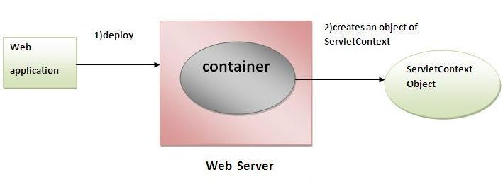
ServletContext

Slide 20
ServletContext parameter syntax
<?xml version="1.0" encoding="UTF-8"?>
<web-app xmlns:xsi="http://www.w3.org/2001/XMLSchema-instance" xmlns="http://java.sun.com/xml/ns/javaee" xmlns:web="http://java.sun.com/xml/ns/javaee/web-app_2_5.xsd" xsi:schemaLocation="http://java.sun.com/xml/ns/javaee http://java.sun.com/xml/ns/javaee/web-app_2_5.xsd" id="WebApp_ID" version="2.5">
<context-param>
<param-name>contextConfigLocation</param-name>
<param-value>classpath:applicationContext.xml</param-value>
</context-param>
</web-app>

Slide 21
Methods in ServletContext
getServletContext() method of GenericServlet class returns the object of ServletContext.
public String getInitParameter(String name): Returns the parameter value for the specified parameter name.
public Enumeration getInitParameterNames(): Returns the names of the context's initialization parameters.
public void setAttribute(String name, Object object): sets the given object in the application scope.
public Object getAttribute(String name): Returns the attribute for the specified name.
public void removeAttribute(String name): Removes the attribute with the given name from the servlet context.

Slide 22
ServletConfig
Object of ServletConfig is created by the web container for each servlet.
Useful to get configuration information from the web.xml
Advantage of ServletConfig:
No need to edit the servlet file if information is modified from the web.xml file.

Slide 23
Method of ServletConfig Interface:
public String getInitParameter(String name):Returns the parameter value for the specified parameter name.
public Enumeration getInitParameterNames():Returns an enumeration of all the initialization parameter names.
public String getServletName():Returns the name of the servlet.
public ServletContext getServletContext():Returns an object of ServletContext.

Slide 24
HttpServletRequest
Extends the ServletRequest interface to provide request information for HTTP servlets.
The servlet container creates an HttpServletRequest object and passes it as an argument to the servlet's service methods (doGet, doPost, etc).
Signature:
protected void doGet(
HttpServletRequest request,
HttpServletResponse response)
throws ServletException, IOException {
}

Slide 25
Methods of HttpServletRequest
Parameters:
Sent as a part of URL.
Or as part of body
Example:
http://jenkov.com/somePage.html?param1=hello?m2=world
protected void doGet(
HttpServletRequest request,
HttpServletResponse response)
throws ServletException, IOException {
String param1 = request.getParameter("param1");
String param2 = request.getParameter("param2");
}

Slide 26
Methods of HttpServletRequest
Headers:
request headers are name, value pairs sent by the browser along with the HTTP request.
Contain information such as:
  browser software is being used
  file types the browser is capable of receiving
  lot of meta data around the HTTP request.
Syntax:
String contentLength = request.getHeader("Content-Length");

Slide 27
Methods of HttpServletRequest
Input Stream:
If the browser sends an HTTP POST request which contain any data, like a file or a SOAP request.
Syntax:
InputStream requestBodyInput = request.getInputStream();
NOTE: You will have to call this method before calling any getParameter() method , as this method parse the message.
Once parsed, you cannot access the body as a raw stream of bytes anymore.

Slide 28
Methods of HttpServletRequest
Session:
We can obtain session Object using HttpServletRequest Object.
Session Object also holds information about the user.
We can also set an object into the session object during one request.
It will be available for us to read during any subsequent requests within the same session time scope.
HttpSession session = request.getSession();

Slide 29
Methods of HttpServletRequest
ServletContext:
The ServletContext contains meta information about the web application.
Access context parameters set in the web.xml file, which can be further forwarded to other servlet.
ServletContext context = request.getSession().getServletContext();

Slide 30
Methods of HttpServletRequest
Dispatching a request:
We can obtain RequestDispatcher object using HttpServletRequest Object.
The RequestDispatcher interface provides the facility of dispatching the request to another resource e.g. html, jsp, servlet.
Syntax:
RequestDispatcher rd = request.getRequestDispatcher("pathToResource");
rd.forward(request, response);
OR
RequestDispatcher rd = servletContext.getRequestDispatcher("/pathToResource");
rd.forward(request, response);

Slide 31
HttpServletResponse
Extends the ServletResponse interface to provide HTTP-specific functionality in sending a response.
For example, it has methods to access HTTP headers and cookies.
The servlet container creates an HttpServletResponse object and passes it as an argument to the servlet's service methods (doGet, doPost, etc).
Signature:
protected void doGet(
HttpServletRequest request,
HttpServletResponse response)
throws ServletException, IOException {
}

Slide 32
Methods of HttpServletResponse
Writing HTML:
We can obtain an object of PrintWriter from the HttpResponse object.
Using this printWriter object we can redirect our HTML message back to browser.
PrintWriter writer = response.getWriter();
writer.write("<html><body>GET/POST response</body></html>");
writer.write("This is just plain text");

Slide 33
Methods of HttpServletResponse
Headers:
We can set a header on the response Object.
Syntax:
response.setHeader("Header-Name", "Header Value");
Its a name, value pair.

Slide 34
Methods of HttpServletResponse
Content-Type:
The Content-Type header is a response header that tells the browser the type of the content you are sending back to it.
Content-type for HTML is text/html.
Content-type for Plain text is text/plain.
Content-type for image is image/png.
Syntax:
response.setHeader("Content-Type", "text/html");

Slide 35
Methods of HttpServletResponse
Content-Length:
The Content-Length header tells the browser how many bytes your servlet is sending back.
For sending binary data back you need to set the content length header.
Syntax:
response.setHeader("Content-Length", "31642");

Slide 36
Methods of HttpServletResponse
Writing Binary Data:
We can also write binary data back to the browser instead of text.
Example:
sending an image back, a PDF file or a Flash file
Set Content-Type header to the type matching the data, e.g. The content type for a PNG image is image/png.
OutputStream outputStream = response.getOutputStream();
outputStream.write(...);

Slide 37
Methods of HttpServletResponse
Redirecting to a Different URL:
You can redirect the browser to a different URL from your servlet.
You cannot send any data back to the browser when redirecting.
Syntax:
response.sendRedirect("http://jenkov.com");

Slide 38
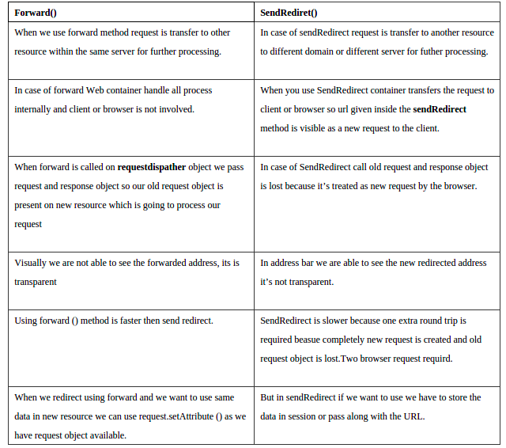
Forward Vs Redirect

Slide 39
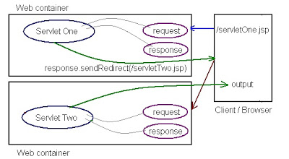
Servlet Chaining and Filtering
Channing:
Output of one servlet act as a input to another servlet and at last request is sent to the browser and final output is achieved.
Servlet allows us to invoke more than one servlet in sequence when the URL is opened with a common servlet.

Slide 40
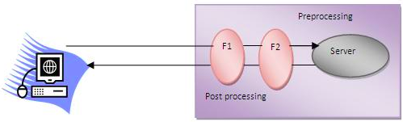
Servlet Chaining and Filtering
Filtering:
A filter is an object that is invoked at the preprocessing and postprocessing of a request.
Used to perform filtering tasks such as conversion, logging, compression, encryption and decryption, input validation etc.

