Slide 1
JAVASCRIPT

Slide 2
AGENDA
What and why
Where to write JavaScript
Variables
Operators
JavaScript Dialog Boxes
Statements (if, else, for, switch)
Functions
DOM
Events
Objects
Intervals and animation

Slide 3
What and Why is JavaScript??
JavaScript is the most popular scripting language on the Internet, and works in all major browsers, such as Internet Explorer, Firefox, Chrome, Opera, and Safari.
Designed to add interactivity to HTML pages
Scripting language
Usually embedded directly into HTML pages
Interpreted language (executes without compilation)

Slide 4
Is Java and JavaScript the same?
NOPE !!!
Java is developed by Sun Microsystems(now Oracle) and is a full fledged language.
Based on ECMA Script and is a scripting language.

Slide 5
What can a JavaScript do?
Gives HTML designers a programming tool - HTML authors are normally not programmers, but JavaScript is a scripting language with a very simple syntax! Almost anyone can put small "snippets" of code into their HTML pages.
Can put dynamic text into an HTML page - A JavaScript statement like this: document.write("<h1>" + name + "</h1>") can write a variable text into an HTML page.
Can react to events - A JavaScript can be set to execute when something happens, like when a page has finished loading or when a user clicks on an HTML element.
Can read and write HTML elements - A JavaScript can read and change the content of an HTML element.
Can be used to validate data - A JavaScript can be used to validate form data before it is submitted to a server. This saves the server from extra processing.
Can be used to detect the visitor's browser - A JavaScript can be used to detect the visitor's browser, and - depending on the browser - load another page specifically designed for that browser.
Can be used to create cookies - A JavaScript can be used to store and retrieve information on the visitor's computer.
Can be used to create UI.
AND MANY MORE......

Slide 6
Points to remember while writing JavaScript
Java like syntax
Semicolon optional
Case sensitive
Runs on client machine
Silently fails
Weakly typed

Slide 7
Where To And How To Include JavaScript In Your File
There are 3 places where we can write JavaScript in our HTML Document
In the Head
In The Body
In a separate file
Each place has its own pros/cons
Remember JavaScript is Case Sensitive

Slide 8
JavaScript Variables
Same as algebra, JavaScript variables are used to hold values or expressions.
A variable can have a short name, like x, or a more descriptive name like carName.
Rules for JavaScript variable names:
Variable names are case sensitive (y and Y are two different variables).
Variable names must begin with a letter or the underscore character.
Reserved keywords cannot be used as variable's name.

Slide 9
Example
var x=5;
var carName="Volvo";
y=x-5;
z=y+5;
Etc..

Slide 10
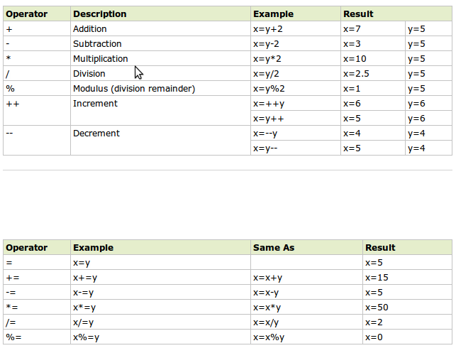
JavaScript Operators

Slide 11
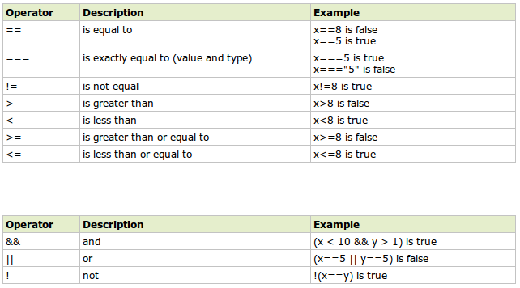
JavaScript Comparators

Slide 12
JavaScript Dialog Boxes
Three types of dialog boxes:
Alert Box
alert("sometext");
Prompt Box
var name = prompt("Please enter your name","Harry Potter");
Confirm Box
var r = confirm("Press a button"); return: [true/false]

Slide 13
JavaScript If...Else Statements
JavaScript supports if, if else, else statements.
<script type="text/javascript">
//If the time is less than 10, you will get a "Good morning" greeting.
//Otherwise you will get a "Good day" greeting.
var d = new Date();
var time = d.getHours();
if (time < 10) {
alert("Good morning!");
} else {
alert("Good day!");
}
</script>

Slide 14
JavaScript Switch Statement
JavaScript Supports Switch Statement
<script type="text/javascript">
var d=new Date();
var theDay=d.getDay();
switch (theDay){
case 5: alert("Finally Friday");
break;
case 6: alert("Super Saturday");
break;
case 0: alert("Sleepy Sunday");
break;
default: alert("I'm looking forward to this weekend!");
}
</script>

Slide 15
JavaScript For Loop
Similar to C/C++
<html>
<body>
<script type="text/javascript">
var i=0;
for (i=0;i<=5;i++){
alert("The number is " + i);
}
</script>
</body>
</html>

Slide 16
Try/Catch Statement
try {
//Run some code here
}
catch(err) {
//Handle errors here
}

Slide 17
Functions
A function contains code that will be executed by an event or by a call to the function.
You may call a function from anywhere within a page (or even from other pages if the function is embedded in an external .js file).

Slide 18
Functions (Cont...)
function displayMessage(){
alert("Hello World!");
}
function product(a,b){
return a*b;
}
function sumArray(arr){
var sum=0;
for(counter in arr){
sum+=arr[counter]
}
return sum;
}

Slide 19
Introduction to DOM
The DOM defines the objects and properties of all document elements, and the methods (interface) to access them.
According to the DOM, everything in an HTML document is a node.
The DOM says:
The entire document is a document node
Every HTML element is an element node
The text in the HTML elements are text nodes
Every HTML attribute is an attribute node
Comments are comment nodes

Slide 20

DOM TREE Example

Slide 21
DOM Manipulation : document.write()
It is used to write text on the document.
Example:
<html>
<body>
<h1>My First Web Page</h1>
<script type="text/javascript">
document.write("<p>" + new Date() + "</p>");
</script>
</body>
</html>

Slide 22
DOM manipulation : Get elements
Var selectBox=document.getElementById("mySelect");
Var textBoxes=document.getElementsByClassName(“password”)
Var textBoxes=document.getElementsByTagName(“div”)
Var textEntered=document.getElementsByName('q')[0].value="123";
Link → http://www.w3schools.com/js/js_htmldom_document.asp

Slide 23
TIP: Break up a Code Line
document.write("Hello \
World!");
document.write \
("Hello World!");

Slide 24
Exercise 1
Make A Function which takes the “ID”, of the element and “HTML” as the parameter, And replaces the content of the element by the HTML supplied.

Slide 25
Events
Events are actions that can be detected by JavaScript.
Every element on a web page has certain events which can trigger a JavaScript action.
We can define the events in the HTML tags.
Events are normally used in combination with functions, and the function will not be executed before the event occurs!

Slide 26
Events Continued ...
The onLoad and onUnload events are triggered when the user enters or leaves the page.
<body onload="myFunction()"></body>
The onFocus, onBlur and onChange events are often used in combination with validation of form fields.
<input type="text" size="30" id="email" onchange="checkEmail()">
The onSubmit event is used to validate ALL form fields before submitting it.
<form method="post" action="xyz.htm" onsubmit="return checkForm()">
OnMouseOut
OnMouseOver
keypress

Slide 27
Built-in JavaScript Objects
Object
String
Date
Array
Math
RegEx

Slide 28
Exercise 2
In application.js Make a function which returns the current date/time.
Also make another function which returns the Date in a defined format (“dd Month, yyyy HH:MM:ss”);
Make a “div” on the Html Page with id=”timeDisp”. Write a function to display current formatted time in the “div” created above.

Slide 29
JavaScript Objects
Now we know that JavaScript has several built-in objects, like String, Date, Array, and more. In addition to these built-in objects, you can also create your own.
An object is just a special kind of data, with a collection of properties and methods.
Example :
personObj=new Object() || {} || Object.create(null)
personObj.firstname="John";
personObj.lastname="Doe";
personObj.age=50;
personObj.calc= function(){};

Slide 30
String methods
toLowerCase()
toUpperCase()
replace()
IndexOf()
trim()
charAt(index)
e.g.
Var upper="Hi Hello".toUpperCase()
Var len="Some".length
alert(upper.toLowerCase())
Var wordsArray=upper.split()

Slide 31
Math methods
Math.round(12.56)
Math.max(4,7)
Math.min(5,6)
Math.sqrt(2)
Math.random()
Math.PI
Math.E

Slide 32
Exercise 3
Create an Object named Clock and encapsulate all functions in it.

Slide 33
Intervals
You can create an Interval
setInterval(“script”,time in mills)
You can erase an interval.
clearInterval(intervalProcessId)

Slide 34
Exercise 4
Make an Interval which calls the method updateTime every one second.
Make a button which can stop this interval.

Slide 35
Useful links
https://developer.mozilla.org/en-US/docs/Web/JavaScript
http://www.w3schools.com/js/js_intro.asp

Slide 36
Final Exercise
1) Prompt for amount, interest rate and no. of years and calculate simple interest.
2) is palindrome string
3) Area of circle
Exercises Using Form
4) On click of a button ask for the name of user and display it inside the text box
5) Copy text of one text field to another on change of text in first text box
6) Allow submission of form only if the user has entered his name(not empty) and age is greater than or equals to 18
7) Change color of the div when mouse is moved over it and restore the color when mouse moves out of it
8) Externalize JavaScript file

