Slide 1
SPRING REFRESHER

Slide 2
Agenda
The What and the Why
- Introduction to Spring
- Cool Things in a Gist
The How
- Bean Containers
- Dependency Injection and Inversion Of Control
- DI Types (Setter and Constructor)
- Initializing Collections (List , Set and Map)
- Autowiring
In Depth
- Bean Scopes in Spring
- Bean Life Cycle

Slide 3
Spring ??
Application framework and inversion of control container for the Java platform.

Slide 4
Spring ??
Spring handles the infrastructure so you can focus on your application.

Slide 5
But Why ??
Dependency Injection
Aspect-Oriented Programming including Spring's declarative transaction management
Spring MVC web application and RESTful web service framework
Spring is both comprehensive and modular.
Foundational support for JDBC, JPA, JMS
Lightweight, the basic version of Spring weighs in at around 2 MB.
Much more...

Slide 6
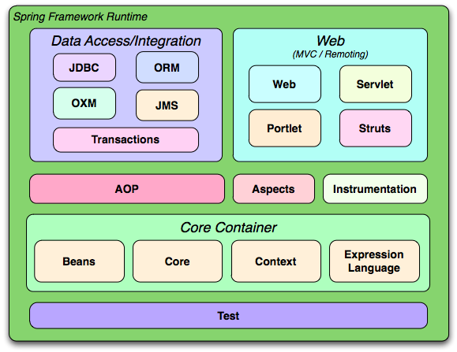
Overview

Slide 7
Agenda
The What and the Why
- Introduction to Spring
- Cool Things in a Gist
The How
- Bean Containers
- Dependency Injection and Inversion Of Control
- DI Types (Setter and Constructor)
- Initializing Collections (List , Set and Map)
- Autowiring
In Depth
- Bean Scopes in Spring
- Bean Life Cycle
- Spring MVC
-Spring AOP

Slide 8
Bean Containers
Spring acts a container of bean or a factory of beans.
Handles the creation, lifecycle and destruction of your objects.
Types
  Bean Factory
  Application Context

Slide 9
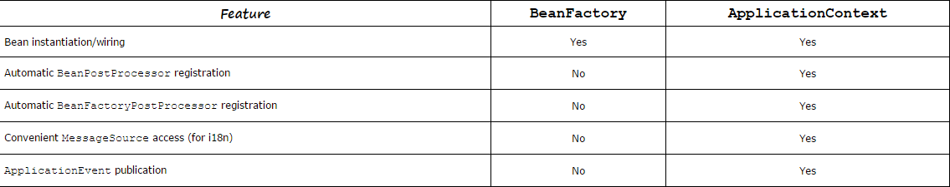
Bean Containers

Slide 10
Finally ... some code !!!
Main Class
BeanFactory beanFactory = new XmlBeanFactory(new FileSystemResource(“spring.xml”));
beanFactory.getBean(“triangle”) // Using Bean Factory
ApplicationContext applicationContext = new ClassPathXmlConfiguration(“spring.xml”);
applicationContext.getBean(“triangle”)// Using ApplicationContext
Xml
<beans>
<bean id=”trinagle” class=”Triangle”/>
</beans>

Slide 11
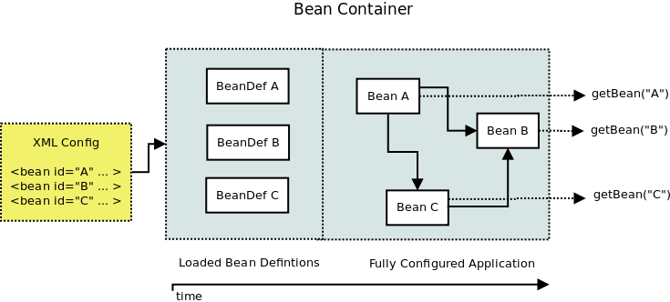
Bean Containers

Slide 12
Inversion Of Control
Don't Call Me ... I'll Call You

Slide 13
Inversion Of Control
The control flow of a program is inverted.
Instead of the programmer controlling the flow of a program, the external sources (framework, services, other components) take control of it.
Can be introduced by
- Dependency LookUp
- Dependency Injection

Slide 14
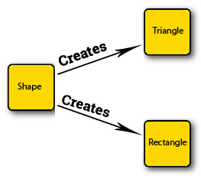
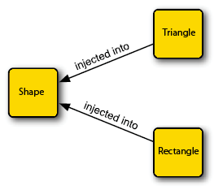
Dependency Injection
V/S

Slide 15
Setter Based Dependency Injection
Preferred method of dependency injection in Spring
Accomplished by the container calling setter methods on your beans after invoking a no-argument constructor .
Setter injection uses the set* methods in a class file to garner property names that are configurable in the spring XML config.
No Brainer – Setters for a property are mandatory otherwise you get an error.

Slide 16
Setter Based Dependency Injection
<beans>
<bean id=”triangle” class=”Triangle”>
<property name=”side” value = “50”></property>
<property name=”height” value = “80”>
</property>
</beans>

Slide 17
Constructor Based Dependency Injection
Invokes a class constructor with a number of arguments, each representing a dependency on other class.
<beans>
<bean id=”triangle” class=”Triangle”>
<constructor-arg value=”50”></constructor-arg>
<constructor-arg value=”80”></constructor-arg>
</beans>
Triangle class should have a constructor (parameterized) which takes all the arguments defined in the <constructor-arg>. If spring doesn’t find the matching constructor, it will generate an error.

Slide 18
Constructor Based Dependency Injection
Supports constructor overloading.
Calls the matching constructor by looking at the values given inside constructor-arg.

Slide 19
Munchies !!
Create a Coordinate class which has 2 data member latitude, longitude. Inject above properties using setter injection and constructor injection.
Inject 2 properties latitude and longitude using setter injection and altitude using constructor injection.
Inject same property using setter injection and constructor injection and see which injection is getting the preference.
Create a Location class and create three Coordinate variables. Inject them using setter and constructor injection.
Create a class. Create two one-argumented constructors .One which takes a String and another an Integer. Inject values using Constructor injection.
Implement index property Of constructor-arg

Slide 20
Initializing Collections
Lists
<property name=”listOfSomething”>
  <list>
  <value=”value1”>
  <value=“value2”>
  <value=“value3”>
  </list>
  </property>

Slide 21
Initializing Collections
Maps
<property name="map">
<map>
<entry key="1" value="First"></entry>
<entry key="2" value="Seconds"></entry>
</map>
</property>

Slide 22
        DEMO

Slide 23
Munchies !!
Inject Bean references using set/Map/List
Create a Person class having list vehicles(String) . Inject vehicles from multiple lists having some common entries such that person has only unique vehicles.
Create a shape Interface. Implement various classes from it (Triangle , Circle etc.). Create Drawing class .Inject List of different shapes inside Drawing class

Slide 24
Autowiring
The Spring container can autowire relationships between collaborating beans without using <constructor-arg> and <property> elements which helps cut down on the amount of XML configuration you write for a big Spring based application.
Types Of Autowiring:
no
byName
byType
constructor
autodetect
Notes:
The value of the belongsTo property in the Engine class is a Map.

Slide 25
Autowiring
By Name
<bean id="point" class="Point"></bean>
<bean id="triangle" class="Triangle"
autowire="byName"></bean>
By Type
<bean id="point" class="Point"></bean>
<bean id="triangle" class="Triangle"
autowire="byType"></bean>

Slide 26
Autowiring
Using Constructor
<bean id="point" class="Point"></bean>
<bean id="triangle" class="Triangle" autowire="constructor">
<property name="point" ref="Point" /></bean>

Slide 27
        DEMO

Slide 28
Excercise
Implement autowiring by name/type / constructor

Slide 29

Agenda
The What and the Why
- Introduction to Spring
- Cool Things in a Gist
The How
- Bean Containers
- Dependency Injection and Inversion Of Control
- DI Types (Setter and Constructor)
- Initializing Collections (List , Set and Map)
- Autowiring
In Depth
- Bean Scopes in Spring
- Bean Life Cycle
Good to Know
- Spring In Grails
- Spring MVC

Slide 30
Bean Scopes In Spring
Bean scope is used to decide which type of bean instance should be return from Spring container back to the caller.
singleton – Return a single bean instance per Spring IoC container
prototype – Return a new bean instance each time when requested
request – Return a single bean instance per HTTP request. *
session – Return a single bean instance per HTTP session. *
globalSession – Return a single bean instance per global HTTP session. *

Slide 31
Bean Scopes In Spring
Singleton
<bean id ="triangle" class="Triangle" scope="singleton">
Prototype:
<bean id ="triangle" class="Triangle" scope="prototype">

Slide 32
Fetch Type
Default : ApplicationContext containers eagerly instantiate singleton beans by default as the container initializes.
Lazy-init: true
Lazily initialisess the bean when it is demanded.In some cases, it may be preferable to create the bean only when it is really going to be used.
Lazy-init:false
Initialises the bean on container startup

Slide 33
        DEMO

Slide 34
Lifecycle Callbacks
There are some ways in spring by which you can call a method when bean is initialized and when it is destroyed.
Using Interfaces : Implement initializing Bean and DiposableBean interfaces.
Using XML: Define init-method and destroy-method with each bean and use it in xml.
Using BeanPostProcessor: Define a class whose methods will be called after initialization of every bean. This is handier as in this we don’t need to write specific method inside each class.

Slide 35
Lifecycle Callbacks
Using XML:
<bean id="lifecycle" class="com.intellimeet.LifeCycleObject" scope="singleton" init-method="init" destroy-method="cleanUp">
<constructor-arg value="10"/>
<property name="var1" value="20"/>
</bean>

Slide 36
Lifecycle Callbacks
Using Interface
class LifeCycleObject implements InitializingBean , DisposableBean {
@Override
void destroy() throws Exception {
}
@Override
void afterPropertiesSet() throws Exception {
}
}

Slide 37
Lifecycle Callbacks
Using BeanPostProcessor
class CustomBeanPostProcessor implements BeanPostProcessor{
@Override
Object postProcessBeforeInitialization(Object bean, String beanName) throws BeansException {
return bean
}
@Override
Object postProcessAfterInitialization(Object bean, String beanName) throws BeansException {
return bean
}
}
In xml: <bean class="CustomBeanPostProcessor"/>

Slide 38
Lifecycle Callbacks
Order in which above methods will be called
default constructor
The setters corresponding to each <property> of the bean
postProcessBeforeInitialization of BeanPostProcessor
afterPropertiesSet Of initialising Bean
the init-method, if specified
postProcessAfterInitialization of BeanPostProcessor
destroy method of disposable Bean
destroy-method

Slide 39
DEMO

Slide 40
Annotations In Spring
@Autowired:
It is given above the setter or above the property itself.
@Autowired Looks for type and if it finds that there is only one bean corresponding to that type it is going to autowire it even if the bean id is different from the name of dependency.
If there are multiple of the same type its going to look at the name If it finds whose bean id is same as the name of the property its going to autowire. Otherwise it will through an exception.

Slide 41
Annotations In Spring
@Autowired
public class Triangle {
Private Point point1;
//getter
//setter
public void draw(){
println(“drawing circle”)
}
}
Add <context:annotation-config/> in xml

Slide 42
Annotations In Spring
@Resource
Does autowiring by name
@Resource(name =”pointC”)
private Point center;

Slide 43
Annotations In Spring
@Component:
In order to tell spring that a particular class is a bean or not we need to use annotation @Component. That way we don’t need to specify that inside the xml.

Slide 44
Annotations In Spring
@Component
public class Circle {
}
This is equivalent to :
<bean id="circle" class="Circle">
</bean>
In XML:
<context:component-scan base-package="com.packagename"></context:component-scan>
This tells spring to scan the package com.packagename and finds the classes which have @component over them.

Slide 45
Annotations In Spring
There are some annotations which tell spring that a bean will perform a particular function
For service we will use @Service. (This will give additional information to spring that this a service)
For data objects we use @Repository
For controller we use @Controller
These annotations are no different from @Component. But @Component is something more generic But if provide @Service or @Controller this will tell what role that bean is going to perform. It also adds little bit of documentation

Slide 46
Spring MVC

Slide 47
Compiling Topics
Spring MVC architecture
Model
View Resolver
Application

Slide 48
MVC in a Web Application
The model is the data and business/domain logic for your application.
The view is typically HTML generated by your application.
The controller receives HTTP requests and decides which domain objects to use to carry out specific tasks

Slide 49
MVC Overview
Model
Model
Model
Controller
Controller
Controller
Controller
Request
Response
View
View
View

Slide 50
Front Controller
Front Controller
Front Controller
Front Controller
Front Controller
Front Controller responsibilities
> Initialize the framework to cater to the requests.
> Load the map of all the URLs and the components responsible to handle the request.
> Prepare the map for the views.

Slide 51
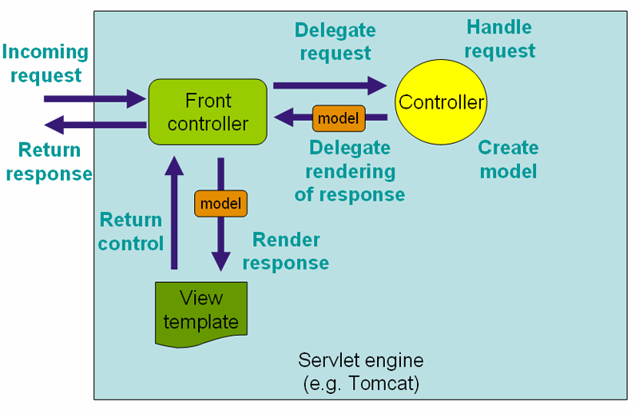
Dispatcher Servlet
[1] Copyright © 2004-2010 Rod Johnson, Juergen Hoeller, et al. See copyright slide for full copyright information.

Slide 52
Spring MVC Framework - Initialization
MultipartResolver
DispatcherServlet
-Initialization
DispactherServlet
(Front controller)
DispatcherServlet
-Initialization
LocaleResolver
DispactherServlet
(Front controller)
DispactherServlet
(Front controller)
ThemeResolver
HandlerMappings
HandlerAdapters
HandlerExceptionResolvers
RequestToViewNameTranslator
ViewResolvers

Slide 53
Interface | Default bean name | purpose
org.springframework.web.servlet.HandlerMapping | handlerMapping | Maps the Request to Handlers(Controllers)
org.springframework.web.servlet.HandlerAdapter | none | Plugs the other frameworks handlers
org.springframework.web.servlet.ViewResolver | viewResolver | Maps the view names to view instances
org.springframework.web.servlet.HandlerExceptionResolver | handlerExceptionResolver | Mapping of the exceptions to handlers and views
org.springframework.web.multipart.MultipartResolver | multipartResolver | Interface to handle the file uploads
org.springframework.web.servlet.LocaleResolver | localeResolver | Helps to resolve the locale from the request
org.springframework.web.servlet.ThemeResolver | themeResolver | Resolves a theme for a Request.

Slide 54
Spring MVC Configuration
1) Step 1 - In your Web Container, the Spring “bean” XML file exists in the same directory as your web.xml file with a “-servlet.xml” appended to it.
webapps
/tradingapp
/WEB-INF/myApp-servlet.xml, web.xml)
/classes
/lib (all jar files)
The dispatcher servlet is mapped to the name “myApp” so it knows to look in the “myApp-servlet.xml” file to look-up a URL-to- Controller match.

Slide 55
Spring MVC Configuration
<servlet>
<servlet-name>myApp</servlet-name>
<servlet-class>DispatcherServlet</servlet-class>
</servlet>
<servlet-mapping>
<servlet-name>myApp</servlet-name>
<url-pattern>*.html</url-pattern>
</servlet-mapping>

Slide 56
Spring MVC Configuration
1) Step 1 - Configure the web.xml with DispatcherServlet and details of the application context file location.
<servlet>
<servlet-name>appServlet</servlet-name>
<servletclass>
org.springframework.web.servlet.DispatcherServlet
</servlet-class>
<init-param>
<param-name>contextConfigLocation</param-name>
<param-value>
/WEB-INF/spring/appServlet/myApp-servlet.xml
</param-value>
</init-param>
<load-on-startup>1</load-on-startup>
</servlet>
<servlet-mapping>
<servlet-name>appServlet</servlet-name>
<url-pattern>/</url-pattern>
</servlet-mapping>

Slide 57
Spring MVC Configuration
2) Step 2 - Configure the contextConfigLocation for the application context to be loaded.
<context-param>
<param-name>contextConfigLocation</param-name>
<param-value>
/WEB-INF/spring/applicationContext.xml
</param-value>
</context-param>
<listener>
<listener-class>
org.springframework.web.context.ContextLoaderListener
</listener-class>
</listener>

Slide 58
Spring MVC Configuration
3) Step 3 - Configure the [servlet-name]-servlet.xml, where [servlet-name] is the name we gave our servlet in Step 2
<beans xmlns="http://www.springframework.org/schema/beans"
xmlns:xsi="http://www.w3.org/2001/XMLSchema-instance"
xmlns:context="http://www.springframework.org/schema/context"
xsi:schemaLocation="http://www.springframework.org/schema/beans
http://www.springframework.org/schema/beans/spring-beans-3.0.xsd
http://www.springframework.org/schema/context
http://www.springframework.org/schema/context/spring-context-3.0.xsd">
<beans:bean
class="org.springframework.web.servlet.view.InternalResourceViewResolve”>
<beans:property name="prefix" value="/WEB-INF/views/" />
<beans:property name="suffix" value=".jsp" />
</beans:bean>
<context:component-scan base-package="com.ttnd.app.controllers" />
</beans>

Slide 59
Handler Mapping

Slide 60
Handler Mapping
The handler Mapping classes are Responsible for mapping the incoming requests to the handler class.
Handler mapping Implementation classes:
1. BeanUrlHandlerMapping
2. SimpleUrlHandlerMapping
3. ControllerClassNameHandlerMapping
4. CommansPathHandlerMapping

Slide 61
Handler Mapping
1. BeanNameUrlHandler Mapping:
The Org.springframework.web.servlet.handler.BeanNameUrlHandlerMapping class is implementation of Handler Mapping interface.
BeanNameUrlHandlerMapping class is default handler Mapping class.
This HandlerMapping strategy Maps The Input request to URL’s url- pattern to controllerclassname.
Syntax: <bean name="/urlpattern.ext" class="controllerclassname" />
<beans>
<bean id="handler” class=“org.springframework.web.servlet.handler.BeanNameUrlHandlerMappin”>
<bean name=“hello.html” class=“com.ttnd.welcomecontroller”>
</bean>
</bean></beans>

Slide 62
Handler Mapping
2. SimpleUrlHandleMapping:
This HandlerMapping approach used to Map url-patterns to bean id of controller classes.
<beans>
<bean id="“handler”" class="“simpleurlHandlerMapping”/">
<property name="“mappings”">
<props>
<prop key="“/welcome.html”">welcome</prop>
</props>
</property>
</bean>
<bean id="“welcome”" class="“com.ttnd.welcomeController”">
</bean>
</beans>

Slide 63
Handler Mapping
3. ControllerClassNameHandlerMapping:
The org.springframework.web.servlet.controllerclassNameHandlerMapping is the implementation class of “Handler Mapping” interface.
If url-pattern name and controllerclassname is matching then DisPatcherServlet will Redirect To particular controller.
controllerclassNameHandleMapping automatically findout The Controller classes based on input Request”url-pattern”.
<beans>
<bean id="“handlerMapping”" class="“org.springframework.web.servlet.ControllerClassNameHandlerMapping”/">
<bean id="“/welcome.html”" class="“com.ttnd.welcomeController”">
</bean>
</bean></beans>

Slide 64
Handler Mapping
4. CommonsPathMapHandlerMapping:
This controller class maps controllers to urlpatterns using source level meta data placed in the controller code.The Meta data is defined using common attributes.
The org.springframework.web.servlet.handler.CommonsPathHandlerMapping is one of the implementation of handler mapping interface.
Note:in annotation approach We use The @RequestMapping.This annotation is used to map the input request.

Slide 65
Controllers

Slide 66
Controllers
Controllers are components that are being called by the Dispatcher Servlet for doing any kind of Business Logic. All Controller Components in Spring implement the org.springframework.web.servlet.mvc.Controller interface.
The following are the Controller Components available in the Spring Distribution
1. AbstractController
2. AbstractCommandController
3. SimpleFormController
4. CancellableFormController

Slide 67
Controllers
1. Abstract Controller:
To implement Custom Controller Component right from the scratch, then instead of implementing the Controller interface, extending AbstractController can be preferred as it provides the basic support for the GET and the POST methods.
The purpose may be as simple as returning a resource to the Client upon request without having the need to examine the Request Parameters
public class MySimpleController extends AbstractController{
public ModelAndView handleRequestInternal(HttpServletRequest request,
HttpServletResponse response){
return new ModelAndView('myView');
}
}

Slide 68
Controllers
2. Abstract Command Controller:
The concept of Command Controller comes into picture when the Business Logic depends upon the values that are submitted by the User. Instead of depending on the Servlet API to get the Request Parameter Values and other session Objects, we can depend on this Abstract Command Controller to take those pieces of Information
public class MySimpleController extends AbstractCommandController{
public MySimpleController(){
setCommandClass(UserInfo.class);
}
public ModelAndView handle(HttpServletRequest request, HttpServletResponse response,
Object command){
UserInfo userInfo = (UserInfo)command;
return new ModelAndView('success');
}
}

Slide 69
Controllers
3. Simple Form Controller:
If a User needs to fill in a Form containing various information and submitting the form, the Simple Form Controller is exactly used for that purpose.
Example:
Client Request a page called empInfo.jsp is rendered to the client containing empName, empAge and empSalary fields. Upon successful completion a Jsp Page called empSuccess.jsp is displayed back to the Client.
public class EmpInfo{ //Command Object
private String empName;
private int empAge;
private double empSalary;
// Getters and setters for the above properties.
}

Slide 70
Controllers
3. Simple Form Controller:
public class EmpFormController extends SimpleFormController{
public EmpFormController(){
setCommandClass(EmpInfo.class);
}
public void doSubmitAction(Object command){
EmpInfo info = (EmpInfo)command;
process(info);
}
private void process(EmpInfo info){
//Do some processing with this object.
}
}
<bean id = 'empForm' class='EmpFormController'>
<property name='formView'>
<value>empInfo</value>
</property>
<property name='successView'>
<value>empSuccess</value>
</property>
</bean>

Slide 71
Controllers
3. Cancellable Form Controller:
The implementation is to support when the Form is cancelled by the User. Cancellable FormController extends SimpleForm Controller
The User clicks the cancel button, the Framework will check in the Request parameter for a key with name 'cancelParamKey'. If it is so, then it will call the onCancel() method.
public class MyCompleteFormController extends CancellableFormController{
public ModelAndView onCancel(){
return new ModelAndView('cancelView');
}
}
Note:In Spring Mvc applications To make our class as a controller class we need to add @Controller .

Slide 72
Model And View :
Model and View (represented by the class org.springframework.web.servlet.ModelAndView) is returned by the Controller object back to the Dispatcher Servlet. This class is just a Container class for holding the Model and the View information.
@RequestMapping("*")
@ResponseBody
public String fallbackMethod(){
return "fallback method";
}

Slide 73
Controllers using @Controller
DispatcherServlet delegates the request to the controllers to execute the functionality specific to it.
The @Controller annotation indicates that a particular class serves the role of a controller.
The @RequestMapping annotation is used to map a URL to either an entire class or a particular handler method.
1. @RequestMapping with Class: We can use it with class definition to create the base URI.
@Controller
@RequestMapping("/home")
public class HomeController {
}

Slide 74
2. @RequestMapping with Method: We can use it with method to provide the URI pattern for which handler method will be used.
@RequestMapping(value="/method0")
@ResponseBody
public String method0(){
return "method0";
}
NOTE: Using @ResponseBody spring will try to convert its return value and write it to the http response automatically.
3. @RequestMapping with Multiple URI: We can use a single method for handling multiple URIs.
@RequestMapping(value={"/method1","/method1/second"})
public ModelAndView method1(){
}

Slide 75
2. @RequestMapping with HTTP Method: We can use @RequestMapping method variable to narrow down the HTTP methods for which this method will be invoked.
@RequestMapping(value="/method2", method=RequestMethod.POST)
@ResponseBody
public String method2(){
return "method2";
}
3. @RequestMapping with Produces and Consumes: @RequestMapping provides produces and consumes variables where we can specify the request content-type for which method will be invoked and the response content type
@RequestMapping(value="/method6", produces={"application/json","application/xml"}, consumes="text/html")
@ResponseBody
public String method6(){
return "method6";
}

Slide 76
4. @RequestMapping with @PathVariable : @PathVariable annotation through which we can map the URI variable to one of the method arguments.
@RequestMapping(value="/method/{id}")
@ResponseBody
public String method(@PathVariable("id") int id){
return "method with id="+id;
}
5. @RequestMapping with @RequestParam: Parameters in the request URL, mostly in GET requests.@RequestParam annotation to retrieve the URL parameter and map it to the method argument
@RequestMapping(value="/method")
@ResponseBody
public String method(@RequestParam("id") int id){
return "method with id= "+id;
}

Slide 77
6. @RequestMapping fallback method : We can create a fallback method for the controller class to make sure we are catching all the client requests even though there are no matching handler methods. It is useful in sending custom 404 response pages to users when there are no handler methods for the request.
@RequestMapping("*")
@ResponseBody
public String fallbackMethod(){
return "fallback method";
}

Slide 78
Data-Binding in Spring
Using @ModelAttribute on a method argument : An @ModelAttribute on a method argument indicates the argument should be retrieved from the model (@SessionAttributes). If not present in the model, the argument should be instantiated first and then added to the model. Once present in the model, the argument’s fields should be populated from all request parameters that have matching names. This is known as data binding in Spring MVC.
@RequestMapping(path = "/owners/{ownerId}/pets/{petId}/edit", method = RequestMethod.POST)
public String processSubmit(@ModelAttribute("pet") Pet pet, BindingResult result) {
if (result.hasErrors()) {
return "petForm";
}
}

Slide 79
Model And View
Model and View (represented by the class org.springframework.web.servlet.ModelAndView) is returned by the Controller object back to the Dispatcher Servlet.
This class is just a Container class for holding the Model and the View information.
Any kind of View Technology (org.springframework.web.servlet.View) can be plugged into the Framework with ease. For example, Excel, Jasper Reports, Pdf, Xslt, Free Marker, Html, Tiles, Velocity etc. are the supported Frameworks as of now.
The Model object (represented by org.springframework.ui.ModelMap) is internally maintained as a Map for storing the Information.

Slide 80
Model And View
View pdfView = …;
Map modelData = new HashMap();
ModelAndView mv1 = new ModelAndView(pdfView, modelData);
View pdfView = …;
Map modelData = new HashMap();
ModelAndView mv1 = new ModelAndView(pdfView, modelData);
ModelAndView mv1 = new ModelAndView('myView', someData);

Slide 81
View Resolvers
The ViewResolver object is responsible to locate the view object that can render a view for the request.
To Render The view Pages into spring mvc application we will use ViewResolver.
Types of view Resolvers:
  InternalResourceViewResolver
  XmlViewResolver
  ResourceBundleViewResolver

Slide 82
View Resolvers
1) InternalResourceViewResolver
The InternalResourceViewResolver maps the jsp and html files in the WebContent/WEB-INF/ folder. It allows us to set properties such as prefix or suffix to the view name to generate the final view page URL. It is configured as shown below in mvc-dispatcher-servlet.xml
<bean class="org.springframework.web.servlet.view.InternalResourceViewResolver">
<property name="prefix">
<value>/WEB-INF/</value>
</property>
<property name="suffix">
<value>.jsp</value>
</property>
</bean>

Slide 83
View Resolvers
2) XmlViewResolver
XmlViewResolver is an implementation of ViewResolver that accepts a configuration file written in XML, where the view implementation and the url of the jsp file are set. Below is the configuration file, views.xml.
<bean id="helloWorld" class="org.springframework.web.servlet.view.JstlView">
<property name="url" value="/WEB-INF/helloWorld.jsp"/>
</bean>

Slide 84
View Resolvers
3) ResourceBundleViewResolver
The ResourceBundleViewResolver uses bean definitions in a ResourceBundle, that is specified by the bundle basename. The bundle is typically defined in a properties file, located in the classpath. Below is the views.properties file.
helloworld.(class)=org.springframework.web.servlet.view.JstlView
helloworld.url=/WEB-INF/helloworld.jsp
<bean class="org.springframework.web.servlet.view.ResourceBundleViewResolver">
<property name="basename" value="views" />
</bean>

Slide 85
Questions ?

Slide 86
AOP with Spring Framework

Slide 87
Aspect Oriented Programming (provides interceptors to intercept an application) entails breaking down program logic into distinct parts called so-called concerns. The functions that span multiple points of an application are called cross-cutting concerns and these cross-cutting concerns are conceptually separate from the application's business logic.
There are various common good examples of aspects like logging, auditing, declarative transactions, security, and caching etc.
The key unit of modularity in OOP is the class, whereas in AOP the unit of modularity is the aspect.
Concern is behavior which we want to have in a module of an application. Concern may be defined as a functionality we want to implement to solve a specific business problem. E.g. in any eCommerce application different concerns (or modules) may be inventory management, shipping management, user management etc.
Cross-cutting concern is a concern which is applicable throughout the application (or more than one module). e.g. logging , security and data transfer are the concerns which are needed in almost every module of an application, hence they are termed as cross-cutting concerns.

Slide 88
AOP Concepts and Terminologies
Aspect | A module which has a set of APIs providing cross-cutting requirements. An application can have any number of aspects depending on the requirement.
Join point | This represents a point in your application where you can plug-in AOP aspect, it could be a method being called, an exception being thrown, or even a field being modified.
Advice | This is the actual action to be taken either before or after the method execution.
Pointcut | This is a set of one or more joinpoints where an advice should be executed. A pointcut defines at what joinpoints, Advice should be applied.
Introduction | An introduction allows you to add new methods or attributes to existing classes.
Target Object/ Advised Object | The object being advised by one or more aspects, this object will always be a proxied object.
Weaving | The process of linking aspects with other application types or objects to create an advised object. This can be done at compile time, load time, or at runtime.

Slide 89
Types of Advice
Spring aspects can work with five kinds of advice mentioned below:
before | Run advice before the method execution.
after | Run advice after the method execution regardless of its outcome.
after-returning | Run advice after the a method execution only if method completes successfully.
after-throwing | Run advice after the a method execution only if method exits by throwing an exception.
around | Run advice before and after the advised method is invoked.

Slide 90
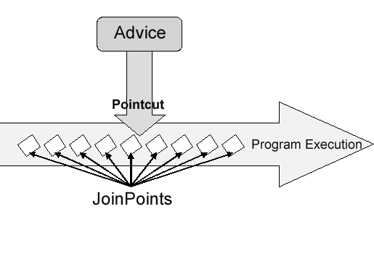
POINTCUT
Pointcuts determine join points of interest, and thus enable us to control when advice executes. Spring AOP only supports method execution join points for Spring beans.
A pointcut declaration has two parts: a signature comprising a name and any parameters, and a pointcut expression that determines exactly which method executions we are interested in.
Pointcut expressions can also be combined using ‘&&’, ‘||’ and ‘!’. It is also possible to refer to pointcut expressions by name.
• execution – for matching method execution join points (This is the primary pointcut designator you will use when working with Spring AOP).
• within – limits matching to join points within certain types.
• this – limits matching to join points where the bean reference (Spring AOP proxy) is an instance of the given type
• target – limits matching to join points where the target object (application object being proxied) is an instance of the given type
• args – limits matching to join points where the arguments are instances of the given types

Slide 91
Examples of various pointcut declarations:
the execution of any public method:
execution(public * *(..))
the execution of any method with a name beginning with “set”:
execution(* set*(..))
the execution of any method defined by the MyService interface
execution(* com.xyz.service.MyService.*(..))
the execution of any method defined in the service package:
execution(* com.xyz.service.*.*(..))
the execution of any method defined in the service package or a sub-package:
execution(* com.xyz.service..*.*(..))
any join point within the service package:
within(com.xyz.service.*)

Slide 92
..contd..
any join point within the service package or a sub-package:
within(com.xyz.service..*)
any join point where the proxy implements the AccountService interface:
this(com.xyz.service.AccountService)
any join point where the target object implements the AccountService interface:
target(com.xyz.service.AccountService)
any join point which takes a single parameter, and where the argument passed at runtime is Serializable:
args(java.io.Serializable)

Slide 93
Introductions
Introductions enable an aspect to declare that advised objects implement a given interface, and to provide an implementation of that interface on behalf of those objects.
An introduction is made using the @DeclareParents annotation. It declares that matching types have a new parent.
For example:
Given an interface UsageTracked, and an implementation of that interface DefaultUsageTracked, the following aspect declares that all implementors of service interfaces also implement the UsageTracked interface.
@Aspect
public class UsageTracking {
@DeclareParents(value="com.xzy.myapp.service.*+", defaultImpl=DefaultUsageTracked.class)
public static UsageTracked mixin;
@Before("com.xyz.myapp.SystemArchitecture.businessService() && this(usageTracked)")
public void recordUsage(UsageTracked usageTracked) {
usageTracked.incrementUseCount();
}
}

Slide 94
WEAVING
Weaving is the process of linking aspects with other outsider application types or objects to create an advised object.
This can be done at compile time (using the AspectJ compiler: ajc), load time, or at runtime. Spring AOP, like other pure Java AOP frameworks, performs weaving at runtime only.

Slide 95
Spring Annonations

Slide 96
Spring Annotations
Supported from Spring 2.5. Allows you to move the bean configuration into the component class itself by using annotations on the relevant class, method, or field declaration.
Annotation injection is performed before XML injection, thus the latter configuration will override the former for properties wired through both approaches.
Annotation wiring is not turned on in the Spring container by default. So, before we can use annotation-based wiring, we will need to enable it in our Spring configuration file, using:
<context:annotation-config/>

Slide 97
<context:annotation-config> and <context:component-scan>
<context:annotation-config> | <context:component-scan>
used to activate applied annotations in already registered beans in application context. | does what <context:annotation-config> does, but additionally it scan the packages and register the beans in application context.
Refer example demo to understand use.

Slide 98
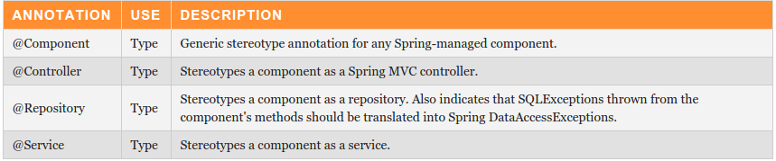
Stereotyping Annotations
@Autowired annotation handles only wiring, you still have to define the beans themselves so the container is aware of them and can inject them for you. But with stereotype annotations in place and after enabling automatic component scanning, spring will automatically import the beans into the container so you don’t have to define them explicitly with XML.
Now you can use another annotation i.e. @RequestMapping.
Transaction Annotations

Slide 99
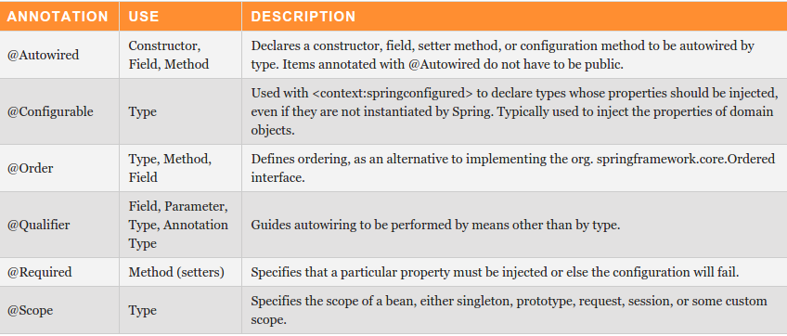
Context Configuration Annotations
Used to define sort order for components annotated with this annotation. Low-High

Slide 100
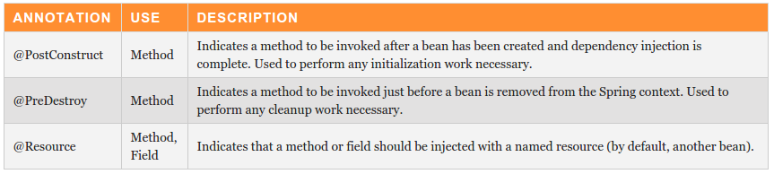
JSR-250 Annotations

Slide 101
@Resource vs @Autowired:
Both, without specifying any attributes of the annotation, perform injection by type. The difference is:
@Resource allows you to specify a name of the injected bean
@Autowired allows you to mark it as non-mandatory.
And, @Autowired+@Qualifier works only for Spring DI, @Resource with all DIs
Another significant difference is @Qualifier does not support dynamic bean wiring, as @Qualifier does not support
placeholder, while @Resource does it very well.
@Value: To define default value of a property
@Lazy: If present and set to true, the @Bean or @Component will not be initialized until
referenced by another bean or explicitly retrieved from the enclosing BeanFactory.

Slide 102
JSR-330 Annotations:
@Inject: Substitute for @Autowired
@Named: Substitute for @Component
Why to use:
Spring’s annotations are more powerful, but only available on Spring framework.
The JSR-330 is a standard spec, and it’s supported on all J2ee environment that follow JSR-330 spec.
Limitations:
@Inject has no “required” attribute to make sure the bean is injected successful.
In Spring container, JSR-330 has scope singleton by default, but you can use Spring’s
@Scope to define others.
No equivalent to Spring’s @Value, @Required or @Lazy.

Slide 103
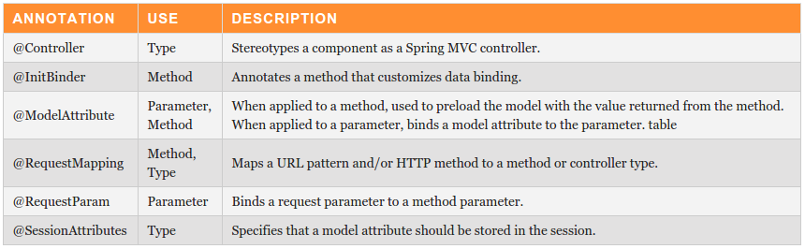
Spring MVC Annotations

Slide 104
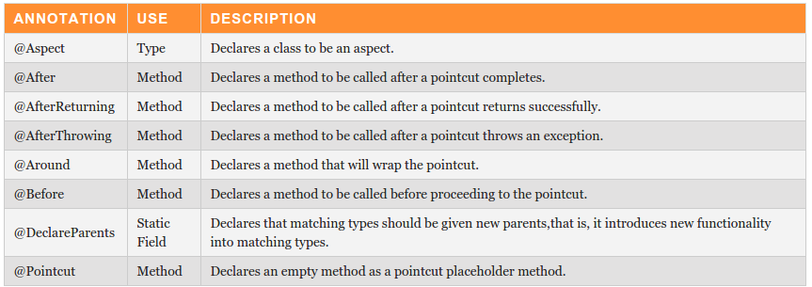
Aspect Annotations

Slide 105
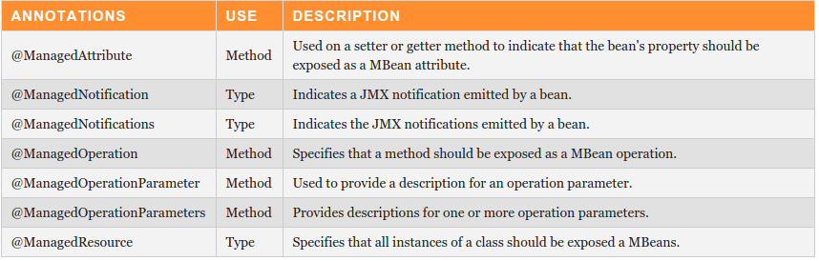
JMX Annotations

Slide 106
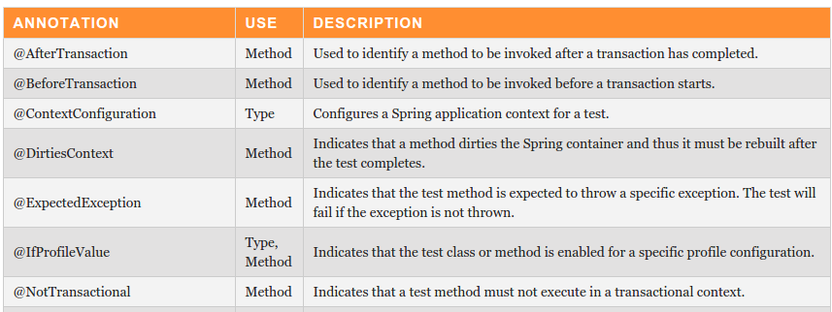
Testing Annotations

Slide 107
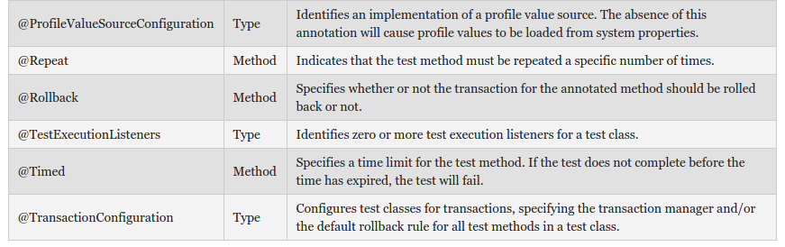
..contd..

Slide 108
Transaction Management

Slide 109
Spring framework provides an abstract layer on top of different underlying transaction management APIs. The Spring's transaction support aims to provide an alternative to EJB transactions by adding transaction capabilities to POJOs.
ACID:
Atomicity: A transaction should be treated as a single unit of operation which means either the entire
sequence of operations is successful or unsuccessful.
Consistency: This represents the consistency of the referential integrity of the database, unique
primary keys in tables etc.
Isolation: There may be many transactions processing with the same data set at the same time, each
transaction should be isolated from others to prevent data corruption.
Durability: Once a transaction has completed, the results of this transaction have to be made
permanent and cannot be erased from the database due to system failure.

Slide 110
Global/Distributed Transaction
Created by an external transaction manager (JTA) and is used to scope work on multiple resources (typically relational databases and message queues).
Requires two phase commit (2PC)
Very complex to configure for properly recovery
Local Transaction
Resource specific so works with single resource
Easier to use but has limitation because cannot be used across multiple transactional resources
Associated with a particalar data source (means they are resource-specific); the most common example would be a transaction associated with a JDBC connection.

Slide 111
2 Types of Transaction Mgmt supported in Spring
Programmatic transaction management: It allows you to manage the transaction with the help of
programming in your source code.
That gives you extreme flexibility, but it is difficult to maintain.
Declarative transaction management: This is the most common Spring implementation as it has the least impact on application code.allows you to manage the transaction with the help of configuration instead of hard coding in your source code.
Less invasive. There is no need for changing application code when using declarative transactions. All you have to do is to modify the application context.
As a kind of crosscutting concern, declarative transaction management can be modularized with the AOP
approach. Spring supports declarative transaction management through the Spring AOP framework.
Spring provides @Transactional used on Service layer, especially when you have several DAOs injected into a Service that need to work together in a single transaction.
<tx:annotation-driven> tag is at the core of the annotation-driven transaction management support. It creates the appropriate transaction management aspects using the @Transactional annotation.

Slide 112
Spring transaction management abstraction
To understand transaction mangement you should understand abstraction(Transaction strategy) in Spring. Which is defined in Spring using PlatformTransactionManager Interface.
public interface PlatformTransactionManager {
TransactionStatus getTransaction(TransactionDefinition definition) throws TransactionException;
void commit(TransactionStatus status) throws TransactionException;
void rollback(TransactionStatus status) throws TransactionException;
}
As you can see in PlatformTransactionManager Interface all methods throw TransactionException. This Exception itself is UncheckedException means developer is not forced to handle these exceptions.

Slide 113
TransactionDefinition:
public interface TransactionDefinition {
int getPropagationBehavior();
int getIsolationLevel();
String getName();
int getTimeout();
boolean isReadOnly();
}
It is a core Interface which specifies further-mentioned 4 points:

Slide 114
1) Isolation: [Eg: @Transactional(isolation = Isolation.READ_COMMITTED) ]
Degree to which particular transaction is isolated from other Transaction. Below is the list of Isolation level and
their details
TransactionDefinition.ISOLATION_DEFAULT: Default isolation level. It uses the isolation of underlying datasource.
READ_COMMITTED: Dirty reads NOT supported; Non-repeatable reads and Phantom reads can occur.
READ_UNCOMMITTED:Dirty reads / Non-repeatable reads / Phantom reads all can occur.
REPEATABLE_READ:Dirty reads and non-repeatable reads are prevented; phantom reads can occur.
SERIALIZABLE:Dirty reads, non-repeatable reads and phantom reads are prevented.
SNAPSHOT: prevents dirty reads, nonrepeatable reads and phantom reads. However, it is susceptible to concurrent update errors.

Slide 115
2) Propagation: [Eg: @Transactional(propagation = Propagation.REQUIRES_NEW)]
MANDATORY: Support a current transaction, throw an exception if none exists.
NESTED:Execute within a nested transaction if a current transaction exists, behave like PROPAGATION_REQUIRED else.
NEVER: Execute non-transactionally, throw an exception if a transaction exists.
NOT_SUPPORTED: Execute non-transactionally, suspend the current transaction if one exists.
REQUIRED: Support a current transaction, create a new one if none exists.
REQUIRES_NEW: Create a new transaction, and suspend the current transaction if one exists.
SUPPORTS: Support a current transaction, execute non-transactionally if none exists.
3) Timeout: This setting is used to define how long this transaction may run before timing out.
Eg: @Transactional(timeout = 2)
4) Read-Only Status: This setting is used to specify a read-only transaction. Flush mode will be set as FlushMode.NEVER in the current Hibernate Session..
Eg: @Transactional(readOnly = true)

Slide 116
Other Attributes of the @Transactional Annotation:
noRollbackFor: Accepts Array of exceptions that the target method can throw but the advice will still commit the transaction.
Eg: @Transactional(noRollbackFor = IllegalArgumentException.class)
rollbackFor: It is to be noted that only unchecked exceptions (that is, subclasses of java.lang.RuntimeException) are rollbacked by default. For the case, a checked exception(other than java.rmi.RemoteException) is thrown, the transaction will be committed! Hence in such cases, this attribute comes useful.
For eg:
@Transactional(rollbackFor=Exception.class): This will rollback transaction after throwing any exception.

Slide 117
TransactionStatus: This interface provides a simple way for transactional code to control transaction execution and query transaction status.
public interface TransactionStatus extends SavepointManager {
boolean isNewTransaction();
boolean hasSavepoint();
void setRollbackOnly();
boolean isRollbackOnly();
boolean isCompleted();
}

