Slide 1
LAR Temp loggers

Slide 2
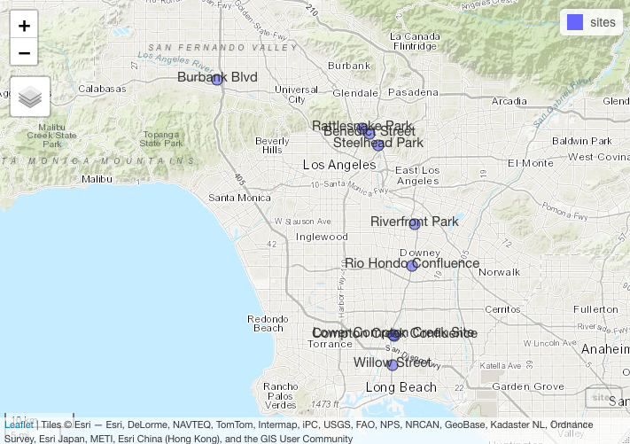
Fix labels

Slide 3
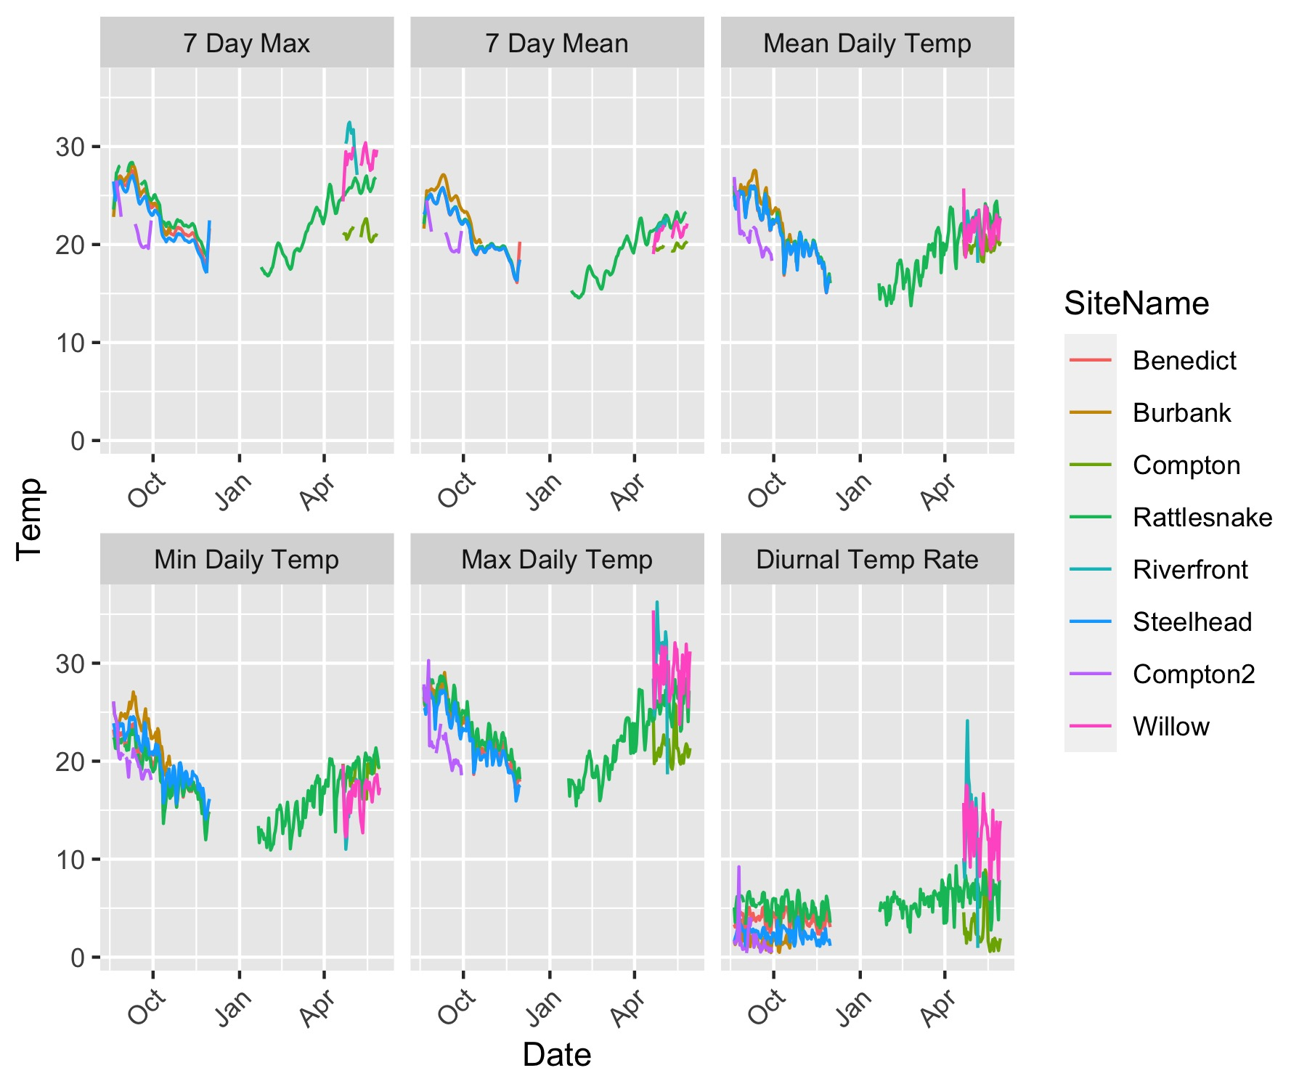
By Metric
Temp data from loggers by metric. Colours on each plot represent different sites

Slide 4
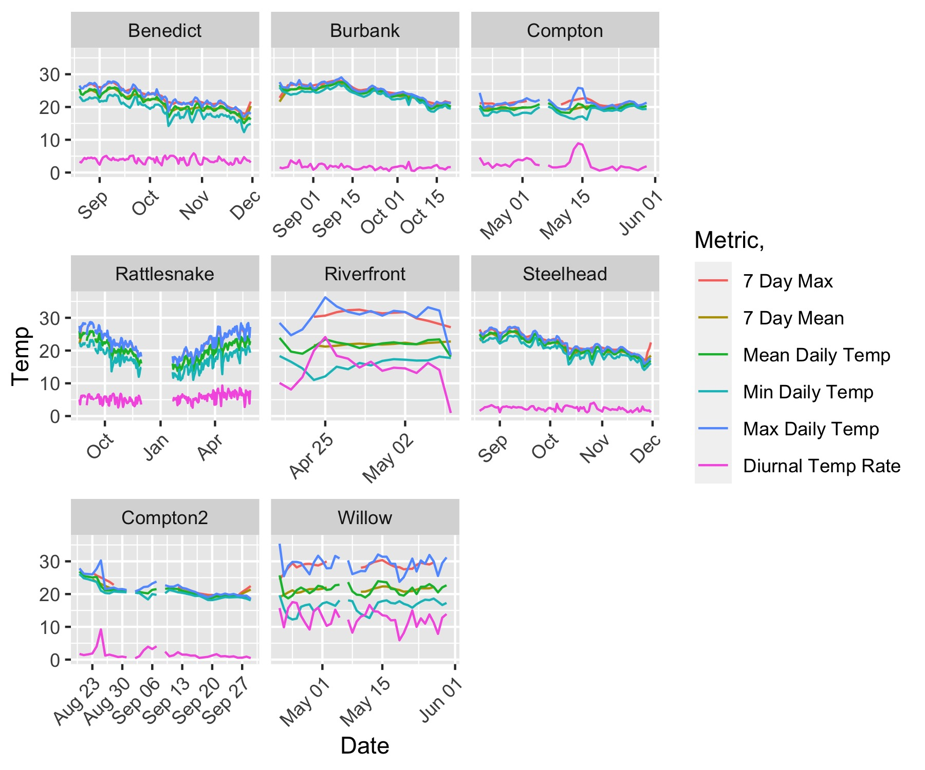
By Site
Temp data from loggers by site. Colours on each plot represent different temperature metrics

Slide 5
Issues
No data for Rio Hondo logger
Compton has 2x sites, but not clear which is which

