Slide 1
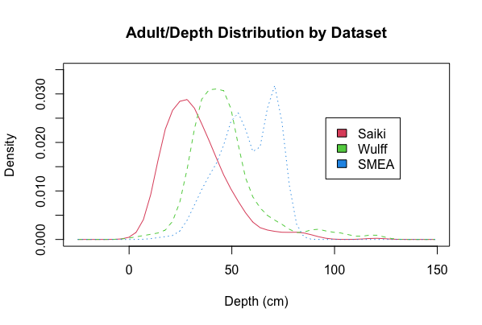
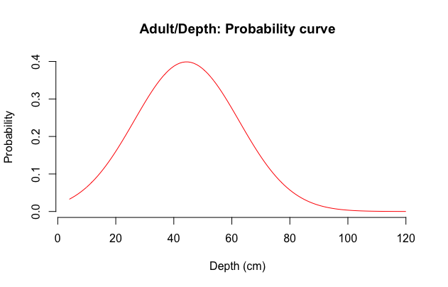
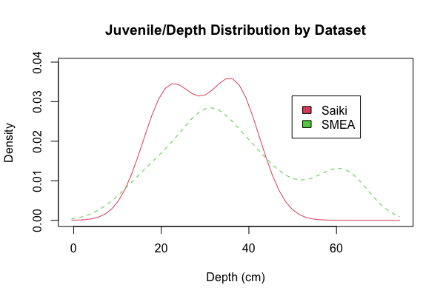
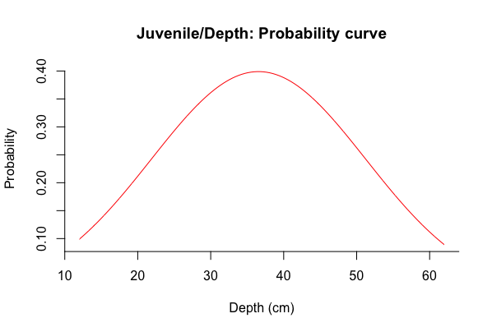
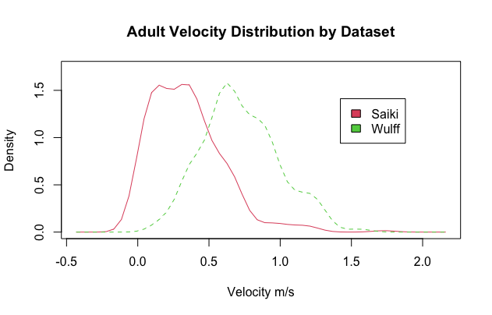
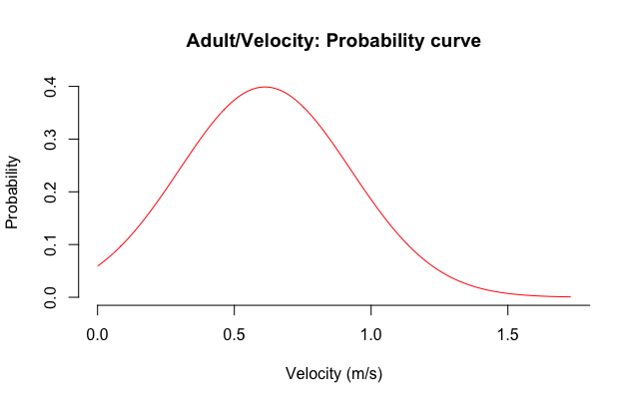
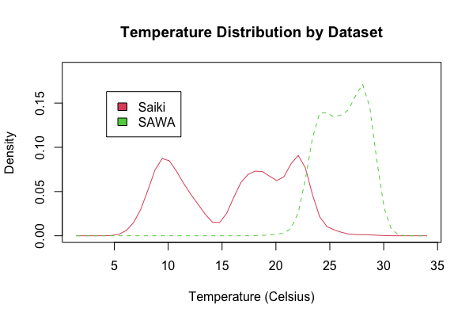
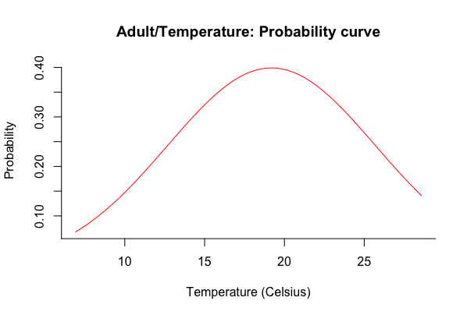
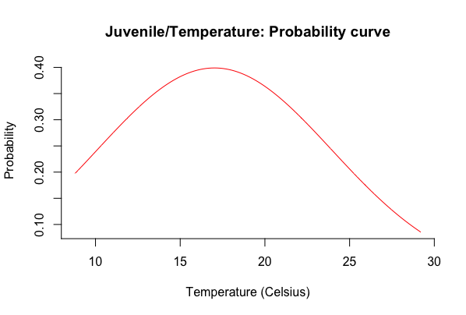
a)
b)
Mean = 44.4cm
n=1376
c)
d)
Mean = 36.5cm
n=257
e)
f)
Mean = 0.61m/s
n=1167
g)
h)
Mean = 19.19 (℃)
n=963
i)
Mean = 17.02 (℃)
n=9

Slide 2
g)
h)
Mean = 19.19 (℃)
n=963
i)
Mean = 17.02 (℃)
n=9

