Slide 1
Habitat curves

Slide 2
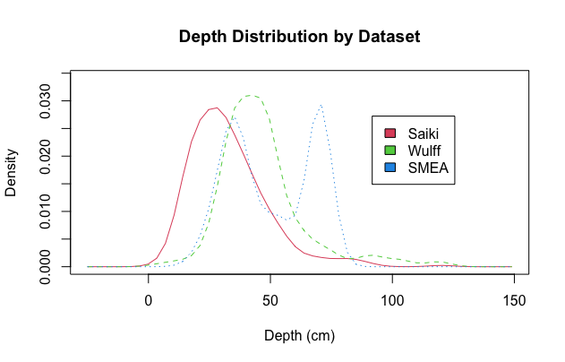
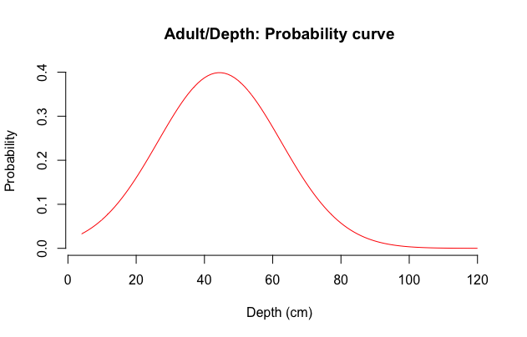
a)
b)
Mean = 44cm

Slide 3
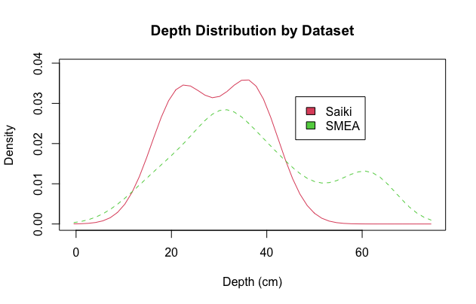
a)
b)
Mean = 44cm
n=1376

