Slide 1
Scanner Generalization for Mitotic Figure Detection
Demo 1 - CSE 4109 AI for Health
Robust mitotic figure detection on real breast cancer pathology images
Focus: scanner-domain shift in MIDOG++
Demo goal: show real dataset, working pipeline, and early results

Slide 2
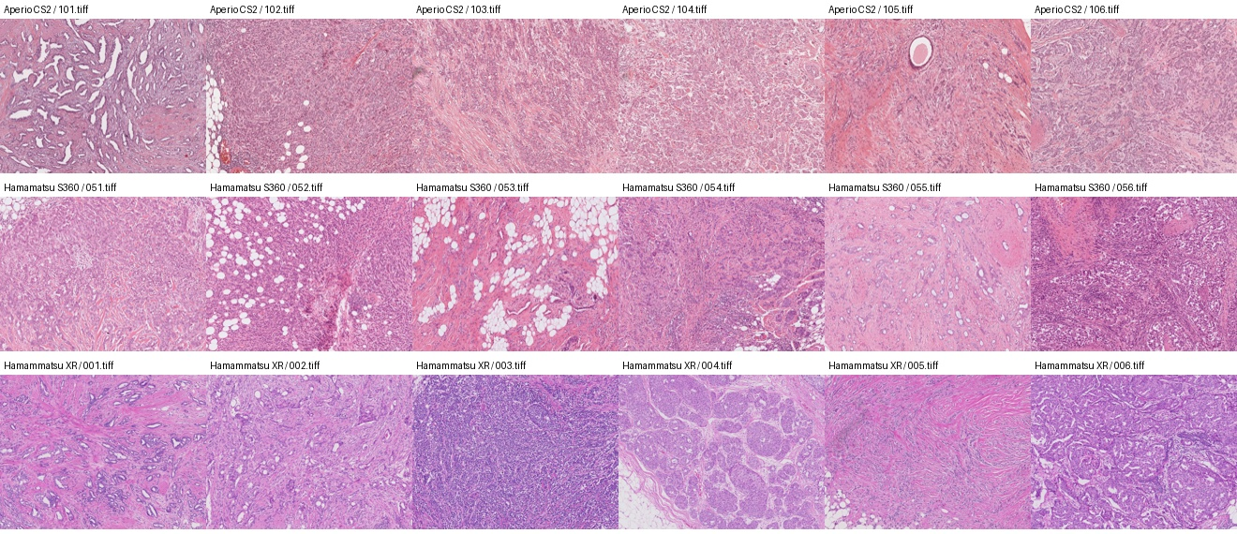
Why This Matters
Pathology AI models can fail when image appearance changes across scanners.
Mitotic figures are clinically important for cancer grading.
Scanner and stain differences affect color, contrast, and detector confidence.
Research question: can a detector trained on some scanners generalize to an unseen scanner?

Slide 3
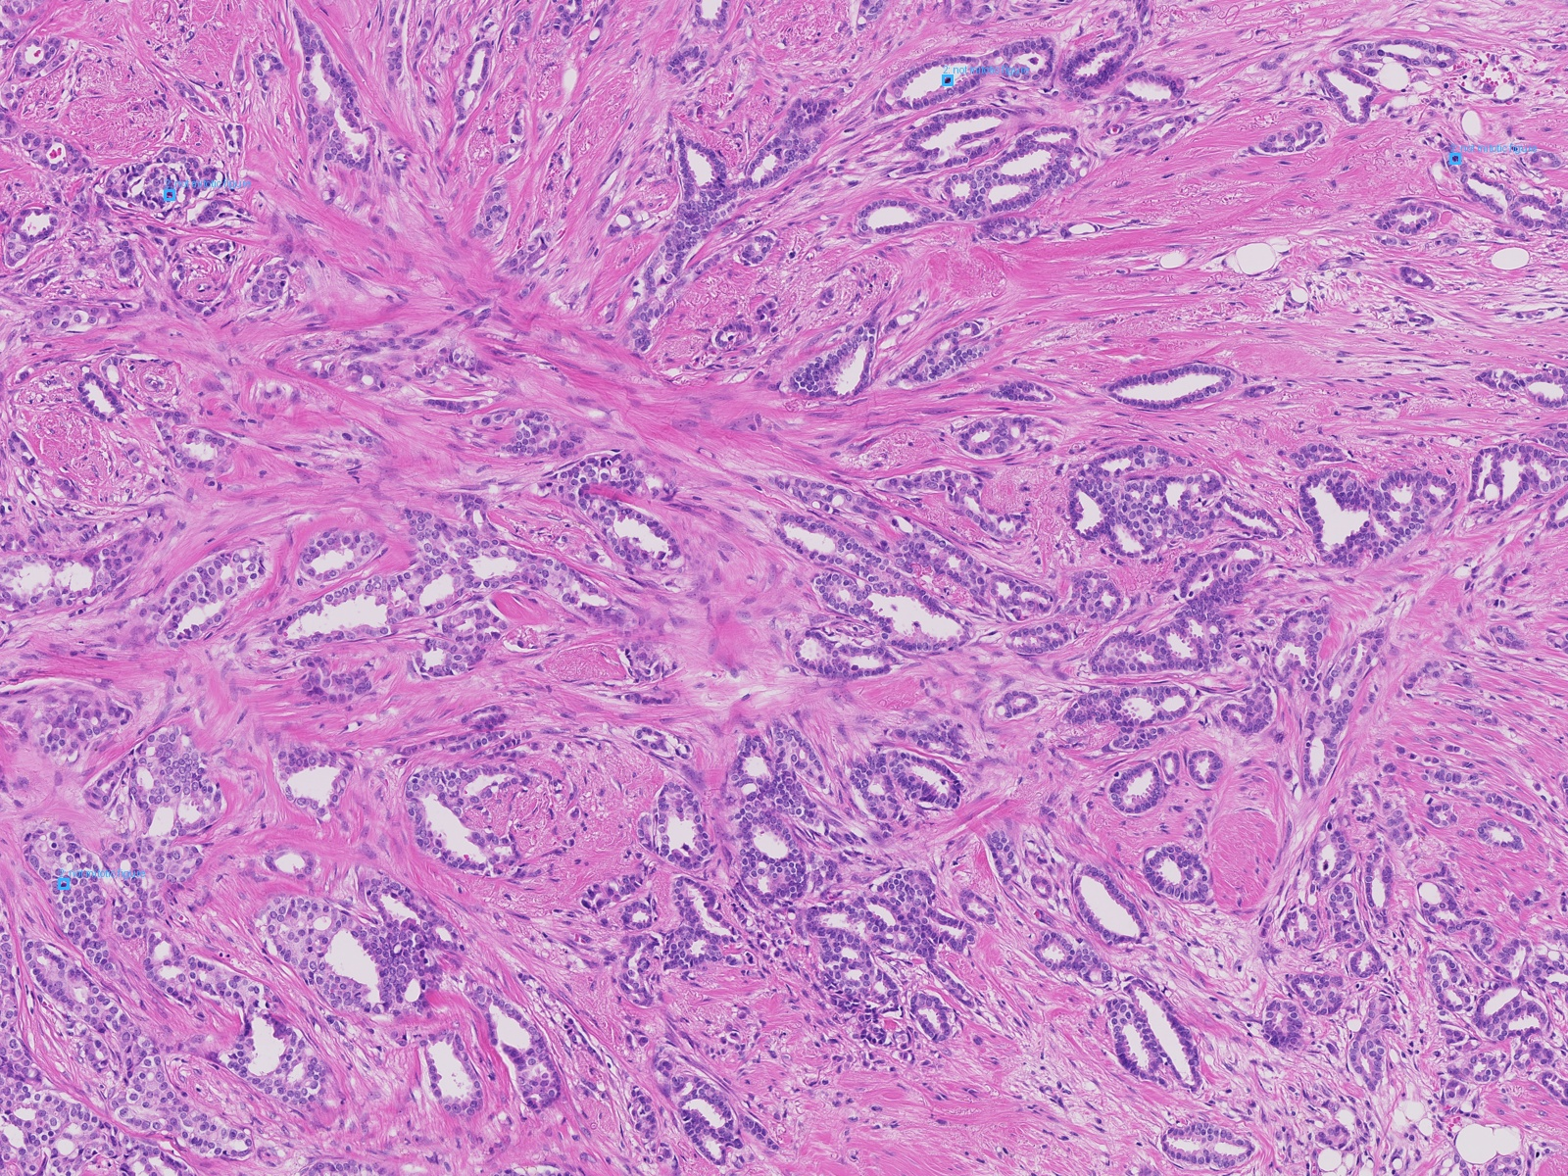
Dataset And Task
MIDOG++ human breast cancer subset
150 TIFF images and 4435 object annotations
Three scanner domains: Aperio CS2, Hamamatsu S360, Hamammatsu XR
Labels are COCO-style bounding boxes for mitotic and non-mitotic candidates
Prepared shareable subset with images, metadata, labels, and README

Slide 4
Experimental Design
Leave-one-scanner-out evaluation
Train on two scanner domains.
Test on the held-out scanner domain.
Keeps tumor type fixed while testing scanner generalization.
Pipeline: annotations -> breast cancer subset -> detection tiles -> Faster R-CNN -> held-out scanner metrics

Slide 5
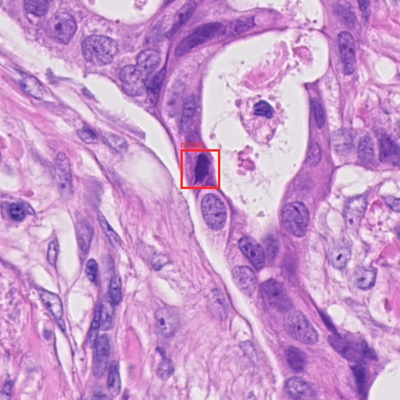
What We Built For Demo 1
Breast cancer subset and teammate-facing metadata documentation
Patch-level scanner robustness experiments
512 x 512 detection tile datasets for all scanners
Faster R-CNN training, evaluation, checkpoint sweep scripts
Visual false positive / false negative comparison panels
First stain normalization experiment

Slide 6
Initial Patch-Level LOSO Results
Logistic regression on cropped candidates: baseline vs color augmentation
Held-out scanner | Base P | Base R | Base F1 | Aug P | Aug R | Aug F1 | Delta F1
Aperio CS2 | 0.444 | 0.384 | 0.412 | 0.460 | 0.440 | 0.450 | +0.038
Hamamatsu S360 | 0.346 | 0.345 | 0.346 | 0.372 | 0.466 | 0.413 | +0.068
Hamammatsu XR | 0.396 | 0.794 | 0.529 | 0.395 | 0.785 | 0.525 | -0.004
Mean | 0.395 | 0.508 | 0.429 | 0.409 | 0.564 | 0.463 | +0.034
Augmentation improved mean F1 from 0.429 to 0.463 and mean recall from 0.508 to 0.564.

Slide 7
Full Detection Results
Faster R-CNN on pathology detection tiles
Stable baseline mean F1: 0.728
Strong color jitter mean F1: 0.698
Stable training and checkpoint selection mattered a lot.
Takeaway: color jitter helped patches but did not improve full object detection.

Slide 8
Normalization Result
Held-out Hamamatsu S360
Stable baseline: precision 0.633, recall 0.817, F1 0.714
Reinhard RGB normalization: precision 0.709, recall 0.721, F1 0.715
Normalization reduced false positives: 379 -> 237
It preserved F1 but became more conservative.

Slide 9
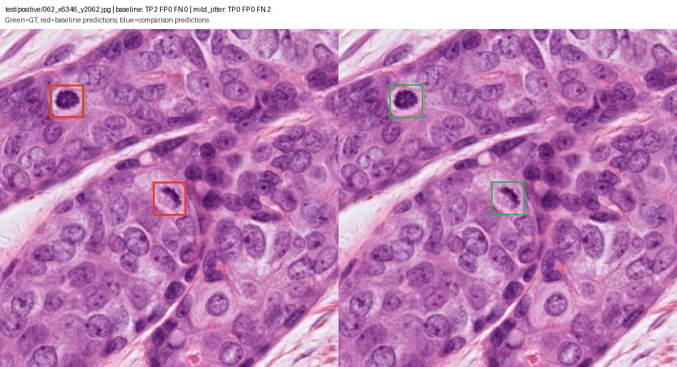
Visual Error Analysis
Example comparison panels
Green boxes: ground truth
Red boxes: baseline predictions
Blue boxes: comparison model predictions
Panels reveal false positives, false negatives, and scanner-specific failure modes.

Slide 10
Interpretation And Next Steps
LOSO gives a real scanner-generalization test.
Patch-level improvement did not automatically transfer to full detection.
Simple normalization is more promising than stronger color jitter so far.
Next: run normalization on all scanners, make baseline-vs-normalization panels, and try Macenko-style stain normalization.

