Slide 1
House of Einherjar
Glibc-2.27
Attack Demonstration

Slide 2
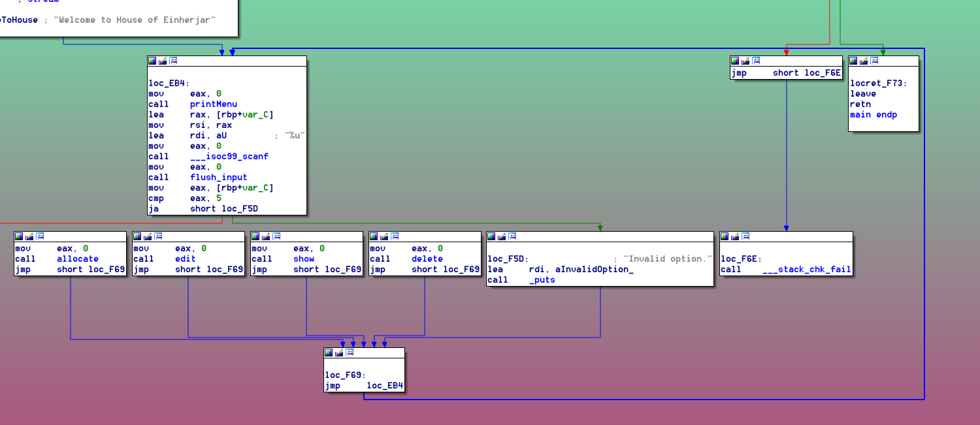
Analyzing the Binary
We can:
Allocate and optionally initialize the data for a new chunk
Edit the data of an existing chunk
Print the string at an existing chunk
Delete an existing chunk
Classic Heap Note Challenge

Slide 3
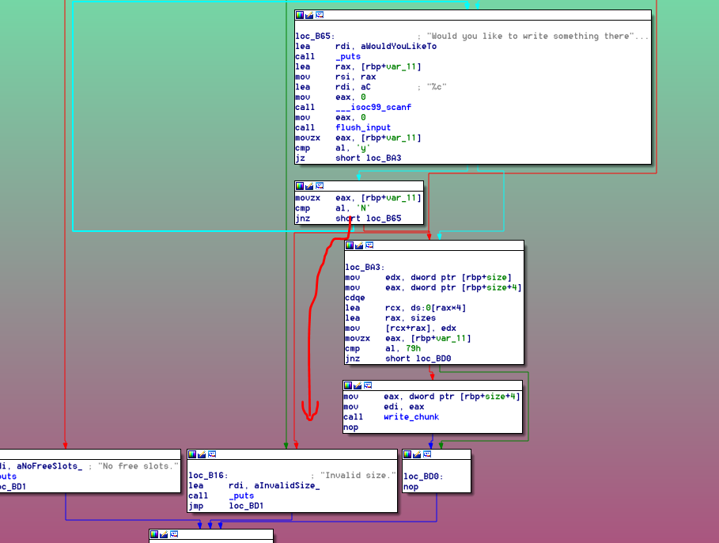
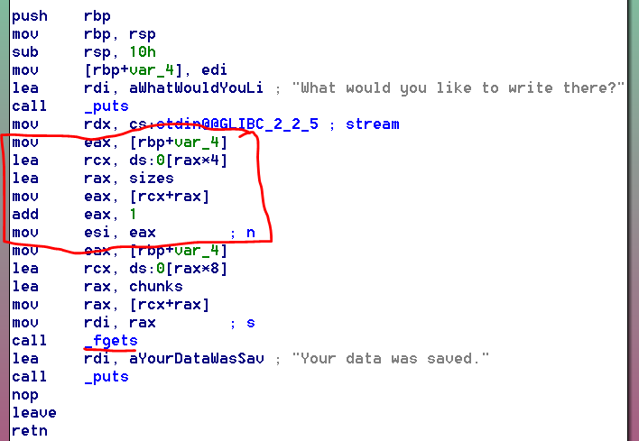
Vulnerabilities
allocate(): does not force new chunks to be initialized, allowing for easy data leaks
write_chunk(): reads in one too many bytes, resulting in potential single null-byte overflow

Slide 4
How To Leverage a Single Null-Byte Heap Overflow?
Recall that glibc heap chunks record the status of the previous (memory-adjacent) chunk in the size field of the chunk
By overflowing a single null byte, we
declare that the previous chunk is not in use, and thus can be unlinked and consolidated if needed
reduce the size field of the previous chunk to the highest multiple of 0x100 below the uncorrupted value (fails if chunk is already <0x100)

Slide 5
Heap Layout
0x101
…
L
0x81
0x101
L
L
…
…
0x80
0x100
Single null-byte overflow in first chunk
0x101
…
…
Overflowed heap layout
Attacker-controlled data in red
Healthy heap layout
Assume tcache[0x100] is filled.
0x100 is not a fastbins size.
Assume third chunk is in use or top.
What happens when we free() the second chunk?

Slide 6
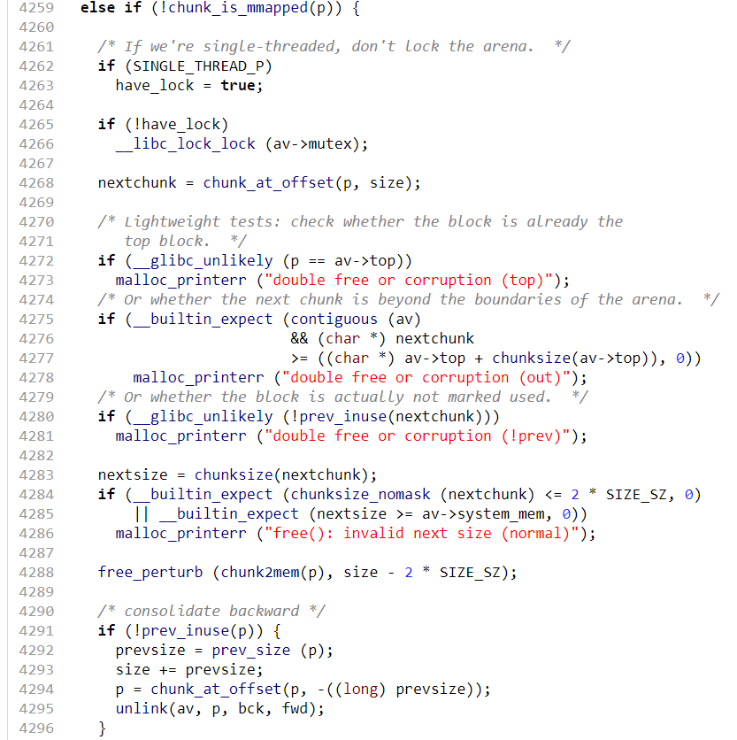
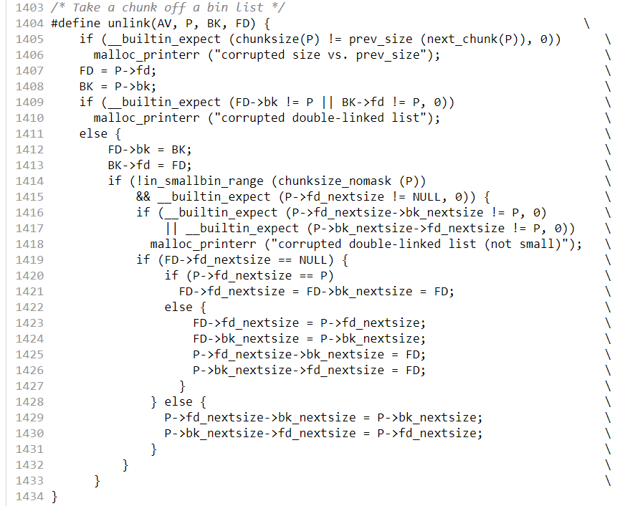

Slide 7
Heap Layout
If third chunk is in use
0x101
0x101
…
…
L
0x81
L
0x181
L
L
unsorted
unsorted
…
Free second chunk
…
0x80
0x100
0x80
0x100
…
…
0x21
0x180
0x20
…
Glibc modifications in blue
…

Slide 8
Heap Layout
If third chunk is top
0x101
0x101
…
…
L
0x81
L
(TOP + 0x180)|1
L
L
L
L
…
Free second chunk
…
0x80
0x100
0x80
0x100
…
…
TOP|1
TOP|1
…
Glibc modifications in blue
…

Slide 9
Exploit
Either way, we get overlapping chunks, so we can control heap metadata of a future allocated chunk through the first chunk
To complete the exploit in 2.27, poison tcache to write to free hook
Allocate chunk (X) from overlapped region
Free X to tcache
Edit first chunk to change X’s next pointer to free hook
Allocate chunk (X returned); initialize with “/bin/sh”
Allocate chunk (free hook returned); initialize with system()
Free X

Slide 10
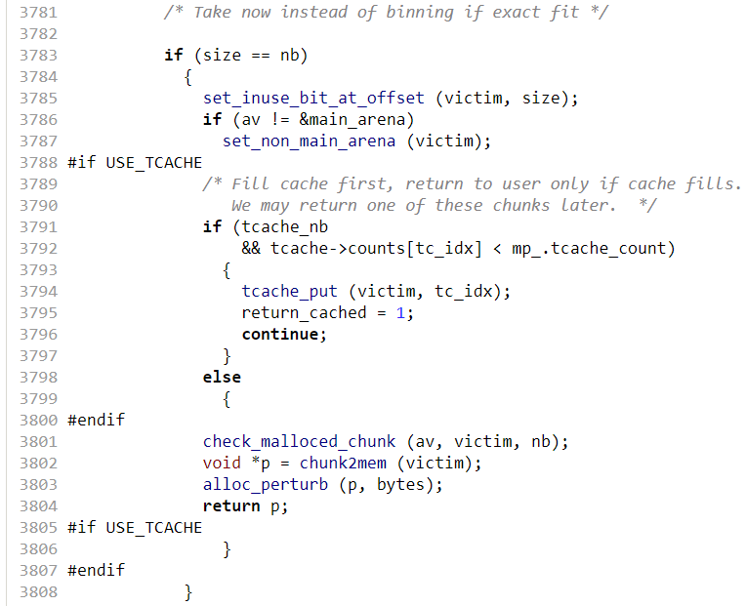
Exploit
What about leaks? Use show()
We require knowledge of the address of the fake chunk (L), which requires a heap leak
Free two chunks to tcache
Reallocate both without initialization
We also need to know the address of free hook and system(), which requires a libc leak
Free non-fastbin small chunk to unsorted bin
Request slightly (0x10) smaller chunk, which first moves the freed chunk to smallbin, then returns the chunk with smallbin address
Requesting the same size doesn’t work, because it will be first stashed to tcache, zeroing out the bin address

