Slide 1
Crop Recommendation System
By Code Crackers

Slide 2
Problem Statement:
Farmers face many difficulties in farming due to various aspects like:
Using wrong pesticides and fertilizers
Growing crops that are not suitable for the land
Lack of knowledge to treat plant diseases
We find ways to help them make their farming more effective.

Slide 3
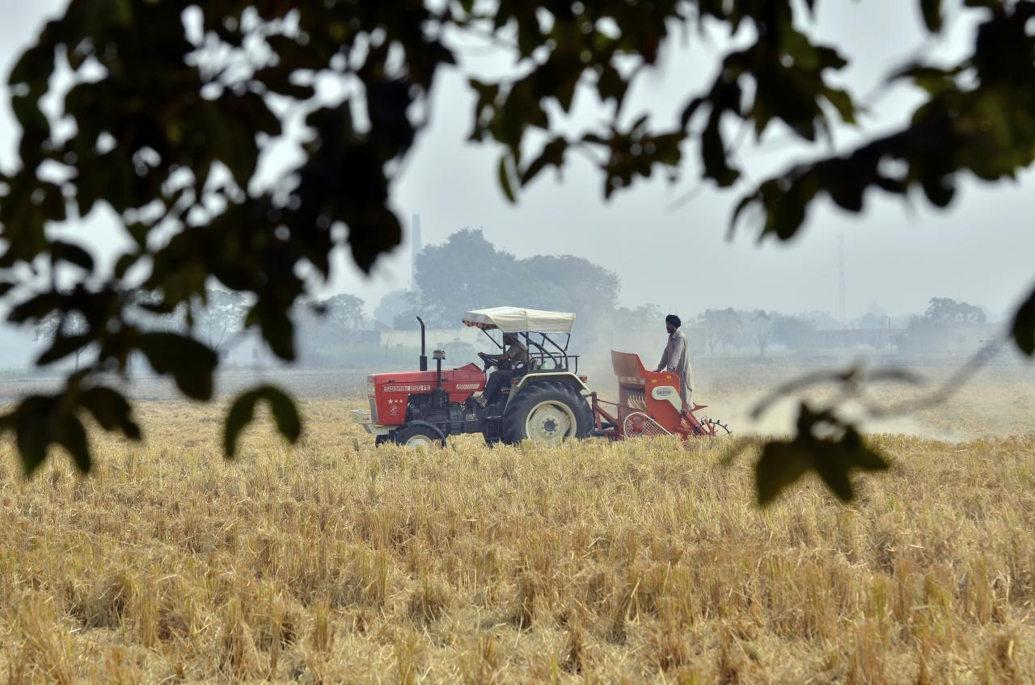
Existing Solutions
Multiple efforts have already been made to help farmers find the best crop and fertilizers for the fields, and image identification for pest and disease detection.
But there is no application which gives the total integration of all the ideas at one place.

Slide 4
Proposed Solution
The various aspects of our application include:
Crop recommendation based on soil properties, temperature, & humidity
Fertilizer recommendation based on crop, soil, geographical conditions
Pest and plant disease identification based on images
Pesticide recommendation for the type of pest observed
Our idea is to develop a web application which can serve as a 360° support system for farmers regarding various aspects of crop maintenance to help them obtain effective farming

Slide 5
Technical Architecture
Collection of various datasets
Data Preprocessing
Train Data
Test Data
Model Building
Deploy by ML Flask
Farmer
Chat Bot
Output

Slide 6
Technologies
Decision Tree
XGBoost
IBM Cloud
Flask Framework
Watson Assistant

Slide 7
Thank you!

