Slide 1
“packagingpartner.com”- Online Packaging Material Store
Presented By
Aman Meshram(233128)
Kamalkishor Kadam(233158)

Slide 2
Points to be discussed
Introduction
Objectives
Specification
Screenshots
S/W and H/W
Conclusion

Slide 3
INTRODUCTION
This project is a web-based shopping system for an existing shop. An Online Shopping Management System where the Admin can Add, Update and Delete products. We are well-known for delivering packaging products such as boxes, tapes, stretch, envelopes & mailer,dispenser tools and equipment. We provide the best pricing in the market and give free home delivery services throughout India.

Slide 4
OBJECTIVES
The objective of the project is to make platform designed to provide a user-friendly and efficient way for customers to browse, select, and purchase sustainable packaging materials and supplies. The platform aims to promote environmentally-friendly practices and cater to businesses and individuals seeking eco-conscious alternatives for their packaging needs.

Slide 5
TECHNOLOGIES USED
Front End – React
Back End – Java Spring Boot
Database – MySql

Slide 6
SCREENSHOTS

Slide 7
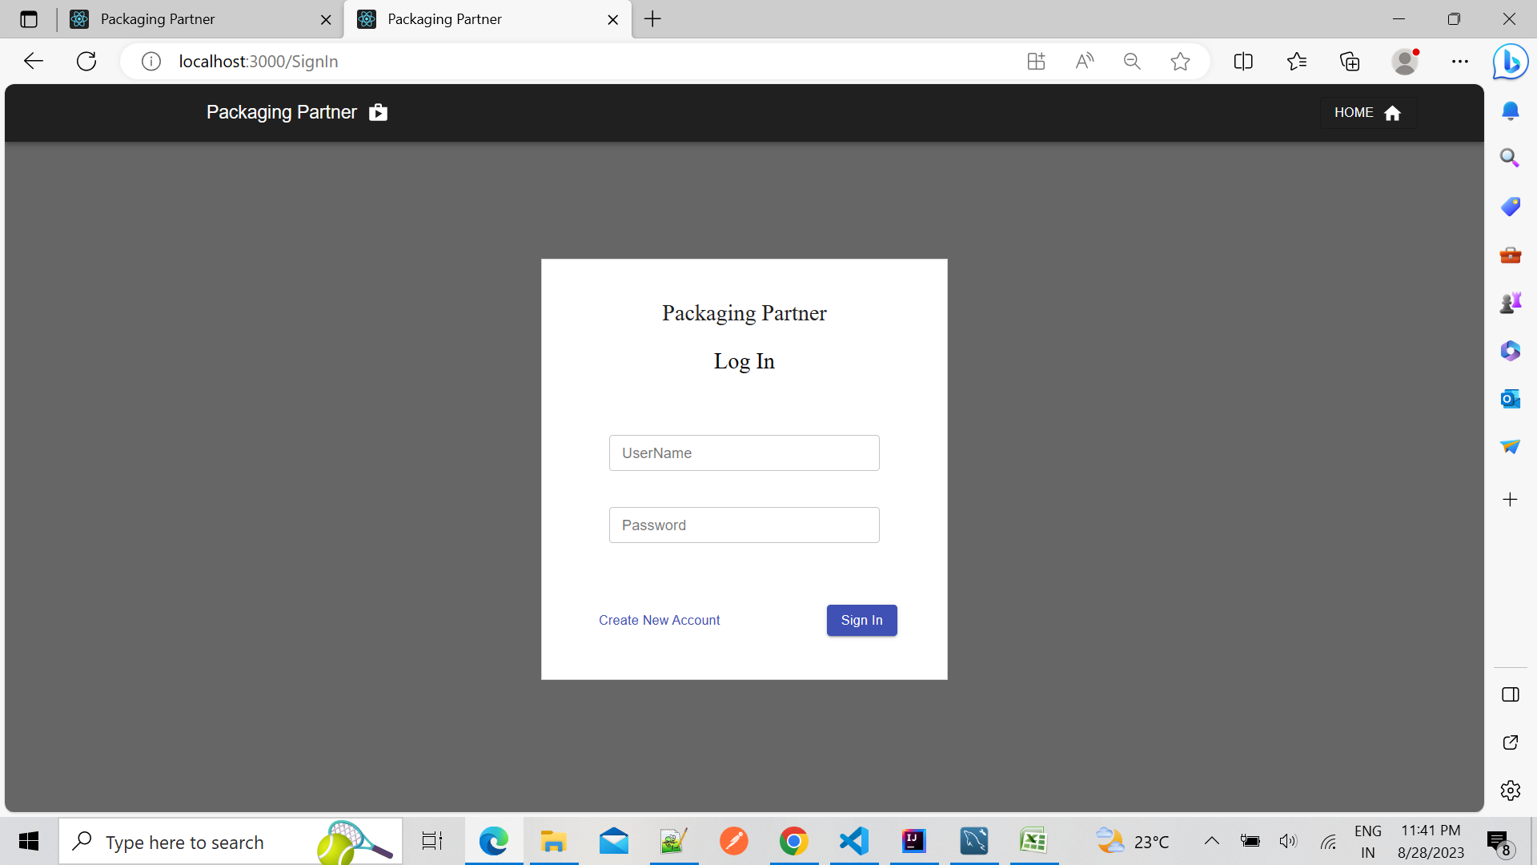
USER REGISTRATION AND LOGIN PAGE

Slide 8
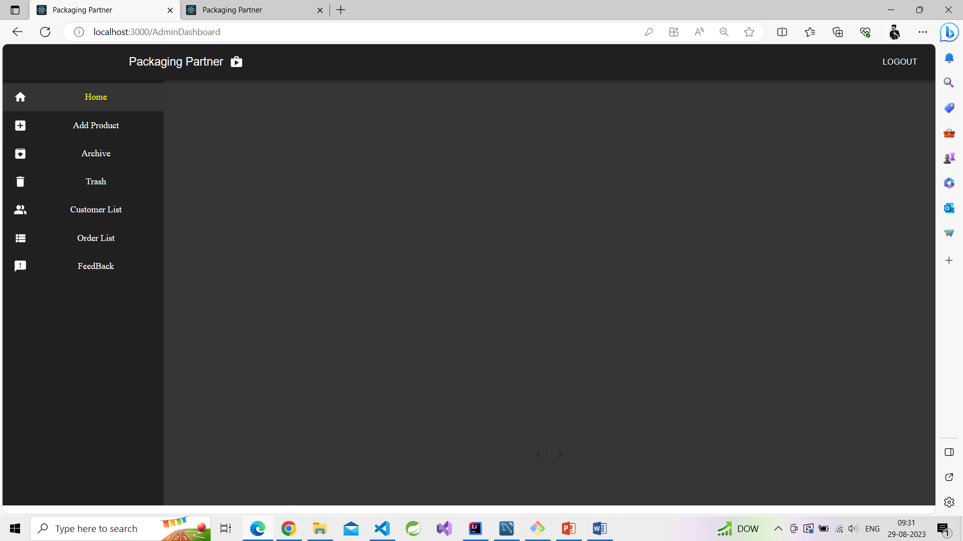
LANDING PAGE AFTER SUCCESSFUL LOGIN FOR ADMIN

Slide 9
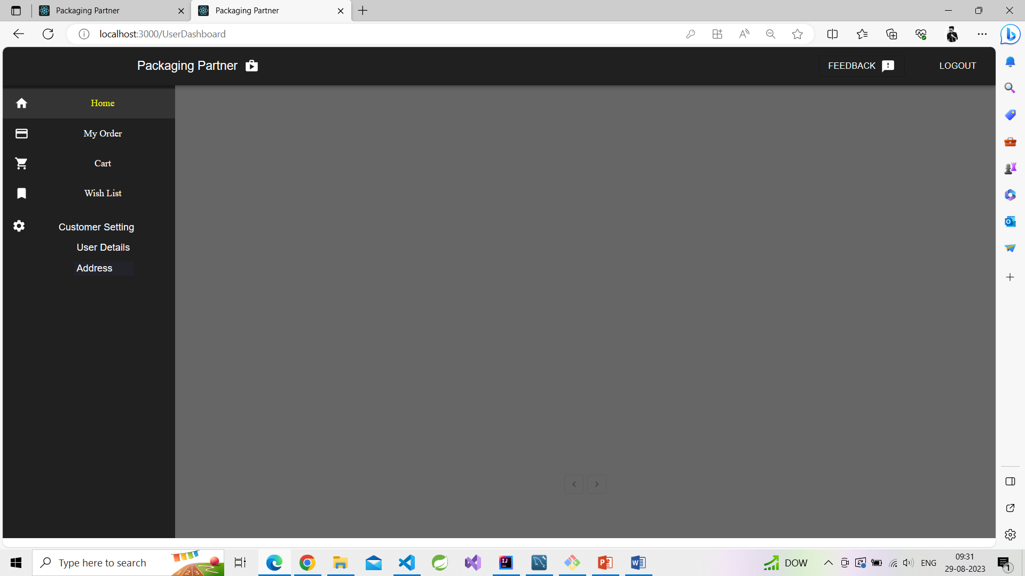
LANDING PAGE AFTER SUCCESSFUL LOGIN FOR CUSTOMER

Slide 10
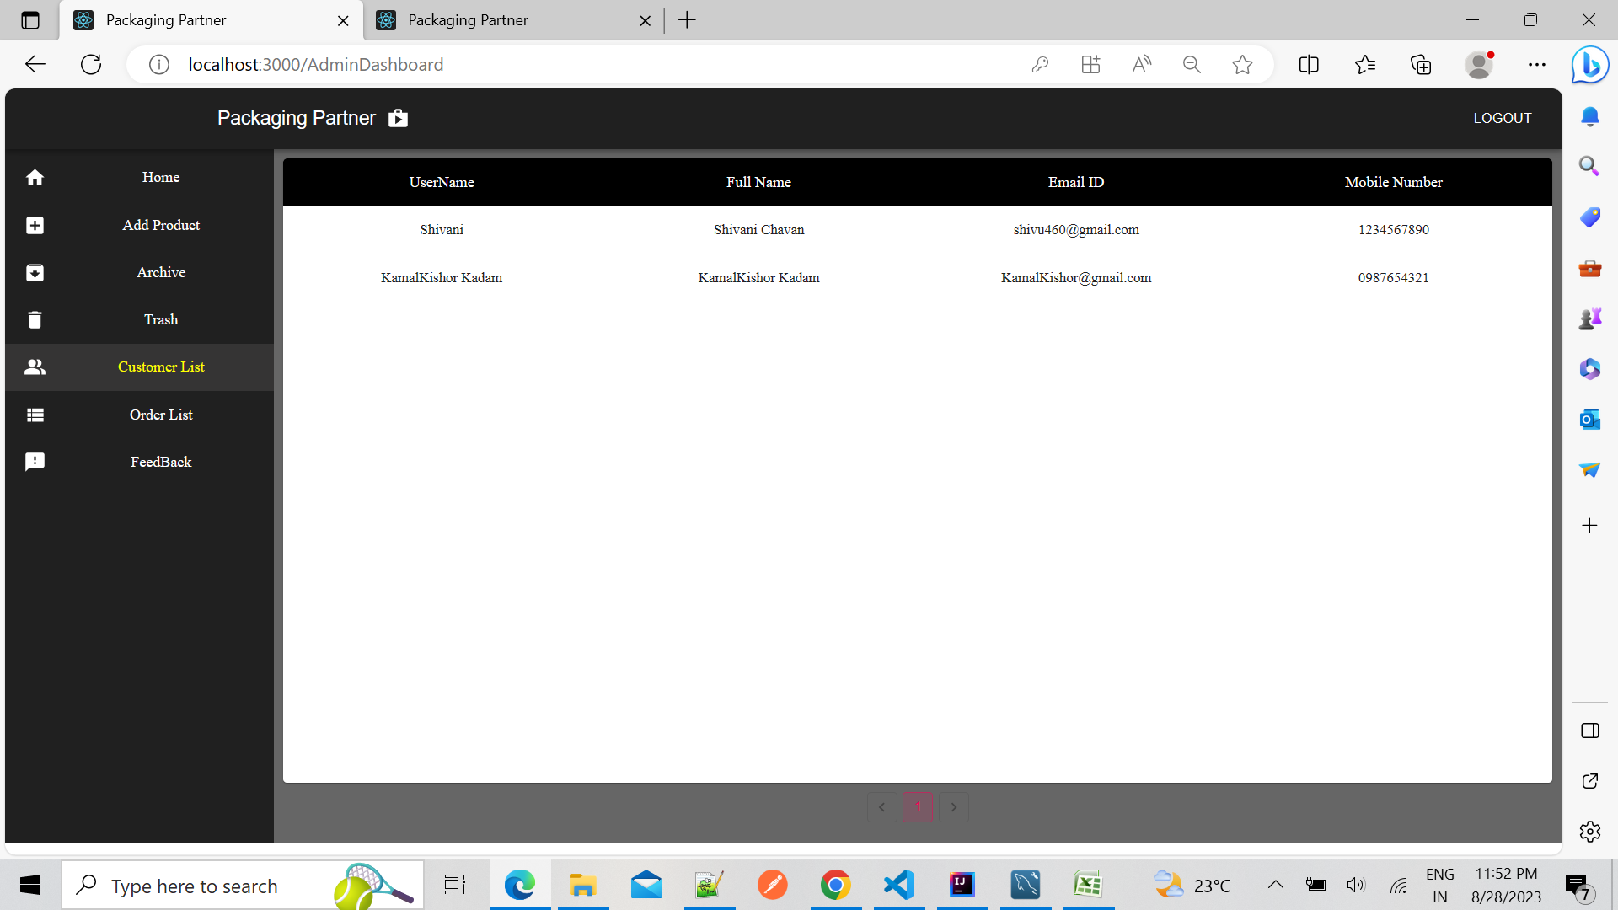
CUSTOMER LIST

Slide 11
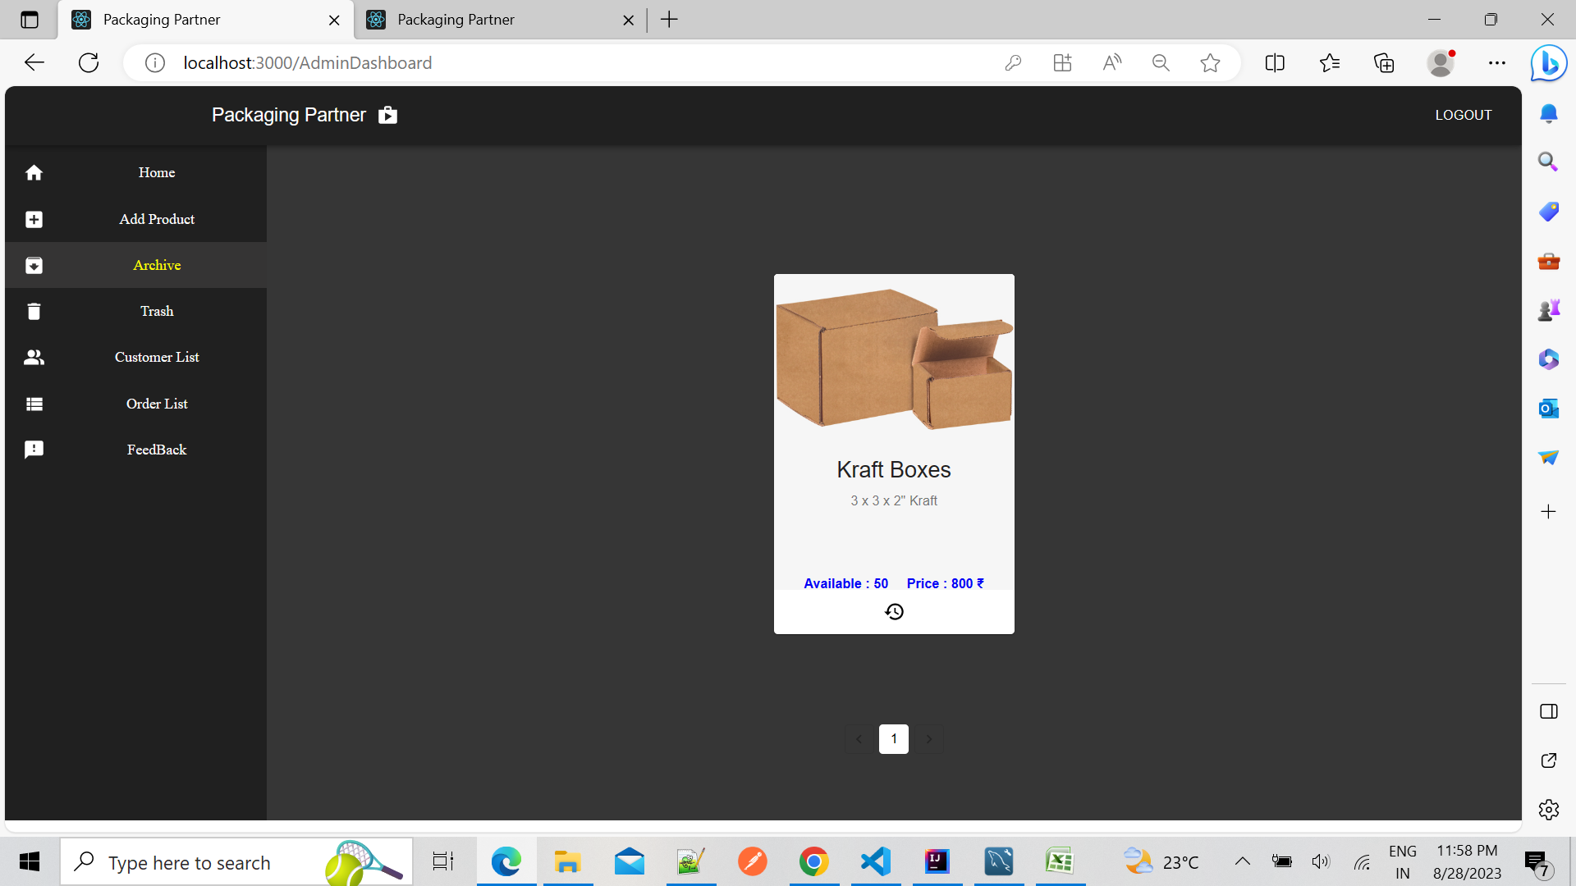
ARCHIEVE PRODUCT

Slide 12
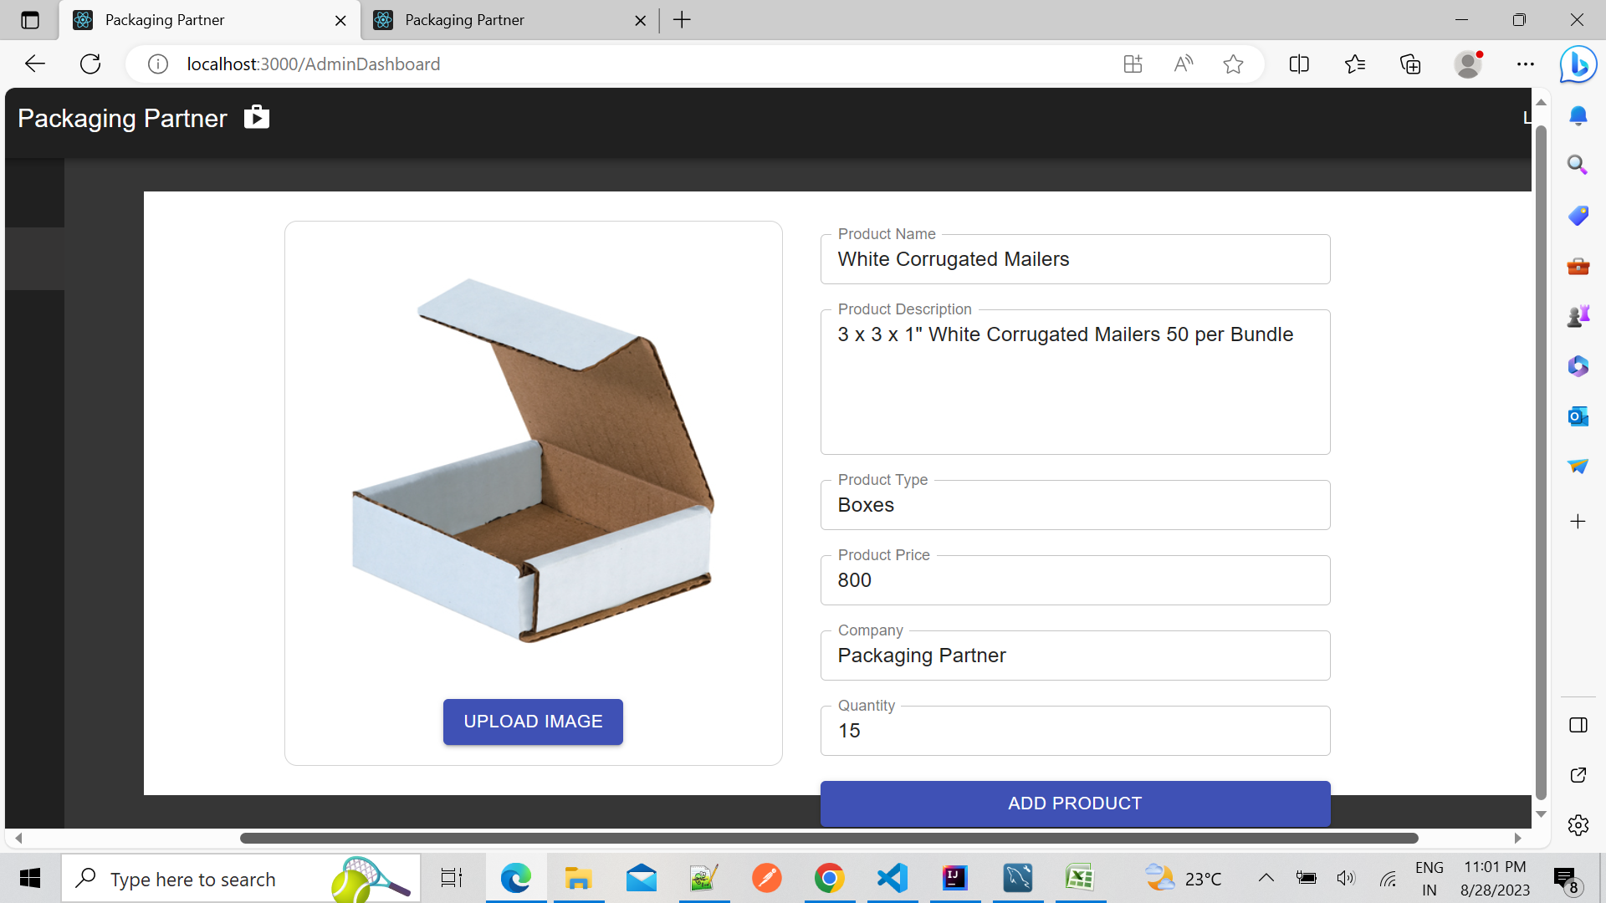
ADD PRODUCTS IN CARTS

Slide 13
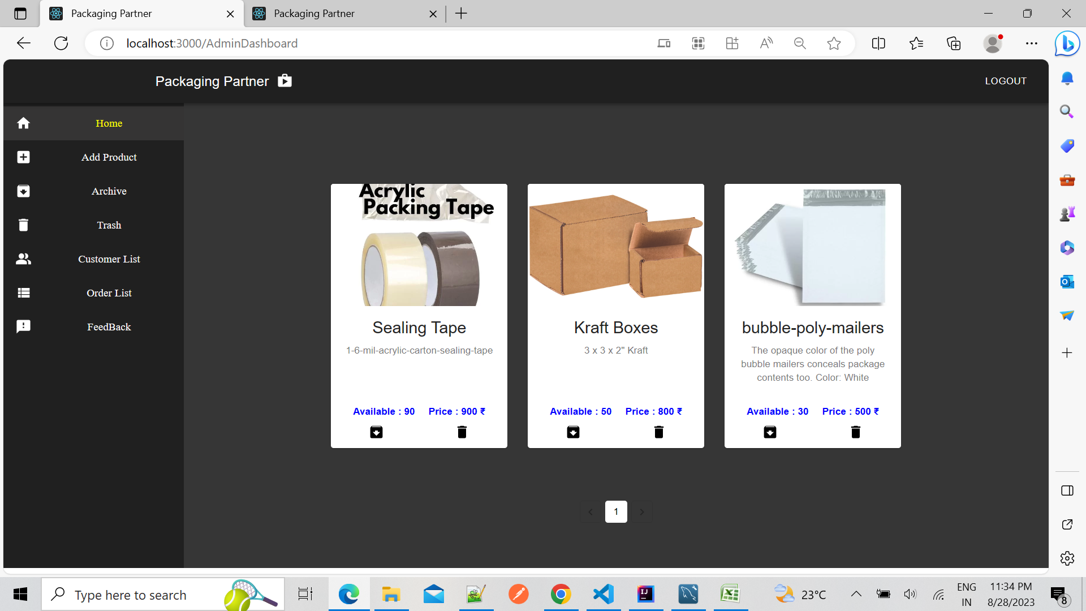
ADMIN DASHBOARD

Slide 14
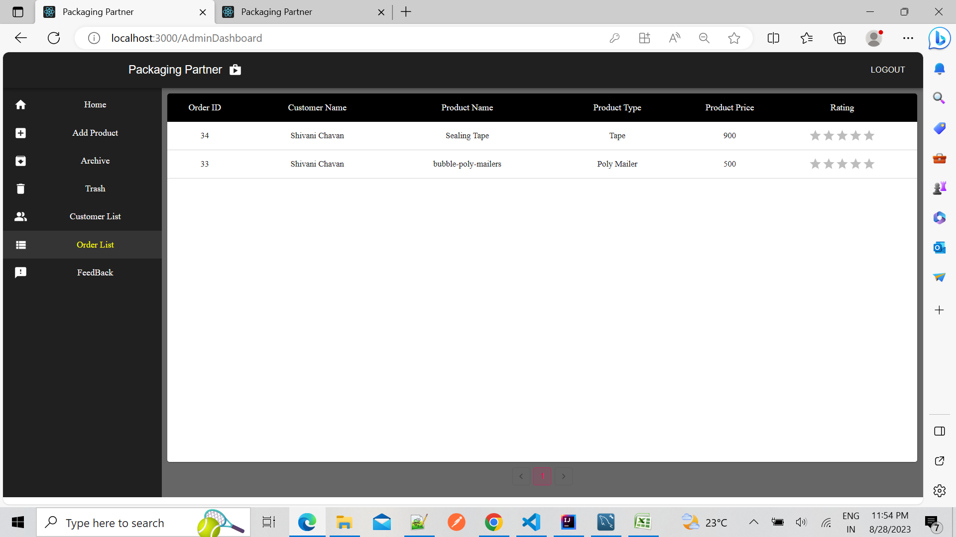
ORDER LIST

Slide 15
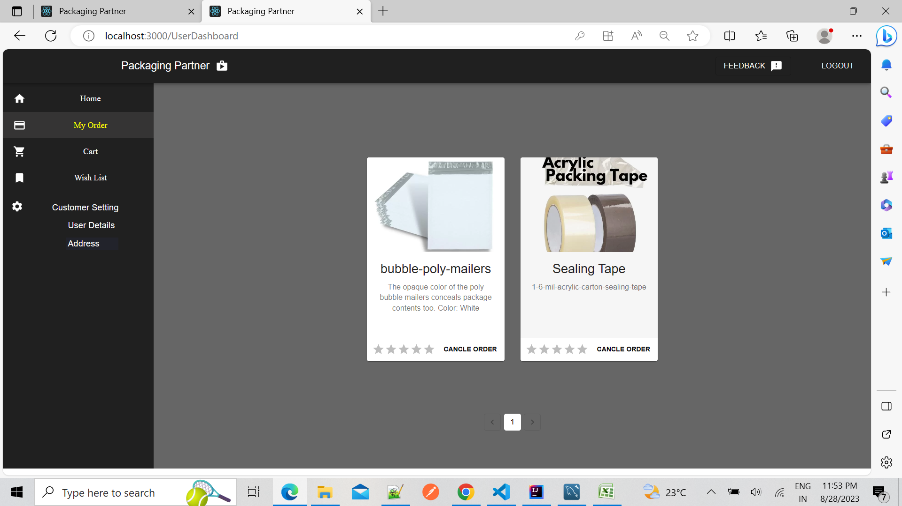
MANAGE ORDERS

Slide 16
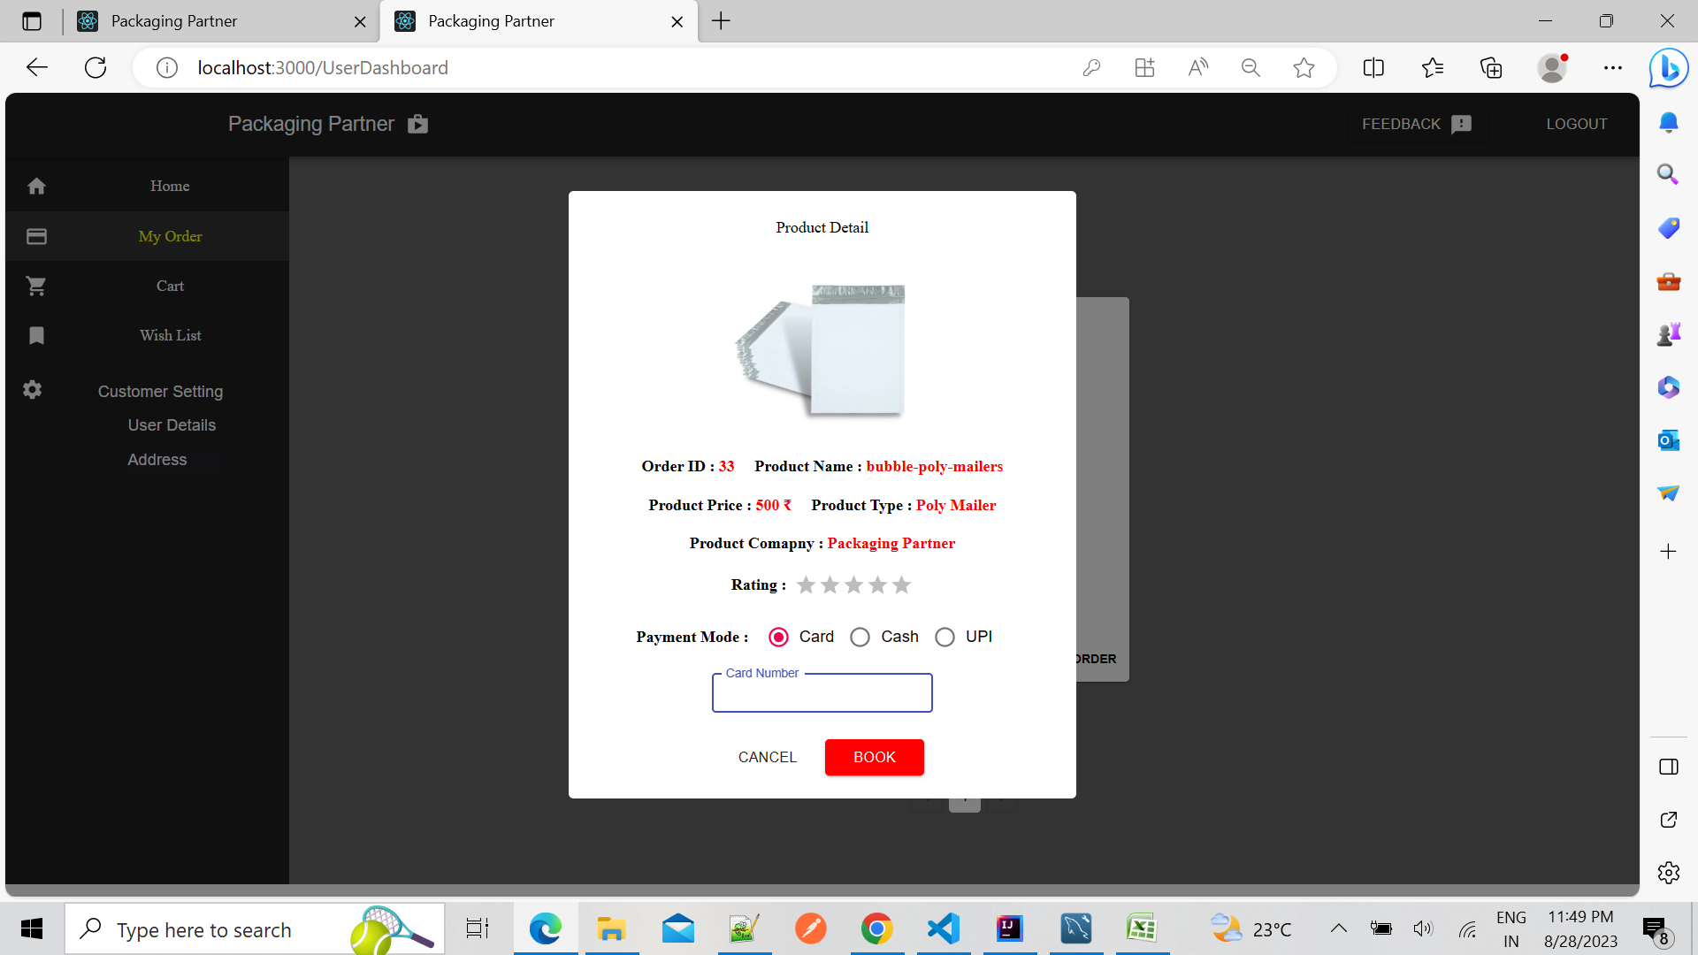
Payment

Slide 17
CONCLUSION
This platform includes designing and developing a digital platform that allows certified sellers to advertise their properties online and allows customers to visit the properties online with ocean of data regarding the property.
This will aid customers with buying and renting legal properties verified with our legal team in accordance with rules and regulations everything online.

