Slide 1

IoT QuickStart with AWS
Kirk S. Kalvar
Senior Software Engineer
KAL Technology
kirk.kalvar@kal.technology

Slide 2
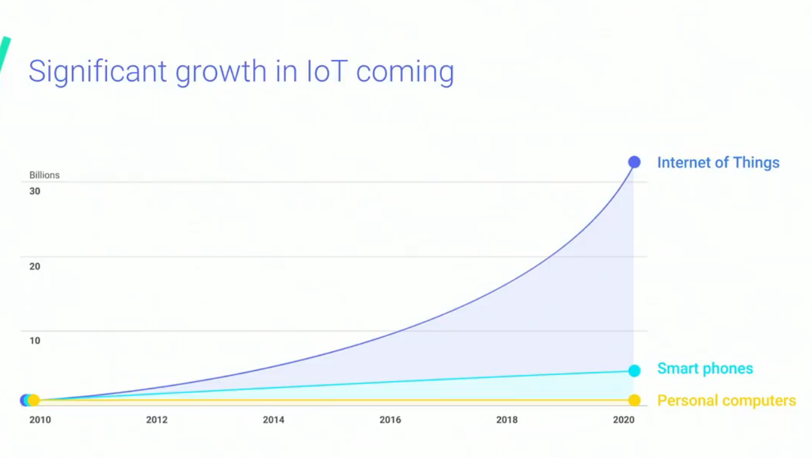
IoT Growth

Slide 3
Problem
Highly Fragmented Industry
Lack of Open Source Solutions with Significant Adoption
Resource Constraints

Slide 4
Why Use AWS IoT?
Experience with AWS
Configurable via Web Console, CLI, or CloudFormation
Quick Prototyping
Extensive SDK Support
Scalable
Secure
Reliable

Slide 5
Design Goals
Keep It Simple Stupid (KISS)
Minimal Viable Product (MVP) Approach
Leverage current skill set (Java/Android/AWS)
Code Reuse

Slide 6
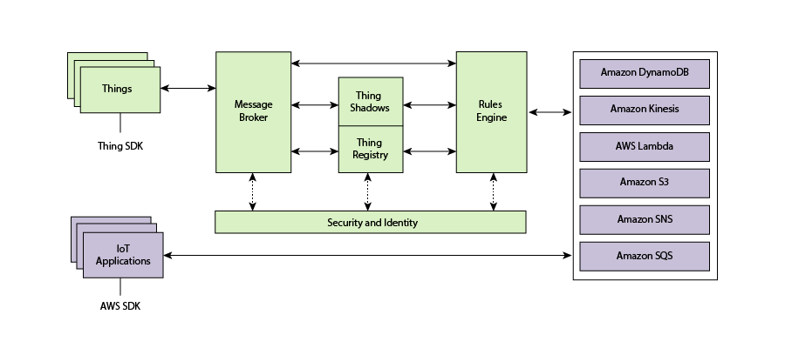
AWS IoT Architecture

Slide 7
Device Shadows Documents
Devices report their state by publishing messages in JSON format on MQTT topics. A shadow document has the following properties:
State:
Desired: applications write to this portion of the document to update the state
Reported: applications read this portion of the document to determine the state
Delta: contains the difference between the desired and reported states.
Metadata: Information about the data stored in the state section of the document
Timestamp: when the message was transmitted by AWS IoT
Version: Every time the document is updated, this version number is incremented

Slide 8
Device Shadow Document
{ "state": { "desired": { "roomTemperature": 60, "windowOpen": true }, "reported": { "roomTemperature": 60, "windowOpen": true } }, "metadata": { "desired": { "roomTemperature": { "timestamp": 1493129996 }, "windowOpen": { "timestamp": 1493129553 } } }, "version": 15, "timestamp": 1493130057 }

Slide 9
Device Shadows Data Flow
The Thing Shadows services acts as an intermediary, allowing devices and applications to retrieve and update thing shadows.
The Thing Shadows service uses MQTT topics to facilitate communication between applications and devices.
Example MQTT topics:
$aws/things/<myiotdevice>/shadow/update
You can update a thing shadow by publishing to the /update topic.
$aws/things/<myiotdevice>/ shadow/update/get
You can retrieve a thing shadow by subscribing to the /get topic. This retrieves the entire document plus the delta between the desired or reported states.

Slide 10
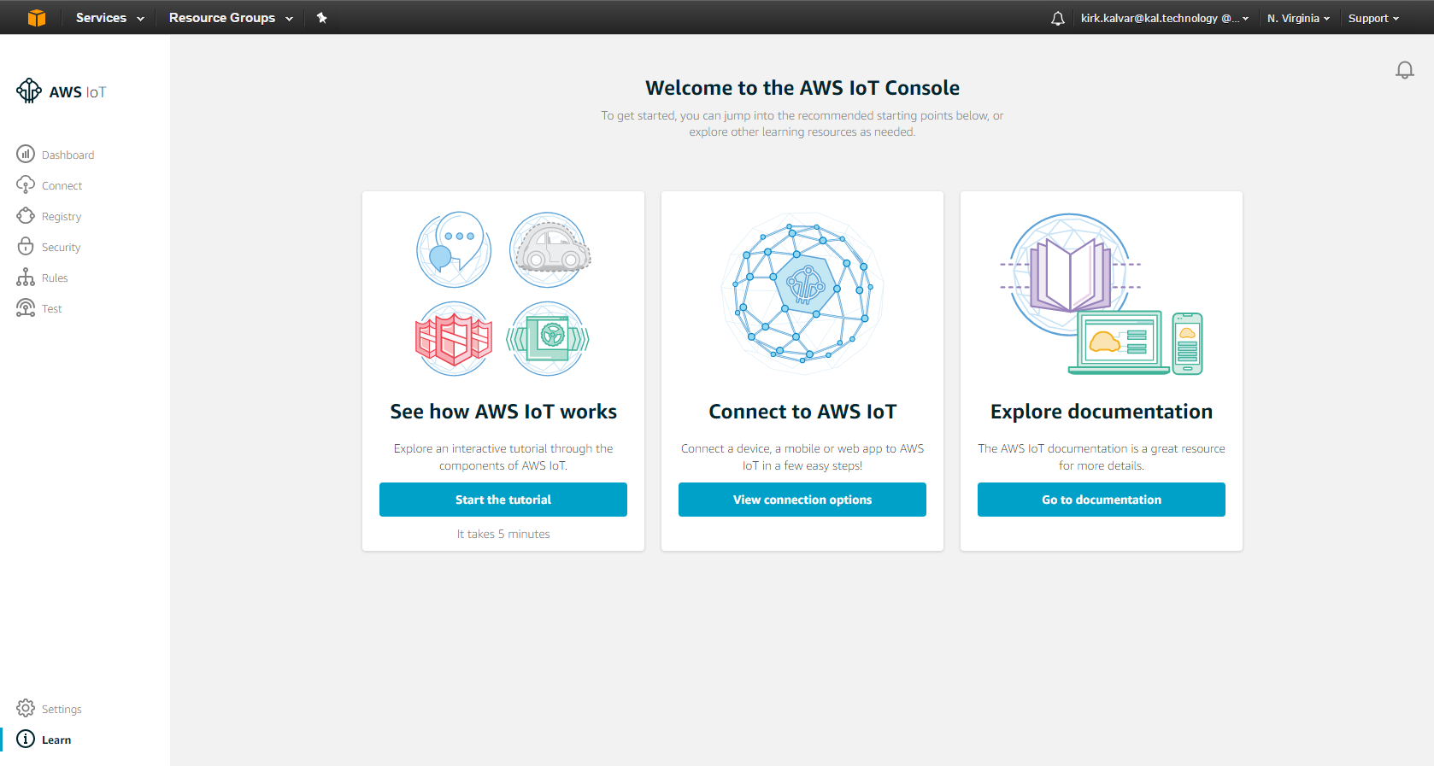
AWS IoT Web Console

Slide 11
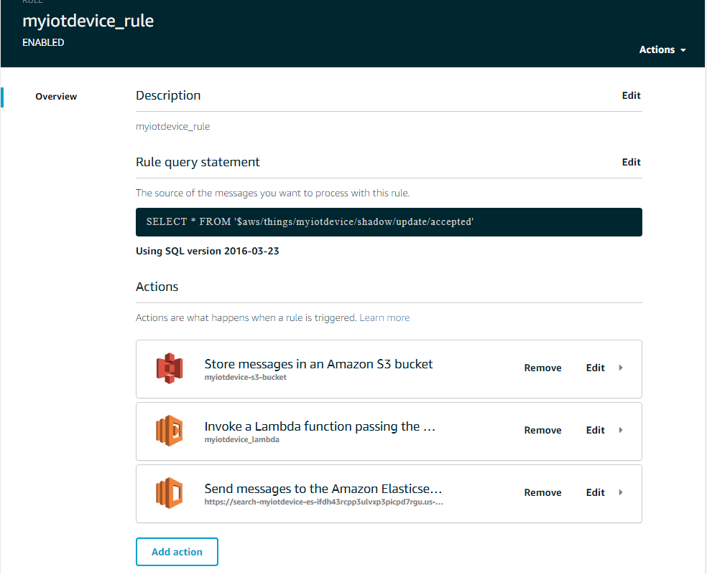
AWS IoT Rule

Slide 12
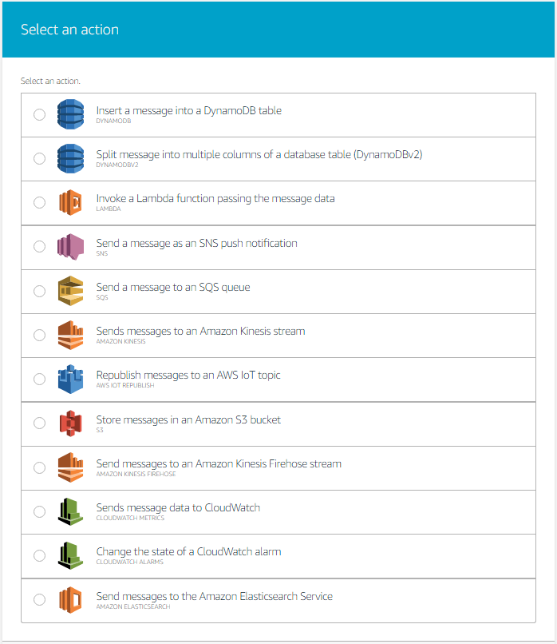
AWS IoT Rule Actions

Slide 13
Quick Demo
Android Mobile Temperature Application with an Open/Close Toggle and Temperature Scale
Temperature Application is configured to communicate with AWS IoT and is authenticated via AWS Cognito
We’ll show how to test basic connectivity with AWS IoT
We’ll fire the following AWS IoT Rules:
S3 to store shadow updates
Lambda to close the window if the window is open and temperature > 72 degrees
Elasticsearch as a near real-time “Dashboard”
Notes:
Send a simple text message
Use representative website
Use phone dialer
Use web browser

Slide 14
Quick Demo
AWS S3
Android Mobile Device
AWS IoT
AWS Lambda
MQTT
AWS Elasticsearch
Notes:
Send a simple text message
Use representative website
Use phone dialer
Use web browser

Slide 15
Conclusion
Pro
Minimal Investment
Fairly Quick Prototyping
Scalable
Secure
Reliable
SDK Support
Con
Not An Open Source Solution (Proprietary)
Must be Familiar with AWS
Requires Jumping Through Hoops Configuring Multiple Services

Slide 16
Questions?

Slide 17
References
https://github.com/kskalvar/AWS-IoT-AndroidStudio.git
http://docs.aws.amazon.com/iot/latest/developerguide/aws-iot-how-it-works.html
https://aws.amazon.com/mobile/sdk

