Slide 1

IoT QuickStart with AWS
kirk.kalvar@kal.technology
@kskalvar

Slide 2
Introduction
Senior Software Engineer
Focused on Open Source Solutions

Slide 3
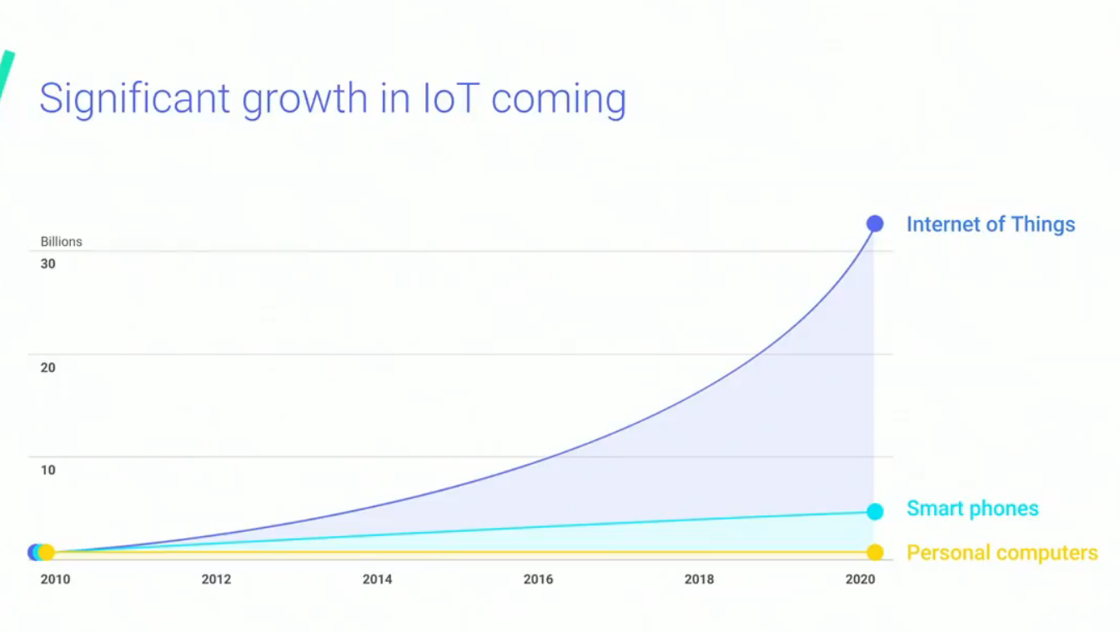
IoT Growth

Slide 4
Problem
Fragmented Industry
Lack of Open Source Solutions with Significant Adoption
Have Limited Resources
Are Cost Sensitive

Slide 5
Why AWS IoT?
Cloud Provider of Choice
Configurable with AWS IoT Console or AWS CLI
Quick Prototyping
Extensive SDK Support
Scalable
Secure
Reliable

Slide 6
Design Goals
Keep It Simple Stupid (KISS)
Leverage current skill set (Java/Android/AWS)
Use as much existing code as possible
Use Minimal Viable Product (MVP) Approach

Slide 7
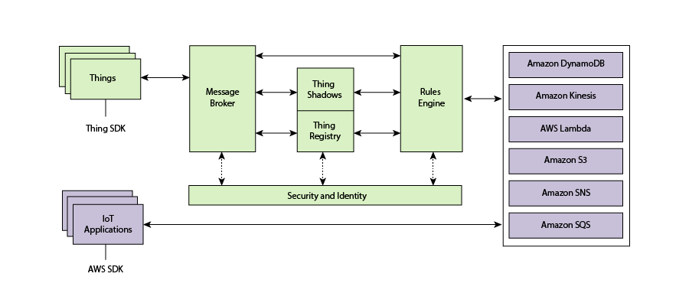
AWS IoT Architecture

Slide 8
Device Shadow Document
Devices report their state by publishing messages in JSON format on MQTT topics. A shadow document has the following properties:
state
desired: applications can write to this portion of the document to update the state
reported: applications read this portion of the document to determine the state of a thing
delta: contains the difference between the desired and reported states.
metadata: Information about the data stored in the state section of the document
timestamp: when the message was transmitted by AWS IoT
version: Every time the document is updated, this version number is incremented

Slide 9
Device Shadow Document
{ "state": { "desired": { "roomTemperature": 60, "windowOpen": true }, "reported": { "roomTemperature": 60, "windowOpen": true } }, "metadata": { "desired": { "roomTemperature": { "timestamp": 1493129996 }, "windowOpen": { "timestamp": 1493129553 } } }, "version": 15, "timestamp": 1493130057 }

Slide 10
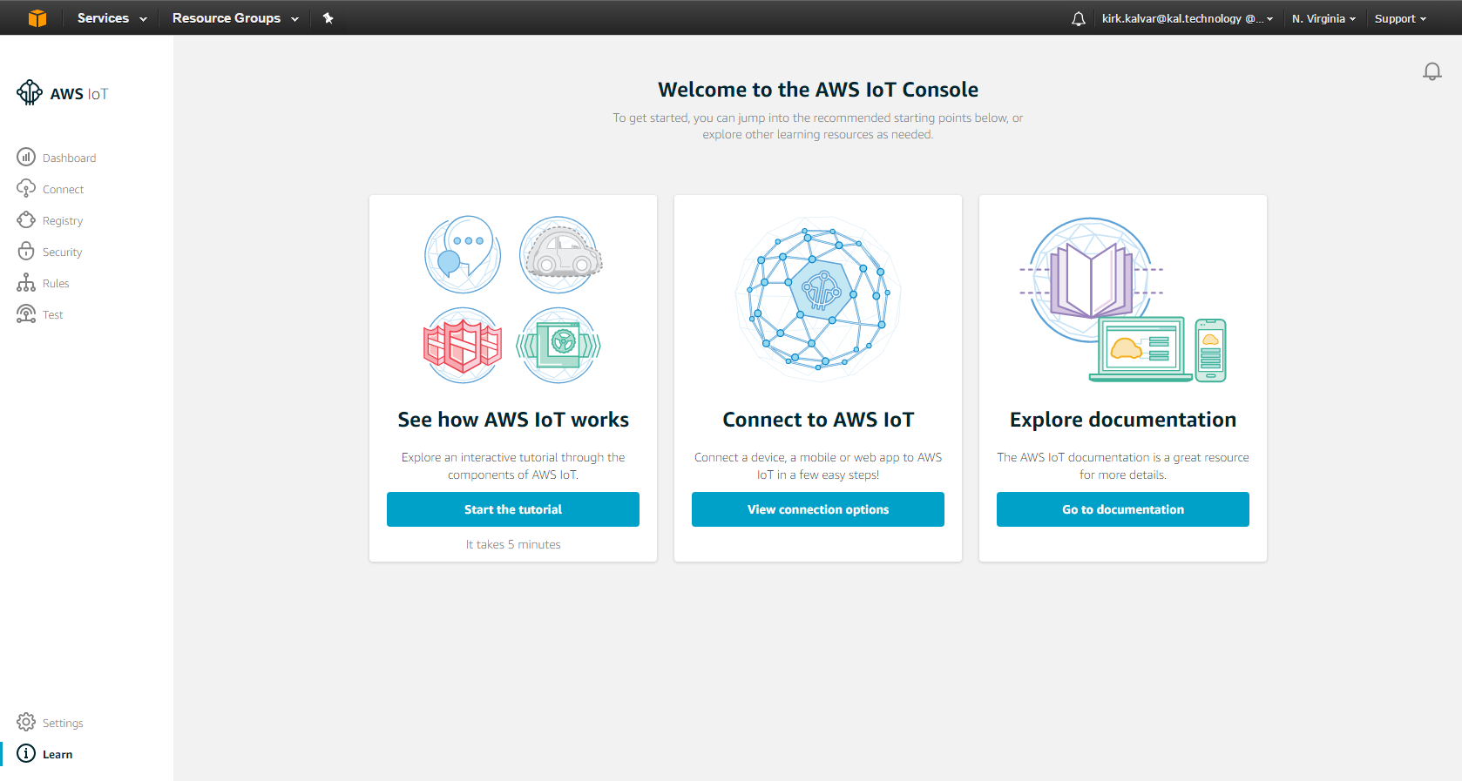
AWS IoT Console
AWS IoT Device can be configured via the AWS IoT Console or via the AWS CLI

Slide 11
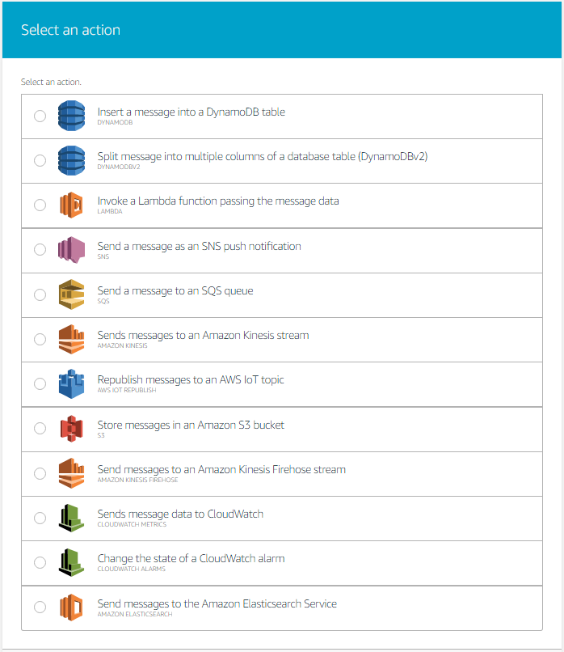
AWS IoT Rule Actions

Slide 12
Quick Demo
Android Mobile Temperature Application with an Open/Close Window toggle and Temperature Scale
Temperature Application is configured to communicate with AWS IoT authenticated via AWS Cognito
We’ll show how to test basic connectivity with AWS IoT
We’ll use the Application to fire the following AWS IoT Rules:
Use S3 to store shadow updates
Use Lambda to automatically close the window if the window is open and temperature > 72 degrees
Use Elastic Search as a near real-time “Dashboard”
Notes:
Send a simple text message
Use representative website
Use phone dialer
Use web browser

Slide 13
Quick Demo
AWS S3
Android Mobile Device
AWS IoT
AWS Lambda
AWS Elastic Search
Notes:
Send a simple text message
Use representative website
Use phone dialer
Use web browser

Slide 14
Conclusion
Pro
Minimal Investment
Quick Prototyping
Scalable
Secure
Reliable
SDK Support
Con
Not An Open Source Solution (Proprietary)
Must be Familiar with AWS
Configuration Requires Jumping Through Hoops with Multiple Services

Slide 15
Questions?

Slide 16
References
https://github.com/kskalvar/AWS-IoT-AndroidStudio.git
http://docs.aws.amazon.com/iot/latest/developerguide/aws-iot-how-it-works.html
https://aws.amazon.com/mobile/sdk

