Slide 1
Washington D.C.

Slide 2
AWS Elastic Kubernetes Service (EKS) CI/CD Pipeline QuickStart
SessionID
Kirk Kalvar
Senior Software Engineer/Principal
KAL Technology
kirk.kalvar@kal.technology

Slide 3
Introduction
So you’ve got a AWS EKS Cluster up and running
What’s Next?

Slide 4
Why a CI/CD Pipeline?
Support Team Development
On Demand Build and Deploy
Fast Feedback Loop
Increased Transparency and Visibility
Modern Software Lifecycle Demand It

Slide 5
Why a CI/CD Pipeline?
OK, We Want to Build a CI/CD Pipeline for our Kubernetes Cluster, what are our options?
No AWS CodeStar Option
Build a Custom Jenkins Pipeline
Build a Pipeline External or Internal to Kubernetes
Geez, it shouldn’t be this tough
Just want to get something running quickly so we can get started
Do we really need to start from scratch?

Slide 6
Why a CI/CD Pipeline?
AWS CodeSuite - Continuous Deployment Reference Architecture for Kubernetes

Slide 7
Requirements
AWS Account (Root)
AWS EKS Cluster Configured
EC2 Instance with “kubectl” installed and configured to talk to the cluster
Optional Kubernetes Dashboard

Slide 8
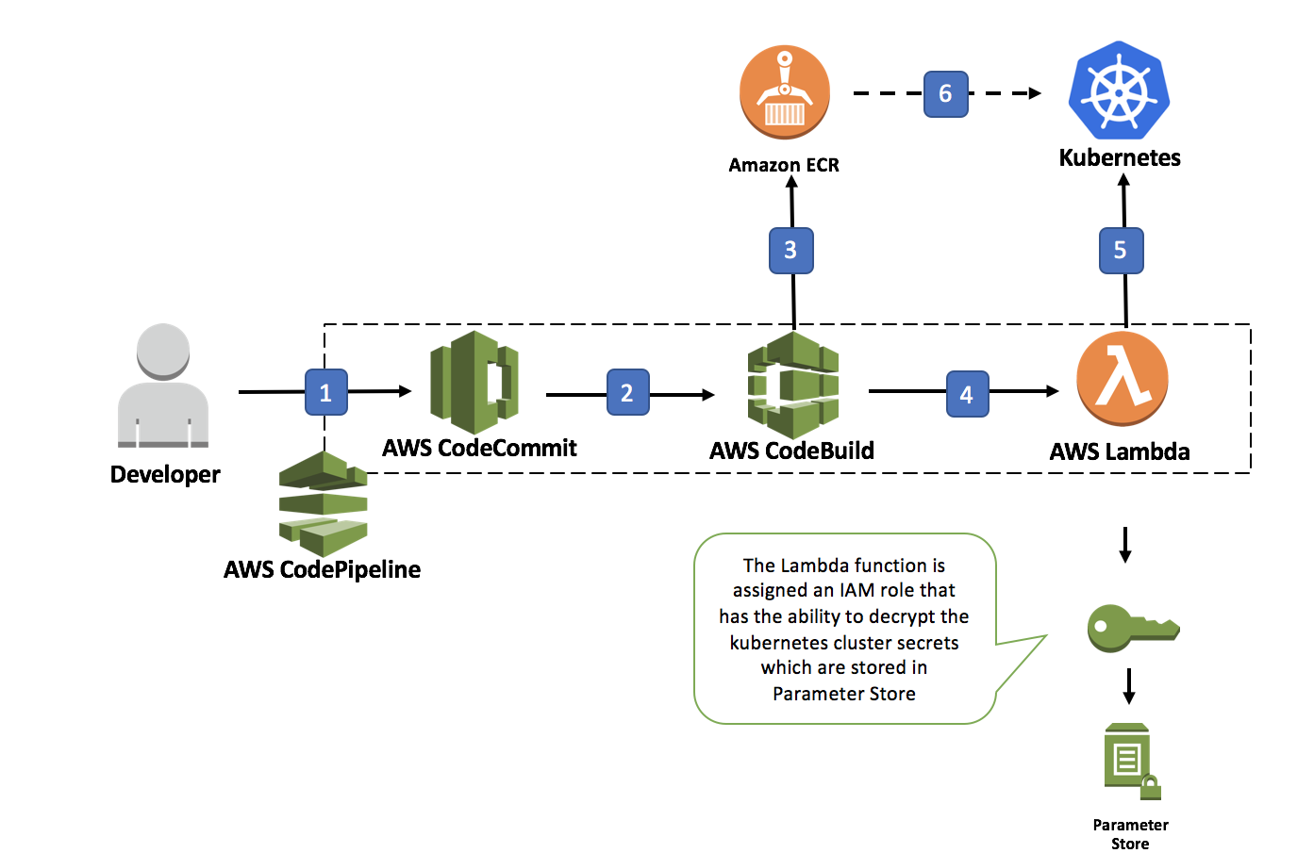
Architecture

Slide 9
Installation Steps
Checkout aws-eks-pipeline-quickstart from github
Deploy the Initial Application
Create S3 Bucket and Upload AWS CloudFormation Deployment Artifacts
Use AWS CloudFormation to Create the CI/CD Pipeline
Give Lambda Execution Role Permissions in AWS EKS Cluster
Add git Credential Helper to Development Environment
Test CI/CD Pipeline

Slide 10
Demo

Slide 11
Demo
To save time the AWS EKS Cluster, the AWS CodePipeline, and the sample-app have already been deployed to the cluster.
We’ll:
Push a simple modification to the AWS CodeCommit Repo
Watch the pipeline automatically pickup the code change, build the container, and push the new container into Kubernetes.
We should see the message “Hello World” appear when we access the load balancer endpoint for the microservice

Slide 12
Conclusions
Cons
Pipeline supports only a Simple Delivery Process
Still a lot of manual steps to setup
Not Production Ready
Pros
Provides a fully managed CI/CD Pipeline in a relatively short time
Saves a huge amount Initial Setup Time
Gives an excellent Baseline from which to build from

Slide 13
Questions?

Slide 14
References
AWS EKS QuickStart
https://github.com/kskalvar/aws-eks-cluster-quickstart
AWS EKS CI/CD Pipeline QuickStart
https://github.com/kskalvar/aws-eks-pipeline-quickstart
CodeSuite - Continuous Deployment Reference Architecture for Kubernetes
https://github.com/aws-samples/aws-kube-codesuite

Slide 15
Kirk Kalvar
Senior Software Engineer/Principal
KAL Technology
kirk.kalvar@kal.technology

