Slide 1
AWS Elastic Kubernetes Service (EKS) CI/CD Pipeline QuickStart
Kirk Kalvar, KAL Technology
kirk.kalvar@kal.technology
@kskalvar

Slide 2
Introduction
So you’ve got a AWS EKS Cluster up and running

Slide 3
Why a CI/CD Pipeline?
AWS Managed Services enables you to quickly and easily deploy your cloud infrastructure
On Demand

Slide 4
Requirements
AWS EKS Cluster
EC2 Instance with kubectl installed and configured to talk to the cluster

Slide 5
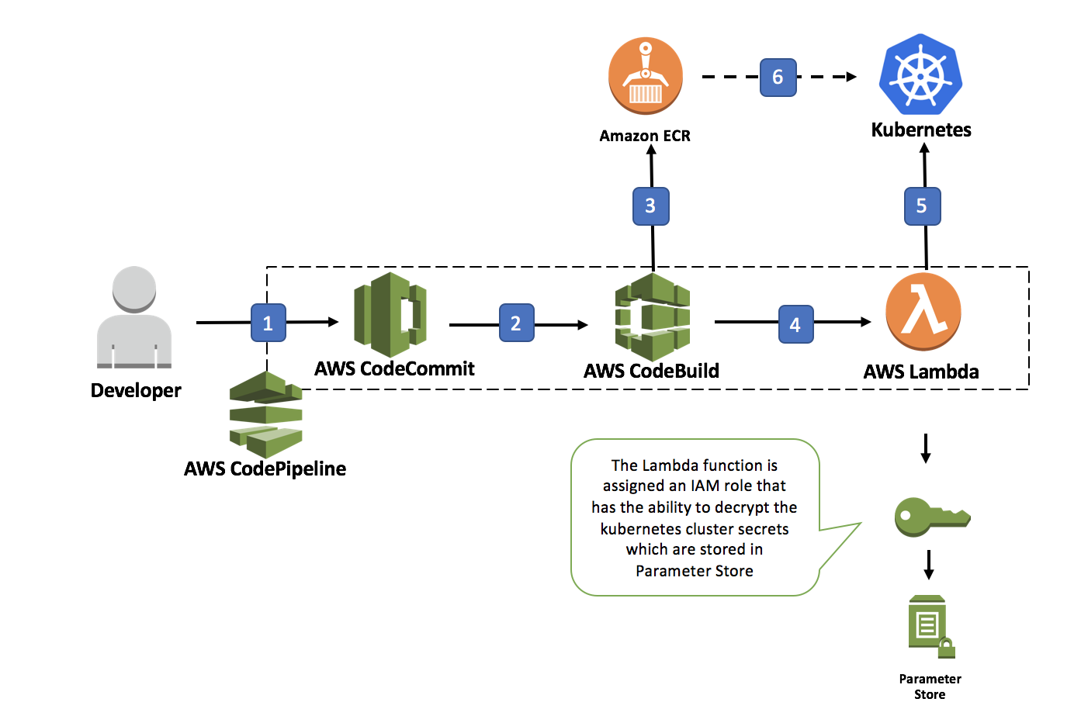
Architecture

Slide 6
Installation Steps
Checkout aws-kube-codesuite from the aws-samples github
Deploy the Initial Application
Create S3 Deployment Bucket
Use AWS CloudFormation to Create the CI/CD Pipeline
Give Lambda Execution Role Permissions in Amazon EKS Cluster
Test CI/CD Pipeline
Remove CI/CD Pipeline

Slide 7
Quick Demo
To save time the AWS EKS Cluster, CI/CD Pipeline, and the sample-app have already been deployed. We’ll:
Modify the sample-app “Hello, World!”
Push the modifications to the aws CodeCommit Repo using Git
Watch the pipeline automatically pickup the code change, build the container, and push the new container into Kubernetes.
You should see the message we changed in the code artifact appear when we access the load balancer endpoint

Slide 8
Conclusions
Cons
The pipeline does not currently support Development Teams
The pipeline does not currently support a more Complex Delivery Process
Pros
Provides a fully managed CI/CD Pipeline in a relatively short time.

Slide 9
Questions?

Slide 10
References
AWS EKS QuickStart
https://github.com/kskalvar/aws-eks-cluster-quickstart
AWS EKS CI/CD Pipeline QuickStart
https://github.com/kskalvar/aws-eks-pipeline-quickstart
CodeSuite - Continuous Deployment Reference Architecture for Kubernetes
https://github.com/aws-samples/aws-kube-codesuite

