Slide 1
AWS SageMaker Bring Your Own Container
Andrew Heifetz, AMPSight
Kirk Kalvar, KAL Technology

Slide 2
Introduction
Amazon SageMaker is a fully-managed platform to build, train, and deploy machine learning models.
Supports TensorFlow, Apache MXNet, Chainer, PyTorch, and Apache Spark out of the box
Since Amazon SageMaker algorithms are packaged as Docker images you can use almost any algorithm code regardless of implementation language, dependent libraries, frameworks. i.e. “Bring Your Own Container”

Slide 3
Why AWS SageMaker?
AWS Managed Services enables you to quickly and easily deploy your cloud infrastructure
On Demand

Slide 4
Overview
AWS SageMaker has a predefined project structure and method calls used for creating your own container
The “scikit bring your own” reference project is an excellent starting point and well documented
Although it uses scikit as it’s ML Library it pretty easy to see upon inspection where you need to plugin your specific code and libraries

Slide 5
Overview
We used PlanesNet-Detector a TFLearn/Python project as a starting point
It has distinct modules for the model, training, and detecting
It was implemented as a stand-alone command line project with clear instructions and testing artifacts

Slide 6
Roles
Data Scientist
Developer/Infrastructure

Slide 7
Process
Build and Test Locally
AWS has provided a local_test directory in the project structure to support building and testing locally your docker container
If everything builds and runs locally, it’s relatively easy to port your container to SageMaker
Build and Test Using AWS SageMaker Jupiter Notebook and SageMaker Python SDK
The “scikit bring your own” reference project provides 90% of the code required for the Notebook.

Slide 8
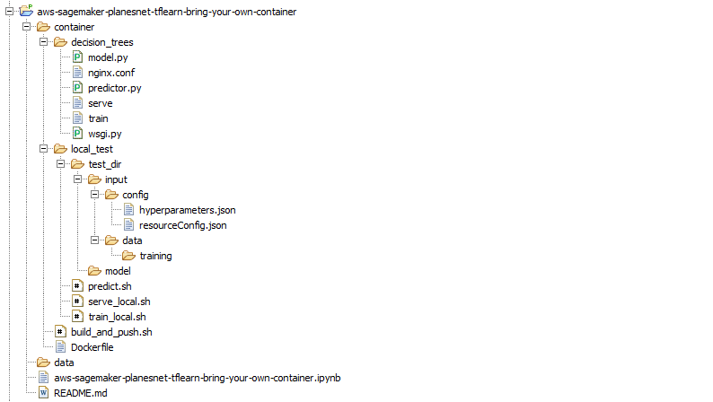
Project Structure

Slide 9
Container Modifications
container/decision_trees/model.py
Your model code
container/decision_trees/predictor.py
Load your model
Run your prediction code
Entry point for Scoring Service
container/decision trees/train
Your training code
container/Dockerfile
Container to support your ML Library and other libraries required by your code
*.ipynb Jupyter Notebook
Your detection code

Slide 10
Local Testing
local_test/input/data/training/
location of your training data for local training
local_test/serve_local.sh
script to run the Scoring Service locally on port 8080
local_test/train_local.sh
script to run training locally on port 8080
local_test/predict.sh
script to run prediction locally on port 8080

Slide 11
Issues To Watch For
When creating a SageMaker Notebook you will create an SageMaker Execution IAM Role. Be sure to add AmazonEC2ContainerRegistryFullAccess policy. Otherwise you won’t be able to access ECR.
Resolving Container dependencies took a lot longer than expected.
Passing data to the predictor.py took way longer than expected. Passing a numpy ndarray correctly wasn’t obvious to me. Initially passed the image chips as files but this was extremely slow. Took some understanding of how numpy ndarray are constructed, how to flatten them, and how to reconstitute them so I could pass them to the predictor.py as a string.
Local testing uses curl to pass data to the predictor.py by reading a file. So I needed to write the image chips which I wanted to run predictions on as a file. I modified and ran the original detector.py from PlanesNet-Detector project to write the chips as a file as they were being processed.

Slide 12
Quick Demo
To save time the AWS SageMaker PlanesNet/TFLearn project has already been run and deployed using the AWS SageMaker Console and a Jupyter Notebook.
We’ll:
Step through the Jupyter Notebook to show the process
Display the output of the Predictor Model

Slide 13
Conclusions
Cons
Creating custom containers is time consuming initially but subsequent iterations are faster as you become more familiar with the process
Requires knowledge of AWS, Docker, ML Framework, Language SDK, etc. Non trivial.
Pros
Managed Service
On Demand

Slide 14
References
Using Your Own Algorithms with Amazon SageMaker
https://docs.aws.amazon.com/sagemaker/latest/dg/your-algorithms.html
* Building your own algorithm container
https://github.com/awslabs/amazon-sagemaker-examples/blob/master/advanced_functionality/scikit_bring_your_own/scikit_bring_your_own.ipynb
PlanesNet-Detector
https://github.com/rhammell/planesnet-detector
My AWS SageMaker PlanesNet TFLearn Bring Your Own Container
https://github.com/kskalvar/aws-sagemaker-planesnet-tflearn-bring-your-own-container

Slide 15
Questions?

