Slide 1

Kubernetes Autoscaling on AWS
Kirk S. Kalvar
Senior Software Engineer
kirk.kalvar@kal.technology

Slide 2
Introduction
Enterprise/Mobile/Infrastructure Developer
Focused on Open Source Solutions
Motivation:
Learn Containers and Container Orchestration

Slide 3
Problem
How to dynamically scale a Kubernetes cluster easily so you can learn and evaluate
Have Limited Resources

Slide 4
Solution
Kubernetes on AWS

Slide 5
Demo Architecture
AWS EC2
EC2 Load Balancer
Kubernetes Cluster
amazon-linux-ami
k8s-master
k8s-minion
k8s-minion
docker
kubectl
aws client
php-apache
php-apache
EC2 Auto Scaling
…
load-generator
EC2 Volumes
k8s-master-pd
AWS S3
kubernetes-staging-*

Slide 6
Kubernetes Setup
The Amazon Linux AMI is not part of the cluster it’s used for installing kubernetes and to run kubectl/aws command line tools.
This presentation assumes you have already have a kubernetes cluster running on AWS

Slide 7
Autoscaling on AWS
There’s two parts to Autoscaling with Kubernetes. The Pod Autoscaling and Node AutoScaling.
Node Autoscaling is not supported on AWS for Kubernetes 1.4, but coming soon (Supposedly 1.5)
With a little tweaking we can get a pretty good approximation of a fully functional Autoscaling Kubernetes Cluster by using the Pod Autoscaler and manually tuning the AWS Scaling Group (ASG) Policies for the Nodes.
Kubernetes already uses the ASG to maintain the cluster nodes so we’re going to just change some settings to help us out.
As usual with AWS you can use the Web UI or command line. For this demo will use the Web UI to modify the ASG.

Slide 8
Autoscaling on AWS
Set Kubernetes Pod Autoscaler
kubectl autoscale deployment php-apache --cpu-percent=50 --min=1 --max=10
Set AWS EC2 Auto Scaling Groups/Scaling Policies
Kube Cluster >= 50 Percent
breaches the alarm threshold: CPUUtilization >= 50 for 300 seconds
Take the action: Add 1 instances when 50 <= CPUUtilization < +infinity
Kube Cluster <= 10 Percent
breaches the alarm threshold: CPUUtilization <= 10 for 300 seconds
Take the action: Remove 1 instances when 10 >= CPUUtilization > -infinity

Slide 9
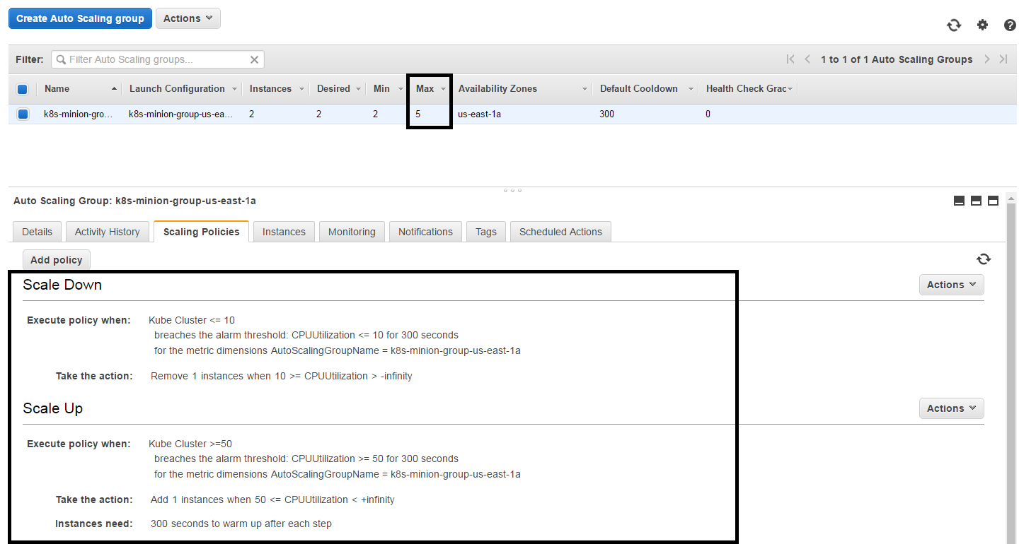
AWS Auto Scaling Groups

Slide 10
Quick Demo
To save time the amazon linux ami and kubernetes cluster are already configured and being load tested
We’ll:
Kill the load-generator and show the cluster will return to idle state with the minimum number of pods and nodes.
Notes:
Send a simple text message
Use representative website
Use phone dialer
Use web browser

Slide 11
Questions?

Slide 12
References
blog.kubernetes.io/2016/07/autoscaling-in-kubernetes.html
github.com/kskalvar/kubernetes-aws-autoscaling

