Slide 1

















6+ Years Experience
AI/ML Development
Web Applications
System Design
Satyam Kumar Chourasiya
Staff Engineer @ SanDisk
NEW
Backend engineering specialist with expertise in scalable systems, distributed storage, and cloud infrastructure
Python
FastAPI
PostgreSQL
AWS
Docker
Microservices
Git
Azure DevOps
Gen AI
Kafka
Elasticsearch

Slide 2
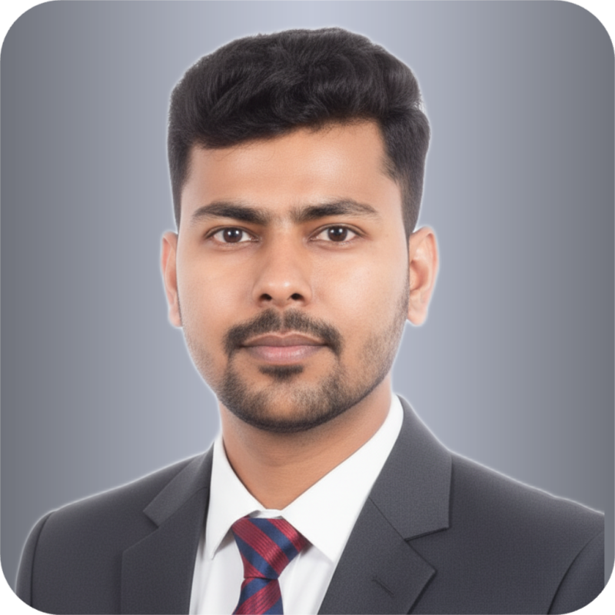



About Me
Staff Engineer at SanDisk
Just Started
6+ Years Experience
I'm Satyam Kumar Chourasiya, recently joined SanDisk as a Staff Engineer with expertise in designing scalable backend systems and distributed solutions. My core strength areas that I'll be focusing on in my new role:
Enterprise Architecture - Have built SaaS-based multi-tenant architecture solutions
AI/ML Development - Have contributed to artificial intelligence and machine learning initiatives
Web Applications (backend) - Have built scalable web applications with modern frameworks and technologies
Python
FastAPI
PostgreSQL
AI/ML
AWS
Docker
Microservices
System Design

Slide 3









Key Achievements & Impact
Major project contributions and key performance metrics at Entropik
Qatalyst Platform
Video Processing Pipeline
RAG Systems
Led a team of 5 developers to build an AI-powered market research platform processing millions of data points
Engineered async task queues and serverless optimization for video content processing
Built Retrieval-Augmented Generation systems using LangChain and open-source LLMs for enhanced insights
AWS Lambda
SQS
AI Analytics
Team Lead
LangChain
LLMs
90% Latency Reduction
5 Developer Team
25% Insights Improvement
25%
20%
25%
Improvement in AI insights generation
Boost in user engagement
Reduction in server costs

Slide 4

Professional Journey
Career progression from left to right highlighting key milestones
Associate Software Engineer
Senior Backend Engineer
Senior Backend Engineer
Senior Backend Engineer
Staff Engineer
NEW
Entropik India
Entropik Abu Dhabi
Entropik India
SanDisk
TeamLease
Aug 2021 - Dec 2022
Dec 2022 - Jan 2025
Feb 2025 - Nov 2025
Nov 2025 - Present
Jul 2019 - Aug 2021
Led team of 5 developers building Qatalyst
Built RAG systems with LangChain
Led cost optimization initiatives
Contributing to AI/ML initiatives AI/ML
Revolutionized email workflow automation
Developed hybrid semantic search engine
Optimized async task queues
Enhanced AI insights with LLMs
Building scalable web applications Web Apps
Led refactoring of legacy TL-Connect modules

Slide 5



Beyond Work
When I'm not coding, I enjoy strategic thinking through chess, watching cricket matches, and playing FIFA.
Chess
Cricket
FIFA

Slide 6



Thank You
Thank you for your time and attention.
Bangalore, Karnataka, India
LinkedIn
GitHub

