Slide 1
Blood Donation
Yash

Slide 2
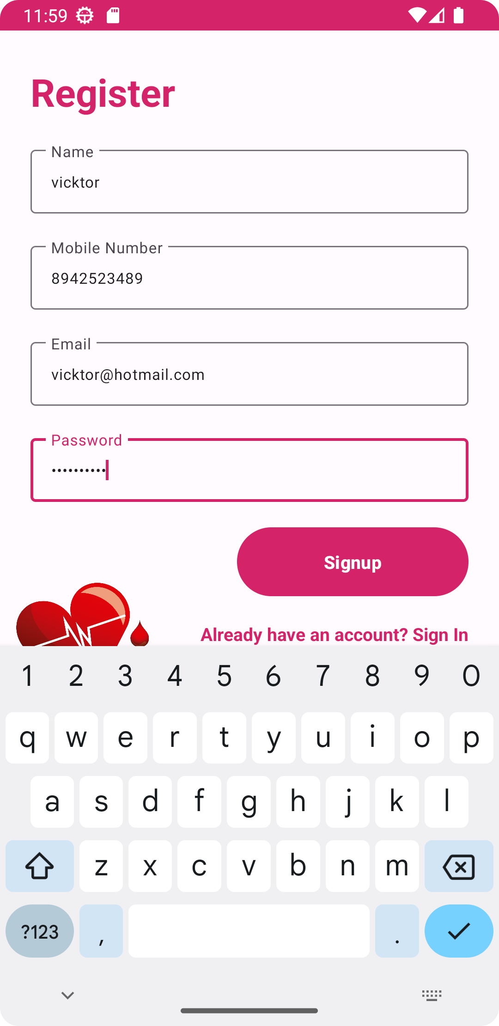
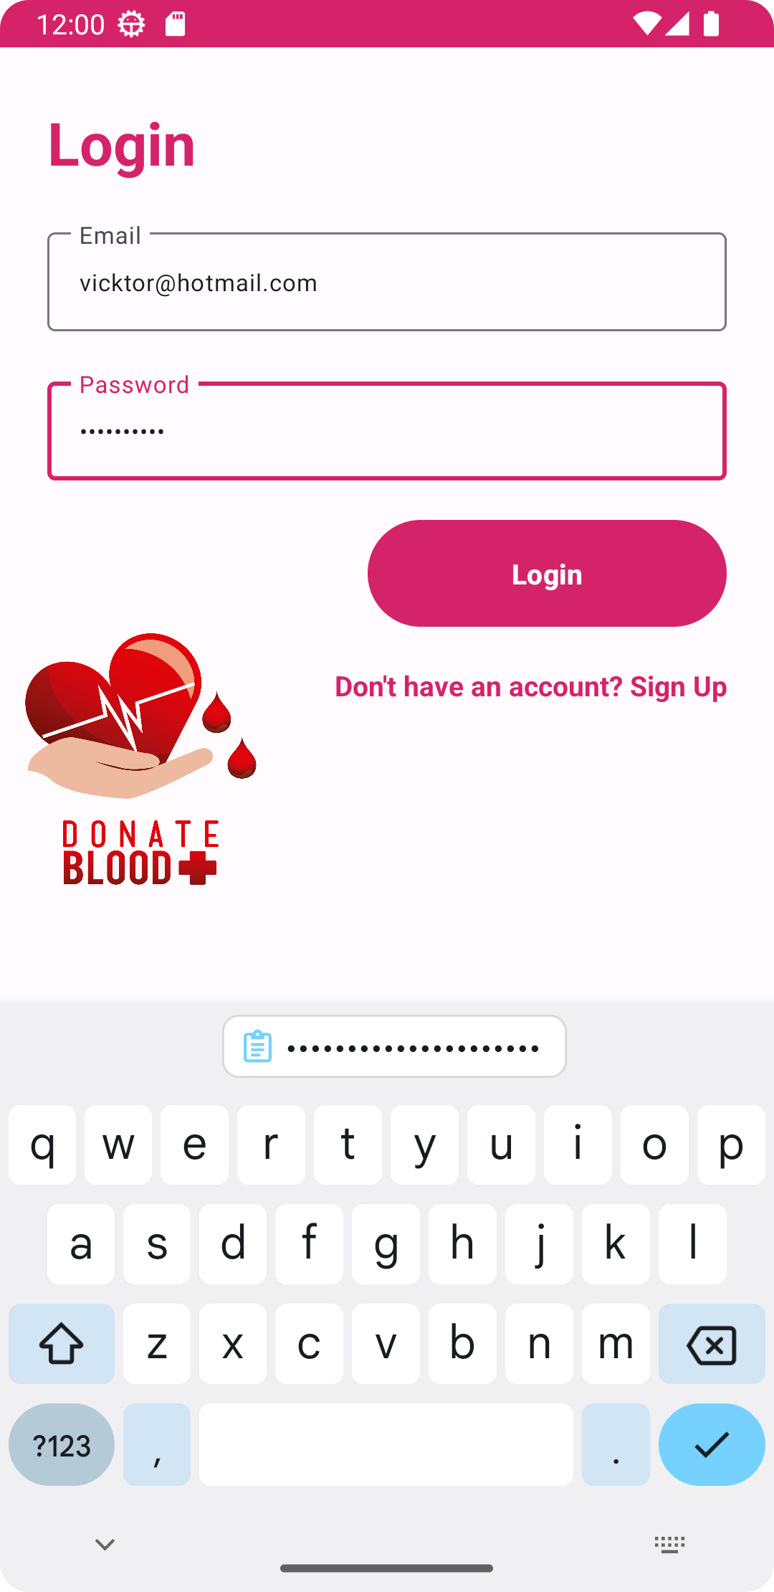
Front End
Sign up Page
Login Page

Slide 3
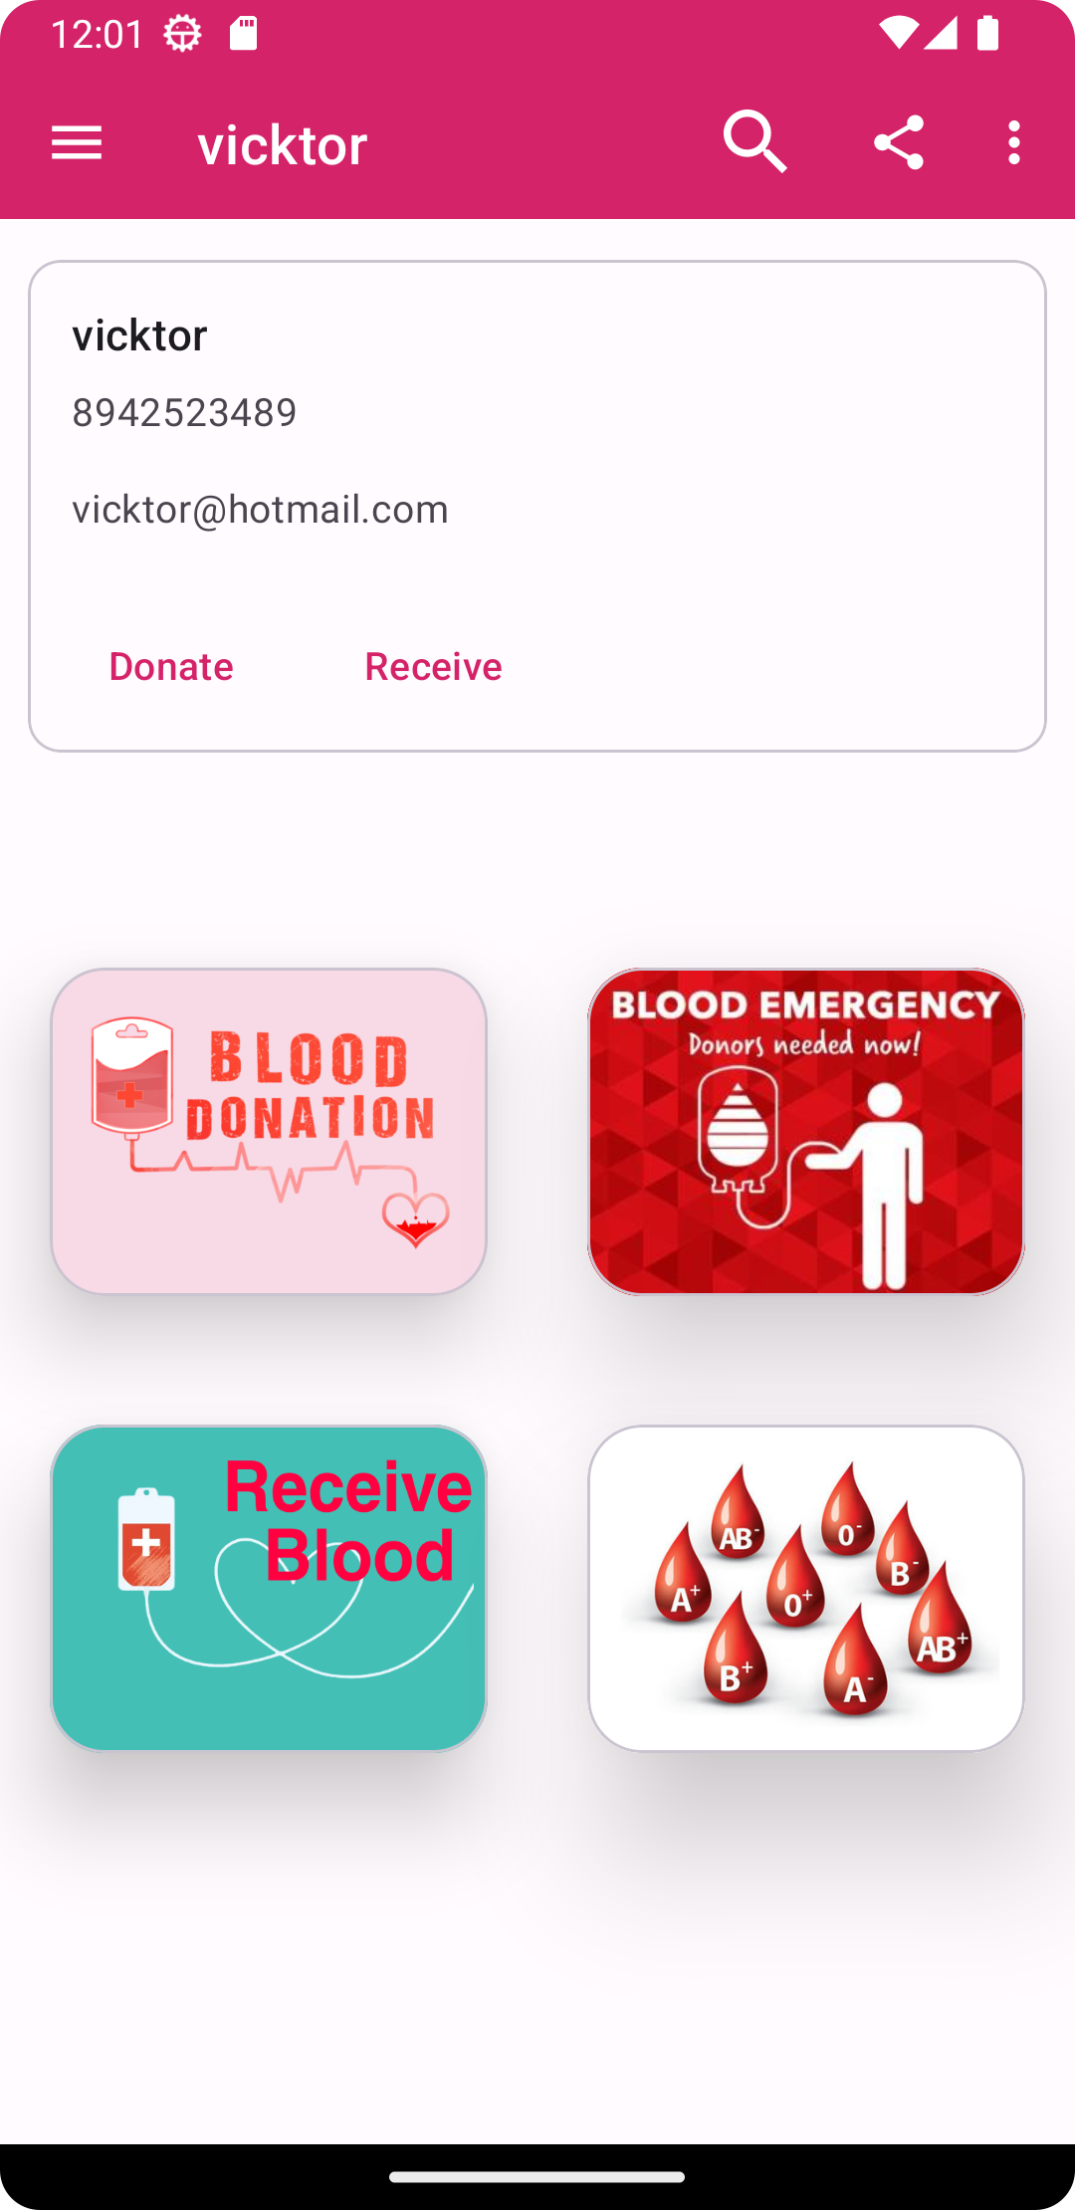
Front End
Home Page
Blood Donation
Receive Blood
Blood Emergency
Available Blood Group
Home Page

Slide 4
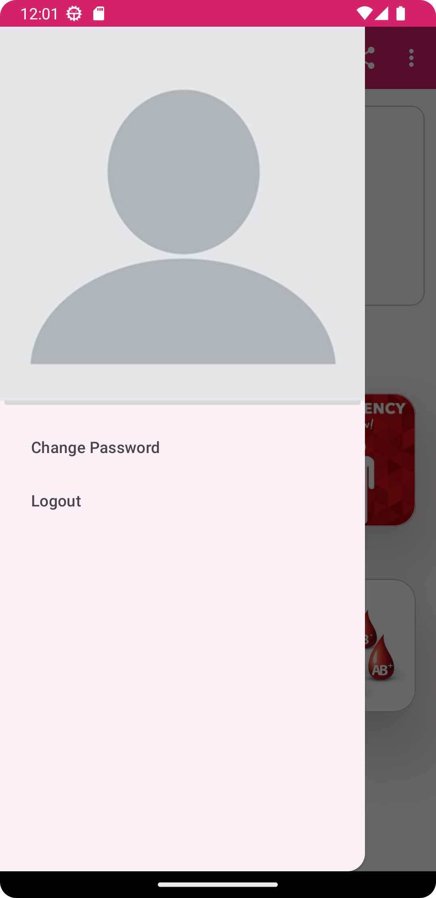
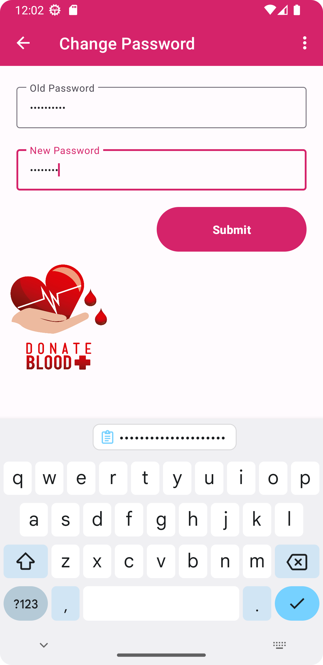
Front End
Side Bar
Change Password

Slide 5
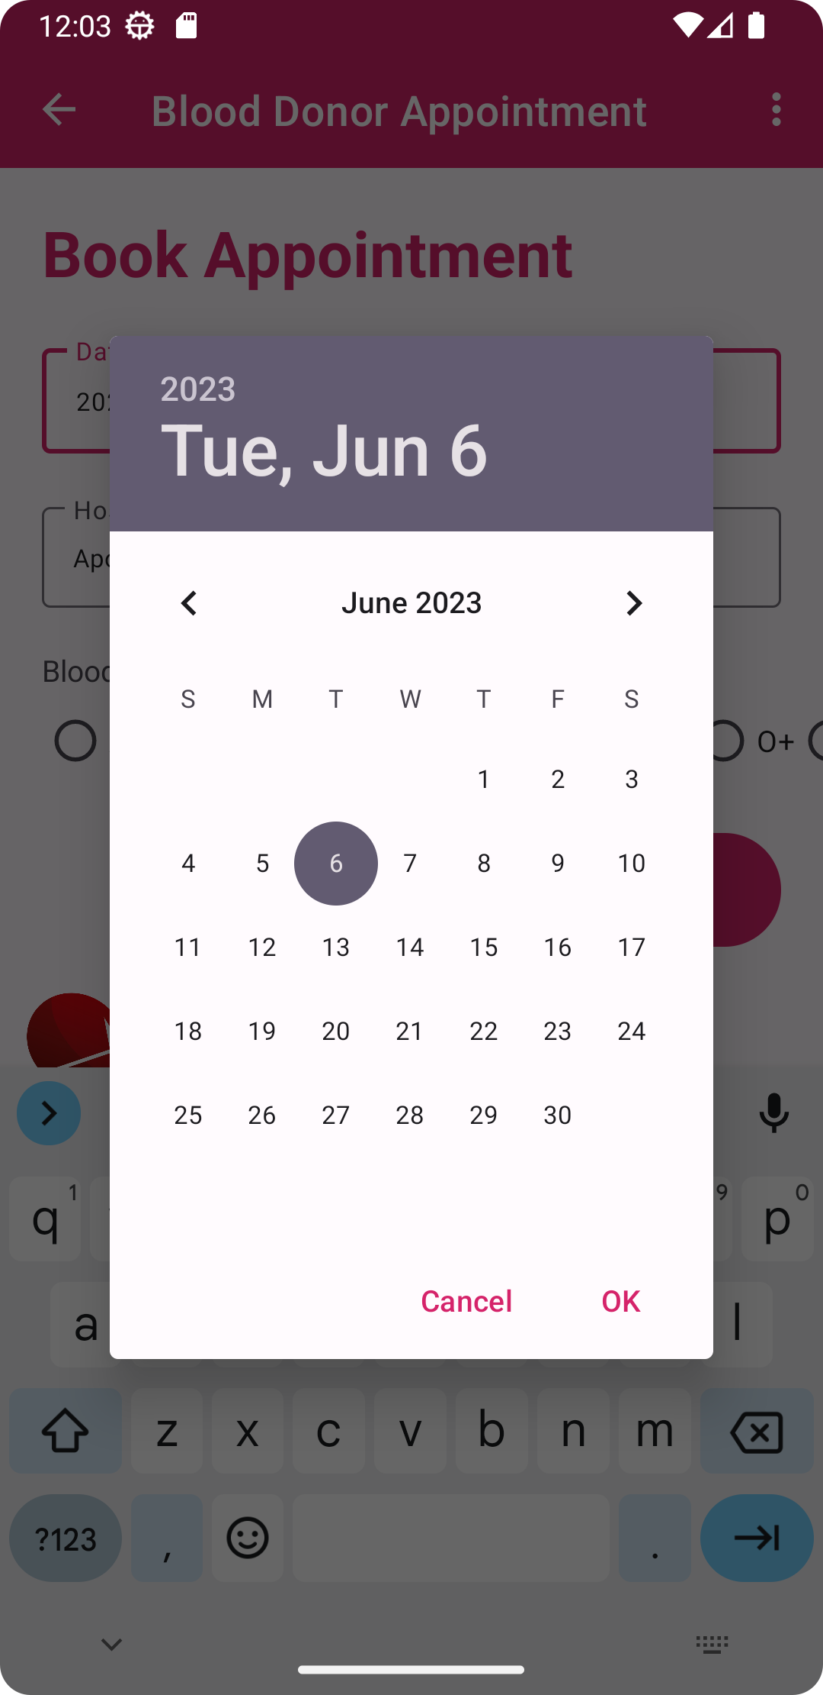
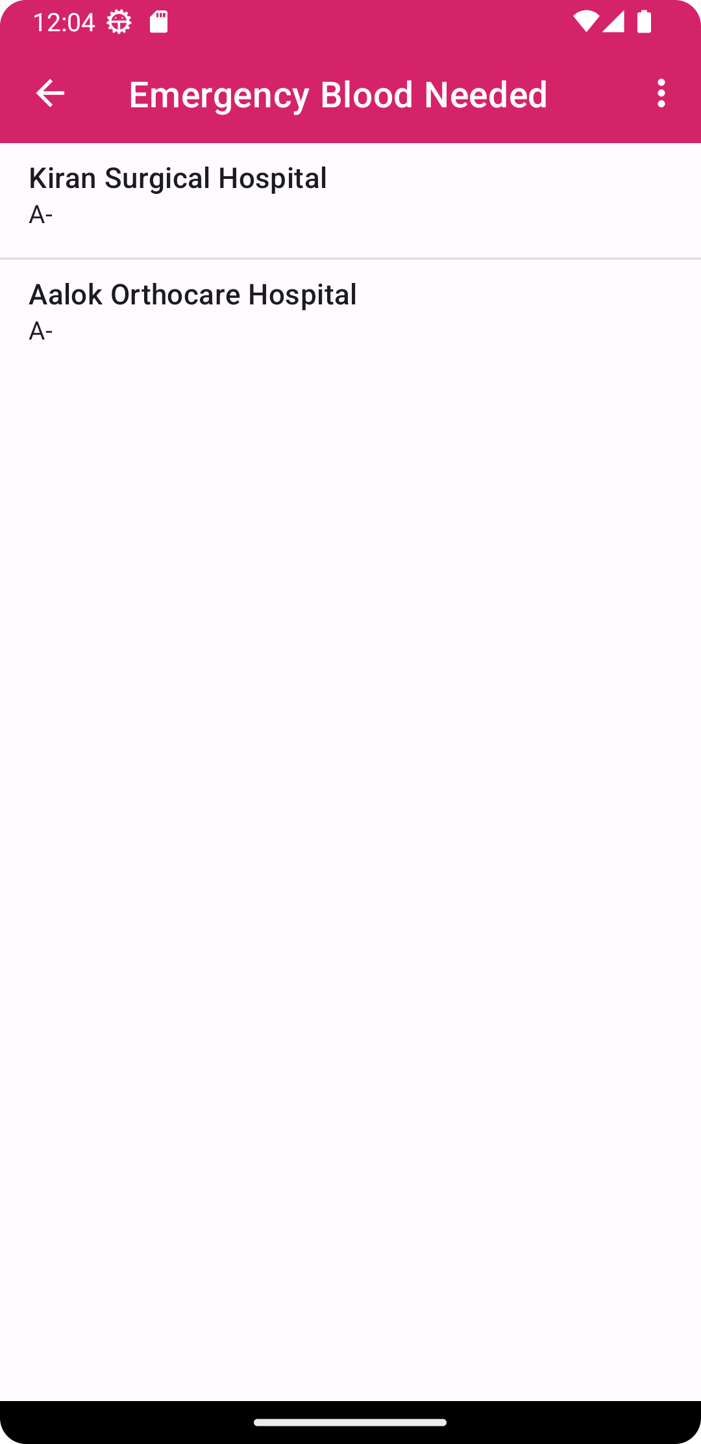
Front End
Date of Submission
Emergency Blood Needed

Slide 6
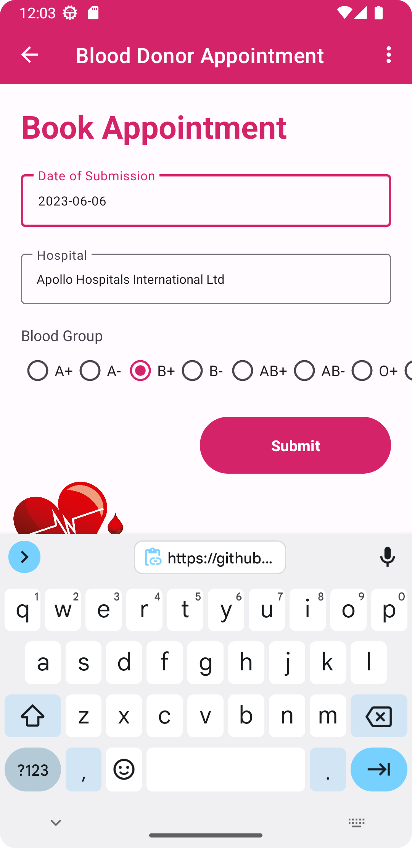
Front End
Donor
validation email, password
userinfo email, hospital, date of submit
Donor Appointment

Slide 7
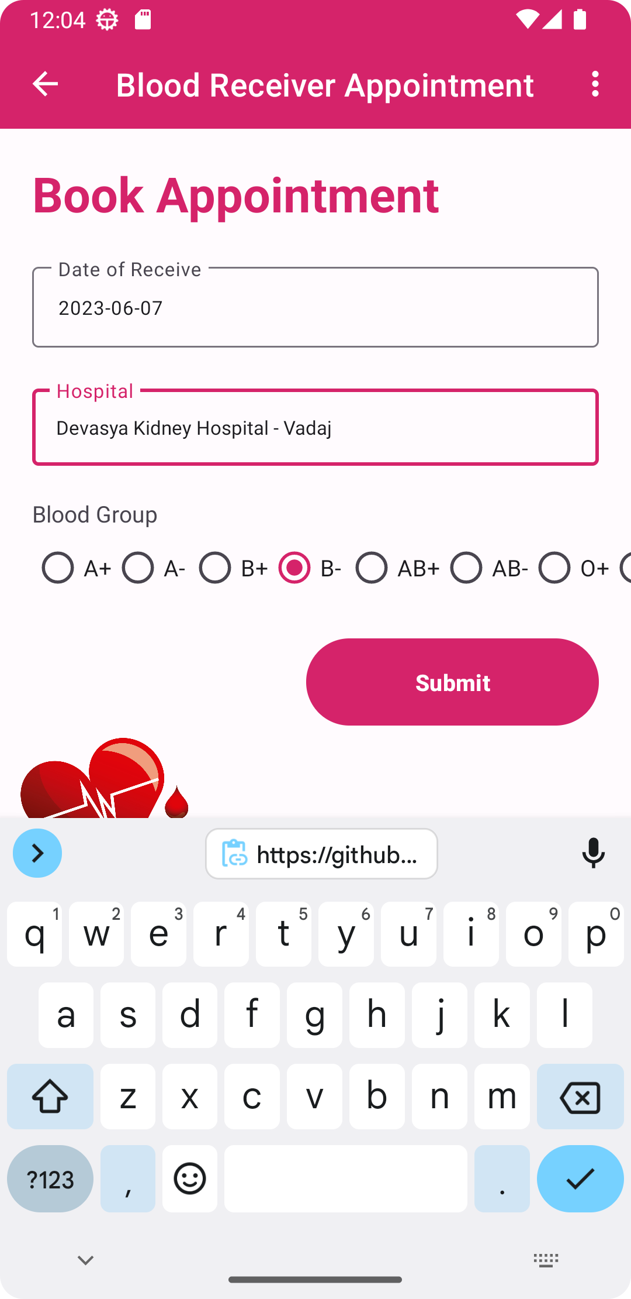
Front End
Receiver
validation email, password
userinfo email, hospital, date of recieve
today means emergency
not today means not emergency
Receiver Appointment

Slide 8
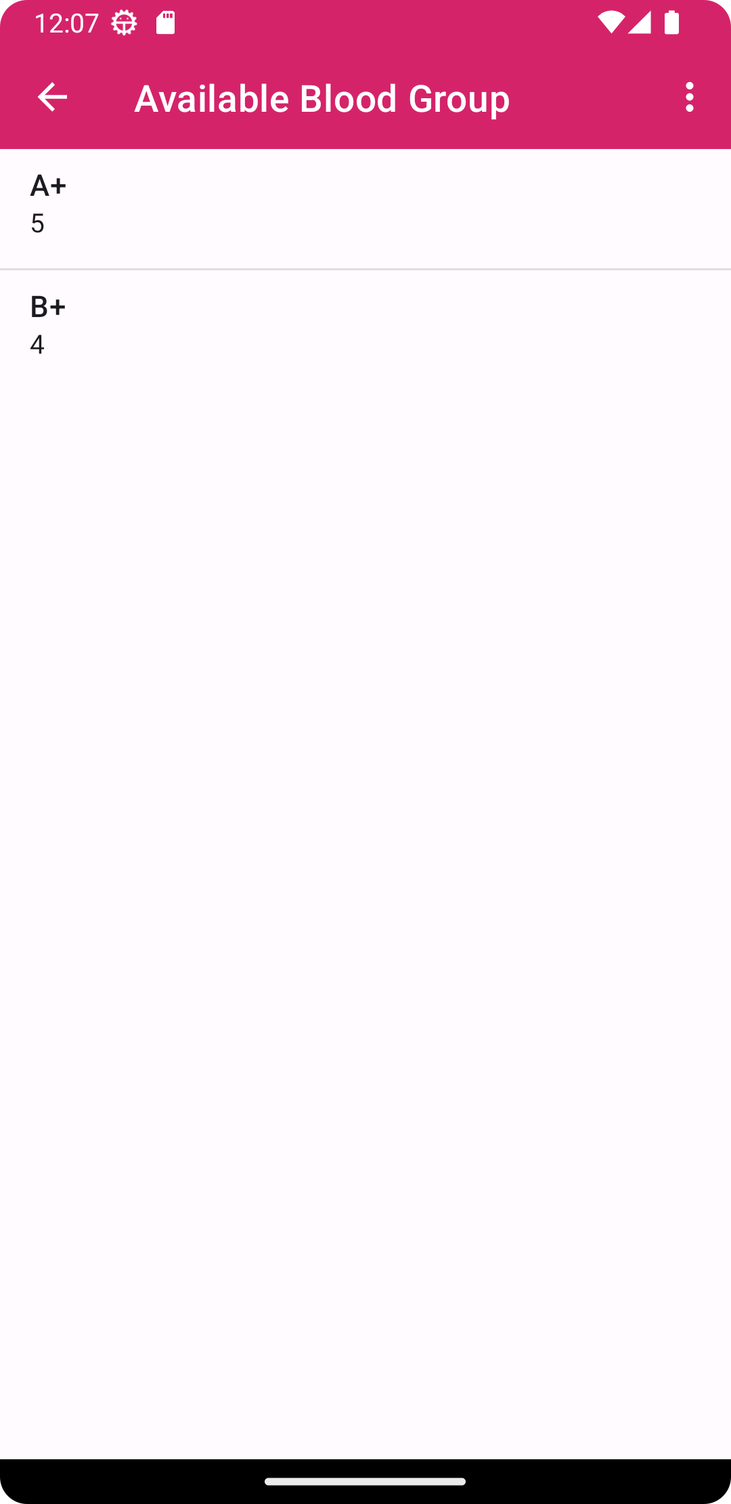
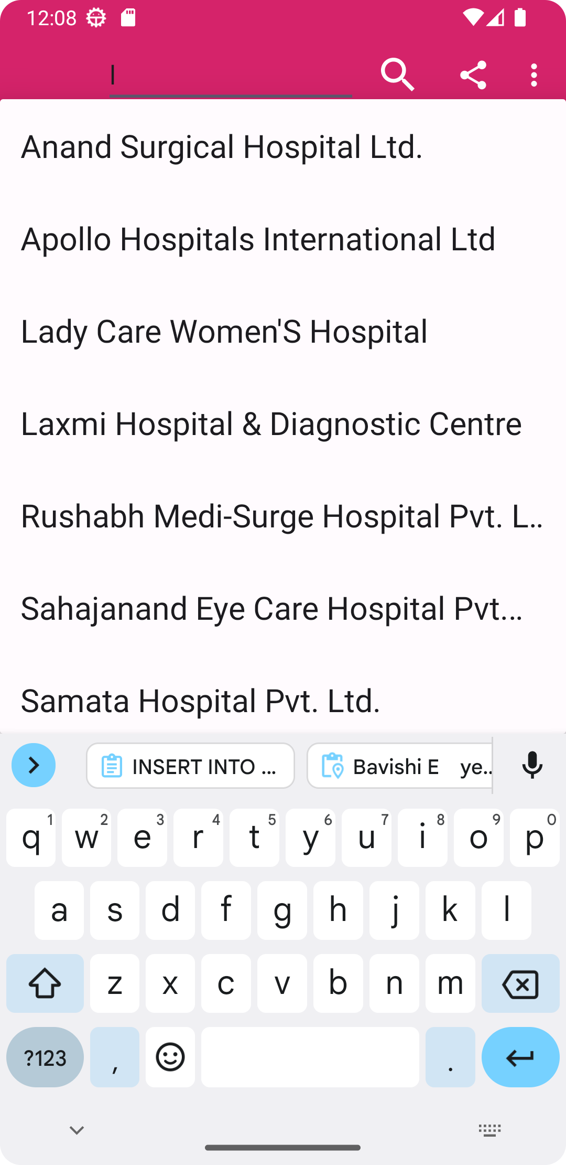
Front End
Available Blood Group
Search Bar

Slide 9
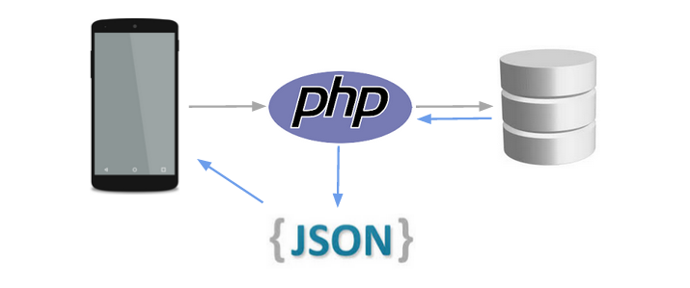
Working

Slide 10
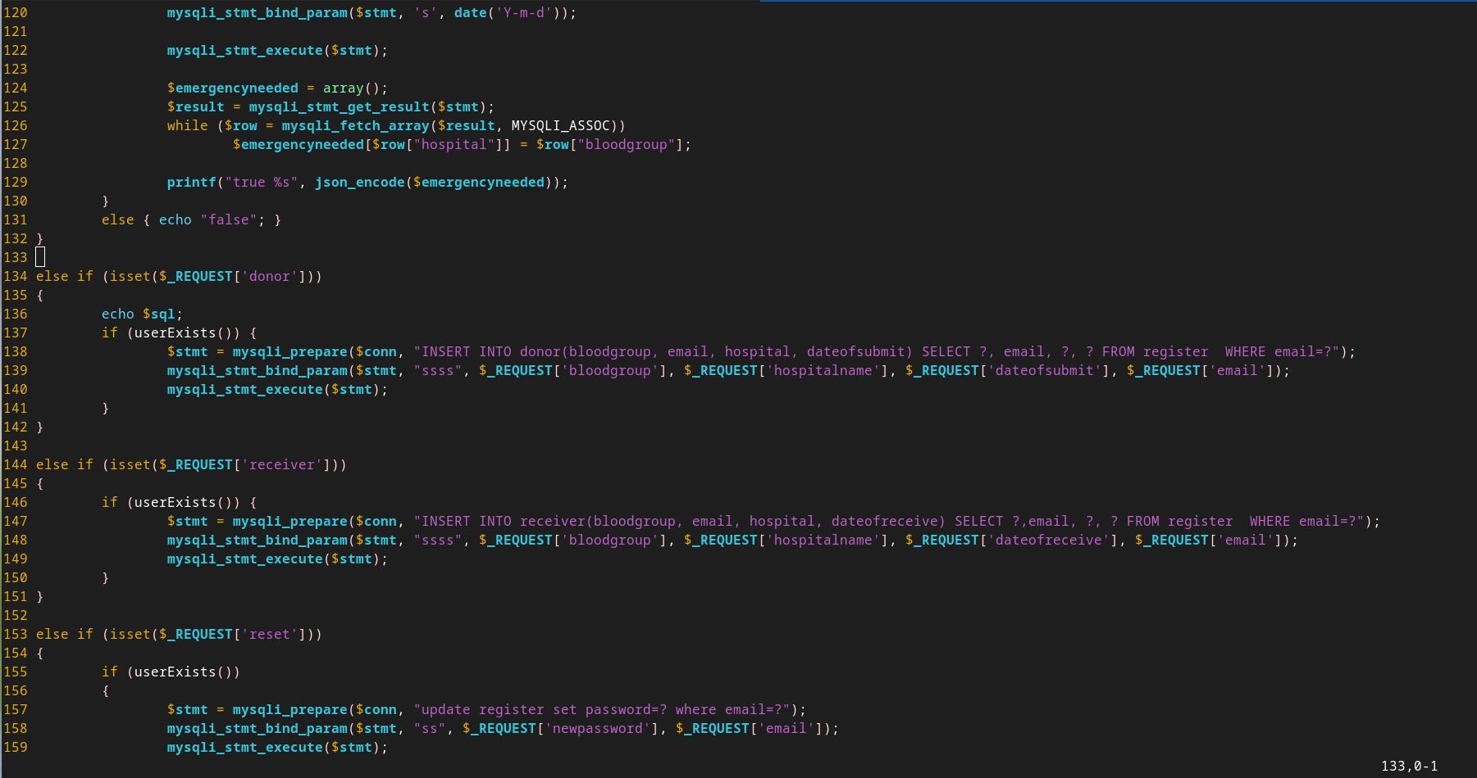
Injection Free Code

Slide 11
Working
User Input is collected by Java
Create new thread send query by PHP
PHP serialize output as JSON
Result is handled by Main Thread of Java
Which deserialized JSON result and Displays on Screen

