Slide 1


Slide 2
What is Hacking ?
Exploiting system vulnerabilities and compromomising security control to gain unauthorized or inappropriate access to the system resources.
Modifying system or application features to achive a goal outside of the creator’s original purpose.

Slide 3
Introduction to Ethical Hacking
An ethical hacker, also referred to as a white hat hacker, is an information security expert who systematically attempts to penetrate a computer system, network, application or other computing resource on behalf of its owners -- and with their permission -- to find security vulnerabilities that a malicious hacker could potentially exploit.

Slide 4
Reasons Why Organizations Recruit Ethical Hacker
Prevent hackers attacking organization’s information systems
Uncover vulnerabilities in system and explore potentional risks.
Analyze and strengthen security posture including policies, network protection infrastructure and user practice

Slide 5
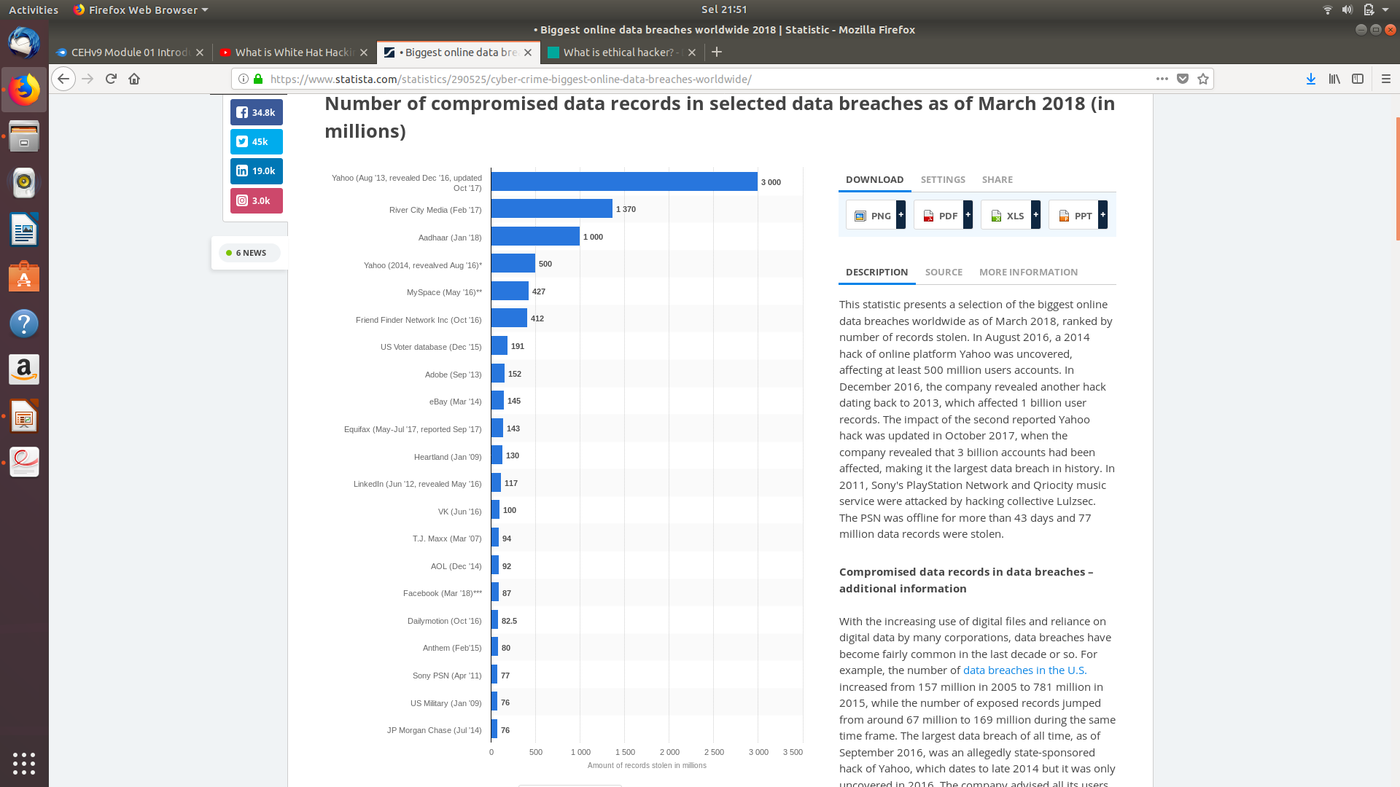
Cyber Crime Statistic

Slide 6
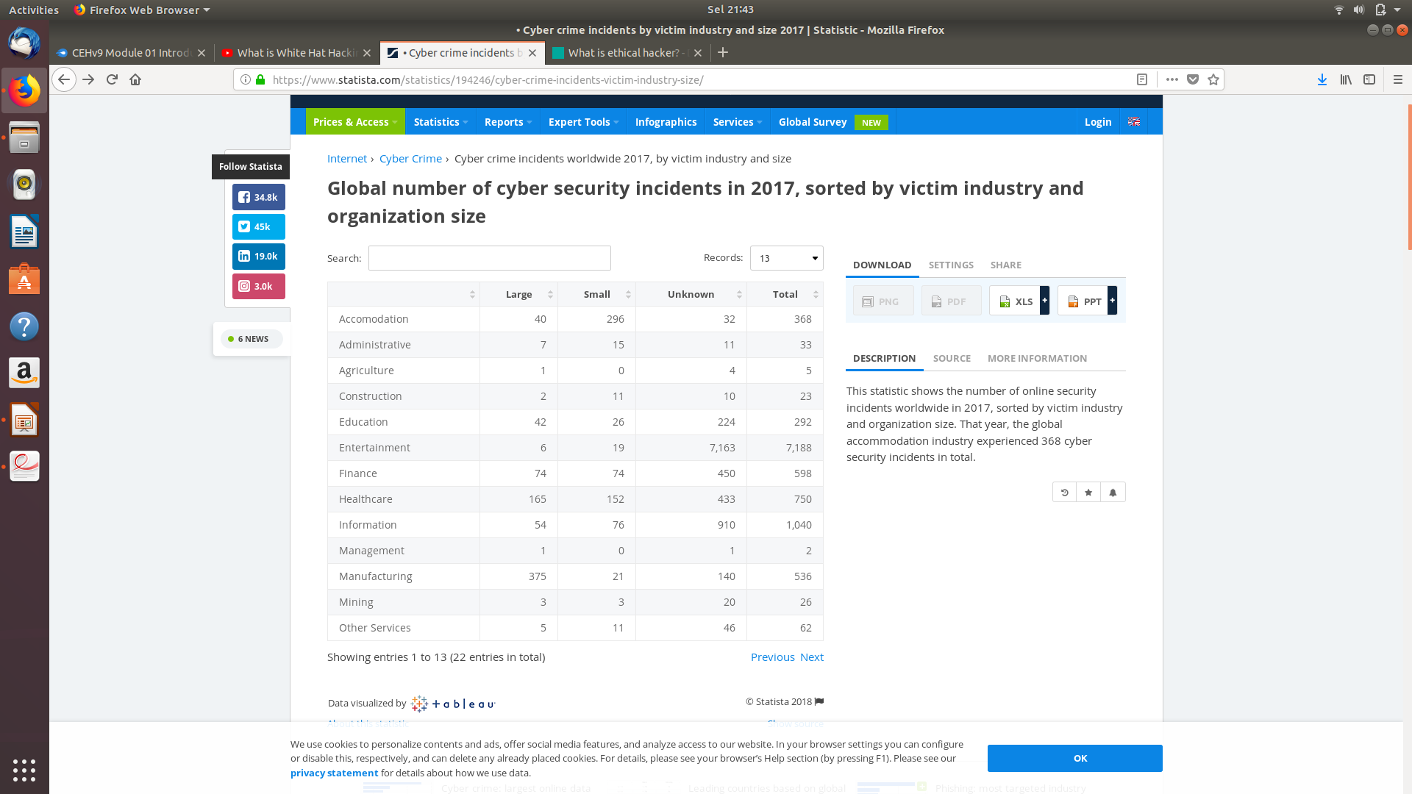
Cyber Crime Statistic

Slide 7

Types of Hackers

Slide 8
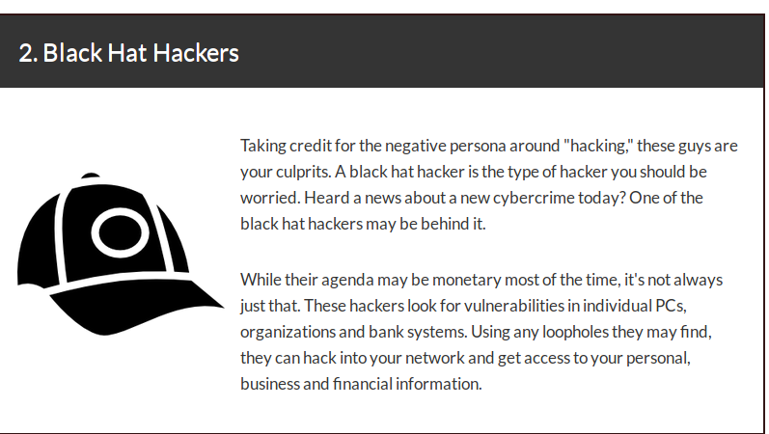
Types of Hackers

Slide 9
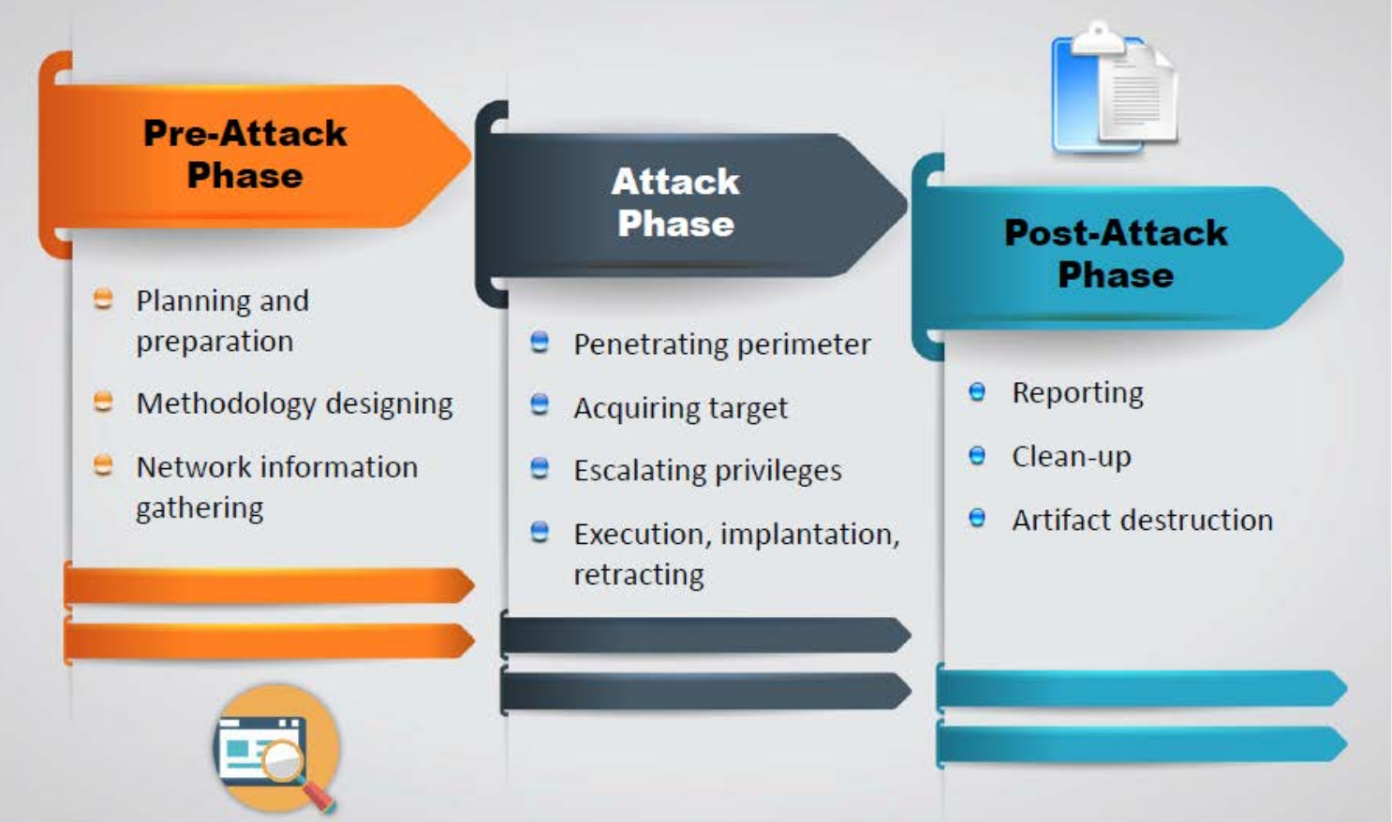
Phases of Penetration Testing

Slide 10
Blue Teaming/Red Timing
Blue Team
Set of security responders performs analysis of an information system to assess the adequency and efficiency of its scurity controls
Defending the system
Has access to all resources and information

Slide 11
Blue Teaming/Red Teaming
Red Team
A team of ethical hackers performs penetration test on an system with no or a limited access to the internal resources
Attacking the system
Conducted with or without warning

Slide 12

Ruby Alamsyah
Pakar Digital Forensik

Slide 13

Park Jin Hyok
Black hat Hacker,using Ransomware Wannacry

Slide 14
Practice
1. bug bountyhttps://www.ethic.ninja/tokopedia-bug-bounty-program
2. Capture The flag
https://ctftime.org/ctfs

