Slide 1


PYTHON and CHATGPT
IUT Longwy

Slide 2
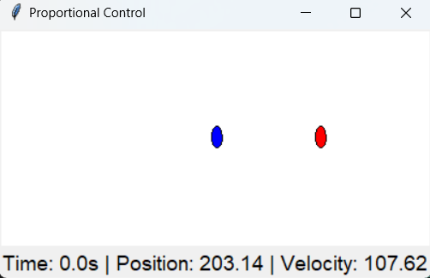
Exercice 1
Building a P-Controlled Position Simulation
RED : is a set point
BLUE : is a vehicle
GOAL : Vehicle try to reach the setpoint !

Slide 3
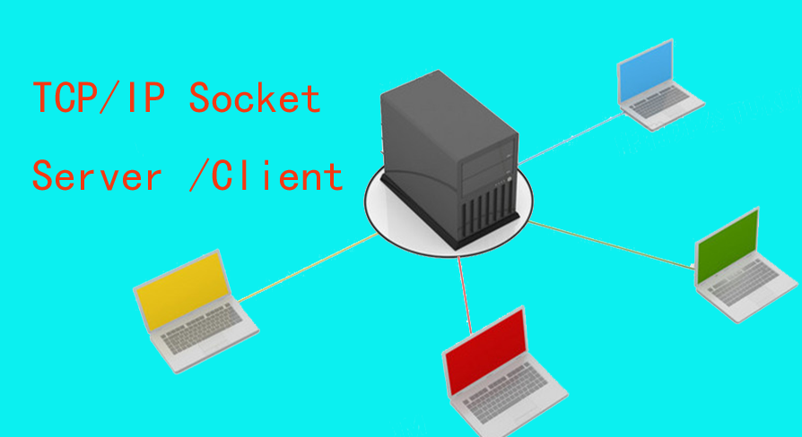
Exercice 2
Before diving into the code, give them a high-level understanding of the project:
What the Project Does
A client connects to a server.
The server:
Sends / Receives and displays chat messages.
The client:
Sends / Receives and displays chat messages.
What You Will Learn
Using socket for communication between a client and server.
Building a GUI with tkinter.
Multi-threading to handle multiple tasks (chat and video) simultaneously.

Slide 4
1. Start with the Basics
Before jumping into the project, ensure they understand the following concepts:
a. Python Fundamentals
Variables, functions, and basic data types.
Loops (for and while).
Basic I/O (reading input and printing output).
b. Modules and Imports
Explain what Python modules are and how to use import.
Show how libraries like socket, threading, and tkinter can extend Python's functionality.
c. Object-Oriented Concepts (optional)
If time allows, briefly touch on classes and methods, as this project is a good example of reusable code.

Slide 5
Step 1: Setting Up a Basic Tkinter GUI
👨‍💻 Student Task:
Create a simple Tkinter window.
Add a canvas where we will visualize movement.
Draw a static setpoint (red dot) and a vehicle (blue dot) at an initial position.
📝 Key Learning Outcome:
Basic GUI programming with Tkinter.
Understanding coordinate placement in a canvas.

Slide 6
Step 2: Simulating Motion Without P-controller
👨‍💻 Student Task:
Move the vehicle at a constant velocity towards the setpoint.
Use pos = pos + velocity * dt to update the position over time.
📝 Key Learning Outcome:
Understand time-stepped simulations.
Learn about numerical integration (updating position with velocity).

Slide 7
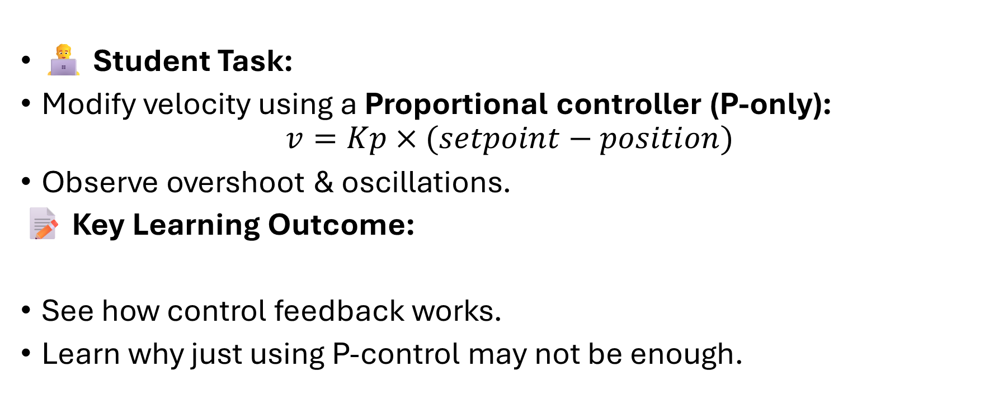
Step 3: Implementing a Simple Proportional (P) Controller
👨‍💻 Student Task:
Modify velocity using a Proportional controller (P-only):
$$v=Kp​×(setpoint−position)$$
Observe overshoot & oscillations.
📝 Key Learning Outcome:
See how control feedback works.
Learn why just using P-control may not be enough.

Slide 8
Overview project 2
Before diving into the code, give them a high-level understanding of the project:
What the Project Does
A client connects to a server.
The server:
Sends / Receives and displays chat messages.
The client:
Sends / Receives and displays chat messages.
What You Will Learn
Using socket for communication between a client and server.
Streaming video using OpenCV.
Building a GUI with tkinter.
Multi-threading to handle multiple tasks (chat and video) simultaneously.

Slide 9
2: Introduction to TCP and UDP Protocols
1. What is a Protocol?
A protocol is a set of rules that define how data is transmitted over a network. There are many protocols, but for communication between computers, the two most common transport protocols are TCP (Transmission Control Protocol) and UDP (User Datagram Protocol).
Feature | TCP | UDP
Connection | Connection-oriented * | Connectionless *
Reliability | Reliable, guarantees delivery | Unreliable, no delivery guarantee
Data Order | Guarantees correct order of data | No guarantee of order
Error Checking | Checks for errors, retransmits if needed | No automatic error correction
Speed | Slower due to overhead | Faster due to lower overhead
Use Cases | File transfers, web browsing, emails | Streaming, online gaming, VoIP
*. TCP (Transmission Control Protocol)
Connection-Oriented: TCP requires a connection to be established between the client and the server before data is sent. This connection is maintained for the entire duration of the communication.
*. UDP (User Datagram Protocol)
Connectionless: Unlike TCP, UDP does not establish a connection before sending data. It just sends the data and doesn’t wait for confirmation from the receiver.

Slide 10
Step-by-Step Coding
Example: Which Protocol is Used in This Code?
Let's analyze the code example you have and determine which protocol is being used:
Server-Client Communication in the Example
The code uses the socket library and calls socket.AF_INET and socket.SOCK_STREAM to create the sockets.
Python
# Server code example server_socket = socket.socket(socket.AF_INET, socket.SOCK_STREAM)
socket.AF_INET: This specifies the use of IPv4 (Internet Protocol version 4) for addressing.
socket.SOCK_STREAM: This specifies that the socket will use TCP as the transport protocol.
Since the socket is created with SOCK_STREAM, it indicates that the code is using TCP.
Conclusion:
TCP is being used in this project for the communication between the client and the server (for both video and chat).

Slide 11
Step 1: Set Up a Basic Server-Client Connection
Introduce the socket library.
Write a simple server that listens on a port.
Write a client that connects to the server and sends/receives a message.

Slide 12
Step 2: Add the GUI
Introduce tkinter and how to build a simple GUI.
Create a window, add buttons, labels, and a text box.
Show how to display the chat log in tkinter.

Slide 13
Final Project
Put the simulation in the server
Client make have button start , to run the simulation in server
Show the information of vehicle in chat log in tkinter.

Slide 14
Final Project
How It Works
Server:
Waits for a client to connect.
Receives a "start" command from the client.
Runs the simulation and sends updates (time, position, velocity) to the client.
Sends "Simulation ended" when the simulation is complete.
Client:
Connects to the server.
Sends a "start" command to the server.
Receives simulation updates from the server and displays them in the GUI.
Closes the connection when the simulation ends.

Slide 15
Here are some ideas that would be great for you to explore
1. Add Multiple Clients to the Server (Multi-Client Support)
2. Implement User Authentication
3. Add Emoji Support to Chat
4. Implement Real-time Voice Chat (VoIP)
5. Send Video (put some effect Filters)
6 . GAME (X/O)

Slide 16
END

Slide 18
Step 4: Add the GUI
Introduce tkinter and how to build a simple GUI.
Teach them to create a window, add buttons, labels, and a text box.
Show how to display the chat log in tkinter.

Slide 19
Step 2: Introduce Threads
Why Threads Are Needed ?
Without threads, the server would have to choose between two tasks and process them one by one. By using threads, we make sure the server can:
Handle incoming video frames and send them in real time.
Process chat messages without waiting for the video stream to complete.
Key Takeaways for Students:
Concurrency: Threads help a program do multiple things at the same time, which is important for real-time applications.
Threads vs. Processes: Threads share the same memory space, making them faster and lighter for tasks that share data (like our chat and video application), while processes are more isolated.
Practical Use of Threads: In this case, threads allow the server to simultaneously handle video streaming and chat messages, both of which are important for an interactive system.

Slide 20
Step 3: Add Video Streaming
Introduce OpenCV and how to capture webcam video.
Show how to serialize (pickle) and send frames over a socket.

Slide 21
Step 5: Combine Everything
Integrate chat, video, and GUI into one program.
Demonstrate how to use threads to handle video, chat, and the GUI simultaneously.

Slide 22
Overview project
Before diving into the code, give them a high-level understanding of the project:
What the Project Does
A client connects to a server.
The server:
Sends a video stream captured from the webcam.
Sends / Receives and displays chat messages.
The client:
Receives and displays the video stream.
Sends / Receives and displays chat messages.
What You Will Learn
Using socket for communication between a client and server.
Streaming video using OpenCV.
Building a GUI with tkinter.
Multi-threading to handle multiple tasks (chat and video) simultaneously.

