Slide 1
IFAC 2025
Learning with
Unknown Input Observers
for Robust Nonlinear Estimation
Physics-bound estimation
+ online residual learning
A teacher–student observer architecture for vehicle systems with unmodeled dynamics.
Q.H. Nguyen · L. Qi · A. Zemouche · H. Rafaralahy · M. Haddad
Université de Lorraine · CRAN · SEGULA Engineering
15-minute presentation
Notes:
Timing: 0:35 Presenter cue: Frame the talk around one question: how can online learning help estimate unknown vehicle dynamics without giving up observer guarantees? [Sources] - User-provided manuscript: ifac/UIO_IFAC.tex

Slide 2
LEARNING WITH UNKNOWN INPUT OBSERVERS
MOTIVATION
Unknown dynamics challenge model-based estimation
Vehicle dynamics are known only approximately—and the uncertainty affects estimation and control.
NONLINEAR PLANT
Why not simply learn μₓ?
ẋ = φ(x, u) + B μₓ
y = Cx
Pure online learning can be unpredictable under distribution shifts.
Safety-critical estimation needs a bounded-error reference.
μₓ captures unmodeled dynamics
and external disturbances
Classical UIOs often fail for the available sensor set.
Examples in a vehicle: tire-road effects, aerodynamic mismatch, parameter variations.
Goal: learn the repeatable part of μₓ while retaining an observer-based guarantee.
02
Notes:
Timing: 1:05 Presenter cue: Introduce μₓ as the mismatch between the nominal vehicle model and the road. The point is not that neural networks are bad; it is that their online behaviour needs a physics-based reference. [Sources] - User-provided manuscript: ifac/UIO_IFAC.tex

Slide 3
LEARNING WITH UNKNOWN INPUT OBSERVERS
MOTIVATION
Classical UIOs can exclude practical sensor suites
Exact unknown-input decoupling requires a rank condition that may not hold with the sensors already on the vehicle.
rank(CB) = rank(B)
Necessary condition for direct unknown-input estimation
IF THE CONDITION HOLDS
IF IT FAILS
A classical UIO can decouple the unknown input.
Sensor limitations can prevent exact decoupling.
In the ideal case, estimation errors converge exponentially.
Common workarounds amplify noise, add sensors, or restrict disturbance dynamics.
This motivates a bounded first estimate rather than demanding exactness immediately.
03
Notes:
Timing: 1:00 Presenter cue: Explain why the rank condition is the core practical obstacle. The method starts by accepting that exact decoupling is not always possible, then controls the resulting estimation error. [Sources] - User-provided manuscript: ifac/UIO_IFAC.tex

Slide 4
LEARNING WITH UNKNOWN INPUT OBSERVERS
LAYER 1 · REGULARIZED UIO
Regularization yields a controlled H¹ error bound
A rank-restoring rewrite is algebraically equivalent to the original system; the induced terms are treated as bounded disturbances.
ORIGINAL SYSTEM
REGULARIZE
OBSERVER DESIGN
ẋ = φ(x,u) + Bμₓ
y = Cx
Eδ₁ μ̇ₓ and Dδ₂ μₓ
are added and subtracted
The remaining terms become ωδ.
LMI design minimizes their effect
on the augmented error.
‖ẑ − z‖H¹ ≤ λδ ‖μₓ‖H¹ + β‖ξ₀‖ · λδ is explicitly driven by δ₁ and δ₂
04
Notes:
Timing: 1:15 Presenter cue: Walk through the principle, not the full derivation. E and D are selected to recover the descriptor rank condition, while δ₁ and δ₂ set the size of the perturbation entering the H¹ bound. [Sources] - User-provided manuscript: ifac/UIO_IFAC.tex

Slide 5
LEARNING WITH UNKNOWN INPUT OBSERVERS
LAYER 1 · GENERALIZED UIO
Output derivatives recover the strong case
The generalized observer augments the model with the measured output and a filtered derivative state.
Measured output
y = Cx
Augmented states
χ₁ = y, χ₂ = ẏ
Generalized
regularized model
Generalized UIO
ẑ = [χ̂₁, χ̂₂, x̂, μ̂ₓ]ᵀ
When rank(CB) = rank(B), choose δ₁ = δ₂ = 0: the generalized UIO recovers exponential convergence. Otherwise, it retains the adjustable H¹ bound.
χ̂₂ acts as a filtered estimate of ẏ, avoiding a posteriori numerical differentiation of noisy measurements.
05
Notes:
Timing: 1:20 Presenter cue: This is the key extension. Do not claim that the method differentiates noisy data afterwards: the augmented observer estimates the derivative state internally. Emphasize the recovery of exponential convergence in the rank-satisfied case. [Sources] - User-provided manuscript: ifac/UIO_IFAC.tex

Slide 6
LEARNING WITH UNKNOWN INPUT OBSERVERS
LAYER 1 · GUARANTEE
LMIs certify a bounded physics-based teacher signal
The Layer 1 observer is designed over a polytopic representation of the nonlinear Jacobian.
DESIGN INGREDIENTS
Certified conclusion
Lipschitz nonlinearity → polytope vertices Aⱼ.
‖ζ − ζ̂‖H¹ ≤ λδ ‖μₓ‖H¹ + β‖ξ₀‖
Decision variables: P ≻ 0 and Q.
The bound is robust to the regularization disturbance and initial error.
Gain: K = P⁻¹Qᵀ.
Layer 1 is not the final learned model—it is the safe supervisory reference for Layer 2.
06
Notes:
Timing: 1:00 Presenter cue: Keep this at the level of the result. The LMI converts the nonlinear error analysis into a tractable design condition and certifies the UIO estimates used as targets later. [Sources] - User-provided manuscript: ifac/UIO_IFAC.tex

Slide 7
LEARNING WITH UNKNOWN INPUT OBSERVERS
LAYER 2 · LEARNING ARCHITECTURE
Layer 2 learns a predictive residual model
The neural adaptive observer uses the UIO output as a physics-consistent proxy target during online adaptation.
y, u
Generalized UIO
Layer 1
x̂UIO, μ̂ₓ
μθ(·)
Neural model
μθ
Neural adaptive observer
Layer 2
Vehicle
plant
Composite loss regularizes Layer 2
with the Layer 1 reference.
Outcome: Layer 1 gives bounded residuals; Layer 2 learns the repeatable state-dependent component.
07
Notes:
Timing: 1:20 Presenter cue: This is the central system diagram. Explain that the UIO is the teacher signal, not a frozen baseline: it remains in the loop to regularize online learning. The controller ultimately uses the Layer 2 state estimate. [Sources] - User-provided manuscript: ifac/UIO_IFAC.tex

Slide 8
LEARNING WITH UNKNOWN INPUT OBSERVERS
LAYER 2 · OBJECTIVE
The loss keeps learning tethered to physics
The loss combines task performance with measurement consistency and UIO supervision.
L = tracking error + output error + UIO consistency + residual regularization
Track
Measure
Match
Learn
x̂NN stays near xref
yNN stays near y
x̂NN stays near x̂UIO
μθ stays near μ̂ₓ
For a given approximation mismatch Δx, an LMI certifies: ‖εNN‖L² ≤ λNN‖Δx‖L² + βNN‖εNN(0)‖.
08
Notes:
Timing: 1:10 Presenter cue: Connect each loss term to a role. The UIO estimate acts as a proxy label because ground-truth μₓ is unavailable online. The L2 result isolates how estimation quality depends on the residual approximation error. [Sources] - User-provided manuscript: ifac/UIO_IFAC.tex

Slide 9
LEARNING WITH UNKNOWN INPUT OBSERVERS
VEHICLE STUDY
Vehicle study: state and tire-force reconstruction
A reduced vehicle model is simulated with tire-force residuals and parametric mismatch.
SYSTEM VARIABLES
State
x = [vx, vy, ψ, r]ᵀ
Vehicle
model
Two-layer
estimator
y
Input
u = [a, δ]ᵀ
Measured
y = [vx, ψ, r]ᵀ
Unknown
μₓ = [fyf, fyr]ᵀ
Reconstruct: unmeasured lateral velocity vy and tire-force residuals fyf, fyr.
09
Notes:
Timing: 0:55 Presenter cue: State only what is measured versus reconstructed. The same controller and reference are used for both observer layers; Layer 2 supplies feedback for trajectory tracking. [Sources] - User-provided manuscript: ifac/UIO_IFAC.tex

Slide 10
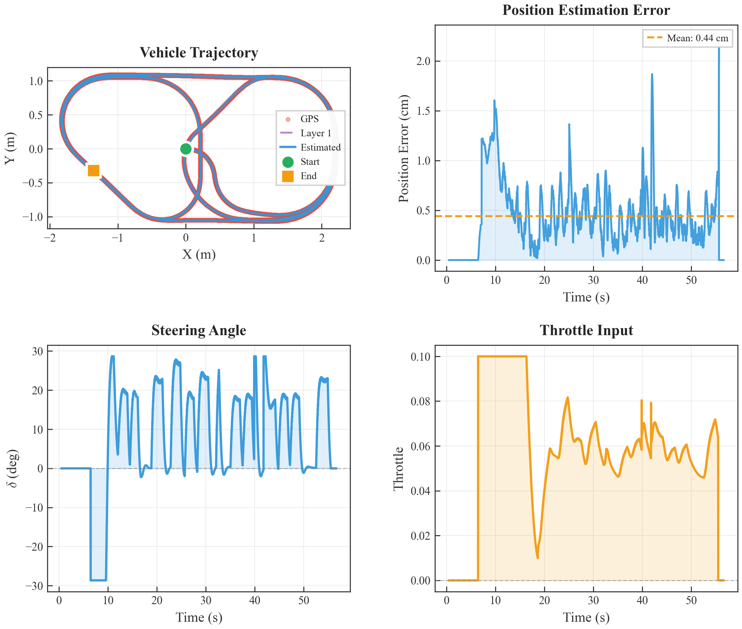
LEARNING WITH UNKNOWN INPUT OBSERVERS
VEHICLE STUDY · RESULTS
Layer 2 supports close tracking and smooth control
The Layer 2 estimates provide useful feedback for the trajectory-tracking controller in the simulated maneuver.
0.44 cm
mean position error
Estimated trajectory follows GPS closely.
Steering and throttle profiles remain smooth and physically consistent.
The position-error metric is reported directly in the simulation figure.
10
Notes:
Timing: 1:05 Presenter cue: Begin with the top-left trajectory and compare the estimates visually. Then use the mean position error from the figure to anchor the claim. The bottom panels show that the corresponding input profiles stay well behaved. [Sources] - User-provided manuscript: ifac/UIO_IFAC.tex - User-provided simulation figure: img/traj_control_py.png

Slide 11
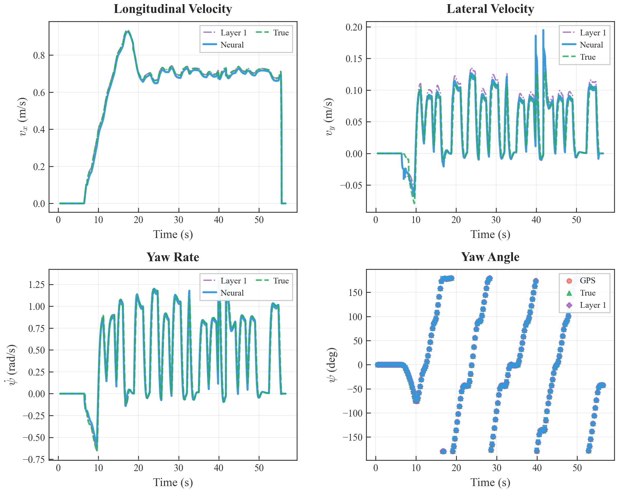
LEARNING WITH UNKNOWN INPUT OBSERVERS
VEHICLE STUDY · RESULTS
The neural layer preserves state-estimation fidelity
Measured states are recovered closely, while the unmeasured lateral velocity is reconstructed through vehicle-dynamics coupling.
Measured: vx, ψ, r
Reconstructed: vy
Layer 1 and neural estimates remain close to the true trajectories; the difficult unmeasured channel is recovered via the model coupling.
11
Notes:
Timing: 1:00 Presenter cue: Use the lateral-velocity panel to make the key point: vy is not directly measured. The Layer 2 neural estimate stays close to the true trajectory while retaining the UIO reference structure. [Sources] - User-provided manuscript: ifac/UIO_IFAC.tex - User-provided simulation figure: img/State_est_py.png

Slide 12
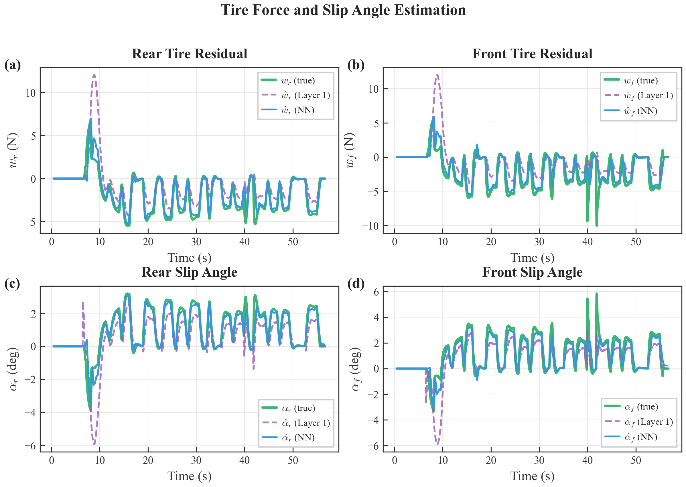
LEARNING WITH UNKNOWN INPUT OBSERVERS
VEHICLE STUDY · RESULTS
Learning improves tire-force residual reconstruction
Both layers are bounded; Layer 2 converges faster and tracks the simulated residuals more closely.
Layer 1 · UIO
bounded physics reference
Layer 2 · Neural
faster convergence and closer tracking
The learned map refines an instantaneous residual estimate into a predictive state-dependent correction.
12
Notes:
Timing: 1:20 Presenter cue: This is the payoff slide. Compare purple Layer 1 versus blue neural estimates against the green truth for the front and rear residuals. State the conclusion cautiously: it is demonstrated in this simulation. [Sources] - User-provided manuscript: ifac/UIO_IFAC.tex - User-provided simulation figure: img/tireforce_slip_py.png

Slide 13
LEARNING WITH UNKNOWN INPUT OBSERVERS
CONCLUSION
Safe learning for unknown vehicle dynamics
1
Rank-relaxed UIO
2
UIO-supervised learning
3
Vehicle evidence
A generalized, regularized observer produces bounded estimates even when exact unknown-input decoupling is unavailable.
The neural observer learns the repeatable part of the unknown input while remaining consistent with the physics-based reference.
Simulation shows accurate trajectory tracking, state reconstruction, and improved tire-force residual estimation.
Next: validation with real driving data and a discrete-time embedded implementation.
Thank you
13
Notes:
Timing: 0:45 Presenter cue: Return to the opening question. The contribution is a learning system that does not discard physics: the UIO provides a certified teacher signal, and Layer 2 turns it into a predictive residual model. Invite questions. [Sources] - User-provided manuscript: ifac/UIO_IFAC.tex

