Slide 1
Ramat
MATLAB Tool for Raman Data Analysis

Slide 2
Why a MATLAB tool?
current process
data acquisition in ControlFIVE
ProjectFIVE:
no support for hierarchical data organisation
data pre-processing
component separation
export to ASCII formats
filtering in MATLAB in batch mode
export to Microsoft Excel
multivariate statistics in Origin
export to ASCII
plotting in GraphPad Prism

Slide 3
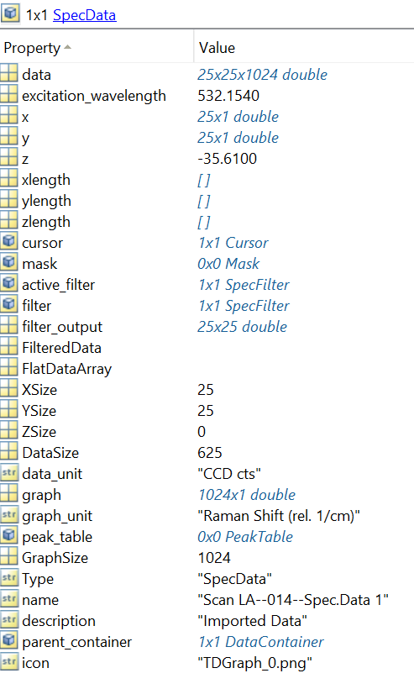
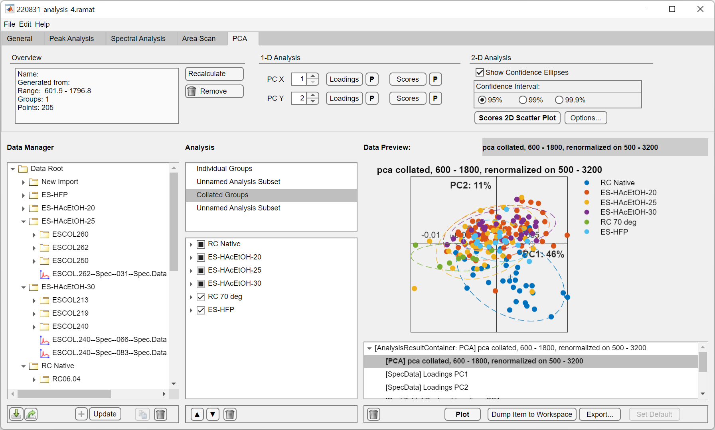
Why RaMAT?
data selection, filtering and export within one graphical user interface
standardised Raman data format

Slide 4
Why RaMAT?
regular import through and analysis with MATLAB scripts
structs, cells, etc…
complicated for-loops
custom functions and scripts for every task
RaMAT:
object-oriented
generalised functions applicable to many datasets

Slide 5
RaMAT is fully object-oriented
fully object-oriented, see object-oriented programming (OOP)
consists of classes
classes
describes what an object type can do
can be instantiated
can be part of superclasses
has properties
has methods
object (also called an “instance”)
one instance of a class

Slide 6
Object-Oriented Programming
e.g. the class <car>
has properties:
color string = “red”
wheels uint8 = 4
velocity double = 0.0
tank_fill_level double = 34.5
tank_max_capacity double = 40.0
engine_running boolean = false
has methods:
start_engine() → will turn “engine_running” into true
accelerate( input_argument )
def accelerate(self, amount): self.velocity += amount
will increase “velocity” by amount

Slide 7
RaMAT basic structure
Group
name = “measurement day 1”
object-oriented structure
makes it easy to have hierarchical data organization:
to data analysis
and keep track of data analysis
DataContainer
name = “measurement 1”
DataContainer
DataContainer
SpecData
data = …
graph = …
excitation_wav = …
SpecData
SpecData
PeakTable
gen_peak_table()
append_data_item()
PeakTable

Slide 8
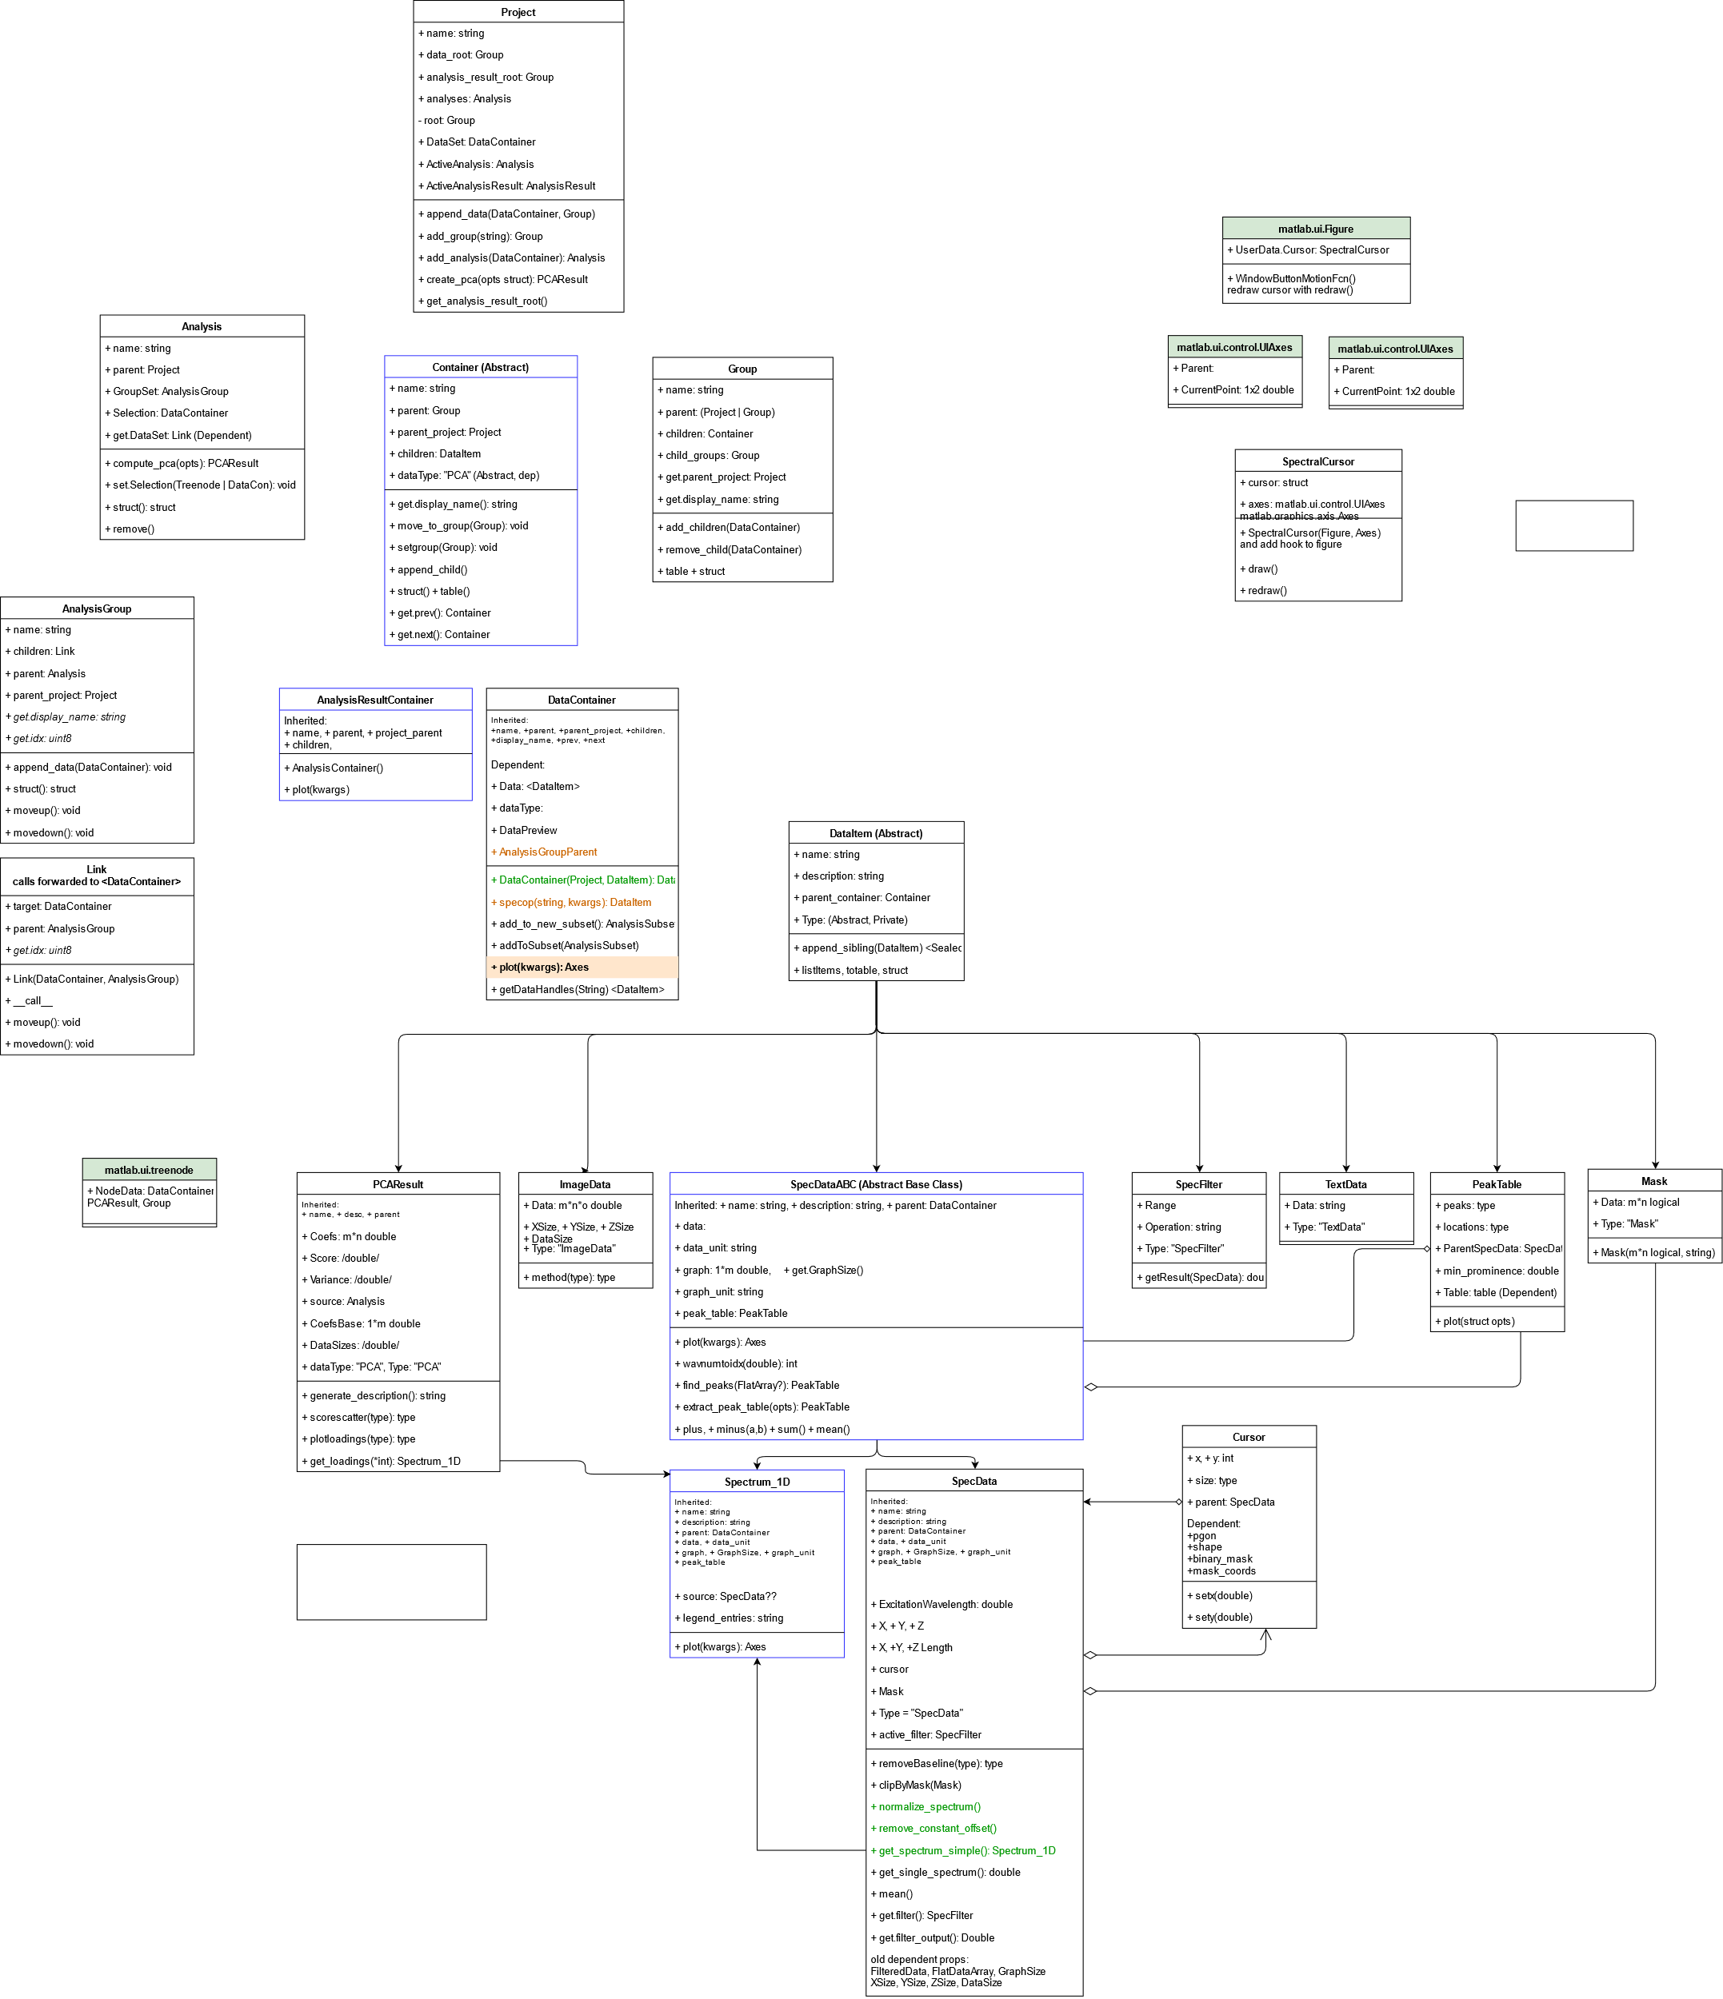
RaMAT Structure
class diagram of RaMAT
data is stored in DataItem
SpecData, large-area scans, single spectra
SpecSimple, loadings
ImageData
TextData
Mask
SpecFilter
PeakTable
PCAResult, PCA analysis results
TSNEResult, t-SNE analysis results
every DataItem is contained in a DataContainer
every DataContainer is then part of a Group

Slide 9
Example class: <SpecData>
has properties:
name: string
parent: DataContainer
data: m*n*o double
graph: o*1 double
graph_unit: string
etc…
has methods:
plot() → will output a plot
gen_peak_table()
searches for peaks and output a <PeakTable>
export(format=“xlsx”, select_random=“true”)
exports randomly selected spectra to a Microscoft Excel spreadsheet
mean()
get_spectrum_simple() → will output a <SpectrumSimple>
etc…

Slide 10
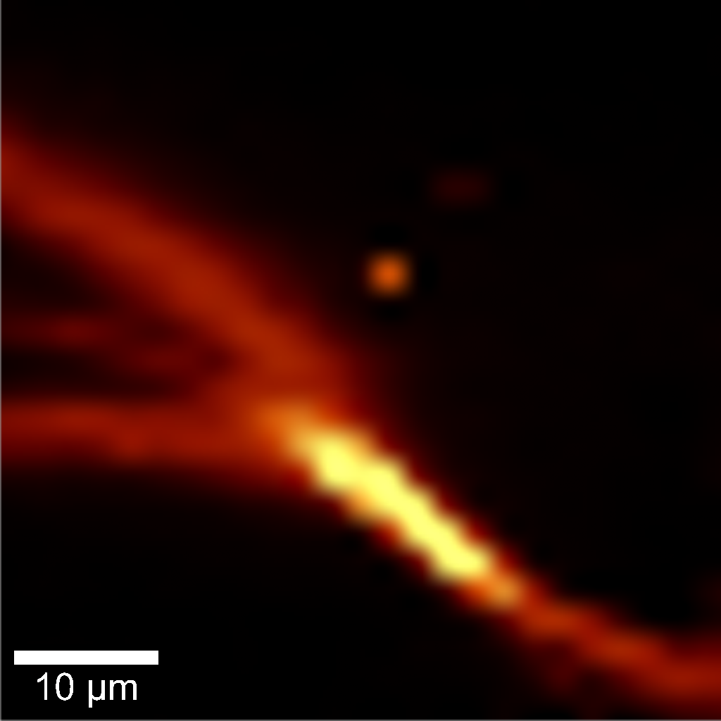
Basic data structure
i = x direction
j = y direction
k = wavenumber
filtering is in k-direction:
k
i
j
SpecFilter.calc(data, operation=“sum”, range=[500,600])
or, when filter has already been assigned:
data.get_filter_output()

Slide 11
Convert to readable data
get_flat_data()

Slide 12
<SpecData>
<ImageData>
<TextData>
<Mask>
<Filter>
<PeakTable>
<PCAResult>
<TSNEResult>

