Slide 1
MACHINE LEARNING FOR MATERIAL DESIGN OF CONCRETE
Presented by:
Krishna Mundra
19CE02004
Under the supervision of:
Dr. Mohammad Masiur Rahaman
Notes:
Good Morning one and all present over here. My name is Krishna Mundra. The topic for my btech project is machine learning for material design OF CONCRETE.

Slide 2
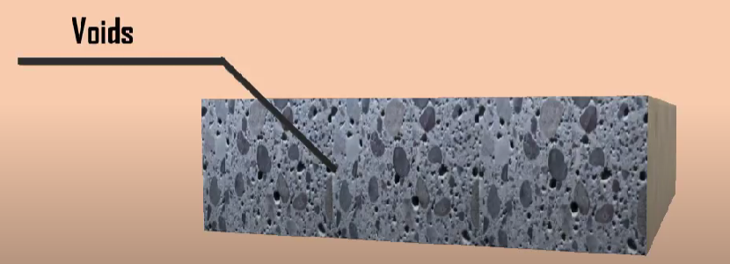
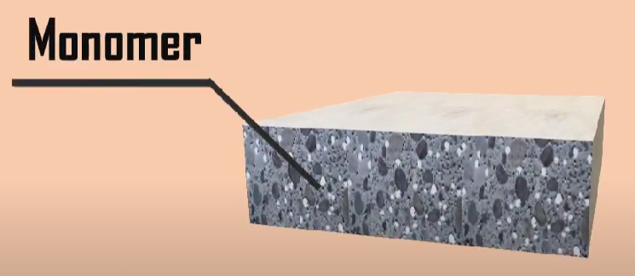
INTRODUCTION
Heterogeneous Material
Polymer Impregnated Concrete
Homogenization
Traditional Technique
Machine Learning Technique
3-D Convolutional Neural Network (3D-CNN)
Notes:
The significance of heterogeneous materials in civil engineering cannot be overstated. The use of different materials with varying properties throughout the structure of a building or infrastructure project can lead to improved strength, durability, and overall performance. Heterogeneous materials can also offer greater design flexibility and aesthetic appeal, as well as contribute to more sustainable construction practices
One such heterogeneous material is Polymer impregnated concrete (PIC). It’s a type of concrete that has gained popularity in recent years due to its exceptional durability, strength, and resistance to harsh environmental conditions. The manufacturing process of PIC involves injecting a polymer resin into the concrete under high pressure, filling the pores and capillaries of the concrete and making it more durable and resistant to cracking.
the study and implementation of homogenization in PIC are of great significance to the field of civil engineering, offering engineers a powerful tool to design and construct safer, more efficient, and more sustainable infrastructure.
Since the homogenization theory was first created to analyse partial differential equations (PDEs) with fast fluctuating coefficients, it has increasingly been employed to describe the mechanics of periodic microstructures in composite materials. Different homogenization techniques have been developed to provide useful properties that may be used to macroscopic structural analysis. Analytical techniques, semi-analytical methods, and numerical methods may be used to classify these approaches.
The popularity of data science has increased recently, which has led to the application of a number of machine learning (ML) approaches in the planning, evaluation, and modelling of materials.
3D convolutional neural network is one such method which can be used for the purpose of material design.

Slide 3
LITERATURE REVIEW
How to determine composite material properties using numerical homogenization.
(Erik Andreassen and Casper Schousboe Andreasen)
Numerical homogenization way to determine effective macroscopic properties.
Matlab implementation of the method.
Elasticity tensor of two material composite.
Extension: Conductivity, thermal expansion and fluid permeability.
Notes:
Numerical homogenization is an efficient way to determine effective macroscopic properties, such as the elasticity tensor, of a periodic composite material.
In this paper an educational description of the method is provided based on a short, self-contained Matlab implementation.
It is shown how the basic code, which computes the effective elasticity tensor of a two material composite, where one material could be void, is easily extended to include more materials.
Furthermore, extensions to homogenization of conductivity, thermal expansion, and fluid permeability are described in detail.

Slide 4
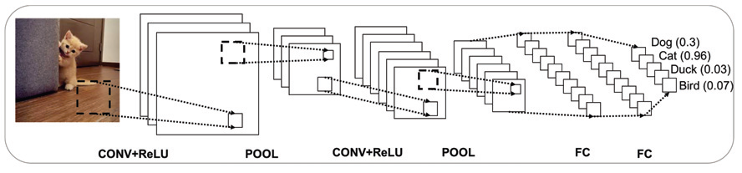
LITERATURE REVIEW
Three-dimensional Convolutional Neural Network (3D-CNN) for Heterogeneous Material Homogenization.
(Rao. Chengping, Yang. Liu. )
The proposed 3D-CNN is characterized with the following benefits:
Predicting the effective material properties from 3D phase voxels.
It is able to reproduce the effective properties with a high accuracy and computational efficiency.
Transferability of trained model.
Notes:
The proposed 3D-CNN is characterized with the following benefits:
It provides an end-to-end solution for predicting the effective material properties from 3D phase voxels
It is able to reproduce the effective properties with a high accuracy and computational efficiency, which would empower a faster product design iteration or design optimization for composite materials;
The knowledge learned by the 3D-CNN model can be transferred to a different type of composite at a relatively low training expense, in which a good prediction performance can still be achieved even on a new dataset of small size with the help of transfer learning. This particular characteristic becomes significant when RVEs data are costly to obtain.

Slide 5
RESEARCH GAP
Significance of homogenization of Polymer Impregnated Concrete.
Use of Deep Learning for predicting elasticity tensor of Polymer Impregnated Concrete.
Notes:
Homogenization of material properties in polymer impregnated concrete (PIC) is of significant importance in the field of civil engineering.
This is because polymer impregnated concrete (PIC) is a composite material that is made up of multiple components with varying mechanical properties at the microscopic level.
Homogenization allows for the calculation of effective properties of the composite material at a macroscopic level, which can be used to design and analyze PIC structures.
This process helps to simplify the analysis of PIC, which can be challenging due to the heterogeneity of the material and allows engineers to accurately predict its mechanical behavior.
This in turn leads to more efficient and accurate design of PIC structures, resulting in safer, more durable, and more sustainable infrastructure.
Homogenization also enables the optimization of the properties of PIC, leading to the development of more advanced and effective materials.
As such, the study and implementation of homogenization in PIC are of great significance to the field of civil engineering, offering engineers a powerful tool to design and construct safer, more efficient, and more sustainable infrastructure.
Use of Deep learning techniques instead of traditional techniques of homogenization makes the process of predicting elasticity tensor of polymer impregnated concrete faster and easier.

Slide 6
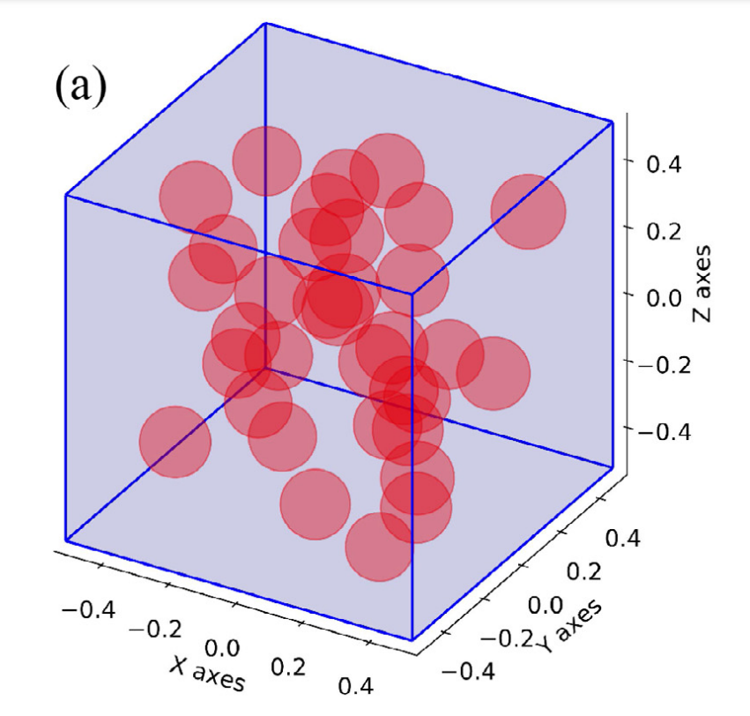
OBJECTIVE & SCOPE
Use Deep Learning to address multiscale issues in Polymer Impregnated Concrete.
Generation of training datasets using 200 Representative Volume Elements (RVEs).
Raw Data transformed into input format of 3D-Convolutional Neural Network.
Comparison between Finite Element Analysis and prediction made by 3D-Convolutional Neural Network.
Prediction of effective properties for Representative Volume Element.
Geometry of Representative Volume Element
Notes:
The goal of my project was to use Deep Learning to address multiscale issues in Polymer Impregnated Concrete (PIC), specifically in the context of homogenization.
The methodology to be employed involves generating training datasets using 200 Representative Volume Elements (RVEs).
During pre-processing, the raw data was transformed into the input format of the 3D-CNN model, a computational homogenization approach was used to obtain the labels, and the labels were rescaled.
To determine the most effective network configuration, a set of parametric experiments were conducted on the hyperparameters of the 3D-CNN.
Subsequently, a comparison is drawn between the results of the Finite Element Analysis (FEA) and the predictions made by the 3D-CNN, with a focus on accuracy and efficiency.

Slide 7
METHODOLOGY
Generation of Dataset and Preprocessing
Theory of homogenization
MATLAB implementation
Input:
Dimension of square: 1mm
Output:
5-D array
Effective Properties: E, G, v.
Volume Fraction:0.02~0.28.
Material | Young’s Modulus | Poisson’s Ratio
Concrete | 50 | 0.25
Polymer | 120 | 0.2
Notes:
The theory of homogenization suggests that one can calculate the macroscopic elasticity tensor of a periodic composite material.
This theory was used to generate the dataset required to train the model.
This theory was implemented on MATLAB which included steps like
The element stiffness matrix and load vectors initialization
Defining Degrees of freedom and periodic boundary conditions
Assembly of the stiffness matrix
Load vectors and solution
Homogenization
Inputs required for this were dimensions of the representative volume element and material properties of both material. Mentioned in presentation
Output given out by this code were: a label consisting of a 5dimensional array consisting the data about presence of material at a particular location and effective properties for each of the element of label
The volume fraction was kept between 0.2 to 0.28.
locally varying stiffness tensor is represented by Epqrs
prescribed macroscopic strain fields are denoted by ε 0(i j) pq
locally varying strain fields ε (i j) pq are defined accordingly.
to displacement fields χ

Slide 8
METHODOLOGY
3D Convolutional Neural Network Model
Phase voxels were preprocesed.
Identification of convolutional layers, 3D convolution filters and pooling process.
Training of filter’s weights and biases.
Defined by a number of parameters: stride, padding, and filter size.
Choosing activation function (ReLU, Sigmoid, tanh).
Choosing loss function between 3D-CNN’s Prediction and training dataset’s ground truth.
Choice of optimizer: Adam, Nadam, Adagrad, etc.
Notes:
As its source of data, the 3D-CNN uses the phase voxels that have been preprocessed.
The subsequent many convolutional layers, together with the 3D convolution filters and the pooling process, make up the crucial component of the CNN.
Each filter’s weights and biases are trained to extract the most important characteristics from the input data.
This process is called ”training”.
Convolutional operations may often be defined by a number of hyperparameters, including stride, padding, and filter size.
The activation layers are used to provide the CNN some nonlinearity, which is achieved by their application. There are several activation functions like ReLU, Sigmoid, tanh
A loss function is chosen between 3D-CNN’s Prediction and training dataset’s ground truth.
An optimizer is chosen from the likes of Adam, Nadam, Adagrad
The term ”stride” refers to the amount of each successive step that filters make.
It is advantageous to pad the input with voxels that have a value of zero since this helps to maintain the spatial size of the output.
If the convolution operations are carried out with a stride of 1 and 2-layer zero padding.
When building a CNN, pooling layers are often included in between the subsequent convolutional layers 3.4.2.
By continuously downsampling the voxel value, it brings the spatial size of the data to a smaller and smaller size.
The greatest value or the average value of a volume may be determined by pooling processes 3.4.3.
The max-pooling operation’s functionality with a volume size of 2x2x2.
Parametric tests are used to choose other hyperparameters, like the number of filters, the depth of convolutional layers, and FC layers. The training of 3D-CNN models uses the Adam algorithm, which optimizes adaptive learning rates.

Slide 9
RESULTS
Design of 3-D CNN Architecture:
Number of parametric test on network’s hyperparameters.
Performance assessed using Mean Squared Error.
Batch size: 25.
Filter size: 5.
Early stopping with lowest MSE after four epochs.
Activation function: ReLu, Optimizer: Adam.
Notes:
A number of parametric tests were run on the network’s hyperparameters, such as filter size, depth, and width, to find the best design for the job.
By comparing the findings of the 3D-CNN with those produced using conventional FEA, the performance of the 3D-CNN was assessed.
Hyperparameters as filter size, the filter number, learning rate, number of hidden layers, and batch size all impact how well CNNs learn
Various hidden layer and filter counts were examined for this work, and the performance of each was assessed using Mean Squared Error (MSE) on the validation dataset.
During training, a batch size of 25 was employed, with a fixed filter size of 5 in each of the three dimensions.
Using early stopping, the trained model with the lowest MSE for each architecture after four epochs was kept. The 3D-CNN architecture with certain hyperparameters was chosen for the remainder of the research based on accuracy and efficiency.
The chosen activation function is ReLu and the chosen optimizer is Adam

Slide 10
RESULTS
Design of 3-D CNN Architecture:
Layer (type) | Output Shape | Param #
conv3d (Conv3D) | (None, 97, 97, 97, 16) | 2016
activation (Activation) | (None, 97, 97, 97, 16) | 0
max_pooling3d (MaxPooling3D) | (None, 48, 48, 48, 16) | 0
conv3d_1 (Conv3D) | (None, 44, 44, 44, 16) | 32016
activation_1 (Activation) | (None, 44, 44, 44, 16) | 0
max_pooling3d_1 (MaxPooling 3D) | (None, 22, 22, 22, 16) | 0
conv3d_2 (Conv3D) | (None, 18, 18, 18, 32) | 64032
activation_2 (Activation) | (None, 18, 18, 18, 32) | 0
max_pooling3d_2 (MaxPooling 3D) | (None, 9, 9, 9, 32) | 0
flatten (Flatten) | (None, 23328) | 0
dense (Dense) | (None, 128) | 2986112
dense_1 (Dense) | (None, 64) | 8256
dense_2 (Dense) | (None, 12) | 780
Total params: 3,093,212
Trainable params: 3,093,212
Non-trainable params: 0
Notes:
This table states the design of the 3-D CNN architecture which was used for this model. This includes 3 convolutional layers, 3 pooling layers amongst others

Slide 11
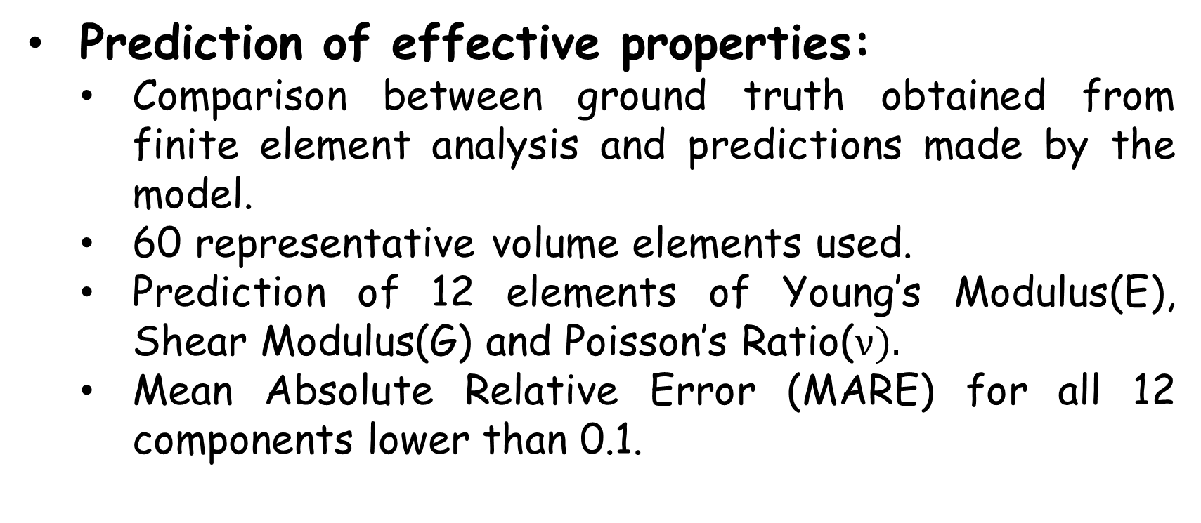
RESULTS
Prediction of effective properties:
Comparison between ground truth obtained from finite element analysis and predictions made by the model.
60 representative volume elements used.
Prediction of 12 elements of Young’s Modulus(E), Shear Modulus(G) and Poisson’s Ratio($ν).$
Mean Absolute Relative Error (MARE) for all 12 components lower than 0.1.
 | $$E_{11}$$ | $$E_{22}$$ | $$E_{33}$$ | $$G_{12}$$ | $$G_{13}$$ | $$G_{23}$$ | $$ν_{21}$$ | $$ν_{31}$$ | $$ν_{12}$$ | $$ν_{32}$$ | $$ν_{13}$$ | $$ν_{23}$$
MARE | 0.058 | 0.037 | 0.038 | 0.057 | 0.052 | 0.085 | 0.012 | 0.013 | 0.012 | 0.012 | 0.014 | 0.016
Notes:
Analysis of the model’s performance is done by contrasting the outcomes with conventional Finite Element Analysis (FEA) by using the trained 3D-CNN to predict the effective characteristics on a testing dataset composed of 60 Representative Volume Elements (RVEs).
60 RVEs with Volume Fraction (VF) values ranging from 2 to 28 make up the validation dataset.
The trained model can predict the 12 elements of Young’s modulus, shear modulus, and Poisson’s ratio with high accuracy.
On RVE samples with high and low VFs, the model performs equally well, while the latter show more unpredictability.
To quantitatively assess prediction ability, the authors compute the mean absolute relative error (MARE) for each component.
As its evident from the tables The MAREs for all 12 components are lower than 0.1.

Slide 12
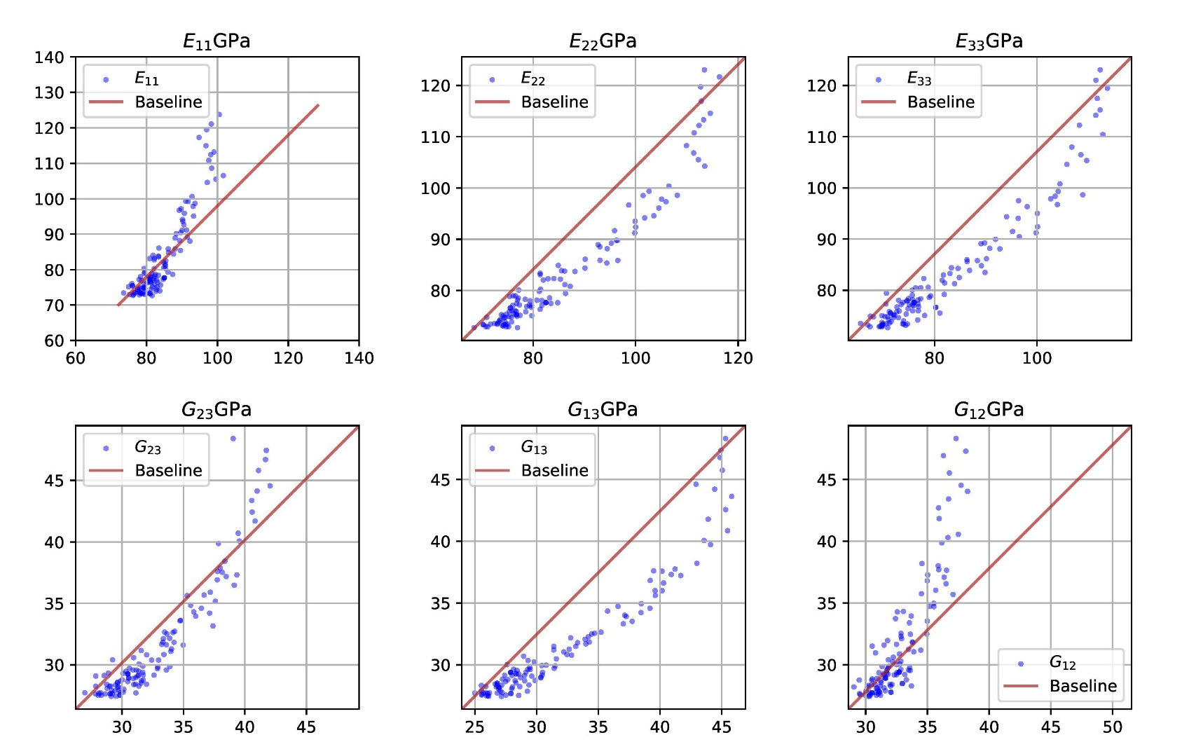
RESULTS
Comparison between the 3D-CNN prediction and ground truth (FEA):
Ground Truth
Prediction

Slide 13

RESULTS
Comparison between the 3D-CNN prediction and ground truth (FEA):
Ground Truth
Prediction

Slide 14
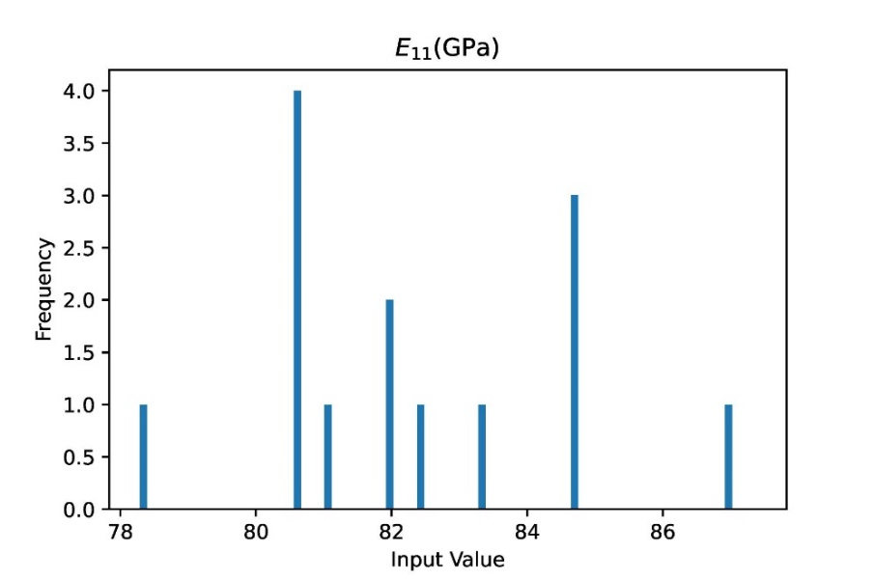
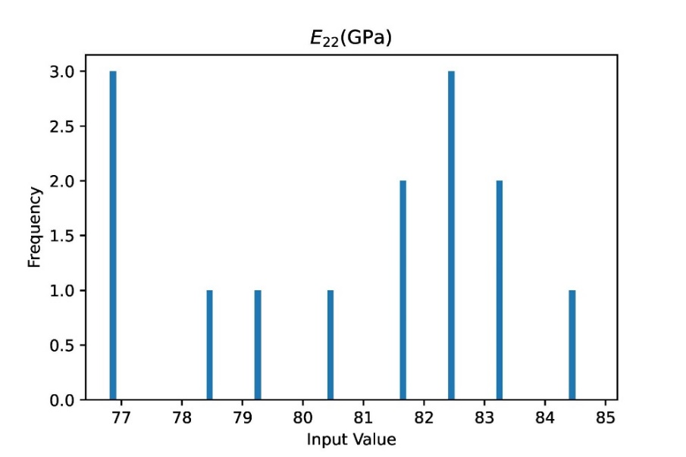
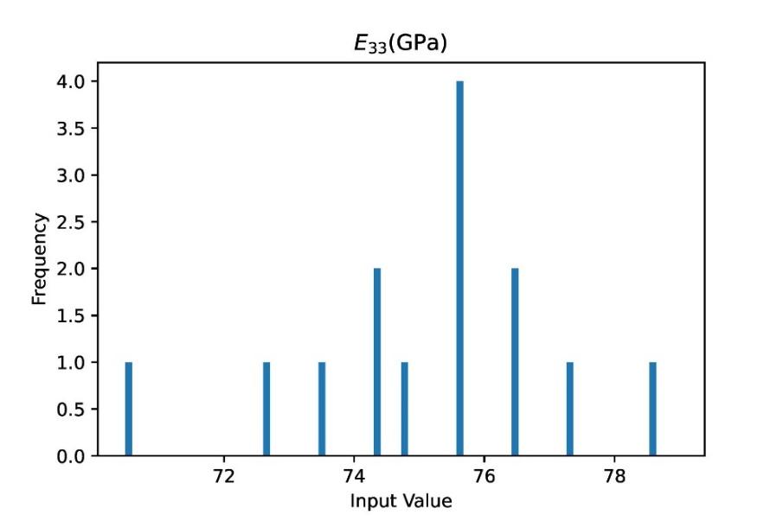
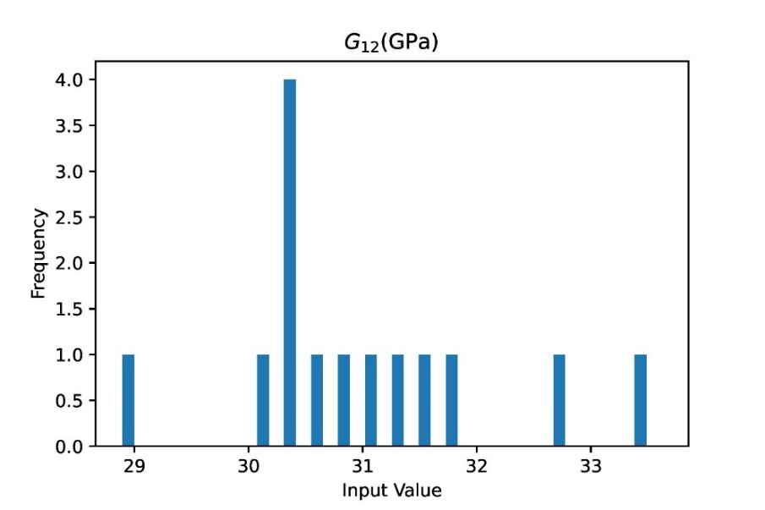
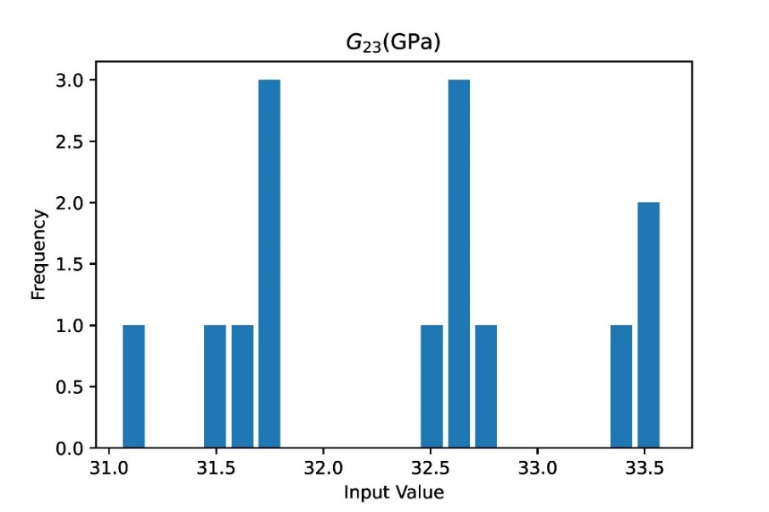
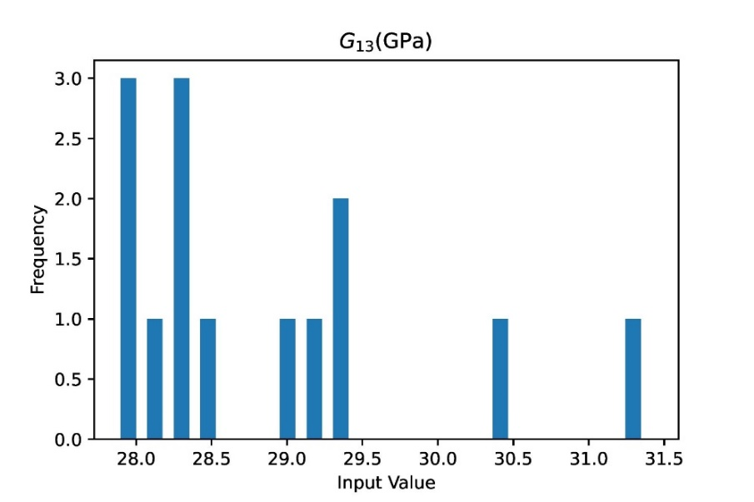
RESULTS
Histogram distribution of predicted effective properties for RVEs with mean VF of 0.07

Slide 15
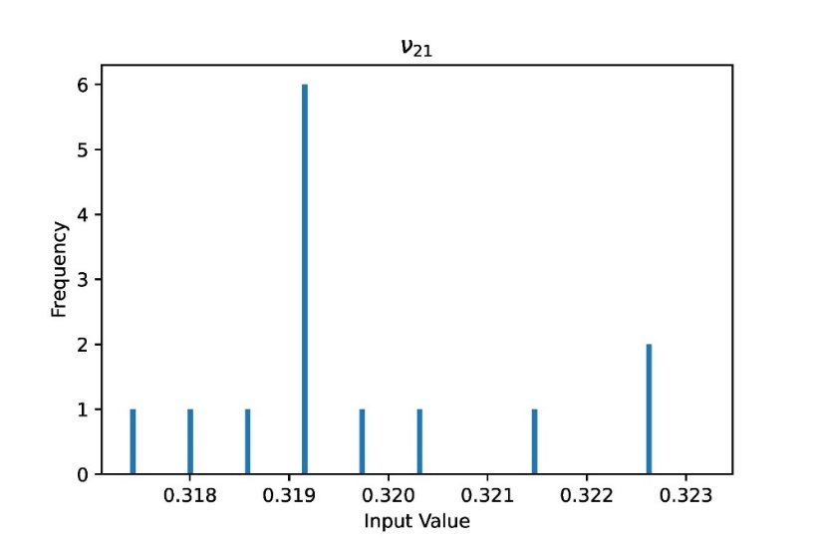
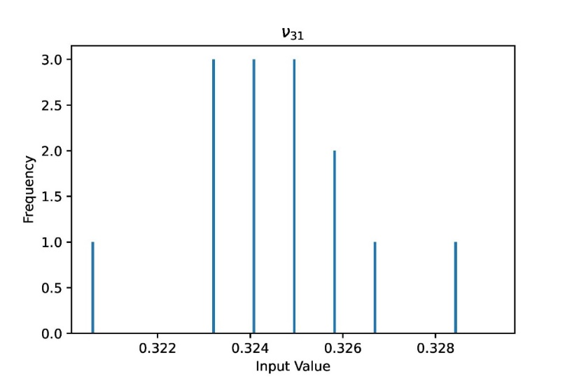
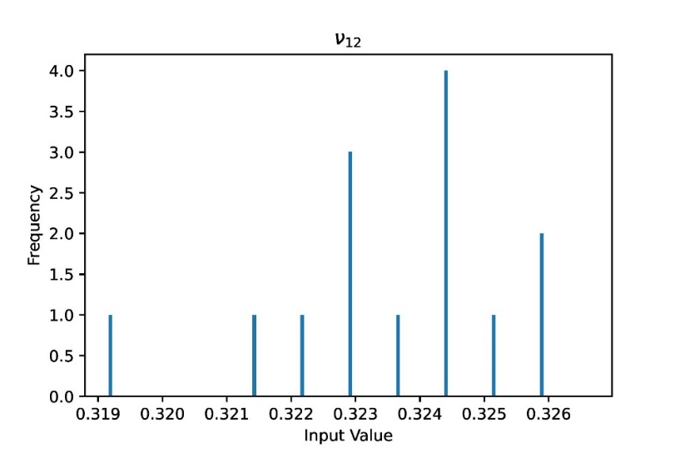
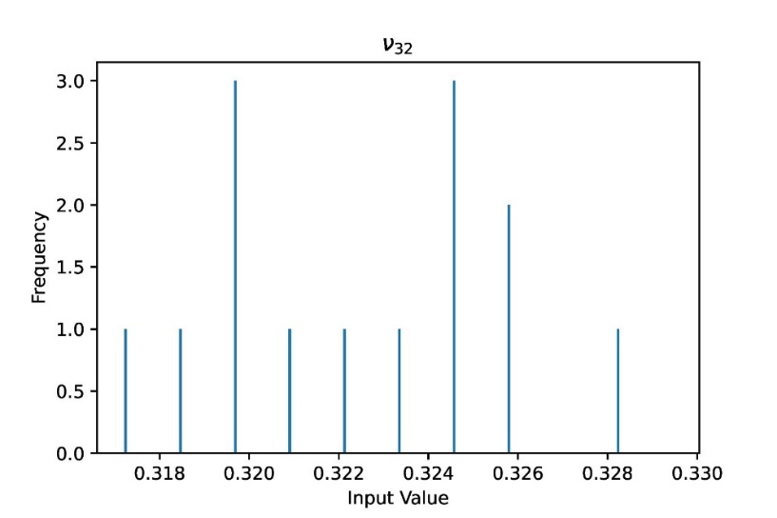
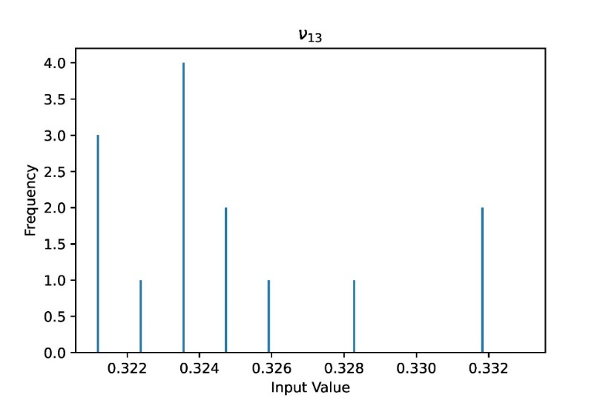
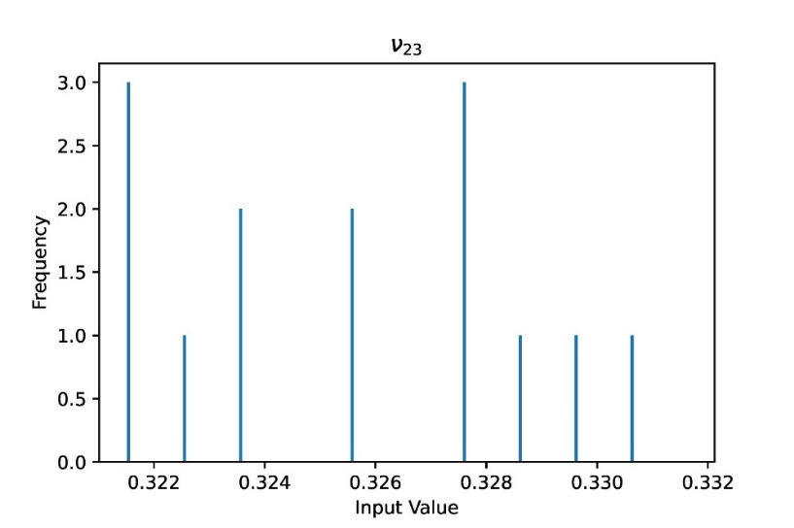
RESULTS
Histogram distribution of predicted effective properties for RVEs with mean VF of 0.07

Slide 16
CONCLUSION
Determination of effective properties of heterogeneous material.
Focus on representative volume elements containing distributed particle inclusion.
Design of 3D-CNN includes many layers: 3D convolution layers, pooling, flattening, and FC layers.
Conduction of parametric study.
Notes:
The projectpresents a novel method that uses a 3D-CNN to determine the effective properties of heterogeneous materials.
This method is particularly focused on RVEs containing distributed particle inclusion.
The design of the 3D-CNN includes various layers such as 3D convolution layers, pooling, flattening, and FC layers.
In order to optimize the network architecture, a parametric study is conducted

Slide 17
CONCLUSION
3D-CNN trained using Finite Element Analysis based linear homogenization.
Test of accuracy.
Provides end to end solution, preserving probabilistic distribution, and transfer learning for different types of composites.
Notes:
The 3D-CNN is then trained with FEA-based linear homogenization.
Through a test of accuracy, the proposed approach is shown to have the potential for efficient design and analysis of composite materials.
The 3D-CNN model developed in this study is shown to accurately and efficiently reproduce effective material properties when compared to traditional FEA.
In addition to its accuracy and efficiency, the proposed method also offers benefits such as providing an end-to-end solution, preserving probabilistic distribution, and transfer learning for different types of composites.

Slide 18
FUTURE SCOPE
Transfer learning: applicability to other heterogeneous material.
Extending it for nonlinear material properties.
Applying trained model for microstructure generation.
Notes:
Future research for this method includes exploring transfer learning for other heterogeneous materials, extending the current 3D-CNN for nonlinear material properties, and applying the trained model for microstructure generation.
Transfer learning could be a useful tool in expanding the applicability of the proposed method to other heterogeneous materials with different types of inclusions or particles.
Extending the current 3D-CNN for nonlinear material properties would further enhance the capabilities of the model.
Finally, applying the trained model for microstructure generation would be useful for designing materials with specific microstructures that have desired effective properties.

Slide 19
REFERENCES
Jacob Aboudi, Steven M Arnold, and Brett A Bednarcyk. Micromechanics of composite materials: a generalized multiscale analysis approach. Butterworth-Heinemann, 2013.
Erik Andreassen and Casper Schousboe Andreasen. How to determine composite material properties using numerical homogenization. Computational Materials Science, 83:488–495, 2014.
Anurag Bhardwaj, Wei Di, and Jianing Wei. Deep Learning Essentials: Your hands-on guide to the fundamentals of deep learning and neural network modeling. Packt Publishing Ltd, 2018.
Chengping Rao and Yang Liu. Three-dimensional convolutional neural network (3d-cnn) for heterogeneous material homogenization. Computational Materials Science, 184:109850, 2020.
M. Kaminski. Boundary element method homogenization of the periodic linear elastic fiber composites. Engineering Analysis with Boundary Elements, 23(10):815–823, 1999.

Slide 20
THANK YOU!

