Slide 1

Semester 07
AY:2025-26
BRA714B
MICRO AND NANO ROBOTICS
DEPARTMENT OF ROBOTICS & AUTOMATION
JSS ACADEMY OF TECHNICAL EDUCATION

Slide 2
COURSE OBJECTIVES
The course will enable the students to:
To develop a comprehensive understanding of the core principles of micro and nano robotics.
To introduce the key fabrication methods, control mechanisms, and the primary application domains of micro and nano robots.
To examine the unique challenges of scaling, material selection, and sensing technologies at micro and nano scales.
To investigate real-world applications of micro and nano robotics in fields such as healthcare, manufacturing, and environmental monitoring.

Slide 3
MODULE 1
Introduction to Micro and Nano Robotics: Overview of robotics at micro and Nano scales, Scaling laws and challenges (e.g., surface forces, adhesion).
Historical development and milestones. Fundamental principles of micro and Nano robotics.
Applications in medicine, manufacturing, and space exploration

Slide 4
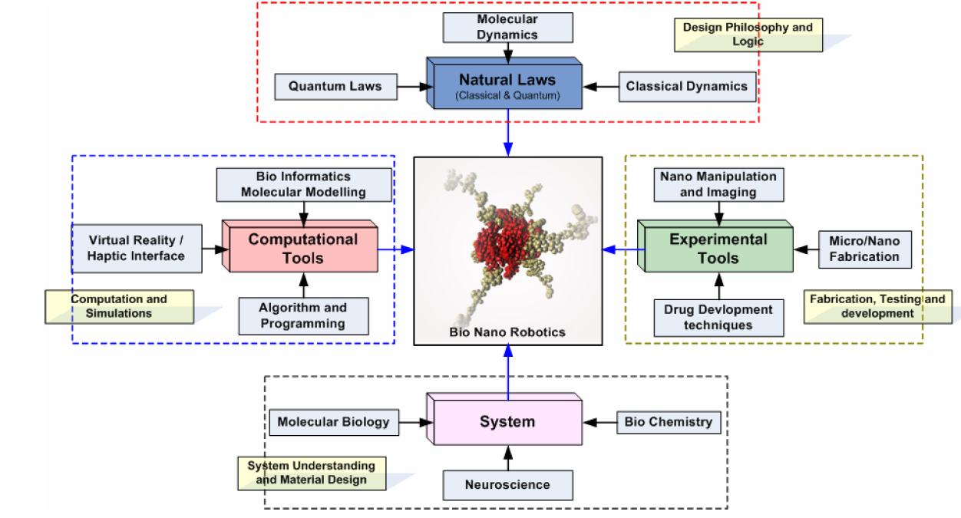
How does nature work?
How do we design and simulate the robot?
How do we build and test it?
What system will the robot work with?
NANOROBOTICS – A MULTIDISCIPLINARY FIELD

Slide 5
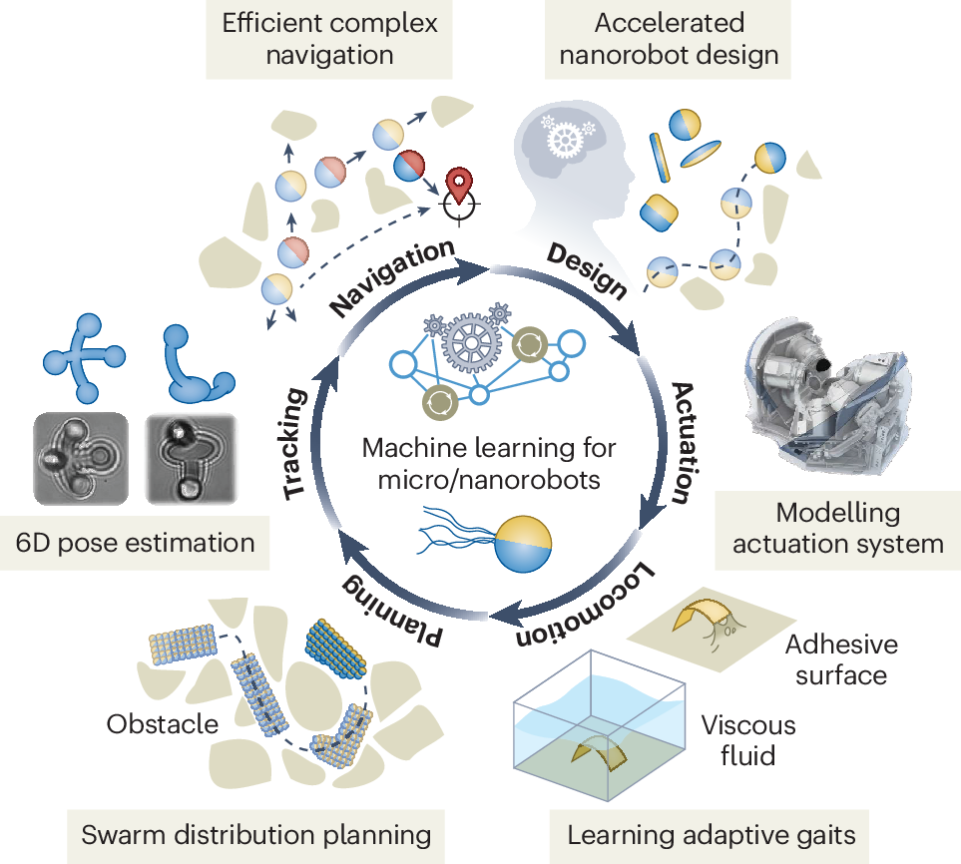
Avoid obstacles.
Choose the shortest or safest route.
Reach a target accurately.
Tests many robot shapes quickly.
Finds the best design.
Reduces the time needed for development.
Model motors or control systems.
Improve movement efficiency.
Respond to changing conditions.
Position
Orientation
Plan routes.
Avoid obstacles.
Coordinate many robots (swarms).
Move in viscous fluids like blood.
Adapt to sticky surfaces.
Learn better movement patterns

Slide 6
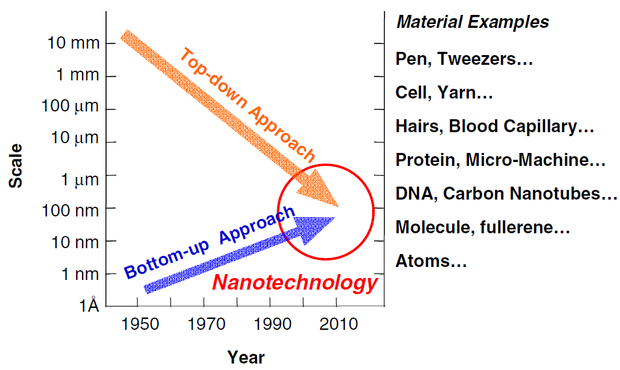
Micro and Nano Robotics: Overview
INTRODUCTION
Micro-robots: Devices typically ranging from 1 micrometer to 1 millimeter in size.
Nano-robots (Nanobots): Operate on the nanometer scale (1nm–1000 nm), often using components at the atomic or molecular level.
Micro- and nano-scale robotics: emerging area
These miniature robots have unique advantages like access to unprecedented and small areas, increased flexibility, functionality and robustness, and low cost, adaptive and distributed (swarms) .
Schematic diagram of “Nanotechnology”
(“Top-Down” and “Bottom-Up”)

Slide 7
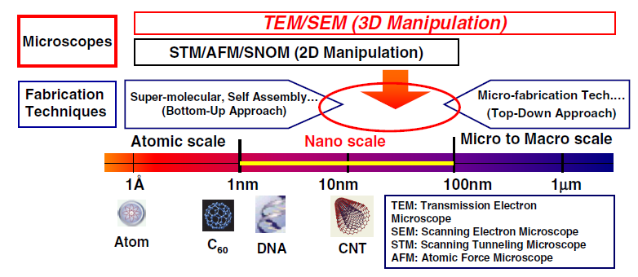
Micro and Nano Robotics: Overview
INTRODUCTION
(Observation & Manipulation)
Nanorobotic manipulation system for nanodevices constructions

Slide 8
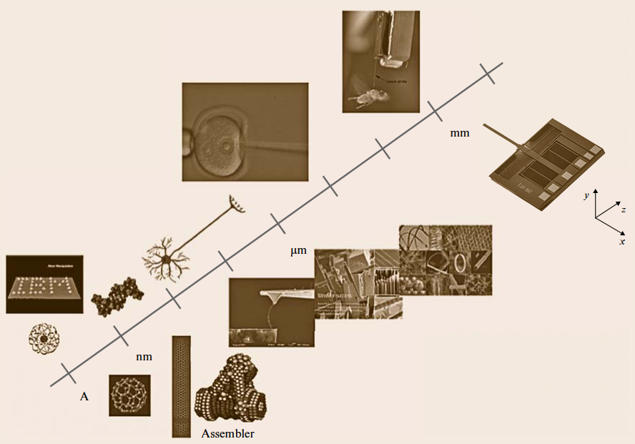
INTRODUCTION
Micro- and Nano-Robotics: Overview
Micro-robots (few millimetres) and nano-robots (1–100 nanometres) are tiny machines designed to perform tasks in places that larger robots cannot reach
The locomotion and manipulation dynamics of these robots are dominated by micro/nano-scale forces and the scaling effects.
Locomotion Dynamics (How Tiny Robots Move)
At the micro- and nano-scale, movement is very different because:
Water behaves like thick honey.
Friction and viscosity are much stronger than inertia.
Gravity has very little effect.
Therefore, robots use special methods to move.
Robotic exploration at micro- and nanometer scales

Slide 9
INTRODUCTION
Micro- and Nano-Robotics: Overview
Manipulation Dynamics (How Tiny Robots Handle Objects)
Manipulation refers to:
grabbing
pushing
carrying
rotating
assembling
or releasing tiny objects.
Micro-Gripping
Drug Deliver
Cell Manipulation
Particle Assembly
Surgical Manipulation
Robotic exploration at micro- and nanometer scales

Slide 10
Micro and Nano Robotics: Overview
INTRODUCTION
Nanorobotics: study of robotics at the nanometer scale, and includes robots that are nanoscale in size, i.e., nanorobots, capable of manipulating objects that have nanometer dimensions with nanometer resolution, i.e., nanorobotic manipulators.
The field of nanorobotics: several disciplines, nanofabrication processes used for producing nanoscale robots, nanoactuators, nanosensors, and physical modelling at nanoscales.
Nanorobotic manipulation technologies: Assembly of nanometer-sized parts, the manipulation of biological cells or molecules, and
Types of robots used to perform manipulation task at nano scale, also form a component of nanorobotics

Slide 11
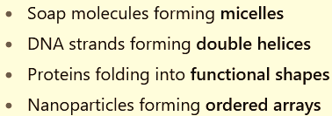
Key Principles & Technologies
1. Fabrication Techniques
Top-down: Photolithography, Electron beam lithography, Laser machining, Etching, Micro-machining
Bottom-up: Chemical synthesis, DNA origami, and molecular assembly, Nano particle assembly
2. Actuation Mechanisms
Micro/nano robots can't use conventional motors; instead, they rely on:
Magnetic fields (e.g., rotating or gradient magnetic fields)
Acoustic waves (ultrasound-induced propulsion)
Chemical reactions (e.g., catalytic propulsion)
Light (optical tweezers) for precise manipulation
Electric fields (dielectrophoresis or electroosmotic flow)
Top-Down = Start with a big material and cut it into smaller parts.
Bottom-Up = Start with atoms or molecules and build upward.

Slide 12
Key Principles & Technologies
2. Actuation Mechanisms
Propulsion Method | How the Robot Moves | Example
Magnetic fields | External magnets pull or rotate the robot | Drug delivery, targeted therapy
Ultrasound | Sound waves push the robot through fluids | Navigation in blood vessels
Chemical propulsion | Chemical reactions generate thrust | Self-propelled microrobots in research
Light (Optical tweezers) | Laser beam traps and positions the robot | Precise laboratory manipulation
Electric fields | Electric forces move the robot or surrounding fluid | Cell sorting, microfluidic systems

Slide 13
Key Principles & Technologies
2. Actuation Mechanisms
Real-world example: Drug delivery to a tumor
A nanorobot carrying an anti-cancer drug:
Magnetic fields guide it through the bloodstream toward the tumor.
Ultrasound helps propel it through narrow blood vessels.
Electric fields may be used in a lab-on-a-chip device to test the robot before use.
Optical tweezers help researchers position and study the robot during development.
Chemical propulsion can allow specially designed robots to move on their own in suitable environments.

Slide 14
KEY PRINCIPLES & TECHNOLOGIES
3. Control and Sensing
Remote control via external fields (magnetic, acoustic, etc.)
Embedded sensors are minimal or non-existent; feedback often comes from real-time imaging (e.g., fluorescence, MRI).
Common Imaging Techniques
🌟 Fluorescence Imaging
The robot is coated with a fluorescent material.
When light shines on it, the robot glows.
Scientists observe the glowing robot using a special microscope or camera.
Example: A glowing nanorobot is tracked as it moves toward cancer cells.
🧲 MRI (Magnetic Resonance Imaging)
MRI creates detailed images of the inside of the body.
If the robot contains magnetic material, it appears in MRI images.
Doctors can see: Where the robot is & Whether it has reached the target
Example: Doctors track a magnetic microrobot delivering medicine inside the brain.

Slide 15
KEY PRINCIPLES & TECHNOLOGIES
Applications
Medical Applications
Targeted drug delivery: Directing nanobots to tumours or infection sites.
Minimally invasive surgery: Microrobots navigating inside the body.
Cell manipulation: Pushing, cutting, or fusing cells.
Bio-sensing: In situ detection of biomarkers.
Environmental and Industrial
Water purification: Nanobots that neutralize pollutants.
Micro-assembly: Fabricating micro-scale components.
Material synthesis: Smart materials that respond to stimuli.

Slide 16
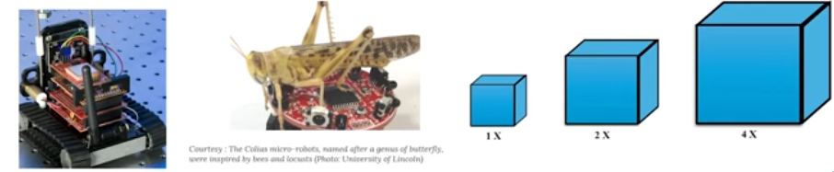
SCALING LAWS
Scaling laws describe how the properties or behavior of a system change when its size changes
When designing and operating micro and nano robots, these laws help us understand the dominant forces, energy constraints, and motion dynamics as robots shrink in size.
The differences occur because physical forces (gravity, surface tension, inertia, friction, etc.) do not scale the same way with size

Slide 17
SCALING LAWS
Why Scaling Matters?
Traditional engineering principles do not apply at small scales: New approached are required
Forces behave differently ( e.g. surface forces dominate, gravity becomes negligible)
Motion requires alternative strategies (e.g., helical propulsion, oscillating magnetic fields)
Powering microrobots is challenging (requiring external energy source)
Manufacturing methods must be adopted to nanoscale fabrication techniques

Slide 18
SCALING LAWS
SCALING LAWS
The laws are based on mathematical relationships between different physical quantities
There are two main types of scaling laws that are applicable to the design of microsystems
1. Scaling Laws Based on Physical Size (Geometric Scaling)
Focuses on how physical quantities change when the dimensions of an object are increased or decreased.
Examples
Rigid body dynamics: A larger machine has much more mass and inertia than a smaller one, so it requires more force to move.
Electrostatic forces: As devices become smaller, electrostatic attraction becomes relatively stronger than gravity.
Electromagnetic forces: The strength of magnetic and electric effects changes with size, influencing the design of motors, sensors, and actuators.

Slide 19
SCALING LAWS
SCALING LAWS
2. Scaling Laws Based on Phenomenological Behavior (Behavioral Scaling)
Focuses on how the dominant physical phenomena change when objects become extremely small, rather than just their dimensions.
At the microscale, new effects become important, while others become almost negligible.
Examples in MEMS
Surface forces become much stronger than gravity.
Friction and adhesion increase.
Heat transfers more quickly.
Fluid flow behaves differently because viscosity dominates.

Slide 20
SCALING LAWS
SCALING LAWS
COMPARISON
First Type (Geometric Scaling) | Second Type (Behavioral Scaling)
Depends on object size and dimensions | Depends on the physical behavior at small scales
Studies changes in length, area, volume, and mass | Studies which forces or phenomena become dominant
Used to calculate changes in geometry and forces | Used to understand microsystem performance
Examples: rigid body dynamics, electrostatic forces, electromagnetic forces | Examples: surface tension, adhesion, friction, heat transfer, fluid flow

Slide 21

Scaling Laws
SCALING LAWS
How the surface area and volume of an object change when its size becomes smaller or larger.
1. Surface-to-Volume Ratio
As size (L) decreases, surface area dominates (increases) over volume.
This increases the effects of surface forces (e.g., friction, adhesion, electrostatics).
Impacts:
Better Heat Transfer: Heat enters and leaves quickly
Faster Chemical Reactions: More surface is exposed.
Better Drug Delivery: Large surface area allows more interaction with cells.
Faster Diffusion: Small particles exchange gases and chemicals quickly.
Strong Surface Forces
At the nano-scale:
Adhesion
Friction
Electrostatic forces become stronger than gravity.

Slide 22

Scaling Laws
SCALING LAWS
2. Viscous vs Inertial Forces (Reynolds Number)
The Reynolds number (Re) is a dimensionless number that tells us whether the motion of a fluid (air or liquid) is dominated by inertial forces or viscous forces.
ρ = Density of the fluid (kg/m³)
v = Velocity of the fluid (m/s)
L = Characteristic length (size of the object or channel)
μ = Dynamic viscosity of the fluid

Slide 23
Scaling Laws
SCALING LAWS
2. Viscous vs Inertial Forces (Reynolds Number)
Inertial Forces:
Inertial forces are due to the motion and momentum of the fluid.
They tend to keep the fluid moving.
They dominate in large systems or at high speeds.
Viscous Forces:
Viscous forces are caused by the internal friction between layers of the fluid.
They resist motion.
They dominate in small channels or at low speeds.

Slide 24
Scaling Laws
SCALING LAWS
2. Viscous vs Inertial Forces (Reynolds Number)
At low Reynolds numbers (Re ≪ 1):
Viscous forces dominate → movement is slow and sticky (Stokes flow).
Motion is non-inertial – objects stop immediately when force is removed.
Propulsion methods like swimming or gliding must overcome high drag.
Effect of Scaling
Suppose a device is reduced from 1 meter to 1 micrometer (10⁻⁶ m).
Since Re ∝ L the Reynolds number becomes one million times smaller.
Means;
Inertial forces decrease significantly.
Viscous forces become much more important.
Therefore, microsystems operate in a viscosity-dominated environment.

Slide 25

Scaling Laws
SCALING LAWS
3. Power and Energy Scaling
In microsystems (MEMS), power and energy do not scale in the same way as size. When a device is made smaller, its mass, force, energy storage, and power consumption change according to scaling laws.
When the dimensions of a device are reduced, different physical quantities reduce at different rates.
Let the characteristic length of a device be L.
Energy Scaling
Energy is related to the size and mass of a system.
For mechanical systems:

Slide 26

Scaling Laws
SCALING LAWS
Let the characteristic length of a device be L.
Energy Scaling
Energy is related to the size and mass of a system.
For mechanical systems:
where:
m = mass
v = velocity
Mass depends on volume:
m ∝ L³
Therefore:
If the size of a device is reduced by a factor of 10: So the stored mechanical energy becomes 1000 times smaller

Slide 27


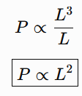
Scaling Laws
SCALING LAWS
where:
P = power
E = energy
t = time
2. Power Scaling
Power is the rate at which energy is used or transferred.
Since energy scales as:
and time is related to the motion scale: t ∝ L, then;
Meaning:
When the size decreases:
Energy decreases rapidly.
Power requirement also decreases.

Slide 28
Summary Table
SCALING LAWS
Quantity | Scaling Relationship | Effect when size decreases
Length | (L) | Decreases
Area | (L²) | Decreases faster
Volume/Mass | (L³) | Decreases very rapidly
Energy | (L³) (mechanical) | Becomes much smaller
Power | (L²) (approx.) | Reduces significantly
Power output (from onboard motors or actuators): P ∝ L³
Heat loss and friction scale with surface area: Q ∝ L²
Implication:
As robots shrink, they lose the ability to store or produce enough power internally.
Most nano/ micro bots use external fields (magnetic, acoustic, light) for actuation.

Slide 29
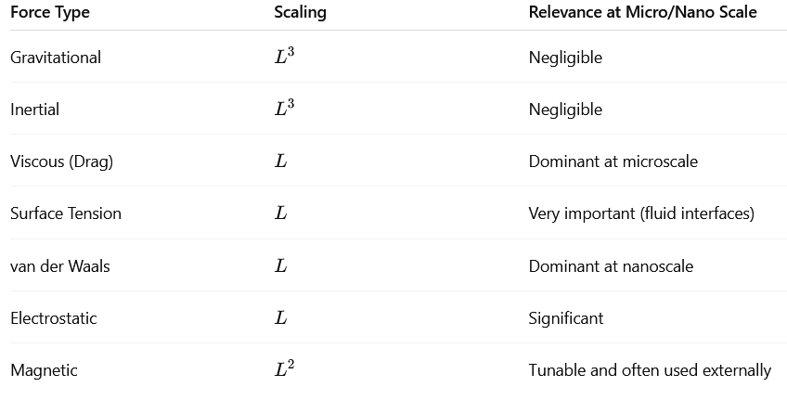
Scaling Laws
SCALING LAWS
4. Force Scaling Summary

Slide 30

Scaling Laws
SCALING LAWS
5. Diffusion Scaling
t: time,
L: distance,
D: diffusion coefficient
Diffusion dominates transport at the nanoscale, but it becomes inefficient over long distances.
Nanoscale robots must operate locally or be transported by flows or fields.

Slide 31

Scaling Laws
SCALING LAWS
6. Thermal and Brownian Effects
Thermal noise and Brownian motion become significant at the nanoscale:
Nanobots randomly jitter, affecting precision.
Control systems must account for stochastic behavior.

Slide 32
Scaling Laws
Engineering Challenges
Actuation
Challenge: Conventional motors don’t scale down well.
Solutions:
Electrostatic, magnetic, piezoelectric, or chemical actuation.
Use of artificial muscles (e.g., dielectric elastomers).
Light-driven or bio-hybrid mechanisms.
2. Power Supply
Challenge: Batteries are difficult to miniaturize; energy density becomes a constraint.
Solutions:
Wireless power (inductive or capacitive coupling).
Harvesting environmental energy (light, vibrations).
Using external fields (magnetic, ultrasonic) for propulsion and control.

Slide 33
Scaling Laws
Engineering Challenges
3. Fabrication
Challenge: Precision and repeatability at small scales.
Solutions:
  MEMS/NEMS (Micro/Nano-Electromechanical Systems) techniques.
  3D nano printing (e.g., two-photon lithography).
  DNA origami, molecular self-assembly.
4 . Sensing and Control
Challenge: Limited space and power for traditional sensors and processors.
Solutions:
  Use of external sensors (microscopy, magnetic resonance).
  On-board smart materials or chemical sensors.
  Swarm intelligence or bio-inspired decentralized control.

Slide 34
Scaling Laws
Engineering Challenges
5. Communication
Challenge: No room for standard antennas; low signal-to-noise ratio.
Solutions:
Optical signaling (light pulses).
Magnetic field modulation.
Molecular signaling (for bio-hybrid systems).
6. Integration and Biocompatibility
Challenge: Integration of components in a biocompatible, robust form.
Solutions:
Use of soft materials (hydrogels, biopolymers).
Encapsulation with biocompatible coatings.
Leveraging biological components (e.g., bacteria or cells as motors).

Slide 35
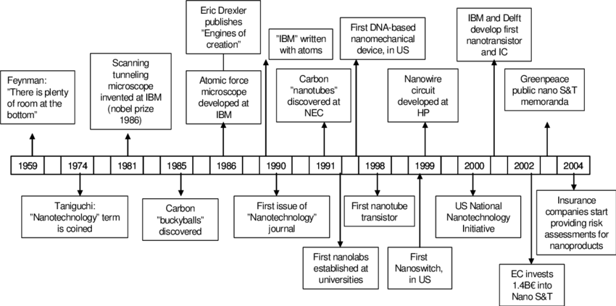
HISTORICAL DEVELOPMENT AND MILESTONES

Slide 36
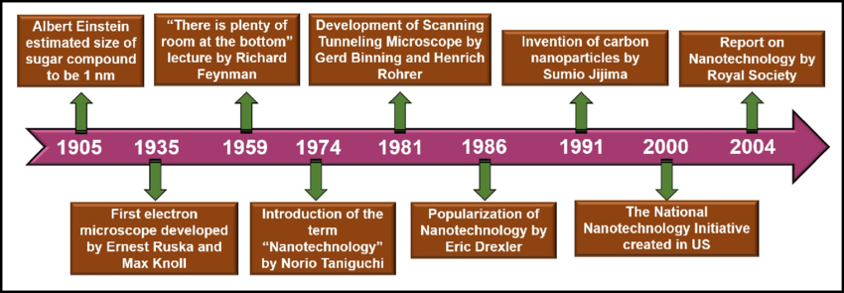
HISTORICAL DEVELOPMENT AND MILESTONES

Slide 37
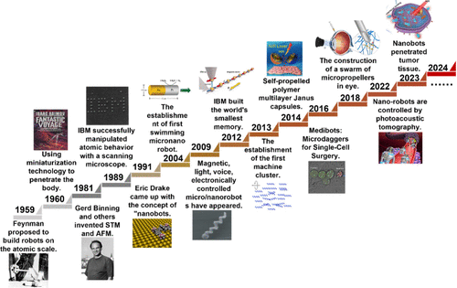

Slide 38
FUNDAMENTAL PRINCIPLES OF MICRO AND NANO ROBOTICS.
The fundamental principles of micro and nano robotics revolve around designing, fabricating, and controlling robots at microscopic (micrometer) and nanoscopic (nanometer) scales.

Slide 39
FUNDAMENTAL PRINCIPLES OF MICRO AND NANO ROBOTICS.
The fundamental principles of micro and nano robotics revolve around designing, fabricating, and controlling robots at microscopic (micrometer) and nanoscopic (nanometer) scales.
1. Scale-Dependent Physics
Low Reynolds Number Regime: At micro and nano scales, fluid dynamics behave differently. Inertia becomes negligible, and viscous forces dominate.
Brownian Motion: Random thermal motion affects the stability and predictability of nano-robots.
Surface Forces: Electrostatic, van der Waals, and surface tension forces dominate over gravitational or inertial forces.

Slide 40
FUNDAMENTAL PRINCIPLES OF MICRO AND NANO ROBOTICS.
2. Actuation Mechanisms
External Fields:
  Magnetic fields (e.g., magnetically driven micro-swimmers)
  Electric fields (dielectrophoresis)
  Acoustic waves (ultrasound propulsion)
  Light (optically driven nanomotors)
Chemical Reactions: Some nano-robots are powered by catalytic reactions (e.g., hydrogen peroxide as a fuel source).
Bio-hybrid Actuators: Integration of biological elements (e.g., bacteria, flagella) for propulsion.

Slide 41
FUNDAMENTAL PRINCIPLES OF MICRO AND NANO ROBOTICS.
3. Fabrication Techniques
Top-down: Lithography, etching techniques, and MEMS (Micro-Electro-Mechanical Systems) fabrication.
Bottom-up: Self-assembly of molecules, chemical synthesis, and biofabrication.
4. Sensing and Control
Sensing: Use of nanosensors to detect chemical, optical, or magnetic signals.
Control:
  Autonomous behavior through onboard logic or stimulus-response systems.
  Remote control via electromagnetic, optical, or acoustic stimuli.
5. Locomotion Strategies
Flagella-based motion: Inspired by bacteria like E. coli.
Helical propulsion: Screw-like movement under rotating magnetic fields.
Surface walking: Using electrostatic or piezoelectric walking strategies.

Slide 42
MEDICAL APPLICATIONS
Micro and nano robots are transforming medicine by enabling ultra-precise, minimally invasive procedures.
Targeted Drug Delivery
Deliver drugs directly to specific tissues or cells (e.g., cancer cells), reducing side effects.
E.g.: Magnetic or chemically driven nano-swimmers delivering chemotherapy agents to tumors.
Minimally Invasive Surgery
Navigate through blood vessels or organs to perform tasks like clearing blockages or repairing tissues.
Cellular and Genetic Manipulation
Perform microsurgery on individual cells (e.g., injecting DNA or editing genes at the cellular level).
Real-Time Diagnosis and Biosensing
Detect biomarkers or pathogens within the body using embedded nanosensors.
E.g.: Detecting early-stage tumors by binding to specific cancer markers.
Wound Healing and Tissue Regeneration
Guide stem cells or deliver growth factors to injured areas to accelerate healing.

Slide 43
MANUFACTURING APPLICATIONS
Micro and nano robots enable the next generation of precision manufacturing.
a. Micro-Assembly
Assembling micro-components in MEMS (Micro-Electro-Mechanical Systems), electronics, or optics.
b. Nanofabrication
Creating nano-scale devices and circuits using robotic manipulation of atoms and molecules.
c. Quality Control
Inspecting defects or contaminants in microelectronics and materials using robotic sensors.
d. 3D Printing at Micro/Nano Scales
Precision deposition and manipulation to build tiny components layer by layer.

Slide 44
SPACE EXPLORATION APPLICATIONS
Their small size and energy efficiency make micro and nano robots ideal for extraterrestrial missions.
Exploration of Hostile Environments
Swarm of nano-robots can explore tight or dangerous environments (lava tubes, Martian soil, etc.).
b. In-situ Resource Utilization
Assist in mining or processing extraterrestrial materials on the Moon or Mars.
c. Structural Health Monitoring
Inspect spacecraft and space station components for microfractures or degradation.
d. Scientific Research
Conduct detailed surface and atmospheric analysis at microscopic levels.

Slide 45
END

