Slide 1
HTTP Fingerprinting The next generation
OWASP AppSec
Sydney 2012
Eldar Marcussen
Stratsec
eldar.marcussen@stratsec.net

Slide 2
Agenda
Why
HTTP
Fingerprinting theory
The next generation
Demo
Conclusion

Slide 3
@wireghoul
Pentester
Blogger
Husband
Father
Geek

Slide 4
Why
Understanding of remote environment
Load balancer vulnerabilities
HAProxy DoS (SA44083)
Pound Format String vuln (SA11528)
Pound Buffer overflow (CVE-2005-1391)
Varnish DoS (SA33852)
mod_proxy Integer overflow (CVE-2010-0010)

Slide 5
Prior work
HMAP: A Technique and Tool For Remote Identification of HTTP Servers - Dustin Lee
Detecting and Defending against Web-Server Fingerprinting - Dustin Lee, Jeff Rowe, Calvin Ko, Karl Levitt
HTTPrint; An Introduction to HTTP Fingerprinting - Saumil Shah
Identifying web servers – Jeremiah Grossman
More

Slide 6
Existing tools
HTTPrint
Hmap
Waffit/wafw00f
Lbd
Halberd
More

Slide 7
HTTP Basics
HTTP 0.9 - http://www.w3.org/Protocols/HTTP/AsImplemented.html
HTTP 1.0 - RFC1945
HTTP 1.1 - RFC2616
IETF - http://tools.ietf.org/wg/httpbis/

Slide 8
HTTP 0.9 Request
GET /CRLF

Slide 9
HTTP 0.9 Response
<html><body><h1>It works!</h1>
<p>This is the default web page for this server.</p>
<p>The web server software is running but no content has been added, yet.</p>
</body></html>

Slide 10
HTTP 1.0 Request
GET / HTTP/1.0CRLF
User-Agent: Mozilla/4.0CRLF
CRLF

Slide 11
HTTP 1.0 Response
HTTP/1.0 200 OK
Date: Wed, 21 Mar 2012 22:22:22 GMT
Server: Apache/2.2.14 (Ubuntu)
ETag: "a711f-b1-4a2e722183700"
Content-Length: 177
Connection: close
Content-Type: text/html
<html><body><h1>It works!</h1>
<p>This is the default web page for this server.</p>

Slide 12
HTTP 1.1 Request
GET/ HTTP/1.1CRLF
Host: localhostCRLF
User-Agent: Mozilla/4.0CRLF
CRLF

Slide 13
HTTP 1.1 Response
HTTP/1.1 200 OK
Date: Wed, 21 Mar 2012 22:22:22 GMT
Server: Apache/2.2.14 (Ubuntu)
ETag: "a711f-b1-4a2e722183700"
Content-Length: 177
Connection: close
Content-Type: text/html
<html><body><h1>It works!</h1>
<p>This is the default web page for this server.</p>

Slide 14
METHOD Example
HEAD / HTTP/1.0CRLF
CRLF
POST / HTTP/1.0CRLF
Content-Type: application/x-www-form-urlencodedCRLF
CRLF
id=1&name=test

Slide 15
Fingerprinting
Analysis of responses
Semantic
Lexical
Syntactical

Slide 16
Semantic analysis
How the agent interprets a request.
Range: 1-, 2-, 3-,
HEAD SHOULDERS KNEES AND TOES

Slide 17
Lexical analysis
Specific words, phrases and punctuation in responses.
HTTP/1.1 501 Unknown or unimplemented http action
HTTP/1.1 501 Method Not Implemented
HTTP/1.0 501 Not Implemented
HTTP/1.0 501 Unsupported method ('POST')

Slide 18
Syntactical analysis
Ordering and context of words, phrases, header, etc.
‘Server’ header occurs after ‘Date’ header
ETag format

Slide 19
Detecting Load balancer
Common indicators
Rejects unusual HTTP requests
HTTP1.0 responses to HTTP/0.9 requests
HTTP/1.0 400 error responses
Adds identifying headers

Slide 20
Detecting WAF
Common indicators
Rejects unusual HTTP requests
Accepts unusual HTTP requests
Rejects valid HTTP requests with “suspicious” characters (./, ../)

Slide 21
Detecting web servers
Common indicators
Server headers
Gracefully handles HTTP/0.9
Defaults to HTTP/1.1 responses
Syntactical evidence (ETag header)

Slide 22
Enumeration
Detecting back-ends / server pools
DNS
Handle debugging headers
Compare responses from large number of requests

Slide 23
BUT WAIT THERE’S MORE

Slide 24
Profiling configuration
Easy
Timeout
Application headers
Also easy?
Configured modules
Script bindings

Slide 25
Apache handlers
Allows module to handle request METHOD
Many modules don’t enforce strict verb checks
Can be used to remotely detect modules and script bindings
Can bypass authentication
Don’t always work

Slide 26
Demo

Slide 27
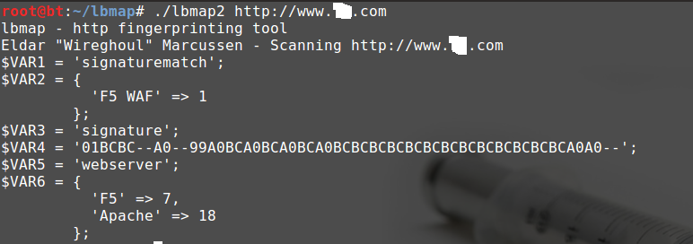
Demo

Slide 28
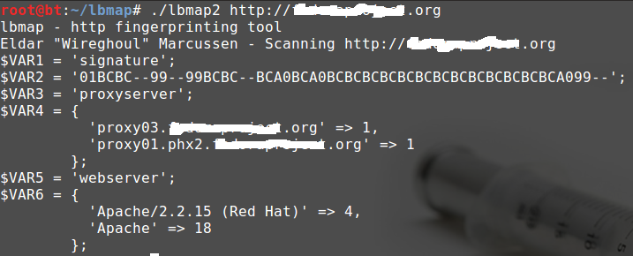
Demo

Slide 29
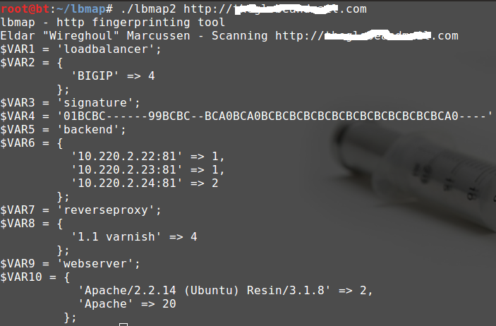
Demo

Slide 30
Summary & Conclusion

Slide 31
Conclusion
Current fingerprinting does not give complete picture
Fingerprinting can do more than just identify web agents
Fingerprinting can be unreliable
Better tools needed

Slide 32
Tools
Source code and download from
https://github.com/wireghoul/lbmap
Please fork and contribute

Slide 33
Thanks
@stratsec
@owasp
@net__ninja
@tecR0c
@dieinafire23
@smokingjohnson
@csearle
@ivanristic
Shodan HQ
And others…

Slide 34

Questions

