Slide 1
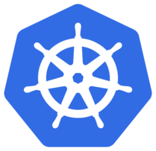
Intro to Kubernetes

Slide 2
Agenda
Why Kubernetes
What’s Kubernetes
How to setup Kubernetes
Components of Kubernetes
Deploying app on Kubernetes

Slide 3
Why Kubernetes
Containers everywhere
Multiple machines to manage
Easy! Peace of mind
To run many different containers with different images
Infrastructure and CSP agnostic
Better management through modularity
Deploying and updating software at scale

Slide 4
Kubernetes Background
Also known as K8s
Greek for "governor", "helmsman" or "captain"
Joe Beda, Brendan Burns and Craig McLuckie who were quickly joined by other Google engineers including Brian Grant and Tim Hockin
first announced by Google in mid-2014
Google already working on project called Borg
Original codeName was Project Seven(7 spokes on logo...not a surprise anymore)
Kubernetes v1.0 was released on July 21, 2015.
Google partnered with the Linux Foundation to form the Cloud Native Computing Foundation offered Kubernetes as a seed technology

Slide 5
What is K8s
open-source container-orchestration system for automating deployment, scaling and management of containerized applications across cluster of machines

Slide 6
What can you do with K8s
User can define how your applications should run and the ways they should be able to interact with other applications or the outside world
You can scale your services up or down, perform graceful rolling updates, and switch traffic between different versions of your applications to test features or rollback problematic deployments
essentially a tool for managing your containers

Slide 7
K8s Setup
Setup steps for installation on Linux
Setup

Slide 8
Architecture
Follows Master-Slave
Individual physical or virtual machines form a cluster using a shared network to communicate between each server
This cluster is the physical platform where all Kubernetes components, capabilities, and workloads are configured
One machine is given the role of master
Other machines are assigned as nodes

Slide 9
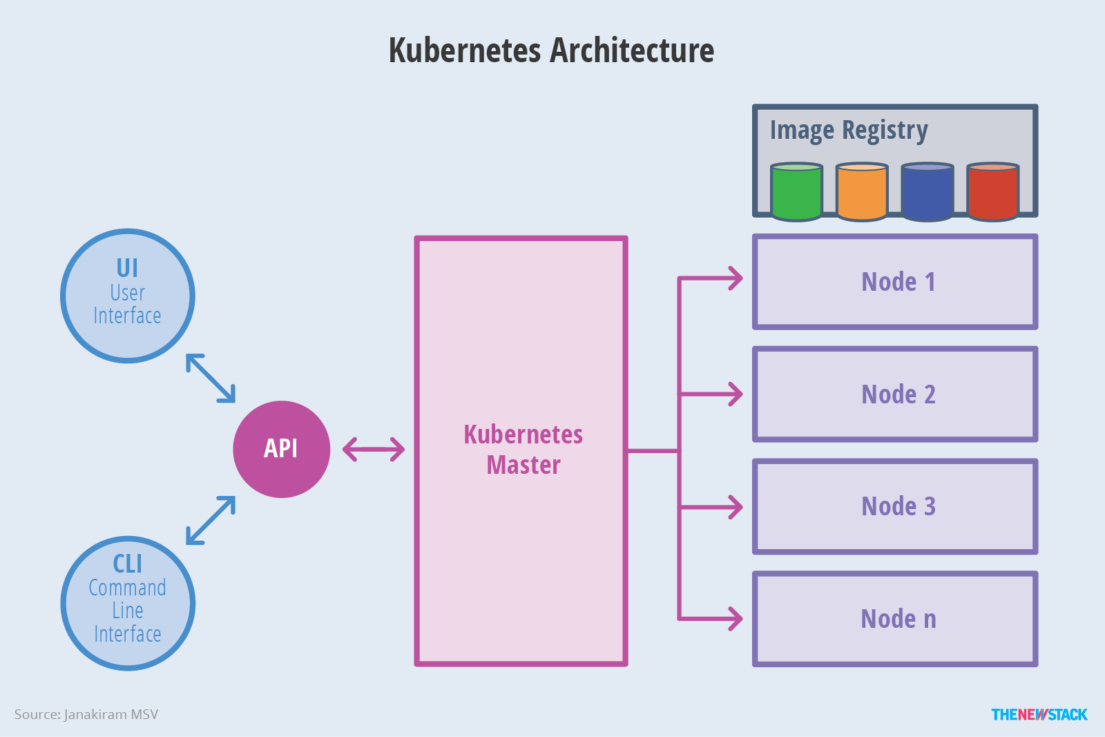
Architecture Contd.

Slide 10
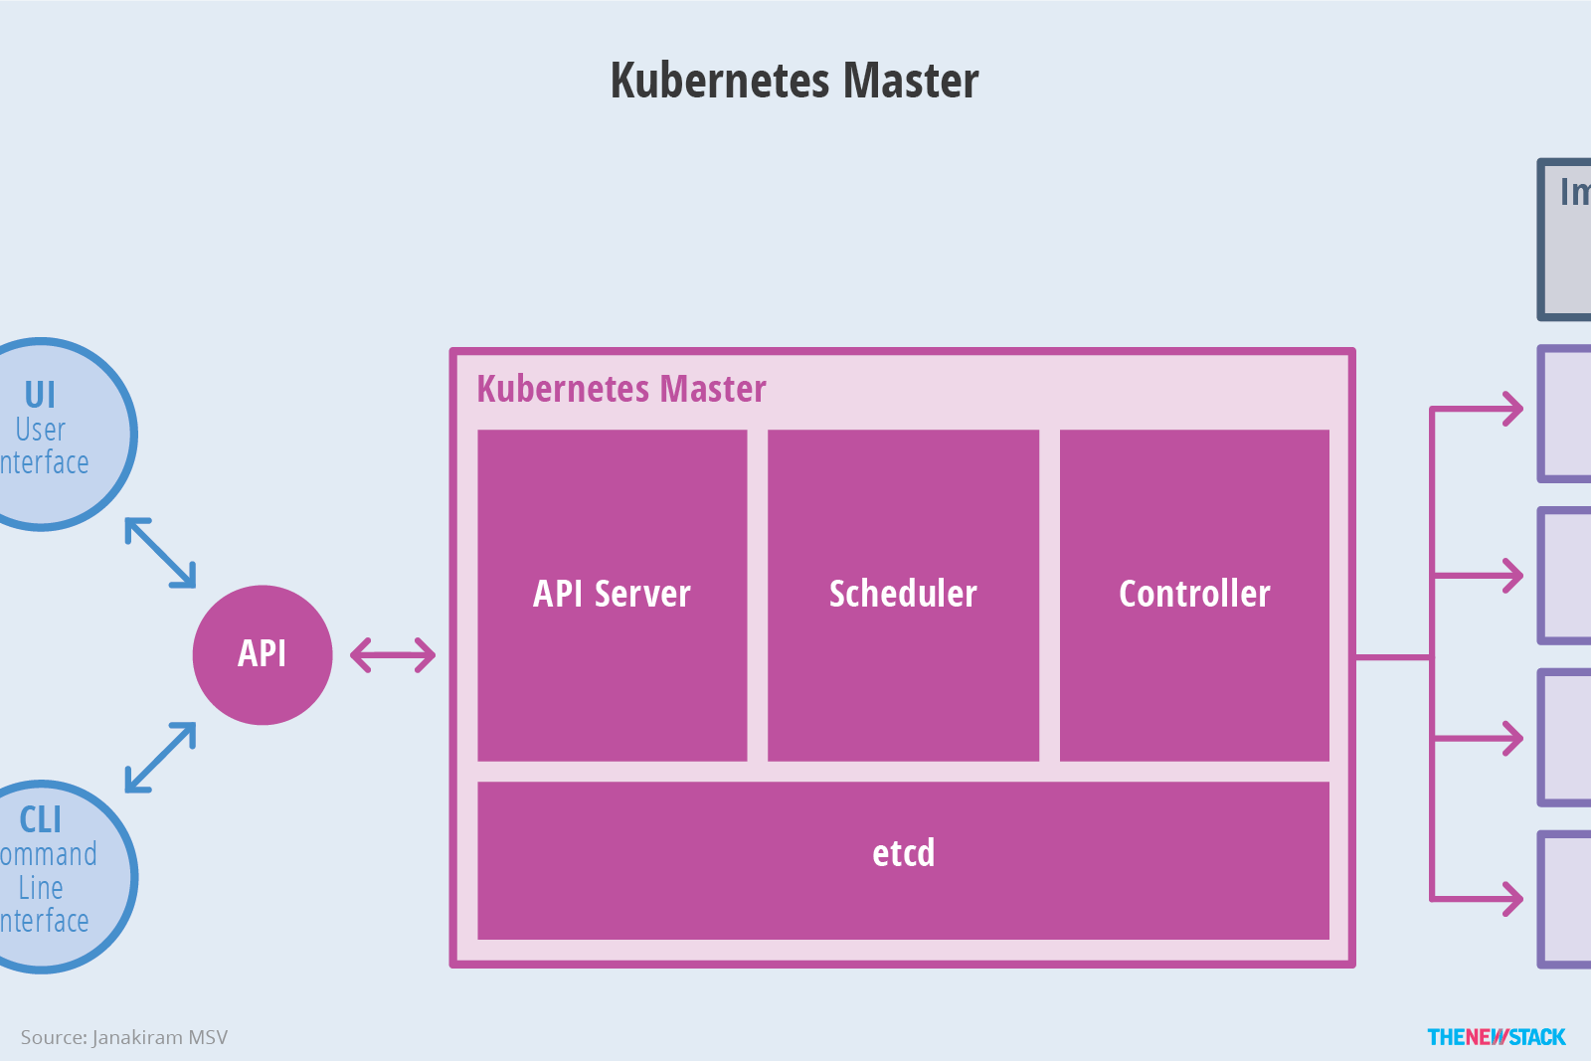
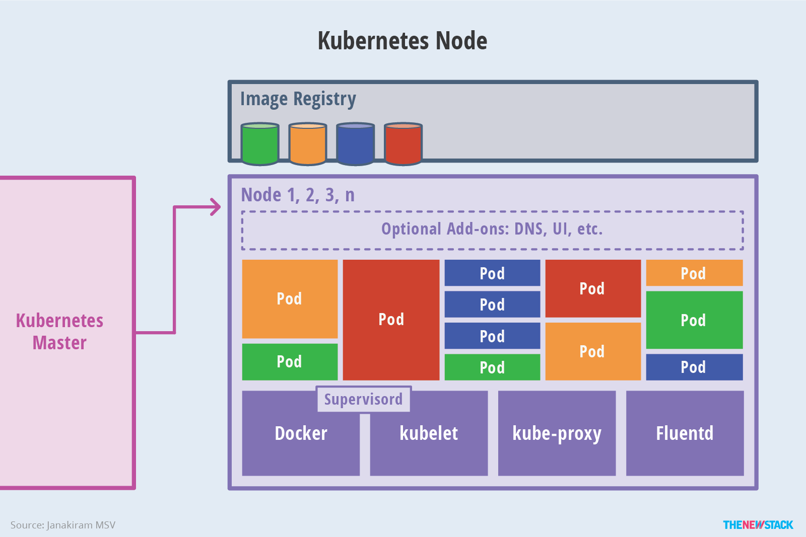
Master - Slave

Slide 11
Master
Acts as gateway/ primary point of contact/ brain
Exposes API to users and clients
Health checking other servers
Deciding how to best split up and assign work(aka scheduling)
Orchestrating communication b/w other components
Responsible for most of centralized logic
Authenticates clients and nodes
Adjust cluster-wide networking
Scaling

Slide 12
Master components
Etcd
  Globally available distributed key-value configuration store
  Developed by CoreOs
  Easily accessible by nodes through HTTP/JSON API
  Used for service discovery
  Help components configure or reconfigure themselves according to up-to-date information
  maintain cluster state with features like leader election and distributed locking

Slide 13
Master Components contd.
Kube-apiserver
  Main management point of the entire cluster
  It allows a user to configure Kubernetes' workloads and organizational units
  It is also responsible for making sure that the etcd store and the service details of deployed containers are in agreement
  It acts as the bridge between various components to maintain cluster health and disseminate information and commands.
  Implements RESTful interface
  A client called kubectl is available as a default method of interacting with the Kubernetes cluster from a local computer.

Slide 14
Master Components contd.
Kube-controller-manager
  Manages different controllers that regulate the state of the cluster
  Manage workload life cycles, and perform routine tasks
  For instance, a replication controller ensures that the number of replicas (identical copies) defined for a pod matches the number currently deployed on the cluster. The details of these operations are written to etcd, where the controller manager watches for changes through the API server
  When a change is seen, the controller reads the new information and implements the procedure that fulfills the desired state
  This can involve scaling an application up or down, adjusting endpoints, etc..

Slide 15
Master Components contd.
Kube-scheduler
  The process that actually assigns workloads to specific nodes in the cluster is the scheduler
  This service reads in a workload's operating requirements, analyzes the current infrastructure environment, and places the work on an acceptable node or nodes
  The scheduler is responsible for tracking available capacity on each host to make sure that workloads are not scheduled in excess of the available resources
  The scheduler must know the total capacity as well as the resources already allocated to existing workloads on each server.

Slide 16
Master Components contd.
cloud-controller-manager
  Act as the glue that allows Kubernetes to interact providers with different capabilities, features, and APIs while maintaining relatively generic constructs internally.
  This allows Kubernetes to update its state information according to information gathered from the cloud provider, adjust cloud resources as changes are needed in the system, and create and use additional cloud services to satisfy the work requirements submitted to the cluster.

Slide 17
Nodes
Servers responsible for accepting and running workloads using local and external resources
Equiped with container runtime like Docker or rkt
Node receives work instructions from the master server and creates or destroys containers accordingly
Adjusts networking rules to route and forward traffic appropriately

Slide 18
Nodes components
Kubelet
  Main contact point b/w nodes and cluster group
  Communicates with the master components to authenticate to the cluster and receive commands and work
  Work is received in the form of a manifest which defines the workload and the operating parameters
  The kubelet process then assumes responsibility for maintaining the state of the work on the node server
  It controls the container runtime to launch or destroy containers as needed.

Slide 19
Nodes components contd.
Kube-proxy
  Manages individual host subnetting and make services available to other components
  This process forwards requests to the correct containers, can do primitive load balancing
  Makes sure the networking environment is predictable and accessible, but isolated where appropriate

Slide 20
Appendix

Slide 21
Companies using K8s
Google
Github
Pokemon Go
Open AI
Shopify
9GAG
Asana
DigitalOcean
Banksalad
CircleCI
Starbucks
Buffer
The New York Times
InVisionApp
Evernote
Harvest
Avocode
Intel
JVM Stack
Teleport
Web Applications
Docplanner
Close.io
Checkr

Slide 22
Questions
Having reviewed kubernetes i feel we have question “how do we relate kuberntes in Opus environment” ?

