Slide 1
Association Rules Mining
IST 707 – Data Analytics

Slide 2
Association Rules
Association rules analysis is an algorithm to discover how items are associated to one another
In large data sets, interesting relationships can be discovered
While association analysis is often used to analyze market basket transactions, it is also applicable to other domains such as bioinformatics, medical diagnosis, Web mining etc.

Slide 3
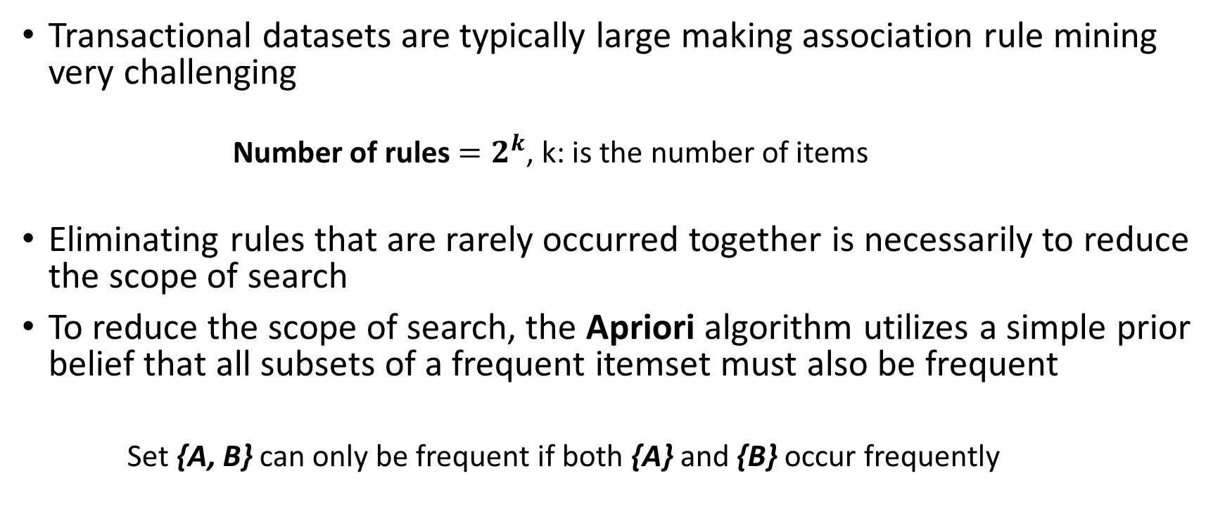
The Apriori algorithm
Transactional datasets are typically large making association rule mining very challenging
Number of rules $=2^{k}$, k: is the number of items
Eliminating rules that are rarely occurred together is necessarily to reduce the scope of search
To reduce the scope of search, the Apriori algorithm utilizes a simple prior belief that all subsets of a frequent itemset must also be frequent
Set {A, B} can only be frequent if both {A} and {B} occur frequently
Notes:
The number of potential itemsets grows exponentially with the number of items
2 items = 4 rules, 5 items = 32 rules, 10 items = 1024 rules, 100 items = 1.26e+30 rules
Evaluating each itemset one by one isn’t ideal because many combinations of items rarely occur together. By ignoring these rare combinations, the score of search can be limited to a more manageable size
If either {A} or {B} is infrequent, any set containing A, B can be excluded from the search

Slide 4
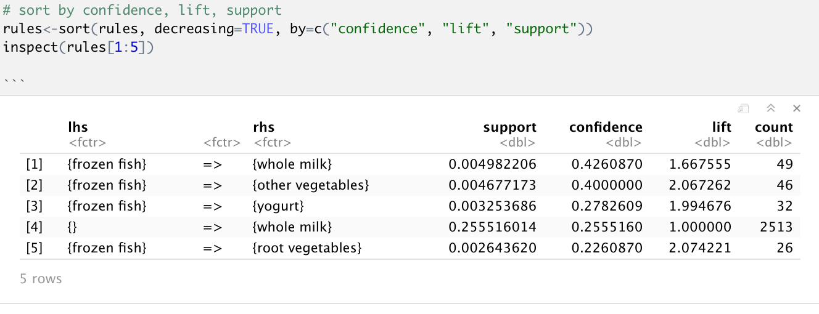
Sample rules

Slide 5
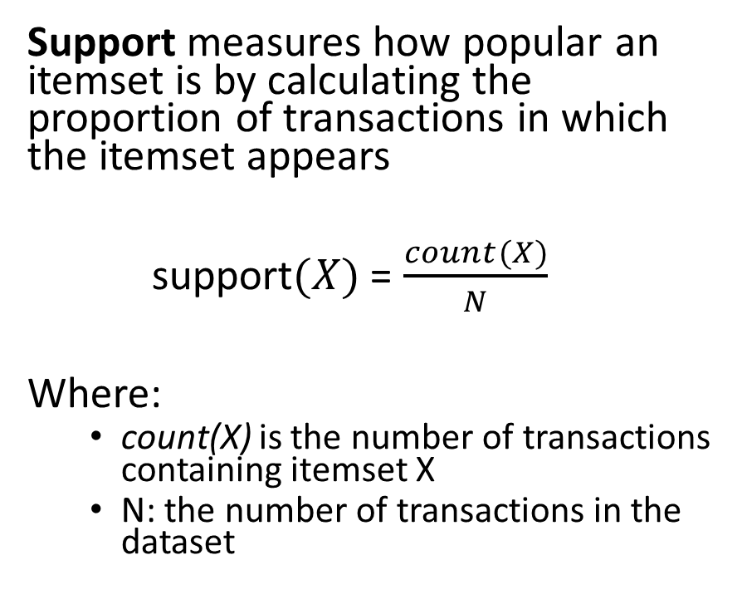
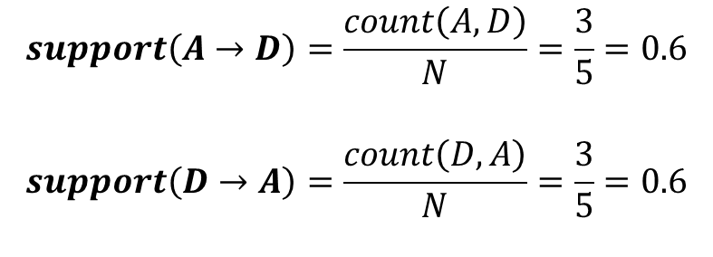
Measuring rule interest - Support
Transaction-id | Items bought
10 | A, B, D
20 | A, C, D
30 | A, D, E
40 | B, E, F
50 | B, C, D, E, F
Support measures how popular an itemset is by calculating the proportion of transactions in which the itemset appears
support$(X)$= $\frac{count(X)}{N}$
Where:
count(X) is the number of transactions containing itemset X
N: the number of transactions in the dataset
{A, D} example of a frequent itemset
{A} -> {D} example of an association rule
$$support\left(A→D\right)=\frac{count\left(A,D\right)}{N}=\frac{3}{5}=0.6$$
$$support\left(D→A\right)=\frac{count\left(D,A\right)}{N}=\frac{3}{5}=0.6$$
Notes:
A rule with low support:
May simply occur by chance
Is likely uninteresting from a business perspective
Support measure is often used to filter out uninteresting rules

Slide 6
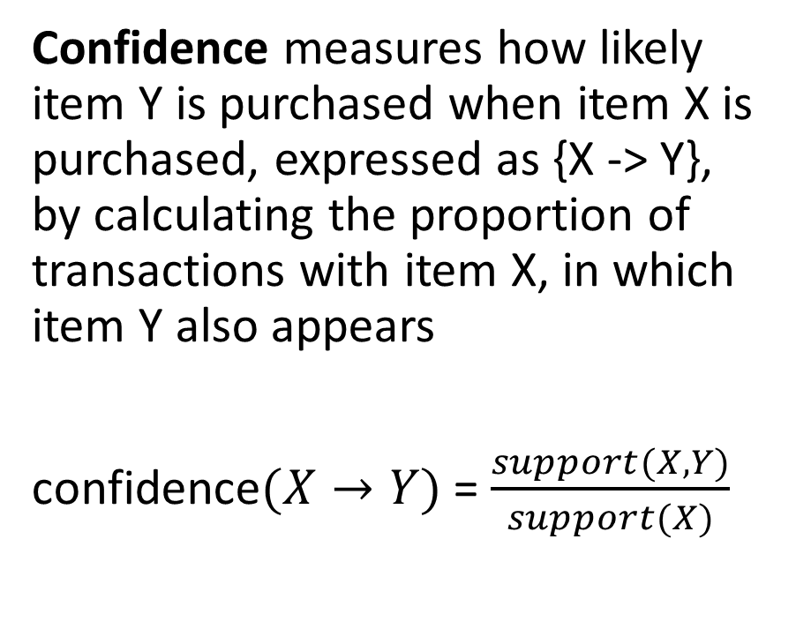
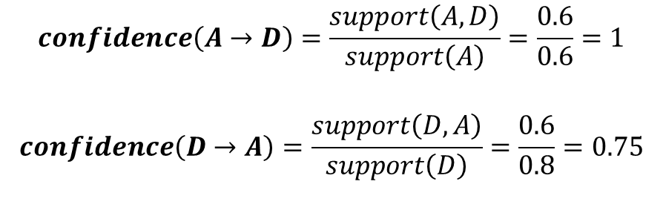
Measuring rule interest - Confidence
Confidence measures how likely item Y is purchased when item X is purchased, expressed as {X -> Y}, by calculating the proportion of transactions with item X, in which item Y also appears
confidence$(X→Y)$= $\frac{support(X, Y)}{support(X)}$
Transaction-id | Items bought
10 | A, B, D
20 | A, C, D
30 | A, D, E
40 | B, E, F
50 | B, C, D, E, F
$$confidence\left(A→D\right)=\frac{support\left(A,D\right)}{support\left(A\right)}=\frac{0.6}{0.6}=1$$
$$confidence\left(D→A\right)=\frac{support\left(D,A\right)}{support\left(D\right)}=\frac{0.6}{0.8}=0.75$$
Notes:
In other words, Confidence measure the reliability of the inference made by a rule. The higher the confidence, the more likely it is for Y to be present in transactions that contains X
Note that the inference made by association rule does not necessarily imply causation. It only suggests a strong co-occurrence

Slide 7
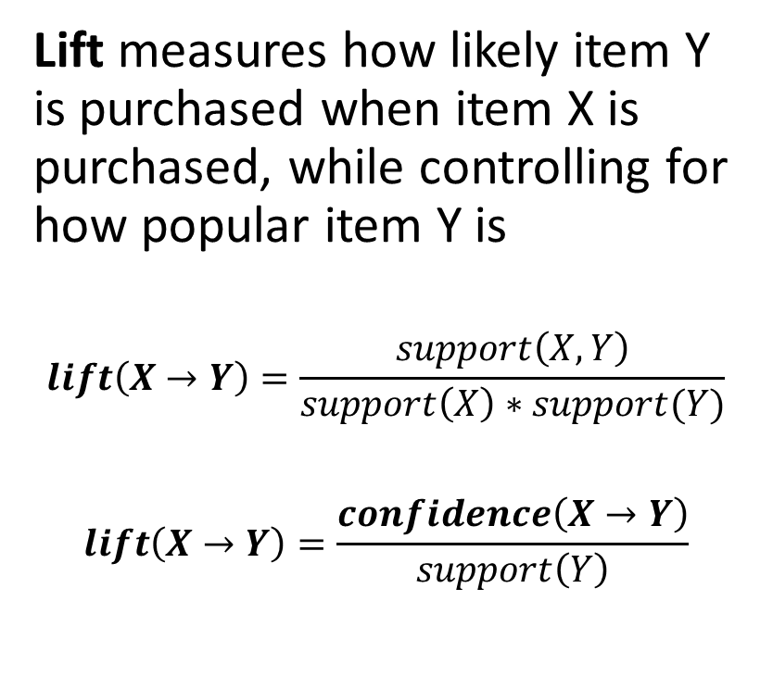
Measuring rule interest - Lift
Transaction-id | Items bought
10 | A, B, D
20 | A, C, D
30 | A, D, E
40 | B, E, F
50 | B, C, D, E, F
Lift measures how likely item Y is purchased when item X is purchased, while controlling for how popular item Y is
$$lift\left(X→Y\right)=\frac{support\left(X,Y\right)}{support\left(X\right)∗support(Y)}$$
$$lift\left(X→Y\right)=\frac{confidence\left(X→Y\right)}{support\left(Y\right)}$$
$$lift\left(A→D\right)=\frac{confidence\left(A→D\right)}{support(D)}=\frac{1}{0.8}=1.25$$
Notes:
Lift > 1 implies that items are found together more often than expected by chance alone.
Large lift value is a strong indicator that the rule is important and reflects a strong connections between items

Slide 8
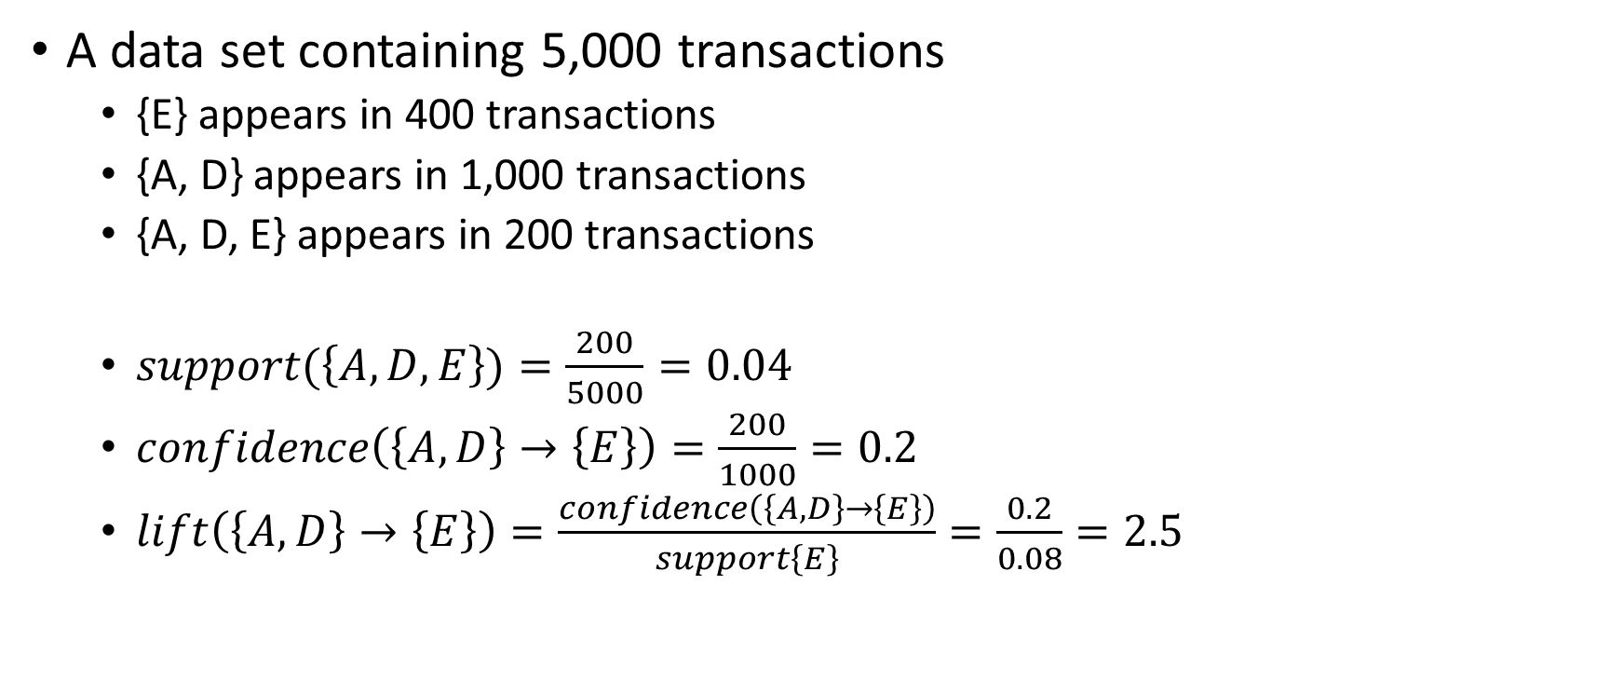
Another Example
A data set containing 5,000 transactions
{E} appears in 400 transactions
{A, D} appears in 1,000 transactions
{A, D, E} appears in 200 transactions
$support(\left\{A, D, E\right\})=\frac{200}{5000}=0.04$
$confidence\left(\left\{A,D\right\}→\left\{E\right\}\right)=\frac{200}{1000}=0.2$
$lift\left(\left\{A,D\right\}→\left\{E\right\}\right)=\frac{confidence\left(\left\{A, D\right\}→\left\{E\right\}\right)}{support\left\{E\right\}}=\frac{0.2}{0.08}=2.5$

Slide 9
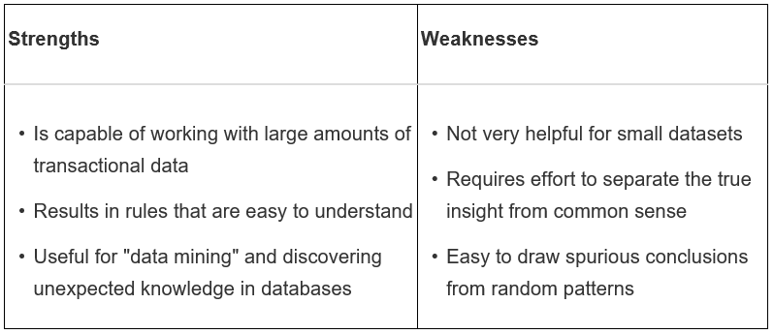
Strengths and Weaknesses

Slide 10
References:
Gareth James, Daniela Witten, Trevor Hastie, Robert Tibshirani. An Introduction to Statistical Learning : with Applications in R. New York :Springer, 2013
Lantz, B (2019). Machine Learning with R. Birmingham, UK: Packt Publishing Ltd.
Pang-Ning Tan, Michael Steinbach, Vipin Kumar. Introduction to Data Mining. Boston, MA: Pearson Education, Inc, 2005

