Slide 1
Data Preparation
IST 707 – Data Analytics

Slide 2
Week 2
Data Preparation Topics
Data Set Types / Attribute Types
Data Quality Issues
Summary Statistics / Visualization
Aggregation / Transformation
Data Sampling
What is Exploratory Analysis?
The tools in R for Exploratory Data Analysis

Slide 3
Data Set Types
Record Data – Data in tabular format
Each row is an observation and each column is an attribute
Text Documents
Image Data
Sequence Data
Transaction Data
Network Data

Slide 4
Attribute Types
Categorical (qualitative): limited number of distinct categories
Ordinal: information to order objects
Grades, {good, better, best}
Nominal: information to distinguish one object from another
Zip code, employee ID, gender
Numerical (quantitative): numerical values
Interval: differences between values are meaningful
Calendar dates, temperature in Celsius
Ratio: differences and ratios are meaningful
Age, mass, monetary

Slide 5
Data Quality
Goals of Data Quality:
Accuracy, Completeness, Uniqueness, Timeliness and Consistency
Handling missing values:
SME inputs
Remove the records with missing value
Use a global constant to fill the missing value
Use mean, median or mode to fill the missing value
Use the most probable value to fill the missing value
Notes:
Accuracy (Is the data recorded correctly?)
Completeness (Does it have all relevant attributes?)
Uniqueness (No duplicated records)
Timeliness (Is the data old?)
Consistency (the data is coherent)

Slide 6
Summary Statistics
Measures of central tendency:
Mean, median, mode
Measure of dispersion:
Range, quartiles, interquartile range

Slide 7
Aggregation & Transformation
Data transformation is a process to transform the original data to a preferable format for the input of certain algorithms. Methods include:
Aggregation, normalization, discretization, smoothing, feature engineering
Normalization – transform or map the data to a smaller or common range. All attributes have equal weight after this process. Methods:
Min-max, z-score
Discretization – convert a numerical variable to a categorical variable base on some criteria. This is a common way of creating a new variable from an existing one. Methods:
Binning, histogram analysis, cluster analysis, decision tree analysis, or correlation analysis
Notes:
Min-max normalization: This preserves the relationships among the original data values and performs a linear transformation on the original data. The applicable ones of the actual maximum and minimum values of an attribute will be normalized.
z-score normalization: Here the values for an attribute are normalized based on the mean and standard deviation of that attribute. It is useful when the actual minimum and maximum of an attribute to be normalized are unknown.
Data discretization by binning: This is a top-down unsupervised splitting technique based on a specified number of bins.
Data discretization by histogram analysis: In this technique, a histogram partitions the values of an attribute into disjoint ranges called buckets or bins. It is also an unsupervised method.
Data discretization by cluster analysis: In this technique, a clustering algorithm can be applied to discretize a numerical attribute by partitioning the values of that attribute into clusters or groups.
Data discretization by decision tree analysis: Here, a decision tree employs a top-down splitting approach; it is a supervised method. To discretize a numeric attribute, the method selects the value of the attribute that has minimum entropy as a split-point, and recursively partitions the resulting intervals to arrive at a hierarchical discretization.
Data discretization by correlation analysis: This employs a bottom-up approach by finding the best neighboring intervals and then merging them to form larger intervals, recursively. It is supervised method.

Slide 8
Data Sampling
Simple random sampling – randomly select cases from a population where each case is equally to be selected
Stratified sampling – first divide the population into homogeneous groups, then randomly sample from each groups
Cluster sampling – first divide the population into clusters, randomly sample a few clusters, then perform a census within these clusters
Notes:
Why do we need to do data sampling?
Resource intensive
Impossible to collect responses from all individual causing biased results
Population change
Simple random sampling is very common. Stratified sampling gives more precise information.
Simple random sampling in R – use the sample_n() function from dplyr
Stratified sampling – usge group_by() then sample_n()

Slide 9
Exploratory Data Analysis

Slide 10
Exploratory Data Analysis
Exploratory Data Analysis (EDA) is an informal process with no strict rules to examine data. While informal with no strict rule, EDA is still extremely critical in any data analysis project.
Notes:
No strict rules? Yes, because there isn’t a step 1, 2, 3 type of process. It is the creative phase where the analysts come up with as many questions as possible to study the quality of the data, discover unknown or validate known facts about the data

Slide 11
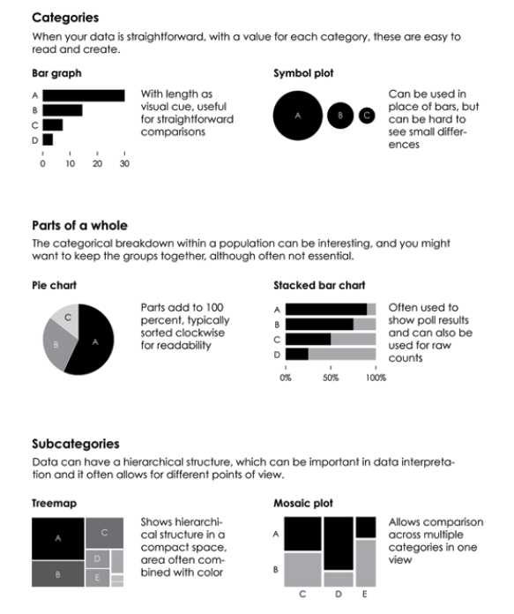
Exploring Categorical Variables

Slide 12
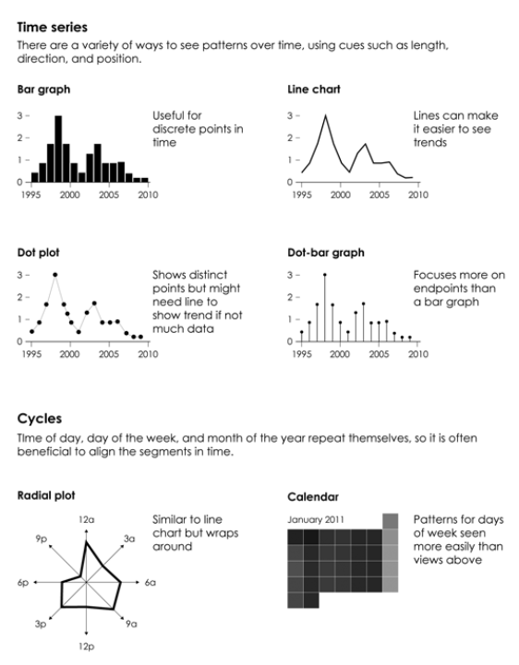
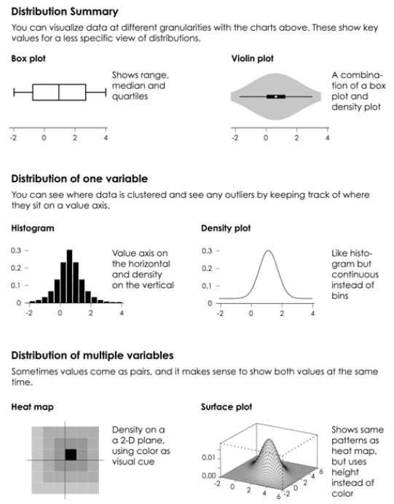
Exploring Continuous Variables

Slide 13
Using dplyr, tidyr and ggplot2 for EDA
dplyr solves data manipulation challenges and can speed up data analysis significantly. There are 5 primary functions:
select() – selects variables
filter() – selects rows
mutate() – creates a new variable or overwrite an existing one
summarise() – aggregates the data
arrange() – sorts rows
tidyr transforms data into tidy format. There are 2 primary functions:
gather() – transforms a data frame from wide to long
spread() – transforms a data frame from long to wide
ggplot2 makes plot using the grammar of graphic principles. There are 3 primary components:
data – the data to plot
aes() – the aesthetic mapping
geom_ - the geometry to plot
Notes:
During EDA, making the most beautiful plot isn’t necessary because the goal here is to examine and get some understanding about the data. Ggplot2 is a great tool for making plots due to its flexibility (even though at times it seems to take more code than a plot function in base R)

Slide 14
References:
Hadley Wickham, Garrett Grolemund. R for Data Science Sebastopol, CA: O’Reilly 2017
Yau, N. (2013). Data Points: Visualization That Means Something. Hoboken, NJ: John Wiley & Sons

