Slide 1
Naïve Bayes
IST 707 – Data Analytics

Slide 2
Bayesian Methods
Naïve Bayes is a probability-based classifier based on Bayesian methods.

Slide 3
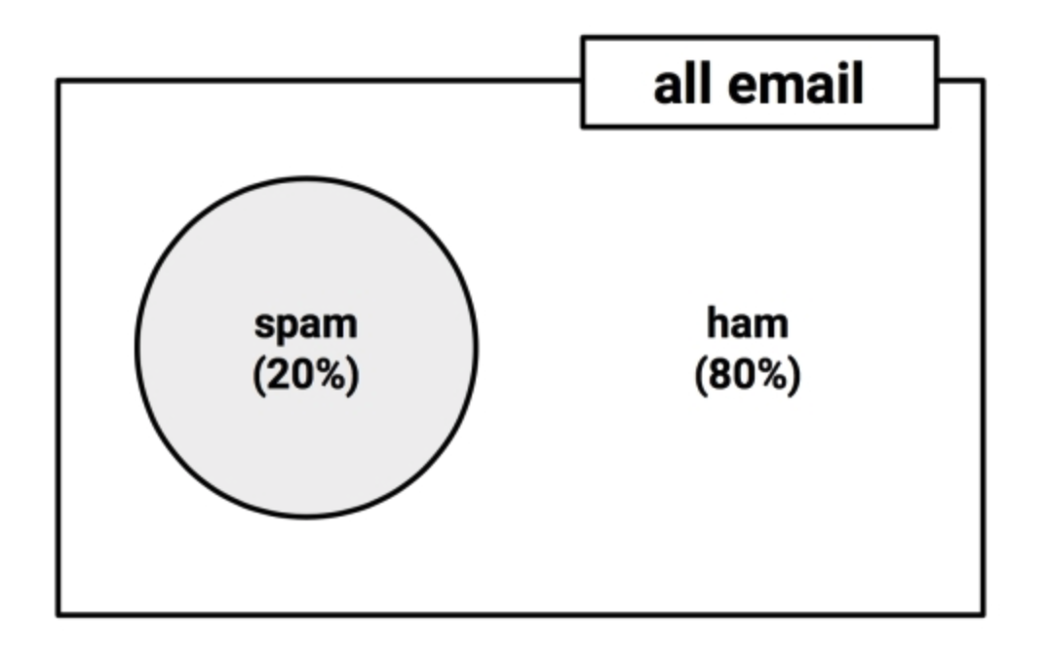
Understanding Probability
The probability of an event A, denoted as P(A), can be estimated by by dividing the number of trials in which the event occurred by the total number of trials
P(spam) = 0.2
P(ham) = 0.8
Notes:
P(ham) can also be calculated as 1 – P(spam) = 1 – 0.2 = 0.8. This is because spam and ham are mutually exclusive and exhaustive events

Slide 4
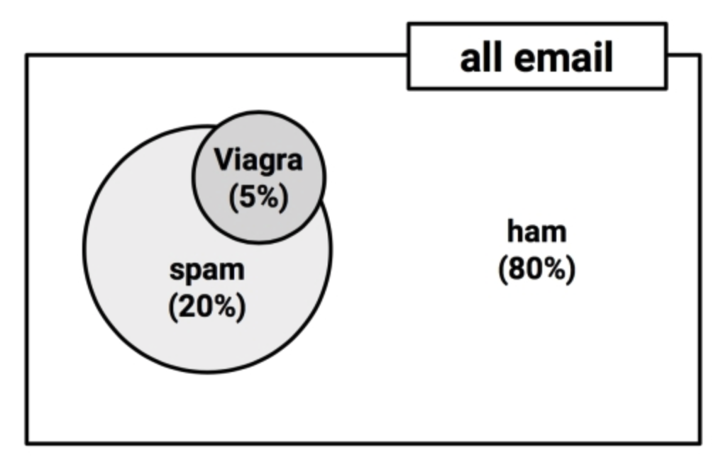
Join Probability
20 % of all messages are spam
5% of all messages contain the word “Viagra”
What is the probability that both P(spam) and P(Viagra) occur? In other words, what is the join probability of spam and Viagra?
Notes:
Often, non-mutually exclusive events are of interest because we can use them to make prediction if we observe certain events occur concurrently with the event of interest

Slide 5
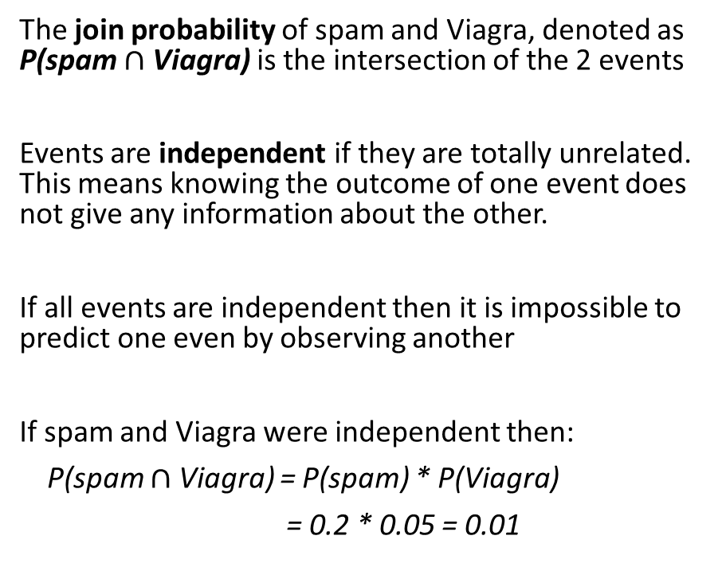
Join Probability cont.
The join probability of spam and Viagra, denoted as P(spam $∩$ Viagra) is the intersection of the 2 events
Events are independent if they are totally unrelated. This means knowing the outcome of one event does not give any information about the other.
If all events are independent then it is impossible to predict one even by observing another
If spam and Viagra were independent then:
P(spam $∩$ Viagra) = P(spam) * P(Viagra)
= 0.2 * 0.05 = 0.01
Spam without Viagra
Ham with Viagra
Viagra
Viagra
&
Spam
Spam
Spam with Viagra
Notes:
It is highly unlikely that spam and Viagra are two independent events, therefore the join probability calculated above is incorrect

Slide 6
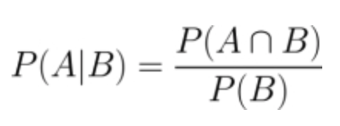
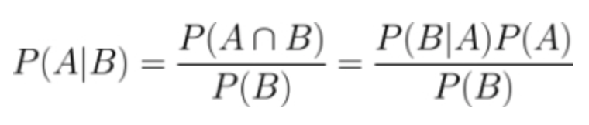
Conditional Probability with Bayes’ Theorem
The relationships between dependent events can be described using Bayes’ Theorem as:
how often A and B occurred together
Probability of A given that B occurred. Also known as conditional probability
how often event B occurred in general
Since $P\left(A∩B\right)=P(B∩$ A), the above equation can be rewritten as:

Slide 7
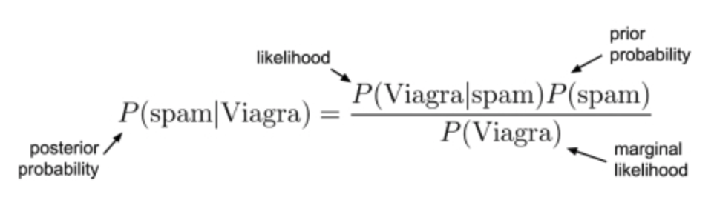
Conditional Probability cont.
prior probability, P(spam), is the probability that any prior messages was spam
likelihood, P(Viagra|spam), is the probability that the word “Viagra” was used in previous spam messages
marginal likelihood, P(Viagra), is the probability that “Viagra” appeared in any messages at all
posterior probability, P(spam|Viagra), measures how likely a message is to be spam

Slide 8
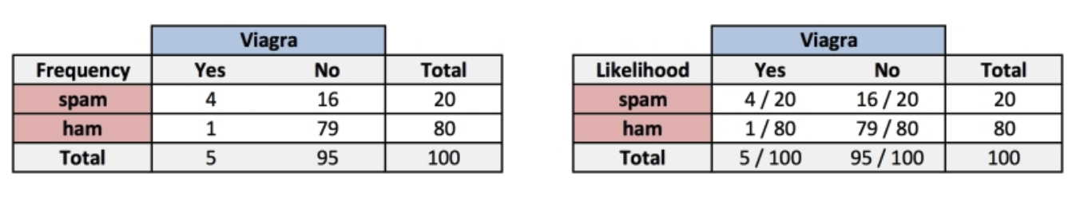
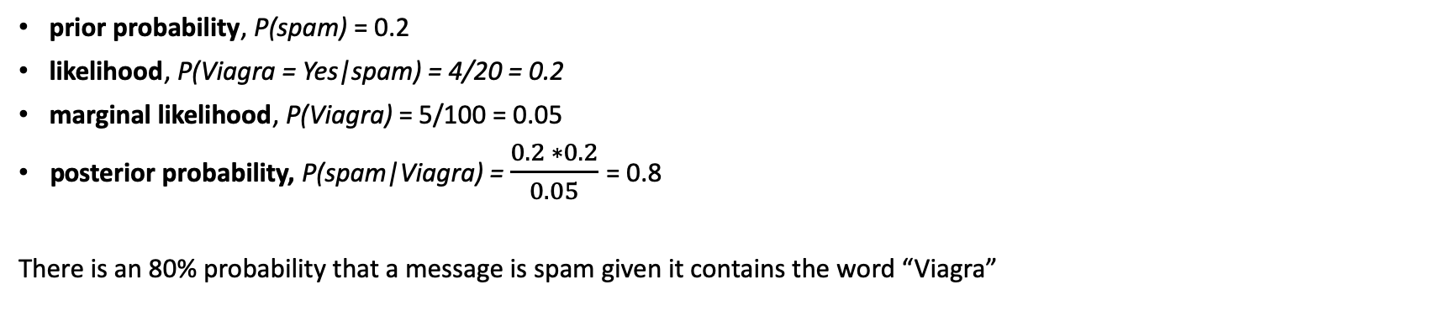
Conditional Probability cont.
prior probability, P(spam) = 0.2
likelihood, P(Viagra = Yes|spam) = 4/20 = 0.2
marginal likelihood, P(Viagra) = 5/100 = 0.05
posterior probability, P(spam|Viagra) = $\frac{0.2 ∗0.2}{0.05}$ = 0.8
There is an 80% probability that a message is spam given it contains the word “Viagra”

Slide 9
Many predictors problem
Viagra
Viagra
Viagra
&
Spam
Spam
Spam
$2^{n}$ possible combinations of values for $n$ binary attributes
Money
Notes:
Adding more predictors complicate the problem.

Slide 10

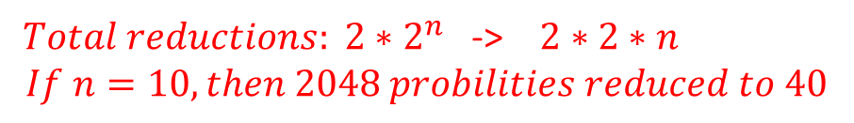
Naïve Bayes algorithm
The Naïve Bayes algorithm applies Bayesian method to estimate the conditional probability of an outcome with some “naïve” assumptions about the data. Naïve Bayes assumes that all of the features in the data set are equally important and independent
$$≈$$
x
${ Total reductions: 2∗2}^{n}$ -> $2∗2∗n$
$$If n=10, then 2048 probilities reduced to 40$$
Notes:
What’s the purpose of making these assumptions? so the calculation of join probabilities of independent even can be simplified
These assumptions are rarely true but Naïve Bayes still often performs fairly well

Slide 11
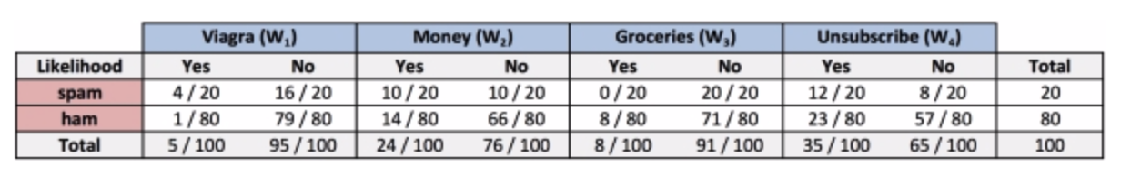

Classification with Naïve Bayes
The probability that the message is spam given Viagra = Yes, Money = No, Groceries = No, Unsubscribe = Yes can be calculated by:
With Naïve Bayes, conditional independence allows the calculation to be simplified as:
Notes:
The shorthand $¬$ notation denote the probability of the event not occurring.

Slide 12



The Laplace correction
A never happened before event based on the observed data
$$≈$$
x
x
$$P\left(A∩B\right)=0$$
To eliminate the zero join probability problem, add a small value to each probability
+1
+1
+1
$$≈$$
x
x
Notes:
If an event has join probability of zero, the entire sequence outcome will be zero regardless of how high the joint probabilities of other events might be. This is not desired.
While an event might have never happened in the past, that does not mean it will never happen in the future.
Laplace estimator adds a small number (typically 1) to each of the count in the frequency table to ensure nonzero probability

Slide 13
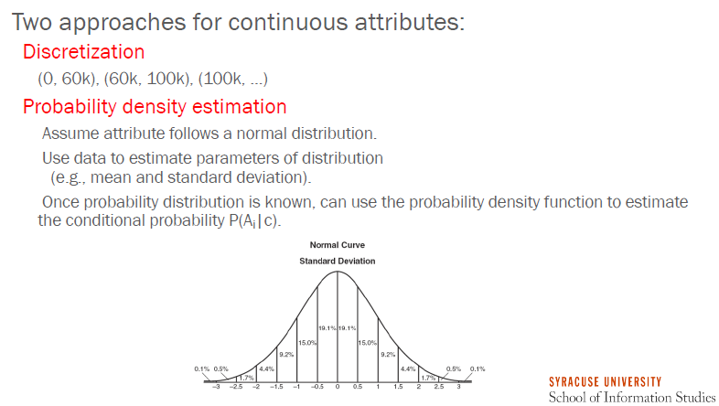
Continuous Attributes
Notes:
Naïve Bayes does not work directly with numeric data because it uses frequency tables to learn the data. In order to create the matrix with the combinations of classes and attribute values, attributes must be categorical.

Slide 14
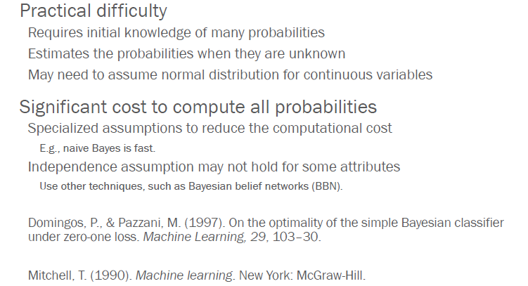
Challenge of Bayesian methods
Notes:
In addition, there are typically lot of data preprocessing are required

Slide 15
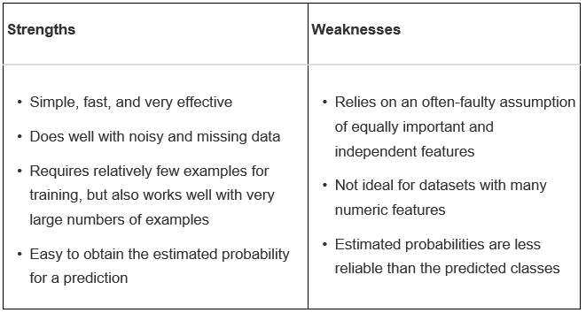
Strengths and Weaknesses

Slide 16
References:
Lantz, B (2019). Machine Learning with R. Birmingham, UK: Packt Publishing Ltd.
Pang-Ning Tan, Michael Steinbach, Vipin Kumar. Introduction to Data Mining. Boston, MA: Pearson Education, Inc, 2005

