Slide 1
Nearest Neighbor Classification
IST 707 – Data Analytics

Slide 2
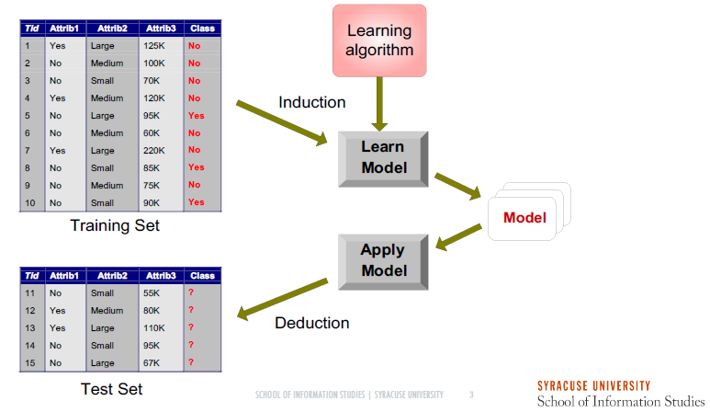
Classification Process

Slide 3
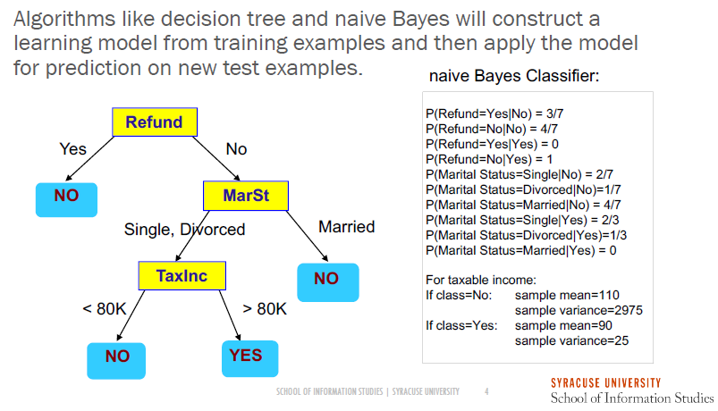
Machine Learning Algorithms

Slide 4
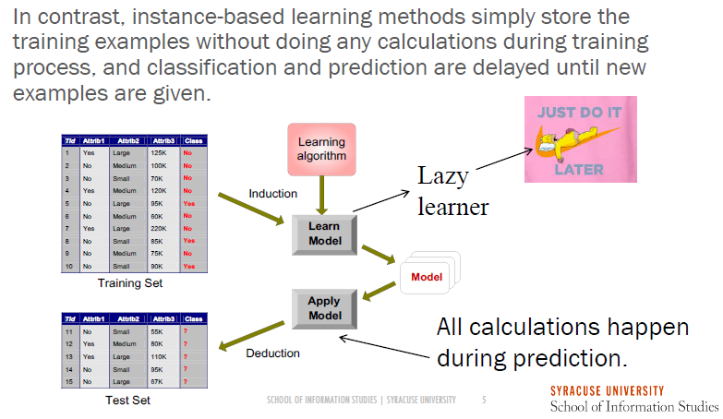
Instance-Based Learning
Notes:
Lazy learner because the entire process of abstraction and generalization is skipped

Slide 5
Nearest Neighbor Classification
Nearest Neighbor classifies unlabeled data by assigning them the class of similar labeled data
Notes:
kNN is one of the most simple predictive algorithms because it doesn’t really actually required any learning. Thus the training phase is done very fast.
kNN only needs a way to measure similarity between examples and make a simple assumption that examples that are close to one another are similar

Slide 6
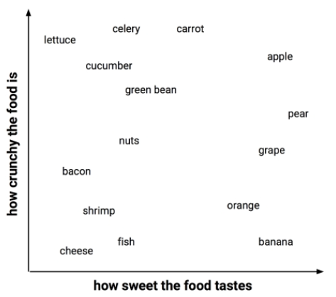
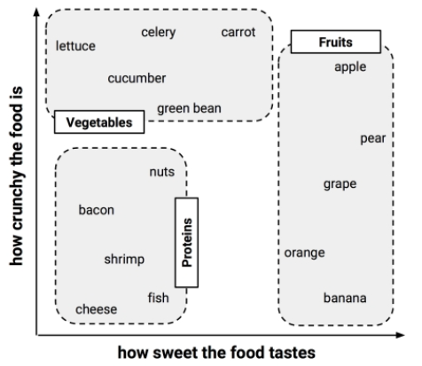
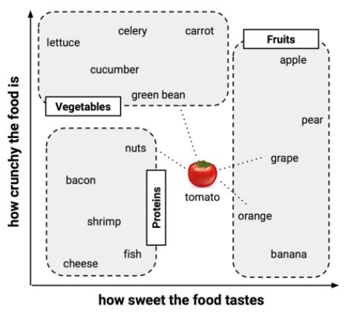
k-Nearest Neighbors algorithm (k-NN)

Slide 7
Measuring Similarity
Similarity and distance: Two opposite concepts
Similarity measures how close or similar two examples are.
Distance measures how far or different two examples are.
Numeric Attribute:
Euclidean, Manhattan, Minkowski
Distance between Nominal Values:
Simple matching, Binary Coding
Notes:
Week 4 for complete reference

Slide 8
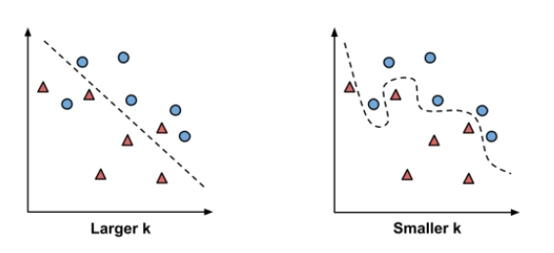
Choosing k
neighborhood may include points from other classes
Sensitive to noises
Notes:
The best k is somewhere between the 2 depicted in pictures above.
When the training data set is large, choosing k becomes less important because even subtle concepts will have a large pool of observations to vote as nearest neighbor
When the training data set is small, a common approach is to start with k = square root of the number of training observations. Alternatively, use several different values of k and test the performance of the test data set

Slide 9



Data Preprocessing
Min-Max Normalization
z-score Standardization
Dummy Coding

Slide 10
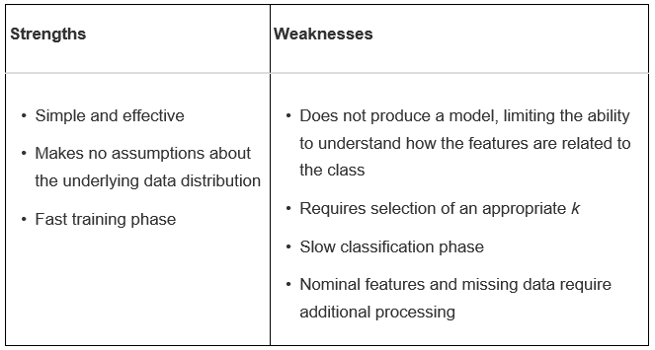
Strengths and Weaknesses

Slide 11
Support Vector Machine
IST 707 – Data Analytics

Slide 12
Support Vector Machine Algorithm
Support Vector Machine (SVM) algorithm combines aspects of both Classification using Nearest Neighbors and Regression Methods to model highly complex relationships. SVM can be used to make classification and numeric prediction
The goal of SVM is to create a flat boundary called a hyperplane, which divides the space to create fairly homogeneous partitions of either side

Slide 13
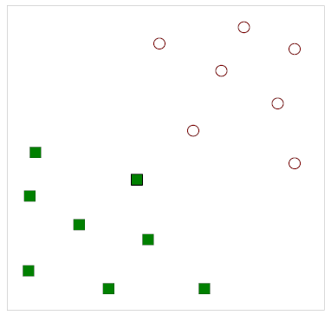
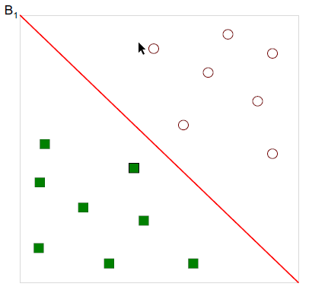
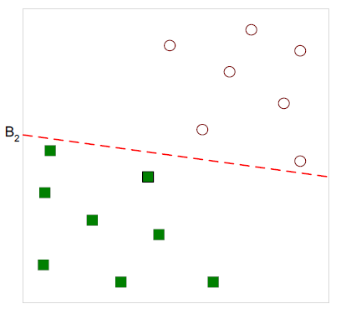
Decision Boundary
Find a decision boundary to
Separate the data
One possible solution:
Another possible solution:
Notes:
Given a data set in Fig 1, find a decision boundary to separate the squares and dots
Many possible solutions but which one is better?
Note: Decision Boundary can have many shapes. They can be lines like above, polynomial curves or many other complex function. Type of decision boundary is called a kernel
- When building model, they type of decision boundary needs to be specified up front

Slide 14
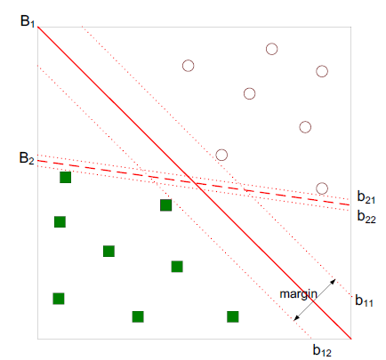
Hyperplane
SVM searches for the Maximum Margin Hyperplane that creates the greatest separation. The greater the separation, the higher chance each point will stay on the correct side of the hyperplane
In this example, B1 is a better choice than B2

Slide 15
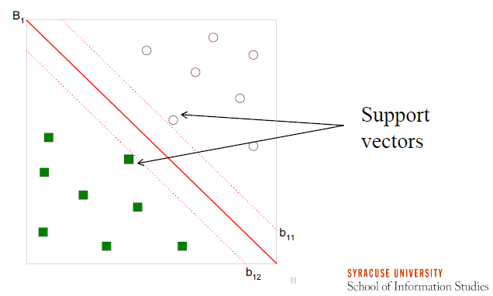
Support Vectors
Support vectors are the training examples (“vectors”) that are located on the margins
Only support vectors determine the decision boundary. At least one support vector is required for each group
Non-support vectors do not participate in prediction
Notes:
The more support vectors, the more complex the model

Slide 16
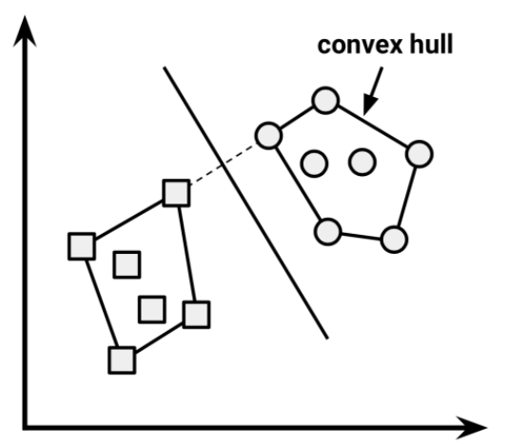
Linearly Separable
When the data is linearly separable, one approach to find the Maximum Margin Hyperplane is by creating the outer boundaries for the two groups (known as convex hall), identifying the shortest line between the 2 convex hulls then drawing a perpendicular line
An alternative approach is to search for all possible hyperplanes to identify a set of 2 parallel planes that are furthest apart

Slide 17
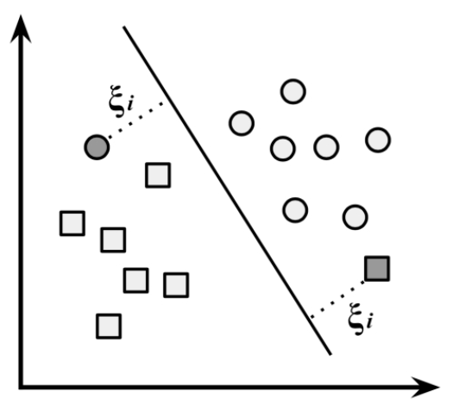
Non-Linearly Separable
When the data is non-linearly separable, a soft margin is created which allows some points to fall on the wrong side of the plane. A cost value, C, is then applied to all of these points
The algorithm is then trying to minimize the total cost instead of maximize the margin
Higher cost – harder to achieve high separation
Low number of support vectors because the margin becomes narrower
Lower cost – too many incorrectly classified points
High number of support vectors
Notes:
Soft margin is very useful when the data is nearly linearly separable

Slide 18
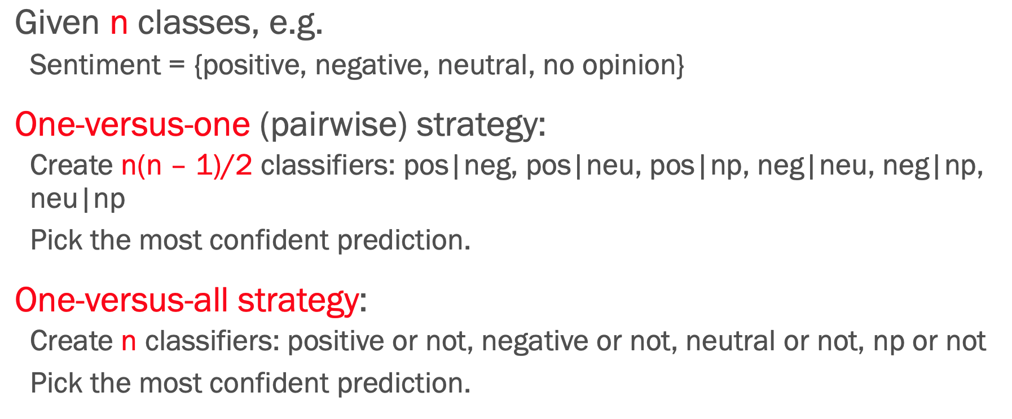
Multiclass Problems
SVM is essentially a binary classifier. However, it can still be applied to multiclass problems.

Slide 19
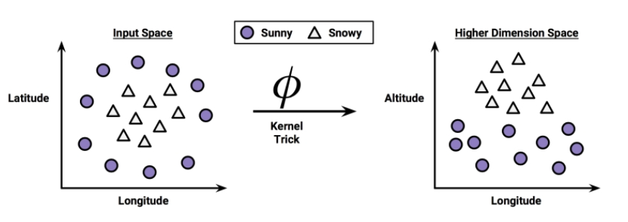
Kernel Trick
An alternative approach in handling non-linearly separable data is known as Kernel Trick which maps the data into higher dimension space. When kernel trick is applied, additional features get created allowing the data to be viewed in new perspectives
Notes:
This is a key feature of SVM, mapping the problem into higher dimension space and it might potentially be linearly separable.

Slide 20
Common Kernels
The linear kernel does not transform the data at all
The polynomial kernel of degree d adds a simple nonlinear transformation of the data
The sigmoid kernel results in a SVM model somewhat analogous to a neural network using a sigmoid activation function
The Gaussian RBF kernel is similar to a RBF neural network. The RBF kernel performs well on many types of data and is thought to be a reasonable starting point for many learning tasks
There is no rule in matching a particular kernel to a learning task. Often time evaluating the outputs of the test dataset is required to choose one that most suitable to the task.
Important to normalize the input data so all the variables have comparable input unit

Slide 21
svm() function from the e1071 package
formula – model to be fit. Specify the dependent and predictor variables
data – data frame containing the data – i.e. train_set
type –
C-classification, nu-classification, one-classification (for novelty detection), eps-regression, nu-regression
kernel – the form of the decision boundary
Linear, polynomial, radial, sigmoid
cost – parameter used to tune model
cost of constraints violation (default: 1)
gamma – parameter used to tune model
parameter needed for all kernels except linear (default: 1/(data dimension))
scale – to scale the data or not

Slide 22
References:
Gareth James, Daniela Witten, Trevor Hastie, Robert Tibshirani. An Introduction to Statistical Learning : with Applications in R. New York :Springer, 2013
Lantz, B (2019). Machine Learning with R. Birmingham, UK: Packt Publishing Ltd.
Pang-Ning Tan, Michael Steinbach, Vipin Kumar. Introduction to Data Mining. Boston, MA: Pearson Education, Inc, 2005

