Slide 1

Query Rewrite for SparkSQL
By Ey-Chih Chow

Slide 2
Query Rewrite in SparkSQL
Materialized View (MV) not supported
Cache support for query rewrite
/** Replaces segments of the given logical plan with cached versions where possible. */
def useCachedData(plan: LogicalPlan): LogicalPlan = { plan transformDown { case currentFragment => lookupCachedData(currentFragment) .map(_.cachedRepresentation.withOutput(currentFragment.output)) .getOrElse(currentFragment)
} }
/** Optionally returns cached data for the given [[LogicalPlan]]. */ def lookupCachedData(plan: LogicalPlan): Option[CachedData] = readLock { cachedData.find(cd => plan.sameResult(cd.plan)) }
Same approach applicable to MV

Slide 3
Query Rewrite and SparkSQL
Extend SparkSQL Data Context Service
/**
* Provides support in a ToolContext for query rewrite
*/
class ExtendedCatalogManager(val database: String) {
private val mvDefinitions = new mutable.HashMap[Set[TableIdentifier], Set[(LogicalPlan,BigInt)]]
private val cacheDefinitions = new mutable.HashMap[Set[TableIdentifier], Set[(LogicalPlan,BigInt)] ]
def queryRewrite(query: LogicalPlan): Option[String] = {
…
}
…
}

Slide 4
An example database, query, and MV
Database:
Trans(tid, fpgid, flid, data, faid, price, qty, disc)
Loc(lid, city, state, country)
Query:
select flid, year(date) as year, count(*) as cnt
from Trans, Loc
where flid = lid and country = ‘USA’
group by flid, year(date)
having count(*) > 100
MV:
select faid, flid, year(date) as year, count(*) as cnt
from Trans, Loc
where flid = lid and country = ‘USA’
group by faid, flid, year(date)

Slide 5
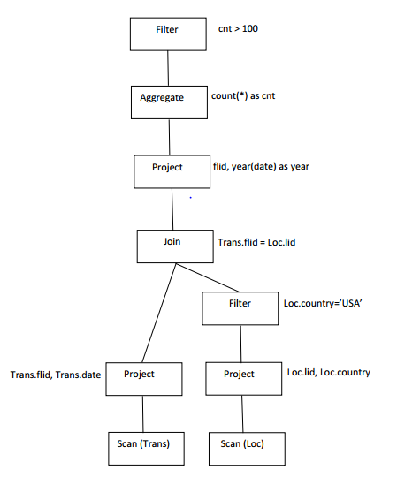
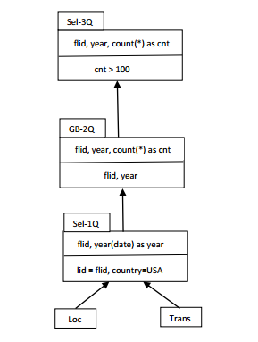
Logical vs. Modular Plan
Logical Plan
Modular Plan

Slide 6
From Logical to Modular Plan
A Logical Plan is transformed to a Modular Plan by applying a set of Pattern Extractions
Every Pattern Extraction uses pattern matching to convert a Tree to another kind of Tree
object GroupByBlock extends Pattern with PredicateHelper {
…
def apply(plan: LogicalPlan): Seq[SemanticPlan] = plan match {
case ExtractGroupBy(output, input, predicate, child) =>
makeGroupByBlock(output, input, predicate, matchLater(child))
case _ => Nil
}
} Triggers other Patten Extractions

Slide 7
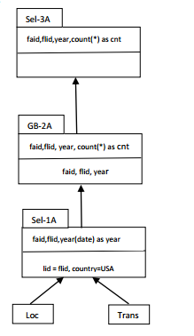
Matching Framework
Query
MV

Slide 8
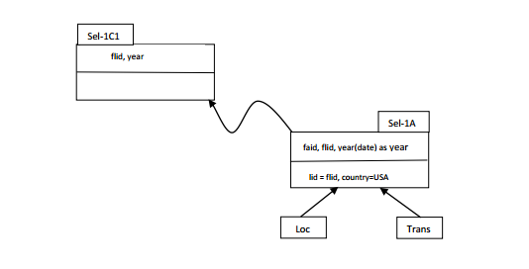
Rule #1: Select-Select-NoChildDelta

Slide 9
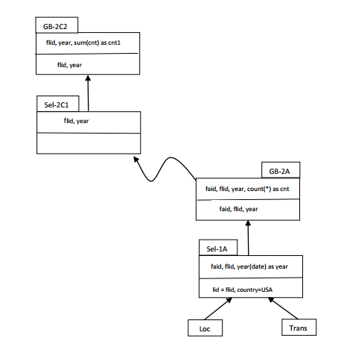
Rule #2: Groupby-Groupby-SelectOnlyChildDelta

Slide 10
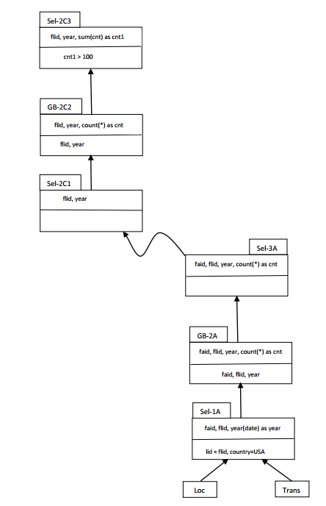
Rule #3: Select-Select-GroupbyChildDelta

Slide 11
From Modular Plan to SQL
[SPARK-12593] Converts resolved logical plan back to SQL
SQLBuilder.toSQL
Scala compiler – coverts Scala AST to Scala code fragment using DSL

Slide 12
Extensions
Union and subqueries
Need a navigator
Cube advisor
Find covering queries as MVs or Cache
Carbon Data
Lineage data for ExtendedCatalog

Slide 13
Extended Catalog
MV Definitions – derived from lineage info
Materialized Views saved in the form of CarbonData
Lineage described logically by SQL query and its input tables
Cache Definitions – derived from cacheData (ArrayBuffer[CachedData]) in CacheManager

Slide 14
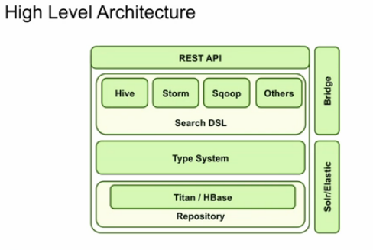
Lineage Data

