Slide 1
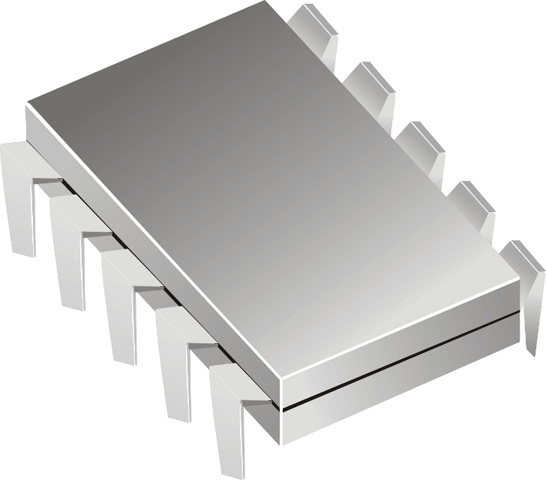
CNN IP Controller
청주대학교 장 경 석

Slide 2

Contents
1. Outline & IP Design Plan
2. FSM Design Plan
3. Block Diagram & Flow Chart
4. Timing Diagram

Slide 3
Convolution Controller
Design Plan
Condition
1) Assumed ARM Interface code and BRAM data are already existed.
2) Input data and Weight data are changed 32bit floating point to 16bit fixed point.
3) Using three block memories.
4) Need to consider kernel size, stride, padding
- Kernel size defines the number of PE modules.
- Stride defines kernel’s movement in PE modules.
- Padding defines edge data of input.
How to consider kernel, stride, padding?
1) Kernel
Kernel size defines the number of PE modules. If using 3x3 filter, the number of filter is 9, using 5x5 filter, the number of filter is 25.
2) Stride
We will use shift register for considering stride.
I
PE
W
S
Image
Weight
Read 5 col of weight
Read 4 col of image
For(x < image_width)
Read 1 col of image
Do MAC
Write Result
Shift Register
Mult

Slide 4
Design Plan
Address Map
How to consider kernel, stride, padding?
3) Padding
Inner Register
0x43C00000
Signal 1
0x43C00004
Signal 2
0x43C00008
Signal 3
0x43C0000C
Signal 4
Reserved
If(count % (224+(padding*2))<padding
0x43C00100
Input
If(count % (224+(padding*2))>224+padding
0x43C0C400
Reserved
0x43C0C500
Weight
If(count / (224+(padding*2))<padding
0x43C0C5F0
Reserved
0x43C0C700
If(count / (224+(padding*2))>224+padding
Conv
0x43C18B00

Slide 5
Finite State Machine (IDLE)
Finite State Machine (READ)
Definition of each signal properties
1) Start signal
2) Input Done signal
3) Weight Done signal
4) Convolution Done signal
5) Write Done signal
IDLE state properties
When Finite State Machine starts, First state is IDLE, means waiting next state signal and doing nothing. If Start signal goes high level, state will be next stage, READ.
Read State properties
When Start signal is high level, Read state begins. In Read state, Finite State Machine send enable signal and specific address to BRAM_Input and BRAM_Weight. It will read input data and weight data that is sent by ARM Interface. When all of input data is read, it will send Input Done signal, 1. and when all of weight data is read, it will send Weight Done signal, 1. If Input Done signal data is 1 and Weight Done signal data is 1, Read state will be done.
If(Addr == (Input Size))
I_Done == 1
READ
IDLE
If(Addr == (Weight Size))
W_Done == 1
Start
I_Done == 1 && W_Done == 1
READ

Slide 6
Finite State Machine (CONV)
Finite State Machine (WRITE)
Convolution State properties
When I_Done & W_Done signal are high level, convolution state begins. If convolution state begin, Input data multiplies to Weight data in PE module. That data will be sum data and output of PE module. Output data will be calculated lots of PE modules. If We choose 3x3 Filter, the number of PE modules is 9, and choose 5x5 Filter, the number of PE modules is 25. When convolution state is done, convolution_Done signal goes high level.
Write State properties
When Convolution_Done signal is high level, Write state begins. If Write state begin, convolution result data will be written and saved in BRAM_Result Memory. When Write state is done(that means all of convolution result data are written and saved in BRAM_Result Memory), Write_Done signal goes high level and current state go back to IDLE state.
BRAM
Address Map
I
PE
I
PE
I
PE
Signal 1
Signal 2
W
W
W
Signal 3
Convolution Result Data in
Signal 4
Reserved
S
S
S
Write Done = 1
Result

Slide 7
How to Design ( Connect BRAM & Controller & Convolution Module & No Arbiter)
< CNN Controller >
BRAM
Controller
Address Map
IDLE
Inner Register
Input
Signal 1
Signal 2
Signal 3
Signal 4
R
Reserved
BRAM
Address Map
Input
Convolution (PE)
I
Weight
W
C
(PE)
Reserved
Weight
BRAM
S
Address Map
Reserved
W
Result
Conv

Slide 8
How to Design
IDLE
< Read State >
( Flow Chart )
Start
BRAM
BRAM
READ
Address Map
Address Map
Signal 1
Weight Data Read
Input Data Read
Signal 1
Signal 2
Signal 2
Signal 3
Weight Done = 1
Input Done = 1
Signal 3
Signal 4
Signal 4
Reserved
Reserved
Weight
Input
If(I_Done &&W_Done)
Conv (PE)
WRITE

Slide 9
How to Design
IDLE
< Convolution State >
(Flow Chart)
Input
READ
Convolution (PE)
I
Weight
W
Conv (PE)
Input / Weight In
Sum
S
If(C_Done == 1)
Convolution_Done = 1
WRITE

Slide 10
How to Design
IDLE
< Write State >
(Flow Chart)
Start
READ
If(W_Done == 1)
Conv (PE)
If(C_Done == 1)
BRAM
Address Map
WRITE
Signal 1
Signal 2
Signal 3
Convolution Result Data in
Signal 4
Reserved
If(Write_Done == 1)
Write Done = 1
Result

Slide 11
CLK
RSTn
cState
nState
Start
En_Input
Addr_Input
Input_Done
En_Weight
Addr_Weight
Weight_Done
Input_Reg
Weight_Reg
Conv_Reg
C_Done
En_Re
Wen_Re
Addr_Result
D_in_Result
Write_Done

Slide 12
Thank you
청주대학교 장 경 석

