Slide 1


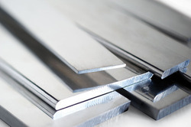


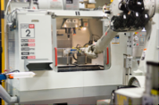



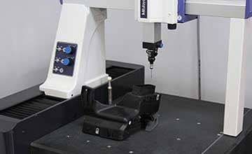

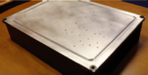
Aluminum Plate Contract Manufacture (L2)
Alumina (L2)
HS Shearing
(L3)
Aluminum Plate Demand (L1)
Alumina Powder
Aluminum Plate
HS Base Shearing
(L3)
Anodizing
(L3)
Accessories (L2)
Smelting (L2)
Finished Heat Sink Demand (L1)
CNC
Machining
(L3)
Accessory Package
Heat Sink Base
Quality
Inspection
(L3)
Supply (L1)
Finished Heat Sink Part
HS Base Drilling (L3)
HS Base PL (L2)
Assembly
(L3)
HS Base Demand (L1)
HS Base Contract
Manufacture (L2)
Manufacturing (L1)
HS PL (L2)
Heat Sink Supply Chain (L0)

