Slide 1

Real Estate Market Predictions
Real Estate Market Predictions:
A look at North Carolina
A look at NC real estate

Slide 2
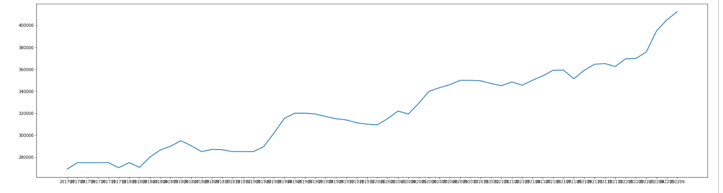
Why real estate? Why now?
A world wide pandemic brought about a low supply of housing with a high demand. This has driven drastic price increases. As inflation begins to increase mortgage rates, will the housing market continue to see such growth? Will prices level off? What are the factors that ultimately affect the price we pay for our homes.
North Carolina Median Home Price
2017-2022

Slide 3
Data Sources
the RDC Core Metrics by Zipcode Inventory of historical data and the RDC Inventory Hotness Metrics Zip History from Realtor.com
US Census
zipcode latitude and longitude data sourced from Github repo
Mortgage rates from FreddieMac
NC crime and school statistics

Slide 4
Questions we hope to answer:
1. What community features most affect house pricing? Crime statistics, school ratings, proximity to parks and recreation, population demographics?
2. Will we continue to see exponential growth of real estate with rising interest rates and inflation?
3. Can we use these features to accurately predict the sale price of Lindsey’s house?

Slide 5
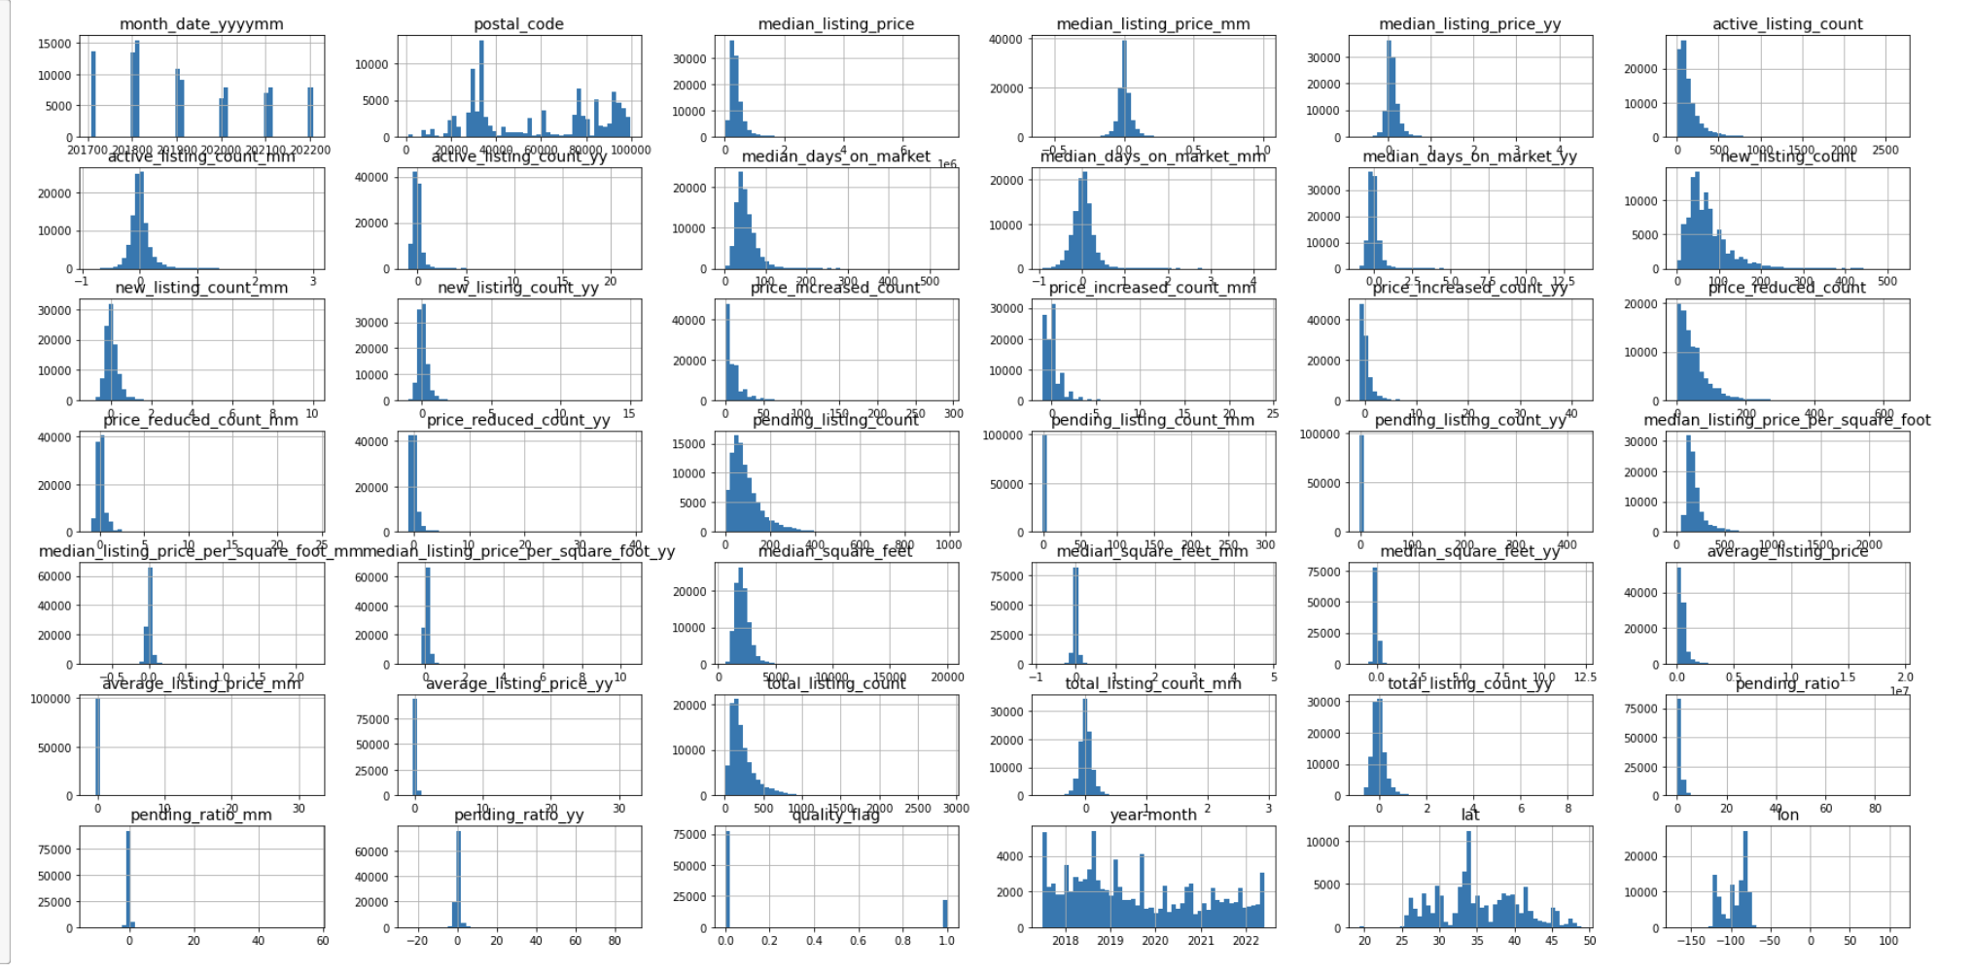
Data Exploration
Utilize pandas to access data types, drop nulls, examine features
Ultimately decided we needed additional datasets with more community features

Slide 6
Data Analysis
The ETL Process
Extract: Extract clean data from multiple confirmed sources as CSV files. Refine what datasets are relevant.
Transform: First apply Pandas to transform data by removing nulls and dropping unnecessary features and columns. Merge datasets creating separate data frames.
Load: Create an entity relational diagram to reference while creating database. Load data to PostgresSQL utilizing pgAdmin. Create joins to explore feature relationships.

Slide 7
Machine Learning
Explore multiple types of machine learning, such as linear regression, clustering, random forest. Determined we needed the additional features we are now looking into.
Will be exploring neural networks and predictive modeling.

