Slide 1
Readmission for Type 2 Diabetics
A disease where the pancreas doesn’t produce enough insulin
Cells respond poorly to insulin and take in less sugar
Not analyzing causes of T2D
Readmitted : 1, not readmitted: 0

Slide 2
Exploratory Data Analysis
Categorical columns were one hot encoded
Numeric columns were standardized
Columns with many NaN or less than 2 unique values were dropped
Very difficult to visualize feature importance

Slide 3
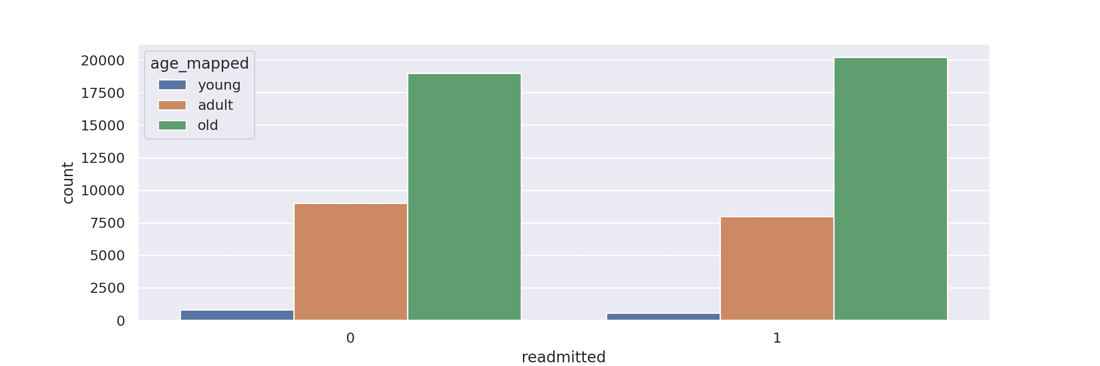
Age

Slide 4
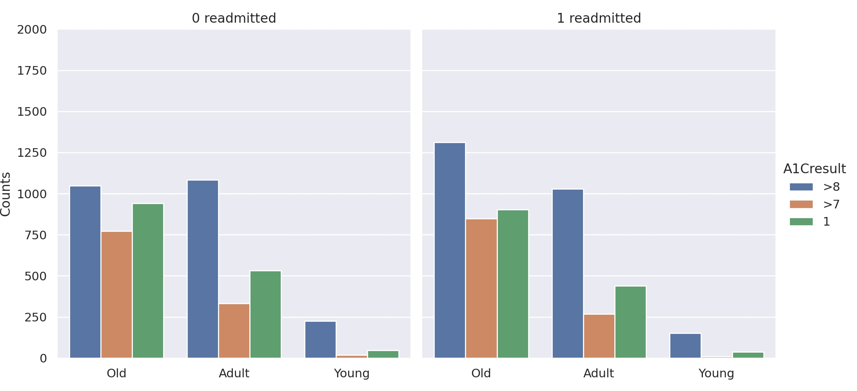

Slide 5
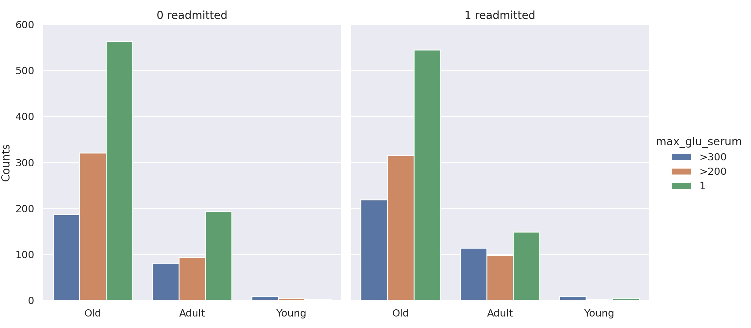

Slide 6
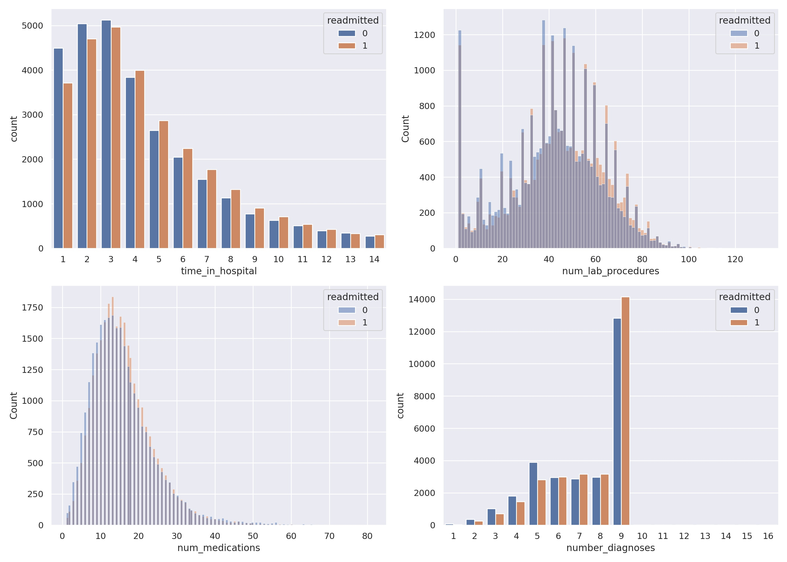

Slide 7
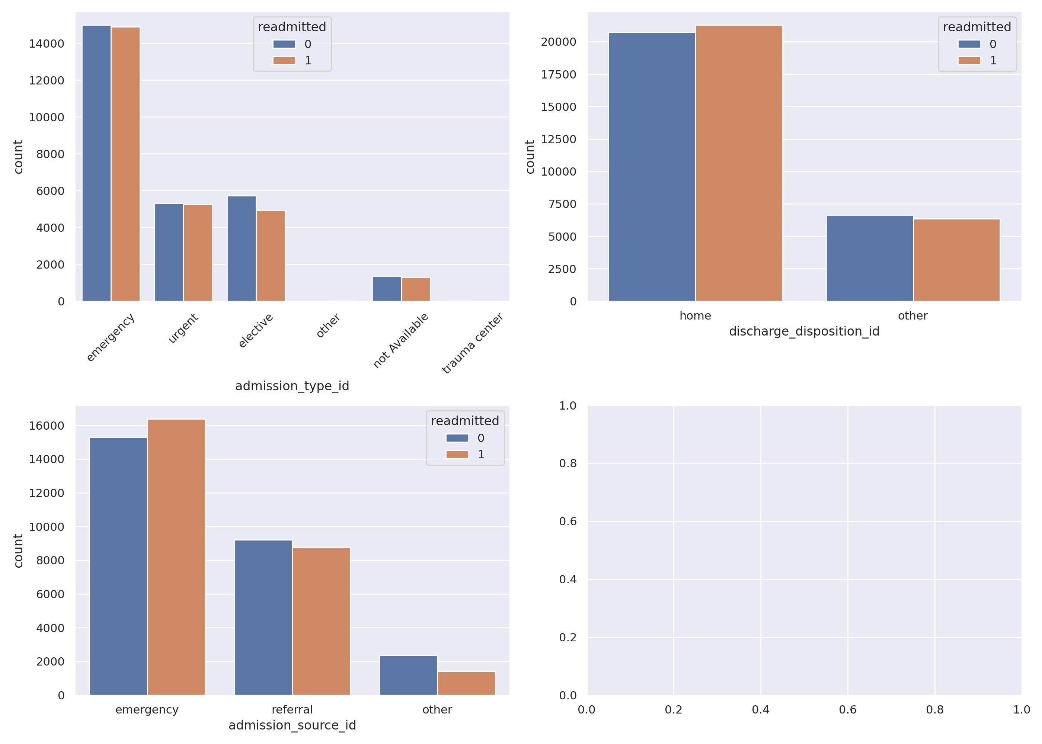

Slide 8
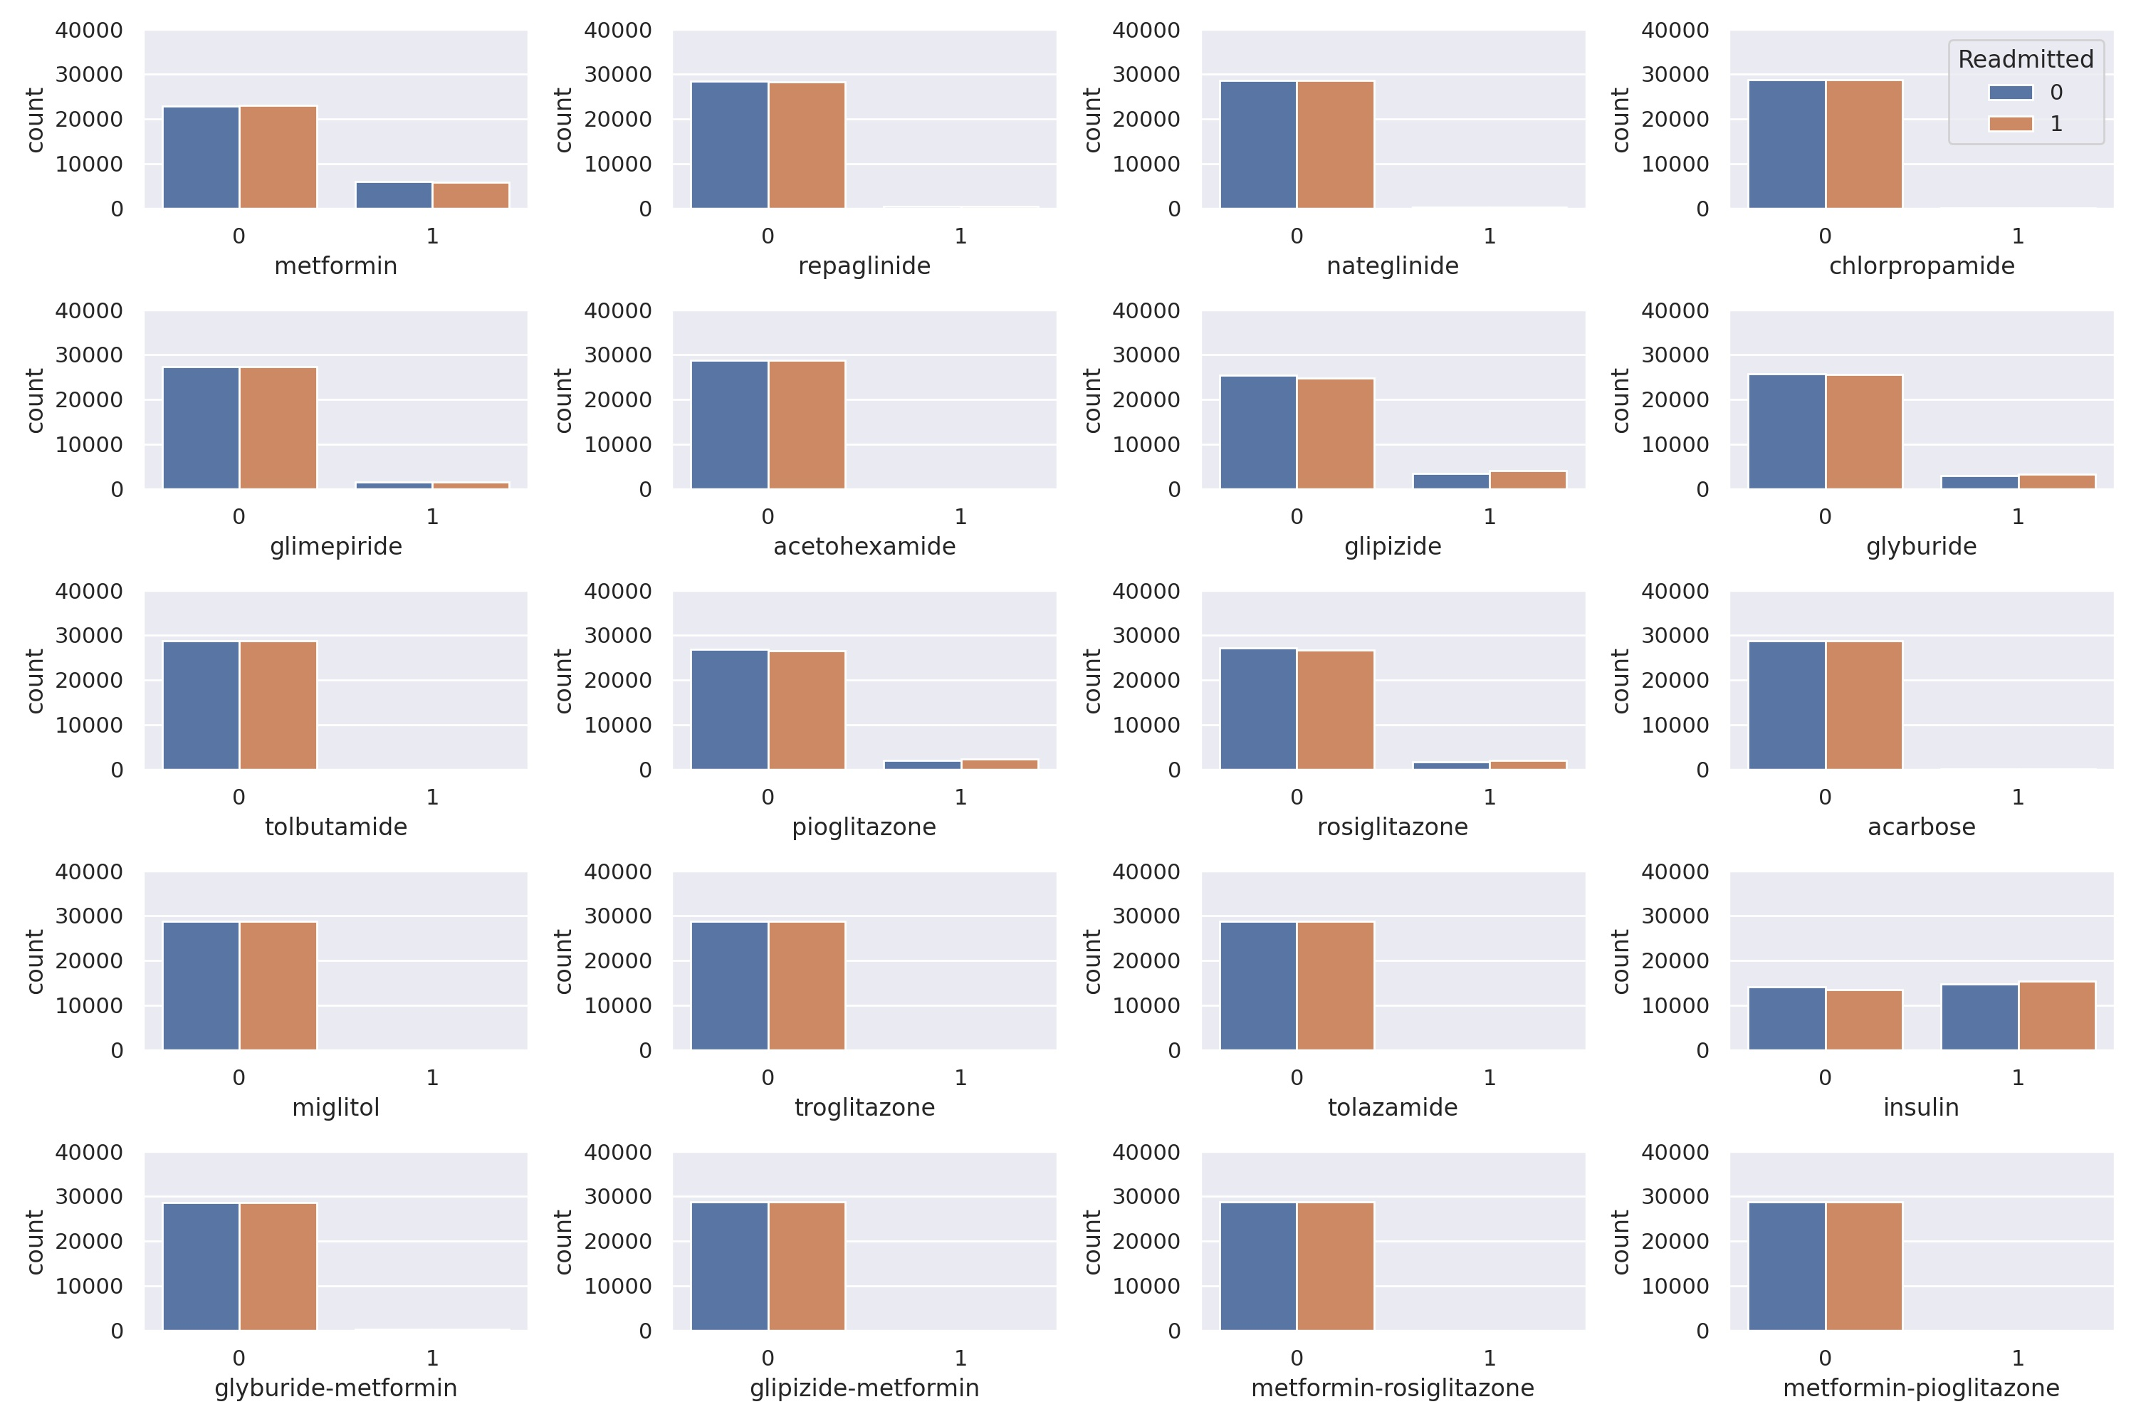

Slide 9
Modeling
Support vector machine
Logistic Regression
Random Forest
Model | Cross Validation Score
SVM | 0.54
Logistic Regression | 0.53
Random Forest | 0.56

Slide 10
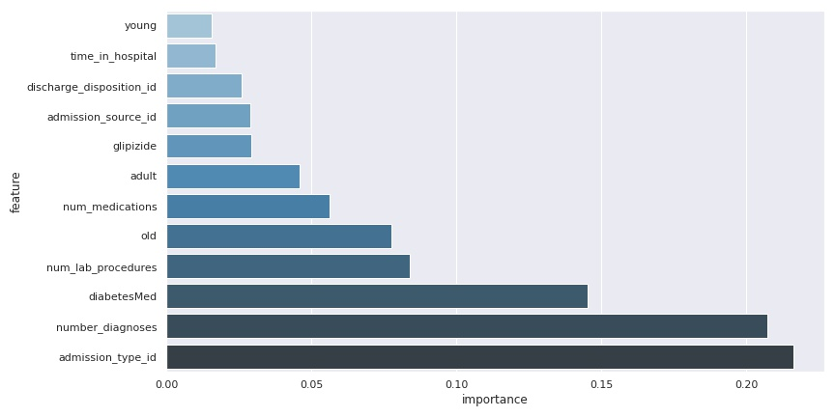
All features
Target | Precision | Recall | F1-Score | Support
0 | 0.59 | 0.48 | 0.53 | 4377
1 | 0.55 | 0.66 | 0.60 | 4258

Slide 11
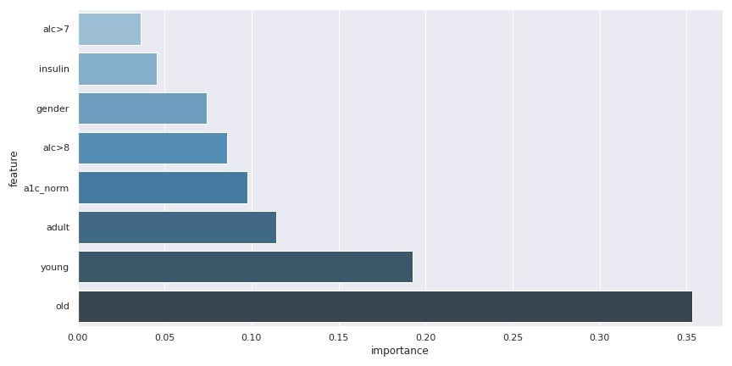
A1C and Age
Target | Precision | Recall | F1-Score | Support
0 | 0.55 | 0.47 | 0.51 | 763
1 | 0.53 | 0.61 | 0.57 | 745

Slide 12
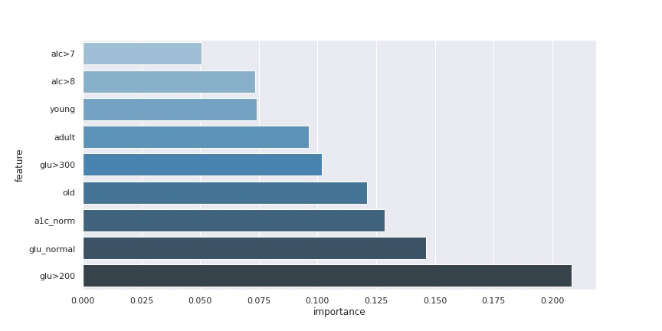
A1C and Glucose
Target | Precision | Recall | F1-Score | Support
0 | 0.00 | 0.00 | 0.00 | 11
1 | 0.65 | 1.00 | 0.78 | 20

Slide 13
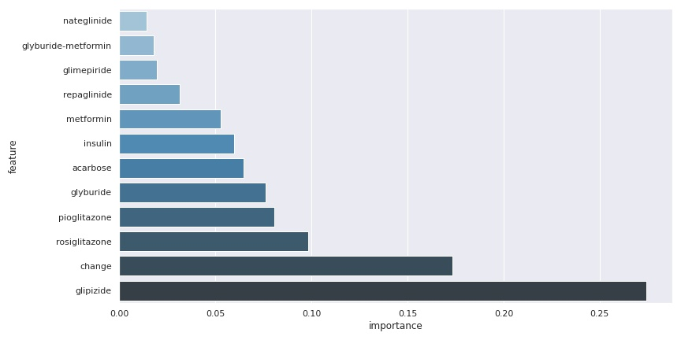
Medications
Target | Precision | Recall | F1-Score | Support
0 | 0.53 | 0.59 | 0.56 | 4335
1 | 0.53 | 0.47 | 0.50 | 4300

Slide 14
Conclusion
Difficulties of making predictions with patients affected by type 2 diabetes.
All models have an F1-score of ~55% while the model three has an F1-score of to 78% only for the positive label.
Age always played a large role in predicting
Diabetic drugs glipizide and rosiglitazone are important
The initial cause of the hospital visit

