Slide 1
Meet up # 5
September 30, 2021

Slide 2
Agenda
Group formation. How are we doing?
Reminder: Homework assignments are due soon
Typo on Homework # 3 – the target variable on the KNN problem is the loan approval status; NOT species. There is no species in the dataset.
Topics:
Decision Trees
Splitting decision
Bias vs. Variance
Random Forest (time permitting)

Slide 3
Job announcement
https://www.linkedin.com/jobs/view/2664896431/?refId=3r%2F4kCUhQQyrS7MzddfmpA%3D%3D
Ignore the no longer taking application part
Please reach out to me if interested. Or, anyone you know…
Amazing hiring manager!

Slide 4

Decision Tree
Root Node
Splitting – divides into two or more sub-nodes
Vocabulary:
Root node
Decision node
Leaf Node
Sub-tree/Branch
Parent and child node
Splitting
Pruning
How do we choose the root node?
- Attribute Selection Measure
Notes:
: ASM: let’s choose the variable with the highest Gain Value
Gain= Entropy (data) - Information (variable)

Slide 5
Attribute Selection Measure (ASM)
“Attribute selection measure is a heuristic for selecting the splitting criterion that “best” separates a given data partition, D, of a class-labeled training tuples into individual classes. It determines how the tuples at a given node are to be split. The attribute selection measure provides a ranking for each attribute describing the given training tuples. The attribute having the best score for the measure is chosen as the splitting attribute for the given tuples.
This paper, perform a comparative study of two attribute selection measures. The Information gain is used to select the splitting attribute in each node in the tree. The attribute with the highest information gain is chosen as the splitting attribute for the current node. The Gini index measures use binary split for each attribute. The attribute with the minimum gini index as selected as the splitting attribute. The results indicates that predicting a attribute selection in Gini index is more effective and simple compared to Information gain.”
http://www.ijoart.org/docs/Construction-of-Decision-Tree--Attribute-Selection-Measures.pdf

Slide 6
ASM Techniques
Two main ones used: Gini Index (lowest), or Highest information gain.
Gini is more effective (see last slide)
Gini Index:
A decision tree splits the data based on lowest Gini index. We basically would choose the attribute/feature/variable with the least Gini Index.
In other words, we choose the variable at the root which gives us the BEST information!
Gini Index measures the degree or probability of a particular variable being wrongly classified when it is randomly chosen.
Gini = 1−∑^{n}_{i=1}(p_{i})² where p is the probability of the outcome being classified in a particular class.
Information gain: (next slide)
Read more: https://blog.quantinsti.com/gini-index/

Slide 7
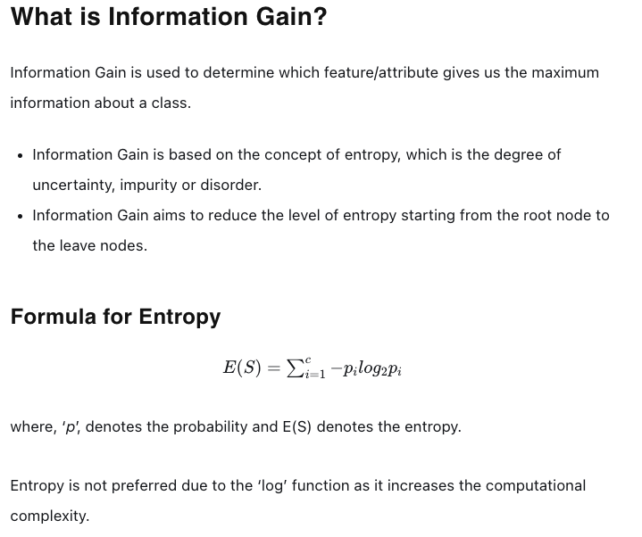
Information gain
E denotes entropy, which is a measure of ‘chaos/variability’ in the data.

Slide 8
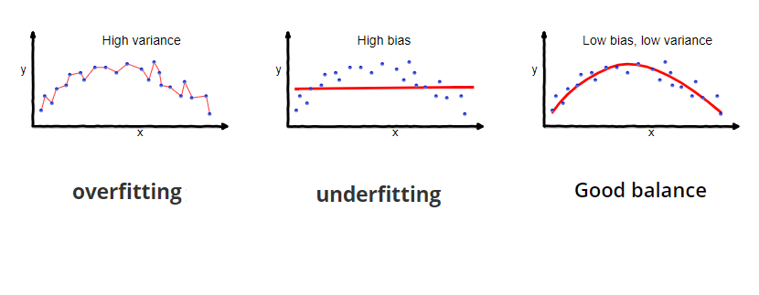
Bias vs Variance…
Source: https://towardsdatascience.com/understanding-the-bias-variance-tradeoff-165e6942b229

Slide 9
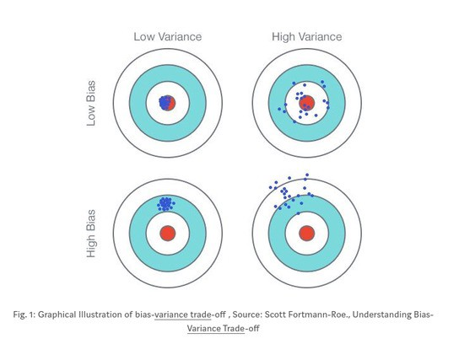
Bias-variance tradeoff
Does it remind anyone of accuracy vs. precision concept?

Slide 10
The methods we are considering in this class…
Methods | Low Bias | High Bias
Low variance |  | Linear Regression Linear Discriminant Analysis Logistic Regression (underfitting is the common issue here)
High Variance | Decision Trees K-NN (kind of depends) Support Vector Machine (overfitting is the common issue here)
Decision Trees fall in the low bias (predicting less assumption about target function; or more flexible) and high variance category (difference between observed vs predicted value is high; or less generalizable).
How about we take a bunch of Decision Trees and average (or, take the majority votes) the results?
That might help us reduce the variance, while still maintain low bias.
Combining base models (trees) is also known as an “ensemble method”. (Music!)

Slide 11

Random Forest
A single (decision) tree is likely not going to generalize well
Why?
A Bagging (short for “bootstrap aggregating”) method
A bunch of Decision Trees → Random Forests
What is Bagging, in general terms?
A very classic ensemble method
What is an ensemble method?
Notes:
-Bagging: prediction of many models– model averaging.

Slide 12
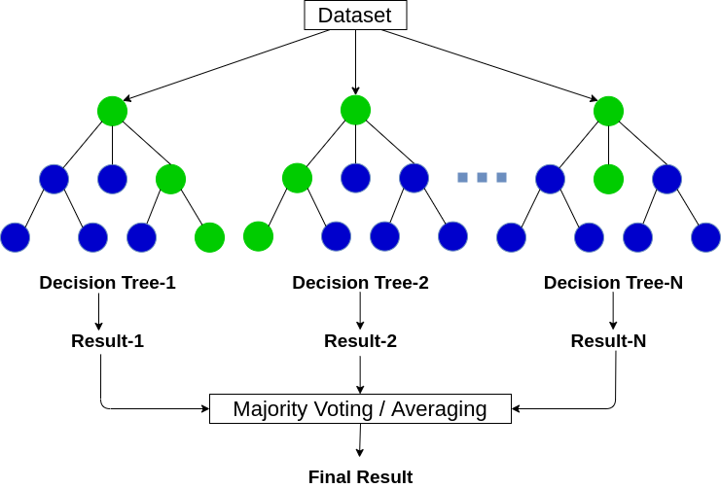
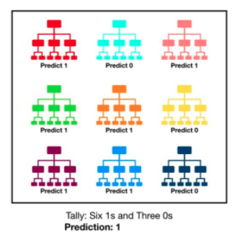
Random Forest
N decision trees are trained, each one on a subset of the original training set obtained via bootstrapping.
What is bootstrapping? (Random Sampling with replacement)
Each decision tree within a forest can only pick from a random subset of main features of the training dataset.
For good performance on a Random Forest Classifier, predictions made by the individual trees need to have low correlations with each other.
How do we achieve this?
Notes:
in the random forest classifier,
each decision tree can only pick from a random subset of the main features of the training dataset.
This brings about more variation among the decision trees in the model. It ultimately results in a lower correlation across the decision trees in the random forest.
Typically, if m is the number of the input features in the original dataset, a subset of randomly extracted [square root of m] input features is considered at each split during training of each decision tree.

Slide 13
Random Forest... Lowering correlations between the trees
In the random forest classifier, each decision tree can only pick from a random subset of the main features of the training dataset.
This brings about more variation among the decision trees in the model. It ultimately results in a lower correlation across the decision trees in the random forest.
Typically, if m is the number of the input features in the original dataset, a subset of randomly extracted [square root of m] input features is considered at each split during training of each decision tree.

Slide 14
Gradient Boosting…
Combines a bunch of weak learners (what is that?)
We use trees where our ‘outcomes’ are residuals.
We limit the number of leaves.
Let’s look at this:
http://uc-r.github.io/gbm_regression
Notes:
For example, a single decision stump?

