Slide 1
Meet up
Sept 24, 2021

Slide 2
Agenda
Logistic regression vs. LDA, QDA
Short intro to Perceptron Algorithm
Train vs Test error
Administrative stuff
Homework, etc.

Slide 3
Classification
Last time we talked about “classification”.
When we have discreet/categorical data, we don’t use regression, but go into classification modeling approach.
So far in previous classes, we saw logistic regression at play and it is still extremely useful and valuable.
So, how is LDA related to Logistic Regression?
LDA can be used as a dimension reducing method
LDA is sometimes more stable than Logistic Regression

Slide 4
LDA and Logistic Regression
For two class, logistic regression directly models Pr(Y=k|X=x)
In this scenario, we are modeling the conditional probability of some value of Y, given X.
In LDA, we model the distribution of each of the predictors (X) separately in each of the response classes (i.e. given Y). And then use Bayes theorem to flip these around into estimates for Pr(Y = k|X=x)
When these distributions are assumed to be normal, the model is very similar in form to logistic regression.
http://www2.stat.duke.edu/~rcs46/lectures_2017/04-classify/04-lda.pdf

Slide 5
So why do we need LDA?
When the classes are very well-separated, the parameters estimates for logistic regression model are very unstable.
LDA is more robust in well-separated classes.
If n is small and the distribution of the predictors X is approximately normal in each of the classes, the linear discriminant model is again more stable than the logistic regression model.
Linear discriminant analysis is popular when we have more than two response classes.
Let’s take a quick look at the penguin dataset and how the species + island are almost perfectly separated.
http://www2.stat.duke.edu/~rcs46/lectures_2017/04-classify/04-lda.pdf

Slide 6
On the other hand…. LDA has its weakness…
In the discriminant analysis methods, the predictor variables are assumed to be coming from multivariate normal distribution.
It assumes the dependent variable as categorical.
Your R code might not work if you a categorical variable in the independent variable columns
If it is a binary variable, technically, it should still work, by the way, but your input needs to numeric.

Slide 7
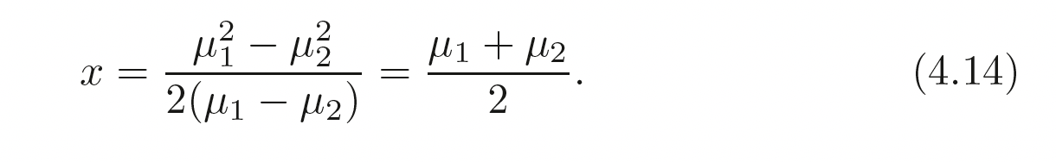
LDA when p = 1, and k = 2
When we have just ONE predictor variable (i.e. one dimension) and two classes, the following formula gets us to the decision boundary.

Slide 8
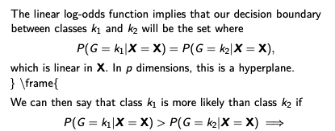
LDA when p>1
For a detailed derivation of the calculation, you could see ISL chapter 4. Or, slides 10 – 35 from here. (the screenshots are from the same lecture slides)
A few key points:
The boundary will be a line for two dimensional problem (p =2)
The boundary will be a hyperplane for a three dimensional problem (p=3), etc.

Slide 9
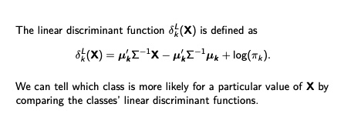
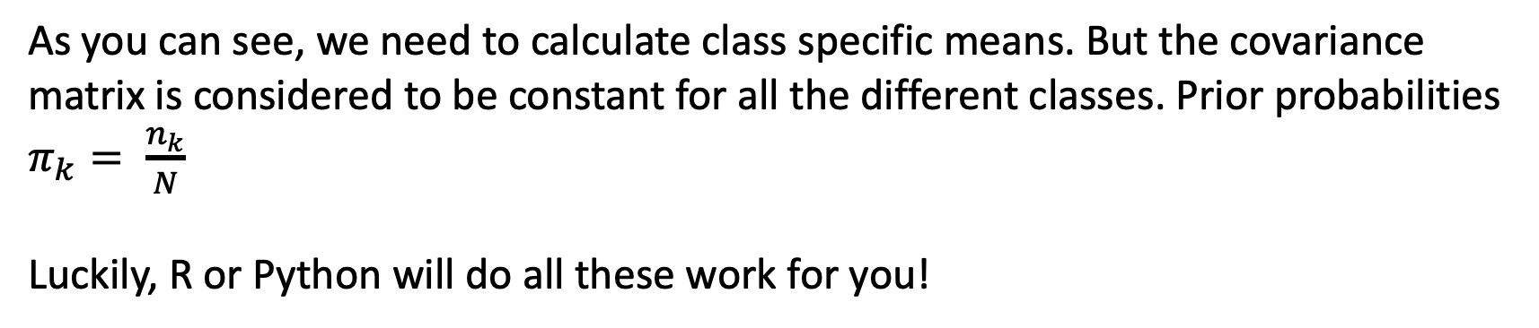
Linear Discriminant Function
As you can see, we need to calculate class specific means. But the covariance matrix is considered to be constant for all the different classes. Prior probabilities $π_{k}= \frac{n_{k}}{N}$
Luckily, R or Python will do all these work for you!

Slide 10
LDA vs. QDA
Key difference is in the name: Linear vs Quadratic
LDA assumes equal covariances across ALL classes. QDA doesn’t have such a stringent requirement.
In calculation, QDA is similar EXCEPT a covariance matrix needs to be estimated for each class K.
Somewhere in the middle of LDA and QDA is Regularized Discriminant Analysis. It is outside the scope of the class. But the main idea is that we should shrink the the covariance matrices from QDA to a common covariance matrix as we do in LDA. This shrinkage factor is chosen based on the performance of the model on validation data.

Slide 11
Perceptron Algorithm…
A single perceptron is the simplest binary classifier
The data MUST be linearly separable. Otherwise, the algorithm will NOT converge.
In contrast, LDA also needs linear separability but will give you some answer even if the data is not linearly separable.
What does wiki say? https://en.wikipedia.org/wiki/Perceptron

Slide 12
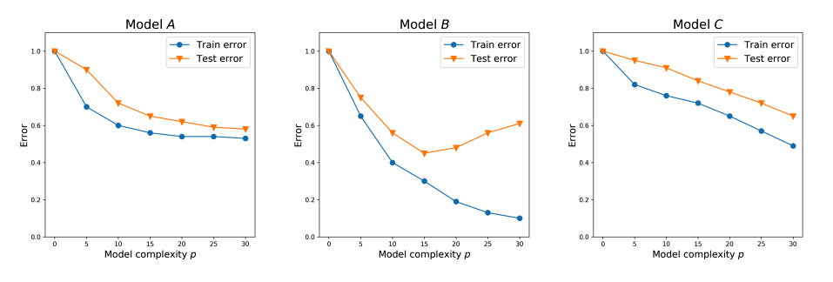
Training and Test Errors

