Slide 1

E-Commerce Site
Internet and Web Programming – ITA6003
Group By:
Kumar Saurav (19MCA1056)
Sahej Deep Singh (19MCA1057)
Rahul Kumar Sharma (19MCA1082)
Faculty:
Dr. Nithya Darshni

Slide 2
CONTENT
Introduction
Objective
Website Structure
Feature of website
Tables used
Advantage of ecommerce
Future Plan

Slide 3
Introduction
Online shopping is the process whereby consumers directly buy goods or services from a seller in realtime, without an intermediary service, over the Internet. It is a form of electronic commerce. An online shop, eshop, e-store, internet shop, webshop, online store, or virtual store evokes the physical analogy of buying products or services at a bricks-and-mortar retailer or in a shopping centre. The process is called Business-toConsumer (B2C) online shopping. The shopping cart project needs to create the shopping cart system to organize the products record and the other information about the customers. How customers can buy products from website can be recognized from their username and password. Online shopping is rising day by day in India. Because India is the country where computer users are increasing day by day so as the online shopping trends are also increasing. This project covers the online selling of cosmetics, fashion accessories, watches etc. The project shows the product category and then product details. From the product details, the product can be added to cart and can be bought.

Slide 4
Objective
Online Shopping is the process whereby consumers directly buy goods and services without any intermediary service over the internet. The goal of this website is to develop a webbased interface for students of Jammu and Kashmir, the website would be easy to use and hence the shopping experience pleasant for the users. The main goal of this website is:
To develop an easy to use web-based interface where users can search for products, view a complete description of the product and order the product.
A user can buy and sell books from home.
After payment can be done after he/she will get the product via home delivery or he/she can pay online.

Slide 5
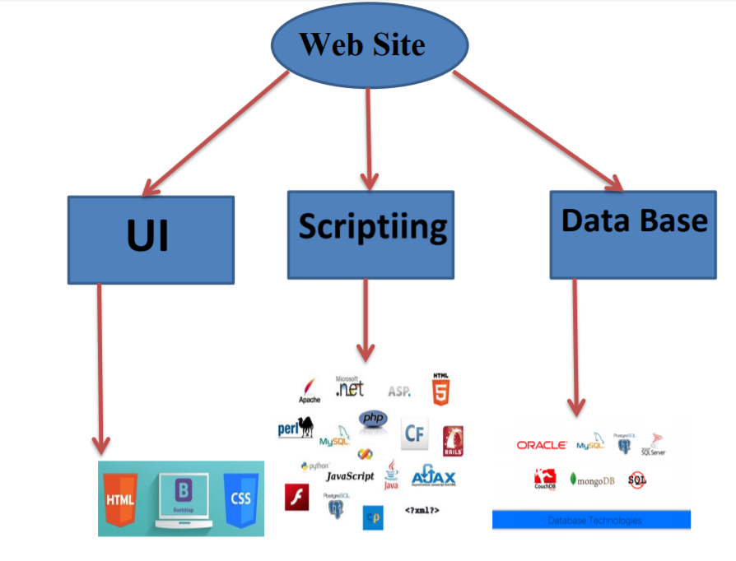
Website Structure
Continue….

Slide 6



UI Development
Module | Description
HTML | Hypertext Markup Language (HTML) is the standard markup language for creating web pages and web applications.
CSS | Cascading Style Sheets (CSS) is a style sheet language used for describing the presentation of a document written in a markup language.
Bootstrap | Bootstrap is a free and open-source front-end web framework for designing websites and web applications.

Slide 7


Scripting Language
Module | Description
Server Side Scripting (PHP) | Server-side scripting is often used to provide a customized interface for the user. These scripts may assemble client characteristics for use in customizing the response based on those characteristics, the user’s requirements, access rights, etc.
Client Side Scripting (JavaScript) | Client-side scripting is changing interface behaviors within a specific web page in response to mouse or keyboard actions, or at specified timing events. In this case, the dynamic behavior occurs within the presentation.

Slide 8
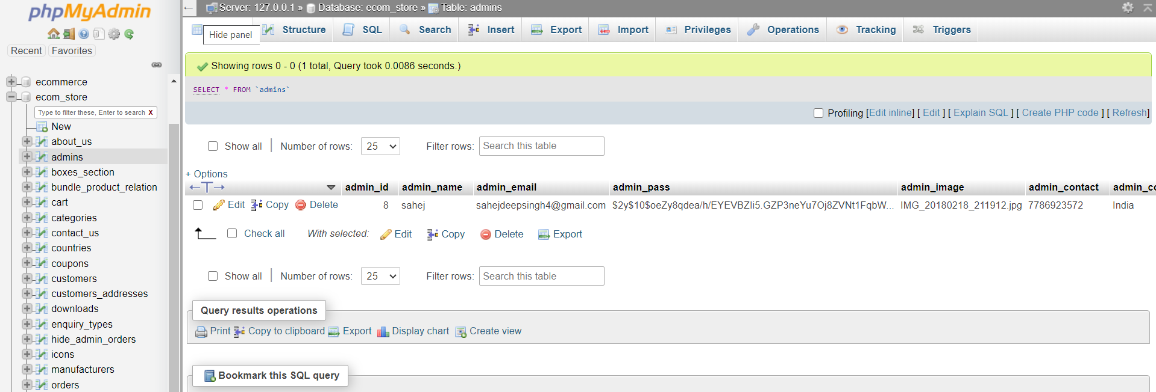
Database
In creation of website we use MySQL database.
A database is a structured collection of data. It may be anything from a simple shopping list to a picture gallery or the vast amounts of information in a corporate network. To add, access, and process data stored in a computer database, you need a database management system such as MySQL Server. Since computers are very good at handling large amounts of data, database management systems play a central role in computing, as standalone utilities, or as parts of other applications.
Continue….

Slide 9
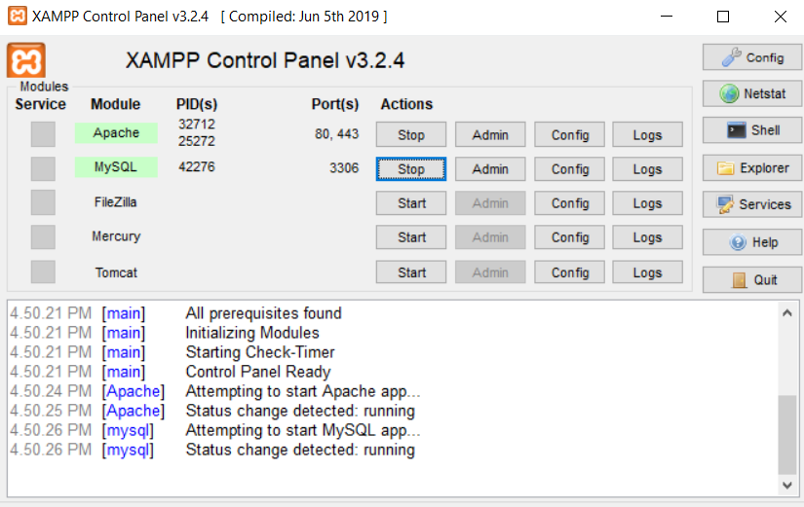
XAMPP
To enable the PHP localhost server and MySQL database we need to use the XAMPP software so that we can access these two things.

Slide 10
Features of website
Menu
Catalog Browsing
Category List
Product List
Catalog Management
Product Browsing
Product Reviews
Related Products
Shopping Cart
Checkout
Auto generated bill
Payment Gateway

Slide 11
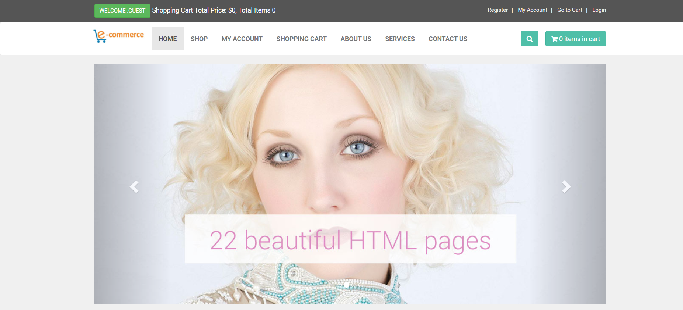
Home Page
In this page all the necessary elements are showed like trending products, login, signup form, search menu, different categories for each product and more.

Slide 12
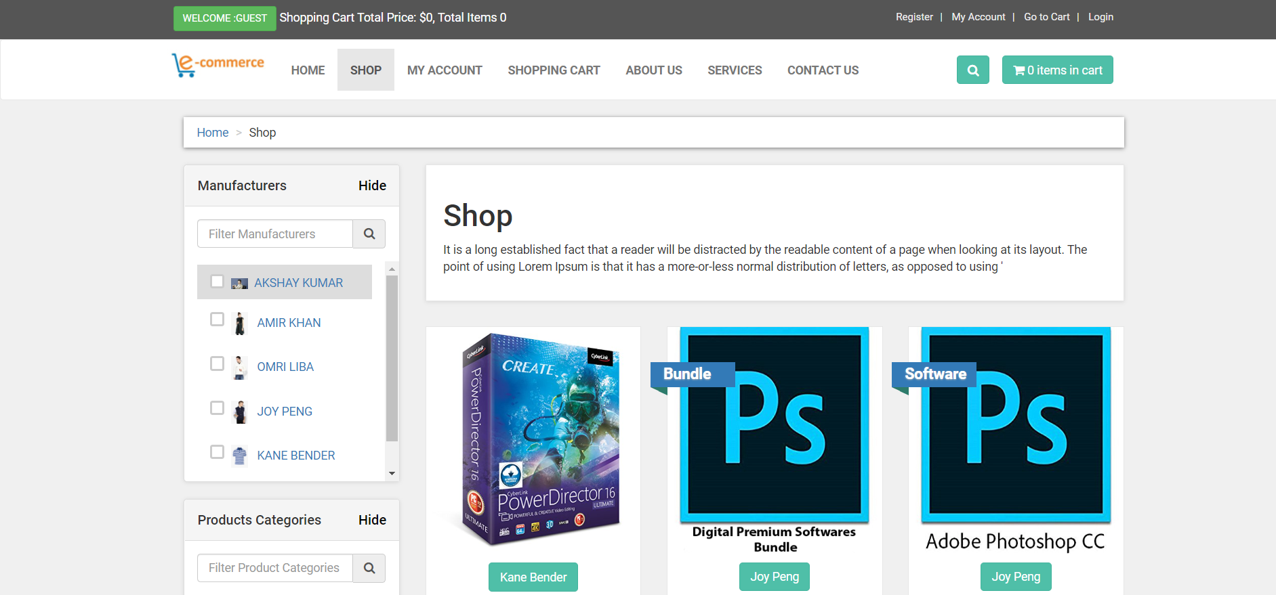
Shop Page
In this page all the different categories of product is available, and you can adjust your setting according to your preferences.

Slide 13
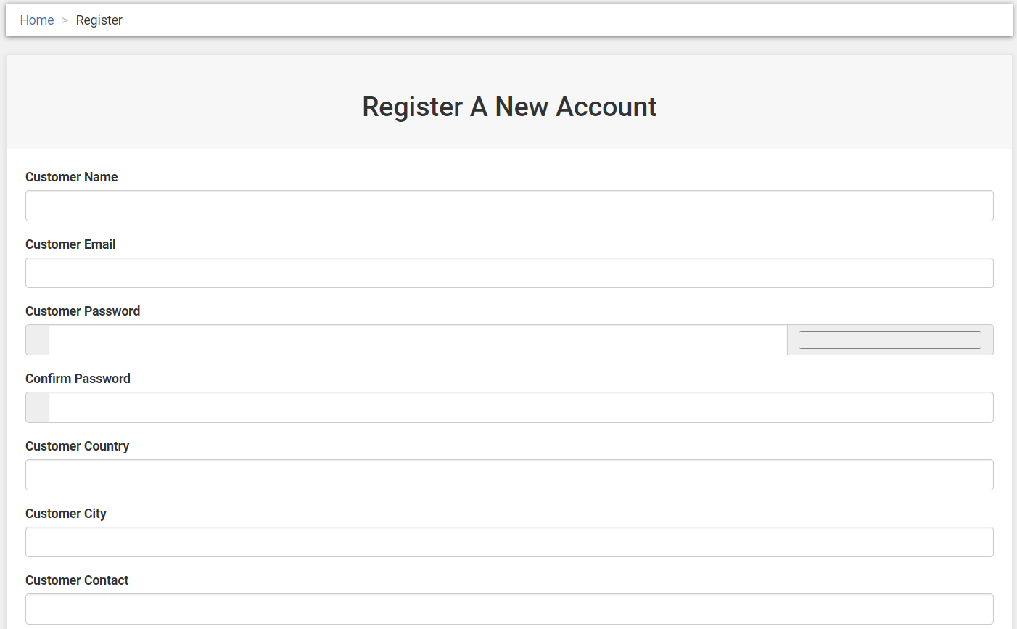
Registration Page
In this it first asks you that if you are a new here than register here if you click on register link than it will take you to the register page.

Slide 14
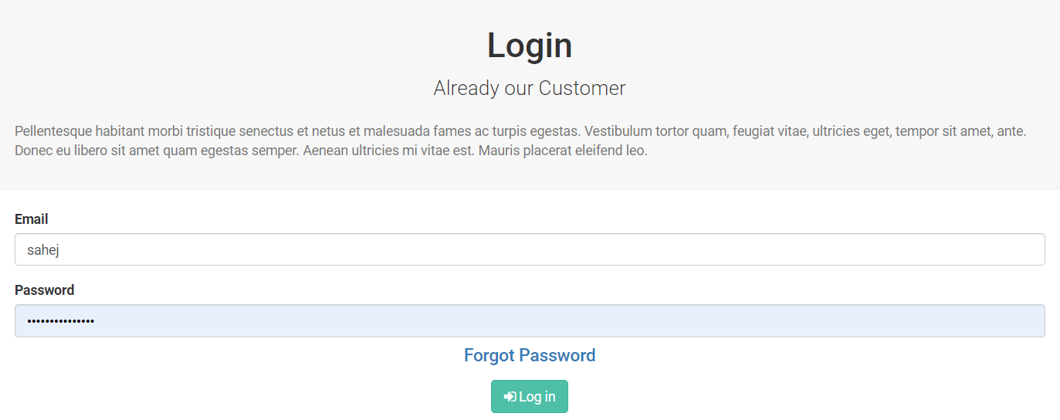
Login Page
After the registration you can login in your account
OR
If you are already a customer than the user will fill the login form.

Slide 15
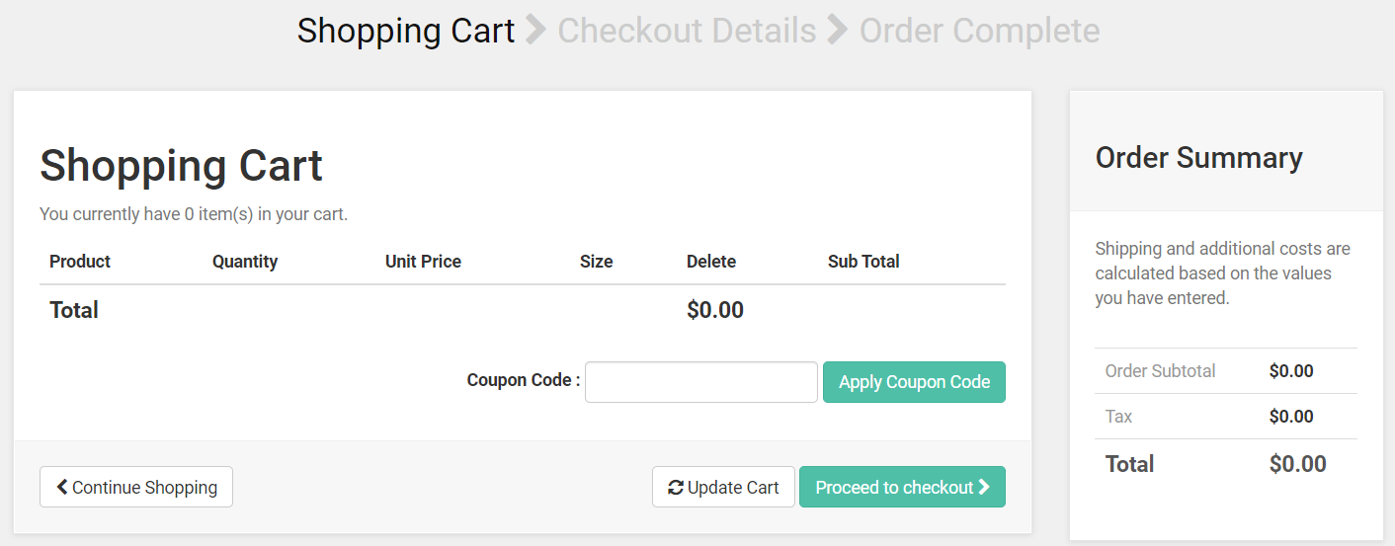
Shopping Cart Page
This page will enable the user to add the number of products they want to give for the service.

Slide 16
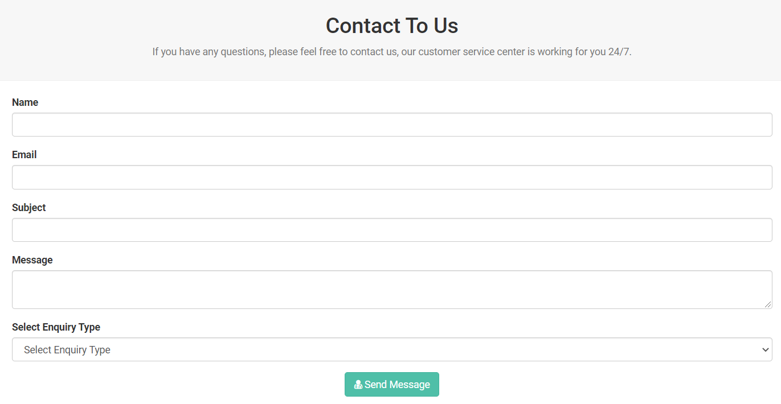
Contact Us Page
In this page the user connects with us. From this page user can send message for what are their requirements or any problem regarding any product.

Slide 17
Tables used
Customer Table
Product Table
Product categories Table
Order Table
Admin Table

Slide 18
Advantage Of E-Commerce
Faster buying/selling procedure, as well as easy to find products.
Buying/selling 24/7.
More reach to customers, there is no theoretical geographic limitations.
Low operational costs and better quality of services.
No need of physical company set-ups.
Easy to start and manage a business.

Slide 19
Future plan
We are thinking of some modifications and adding some advanced new
features in out system. Some of them are –
# GUI modification (more user friendly)
# Users can sell their products
# Users can signup / login using their social media account such as
facebook , google+ etc.

Slide 20
THANK YOU

