Slide 1
A Hardware-assisted Translation Cache for Dynamic Binary Translation in Embedded Systems
Filipe Salgado, Tiago Gomes, Adriano Tavares, and Jorge Cabral
2018 IEEE 23rd International Conference on Emerging Technologies and Factory Automation (ETFA)

Slide 2
Outline
Introduction
Hardware-assisted Translation Cache
Evaluation
Conclusion

Slide 3
Outline
Introduction
Hardware-assisted Translation Cache
Evaluation
Conclusion

Slide 4
Introduction
This paper base on another paper
Y. Yao, Z. Lu, Q. Shi, and W. Chen, “FPGA based hardware-software co-designed dynamic binary translation system,” 2013 23rd International Conference on Field Programmable Logic and Applications, FPL 2013- Proceedings. IEEE Computer Society., pp. 0–3, 2013.

Slide 5
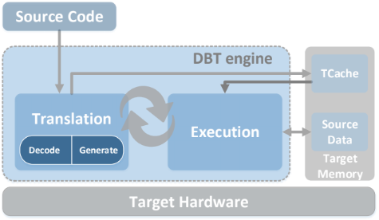
Dynamic Binary Translation(DBT)
Dynamic binary translation (DBT) is a technique that was developed for architectural compatibility, i.e., to run machine binary code on architectures different from the one it was compiled for.

Slide 6
Translation Cache (TCache)
Tcache is a translation buffer where the translated code is stored prior its execution
It requires different features from the source binaries cache.
Write and Execution Privileges
Content Management
Eviction Mechanism

Slide 7
Outline
Introduction
Hardware-assisted Translation Cache
Evaluation
Conclusion

Slide 8
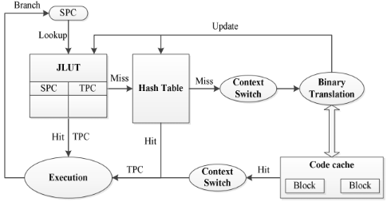
Flowchart of the HW/SW co-designed DBT system

Slide 9
Problem
This approach relies on a heavy software-based backup mechanism to handle missing translations from the hardware management.
The software hash table mechanism should be avoided in the resource-constrained embedded systems, because of the well known latency it originates.

Slide 10
Solution
The implemented approach avoids the use of the software hash table through an adjustment to the new entry insertion mechanism of LUT.
The new entries are inserted sequentially until the insertion index overflows and starts to overwrite the first entries.

Slide 11
Problem of the solution
The eventual look-ups of overwritten entries will generate a false miss because the translation is indeed stored at the TCache allocated memory, but its look-up position was given to another TBBs.

Slide 12
Outline
Introduction
Hardware-assisted Translation Cache
Evaluation
Conclusion

Slide 13
Experimental Environment
Benchmark: Bristol Energy Efficiency Benchmark Suite (BEEBS)
Source ISA: Intel 8051
Target ISA: Arm Cortex-M3
The tests were repeated for four different TCache sizes: 4 KB, 8 KB, 16 KB and 32 KB.

Slide 14
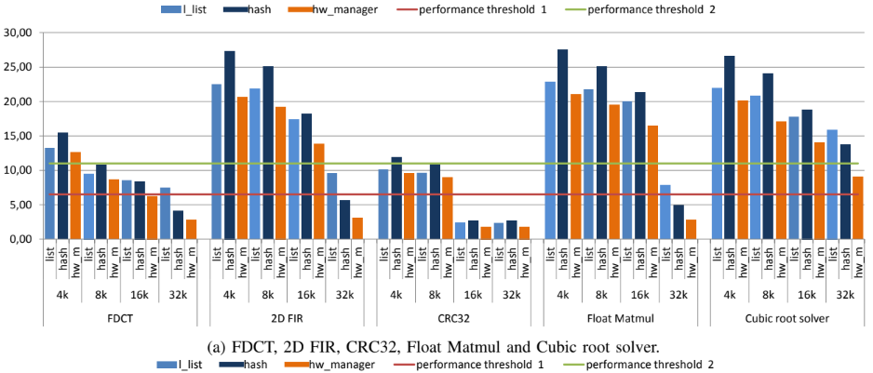
TCache size variation

Slide 15
Software-based TCache mechanisms

Slide 16
Hardware-assisted TCache vs. Software-based TCache

Slide 17
Outline
Introduction
Hardware-assisted Translation Cache
Evaluation
Conclusion

Slide 18
Conclusion
This article addresses the functionality extension of the DBT engine using external hardware support.
The hardware LUT has a reduced and fixed insertion and search time, leading to better performance and scalability

