Slide 1
Assemblers

Slide 2
Outlines
Fundamental functions of an assembler
A simple SIC assembler
Assembler algorithm and data structure
Machine-dependent features
Instruction formats and addressing modes (SIC/XE)
Program relocation
Machine-independent features
Literals
symbol-defining statements
Expressions
Program blocks
Control sections and program linking
Design options: one-pass vs. multi-pass

Slide 3
Basic SIC Assembler Functions, Algorithm, and Data Structures

Slide 4
Role of Assembler
Assembler
Object
Code
Linker
Source
Program
Executable
Code
Loader

Slide 5
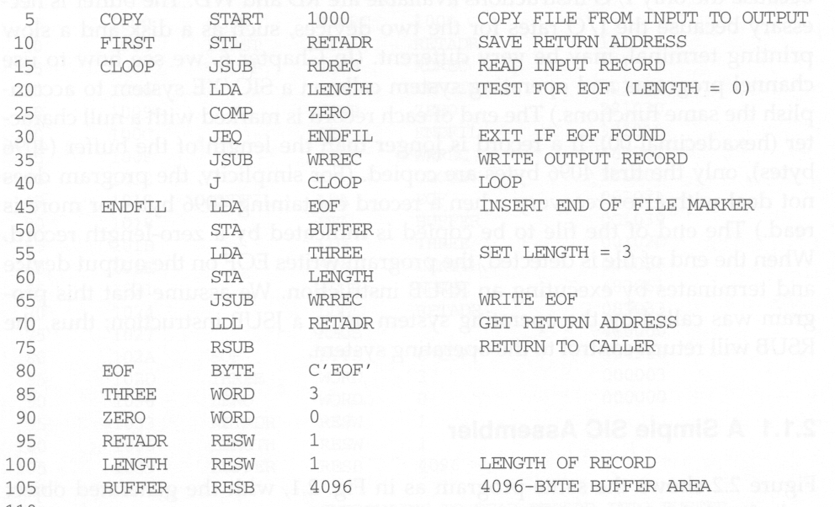
SIC Assembly Program
Line numbers
(for reference)
Mnemonic opcode
comments
Fixed format
Address labels
operands

Slide 6
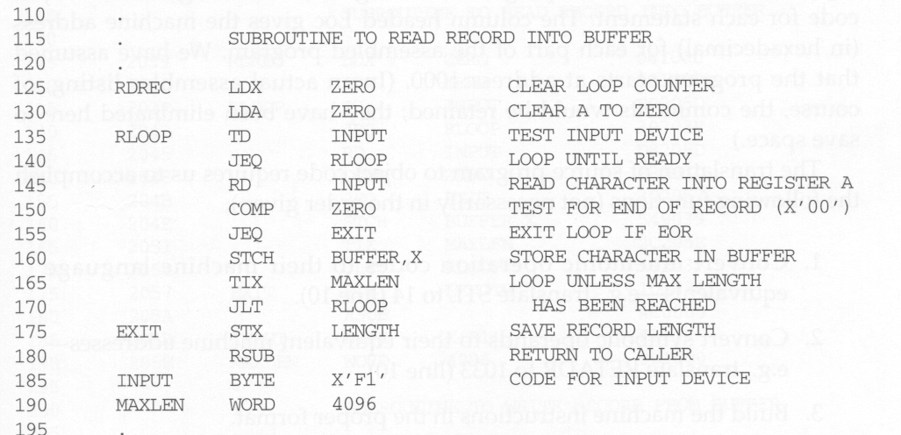
SIC Assembly Program
Indicate comment lines
Index addressing

Slide 7
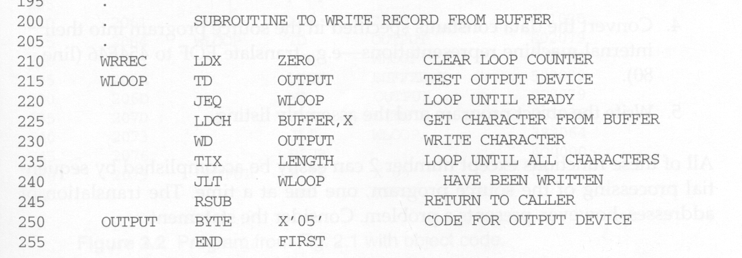
SIC Assembly Program

Slide 8
Assembler Directives
Basic assembler directives (pseudo instructions):
START :
Specify name and starting address for the program
END :
Indicate the end of the source program, and (optionally) the first executable instruction in the program.
BYTE :
Generate character or hexadecimal constant, occupying as many bytes as needed to represent the constant.
WORD :
Generate one-word integer constant
RESB :
Reserve the indicated number of bytes for a data area
RESW :
Reserve the indicated number of words for a data area

Slide 9
SIC Assembler
Assembler’s task:
Convert mnemonic operation codes to their machine language equivalents
Convert symbolic operands to their equivalent machine addresses
Build machine instructions in proper format
Convert data constants into internal machine representations (data formats)
Write object program and the assembly listing
difficult

Slide 10
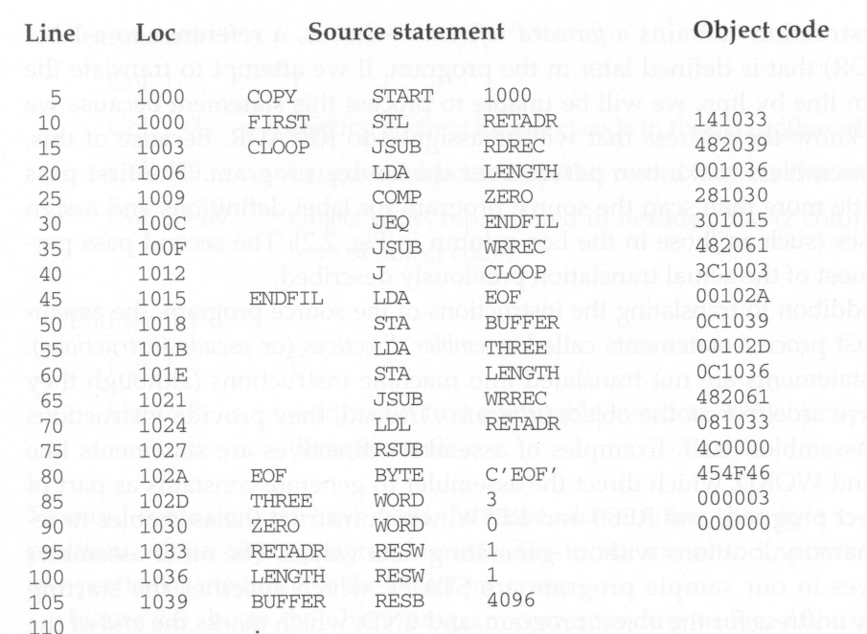
Assembly Program with Object Code
Forward
reference

Slide 11
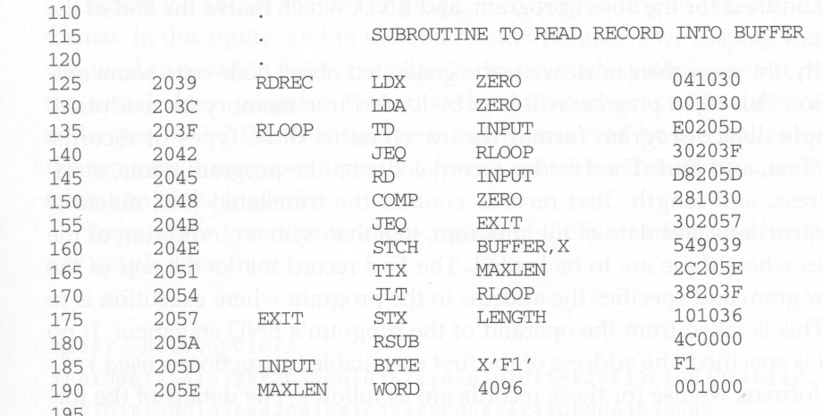
Assembly Program with Object Code

Slide 12
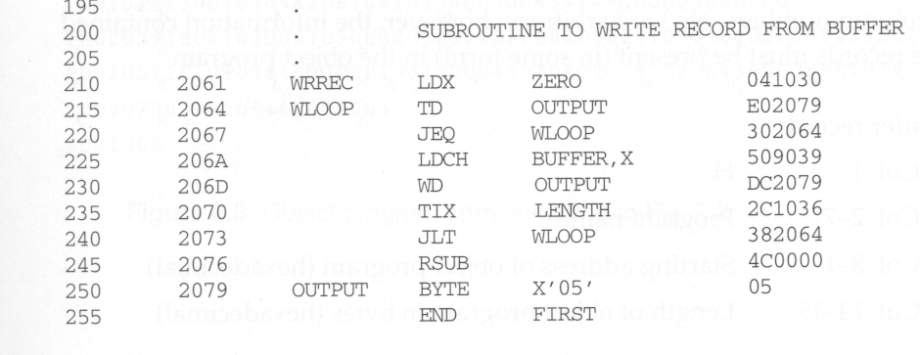
Assembly Program with Object Code

Slide 13
Forward Reference
Definition
A reference to a label that is defined later in the program
Solution
Two passes
First pass: scan the source program for label definition, address accumulation, and address assignment
Second pass: perform most of the actual instruction translation

Slide 14
LOCCTR (Location Counter)
SYMBOL TABLE
FIRST | 1000
CLOOP | 1003
BUFFER | 1039
RDREC | 2039

Slide 15
FIRST STL RETADR
---- ---- X--- ---- ---- ----
0001 0100 0001 0000 0011 0011➔141033
STCH BUFFER,X
---- ---- X--- ---- ---- ----
0101 0100 1001 0000 0011 1001➔549039

Slide 16
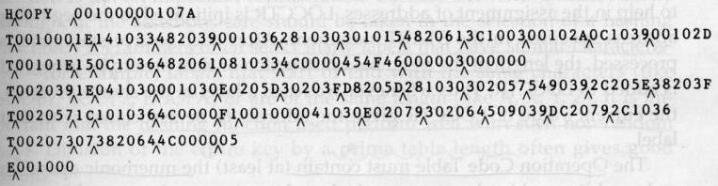
Object Program Format
Header
Col. 1 H
Col. 2~7 Program name
Col. 8~13 Starting address of object program (hex)
Col. 14-19 Length of object program in bytes (hex)
Text
Col.1 T
Col.2~7 Starting address for object code in this record (hex)
Col. 8~9 Length of object code in this record in bytes (hex)
Col. 10~69 Object code, represented in hex (2 col. per byte)
End
Col.1 E
Col.2~7 Address of first executable instruction in object program (hex)
1033-2038: Storage reserved by the loader

Slide 17
Two Pass SIC Assembler
Pass 1 (define symbols)
Assign addresses to all statements in the program
Save the addresses assigned to all labels for use in Pass 2
Perform assembler directives, including those for address assignment, such as BYTE and RESW
Pass 2 (assemble instructions and generate object program)
Assemble instructions (generate opcode and look up addresses)
Generate data values defined by BYTE, WORD
Perform processing of assembler directives not done during Pass 1
Write the object program and the assembly listing

Slide 18
Data Structures
Operation Code Table (OPTAB)
Symbol Table (SYMTAB)
Location Counter (LOCCTR)
OPTAB
Pass 1
Pass 2
Source program
Intermediate file
Object program
SYMTAB
LOCCTR

Slide 19
OPTAB
Contents:
Mnemonic operation codes
Machine language equivalents
Instruction format and length
During pass 1:
Validate operation codes
Find the instruction length to increase LOCCTR
During pass 2:
Determine the instruction format
Translate the operation codes to their machine language equivalents
Implementation: a static hash table

Slide 20
LOCCTR
A variable accumulated for address assignment, i.e., LOCCTR gives the address of the associated label.
LOCCTR is initialized to be the beginning address specified in the “start” statement.
After each source statement is processed during pass 1, instruction length or data area is added to LOCCTR.

Slide 21
SYMTAB
Contents:
Label name
Label address
Flags (to indicate error conditions)
Data type or length
During pass 1:
Store label name and assigned address (from LOCCTR) in SYMTAB
During pass 2:
Symbols used as operands are looked up in SYMTAB
Implementation:
a dynamic hash table for efficient insertion and retrieval
Should perform well with non-random keys (LOOP1, LOOP2).

Slide 22
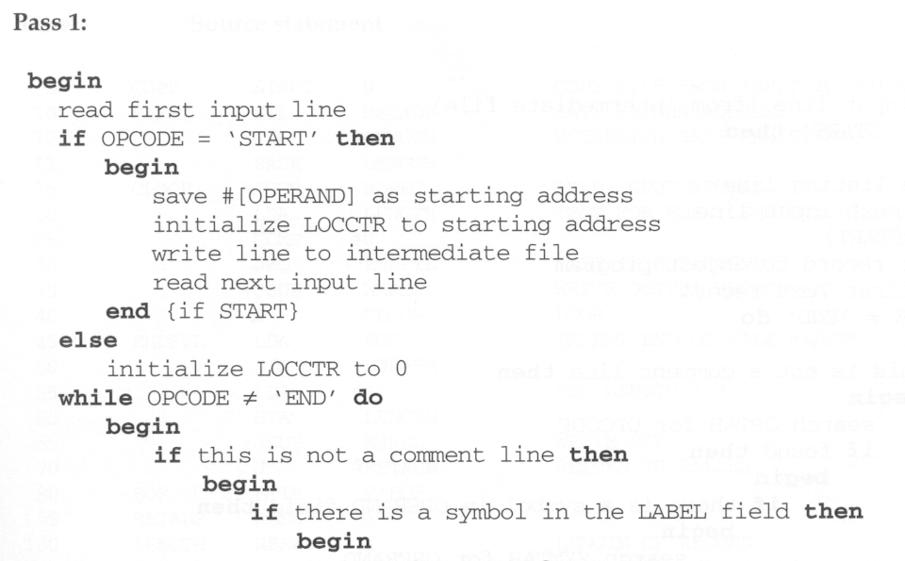
Pseudo Code for Pass 1

Slide 23
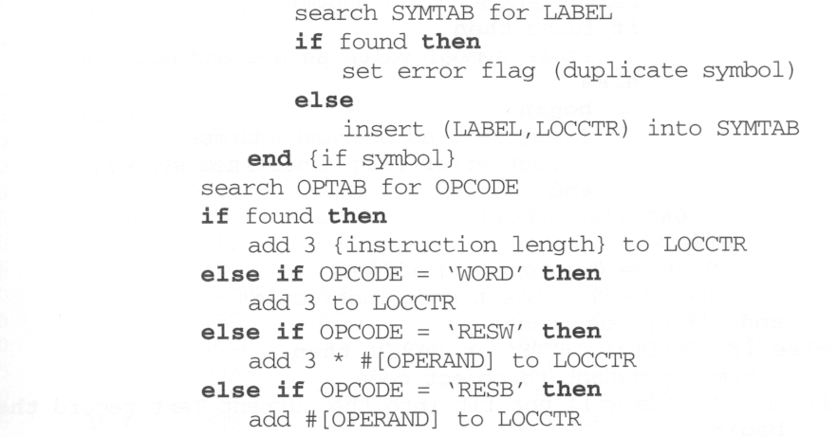
Pseudo Code for Pass 1

Slide 24
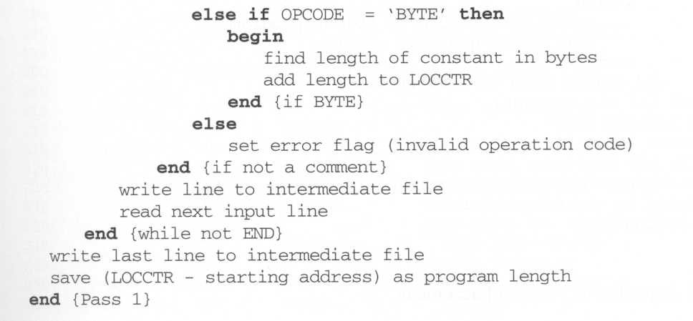
Pseudo Code for Pass 1

Slide 25
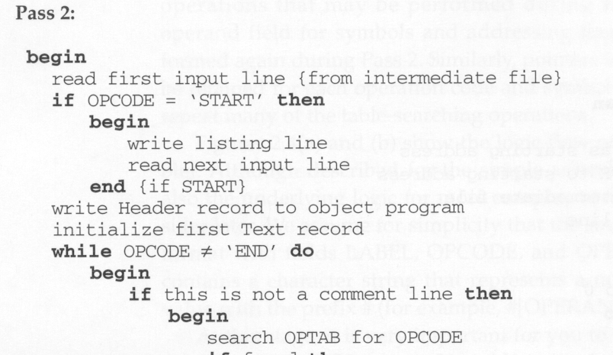
Pseudo Code for Pass 2

Slide 26
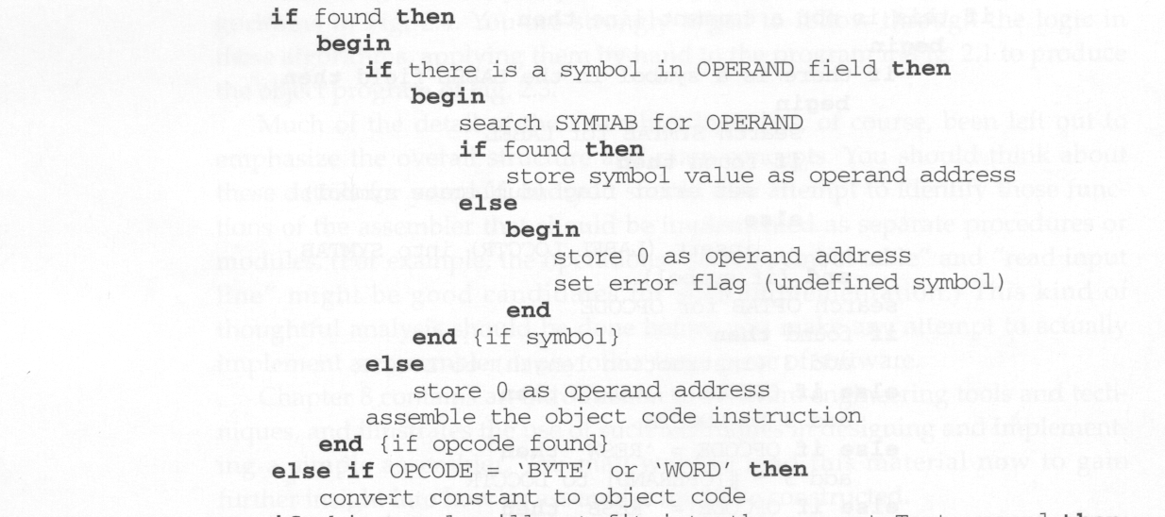
Pseudo Code for Pass 2

Slide 27
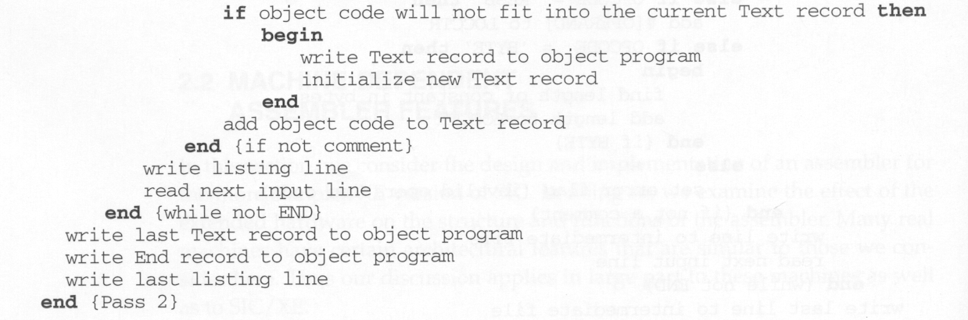
Pseudo Code for Pass 2

