Slide 1
Loaders and Linkers

Slide 2
Processes to Run an Object Program
Loading
  Brings object program into memory
Relocation
  Modifies the object program where absolute addresses are specified
Linking
  Combines two or more separate object programs and supplies information needed to allow cross-references.
Linking loader
Loader
Absolute loader
Linker

Slide 3
Absolute Loader for SIC Machine

Slide 4
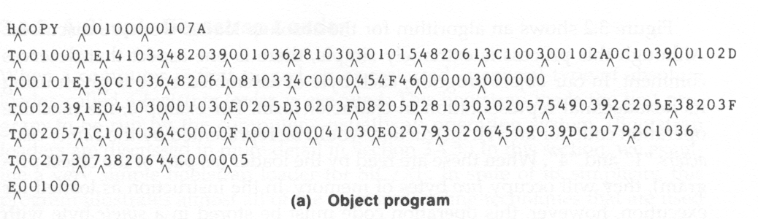
Absolute Loader
In a single pass
  Check the Header record for program name, starting address, and length
  Bring the object program contained in the Text record to the indicated address
  No need to perform program linking and relocation
  Start the execution by jumping to the address specified in the End record

Slide 5
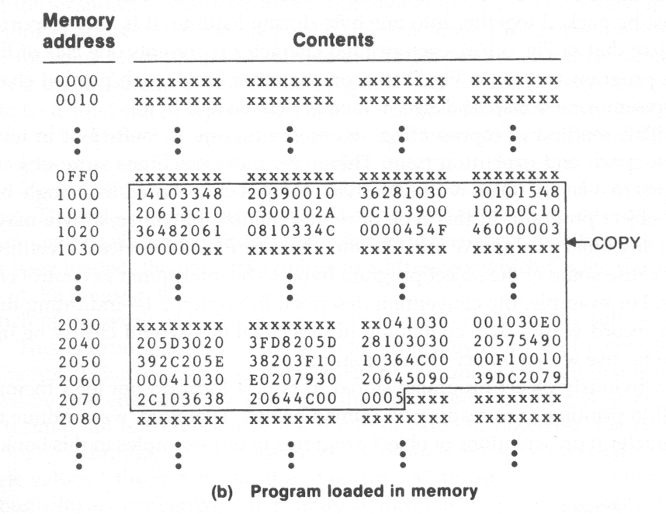
Program Loaded in Memory
Unchanged content
(no Text record)

Slide 6
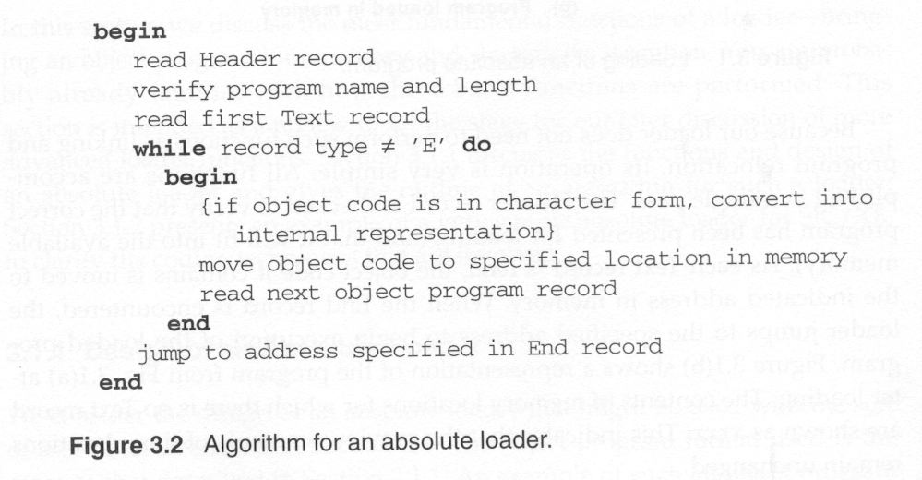
Algorithm for an Absolute Loader
E.g., convert the pair of characters “14” (two bytes) in the object program to a single byte with hexadecimal value 14

Slide 7
A Simple Bootstrap Loader for SIC/XE Machine

Slide 8
Bootstrap Loader
A special type of absolute loader
Executed when a computer is turned on or restarted
Begins at address 0 in the memory
Loads the first program (usually an OS) from a specific device (e.g., device F1)
Load a very simple format of object program (no Header and End records or control information)
Load the program into consecutive bytes of memory, starting at a specific address
Jumps to the starting address to execute the program after all of the objected code has been loaded

Slide 9
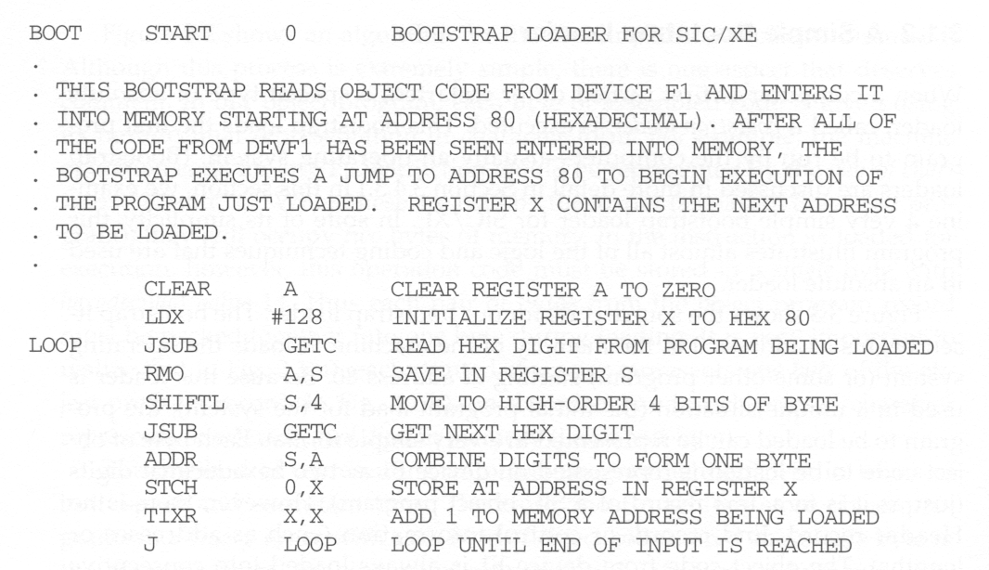
A Simple Bootstrap Loader for SIC/XE

Slide 10
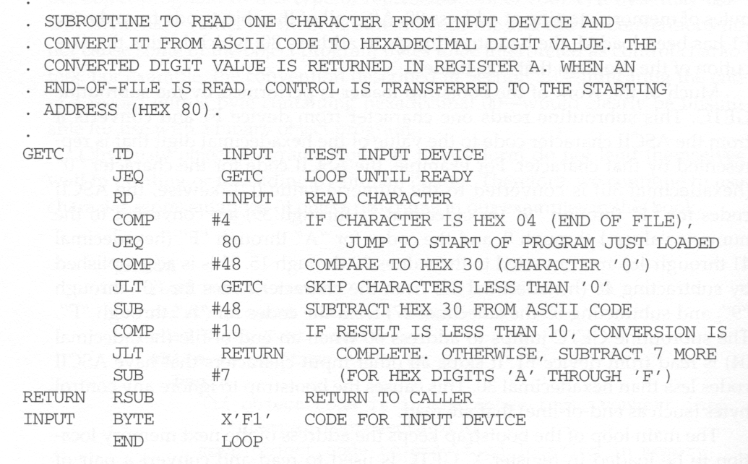
A Simple Bootstrap Loader for SIC/XE

