Slide 1
Chapter 2
Assemblers
Source Program
Object Code
Object Program
Assembler
1

Slide 2
Outline
2.1 Basic Assembler Functions
 A simple SIC assembler
 Assembler tables and logic
2.2 Machine-Dependent Assembler Features
 Instruction formats and addressing modes
 Program relocation
2.3 Machine-Independent Assembler Features
2.4 Assembler Design Options
 Two-pass
 One-pass
 Multi-pass
2

Slide 3
2.1 Basic Assembler Functions
Figure 2.1 shows an assembler language program for SIC.
 The line numbers are for reference only.
 Indexing addressing is indicated by adding the modifier “,X”
 Lines beginning with “.” contain comments only.
 Reads records from input device (code F1)
 Copies them to output device (code 05)
 At the end of the file, writes EOF on the output device, then RSUB to the operating system
3

Slide 4
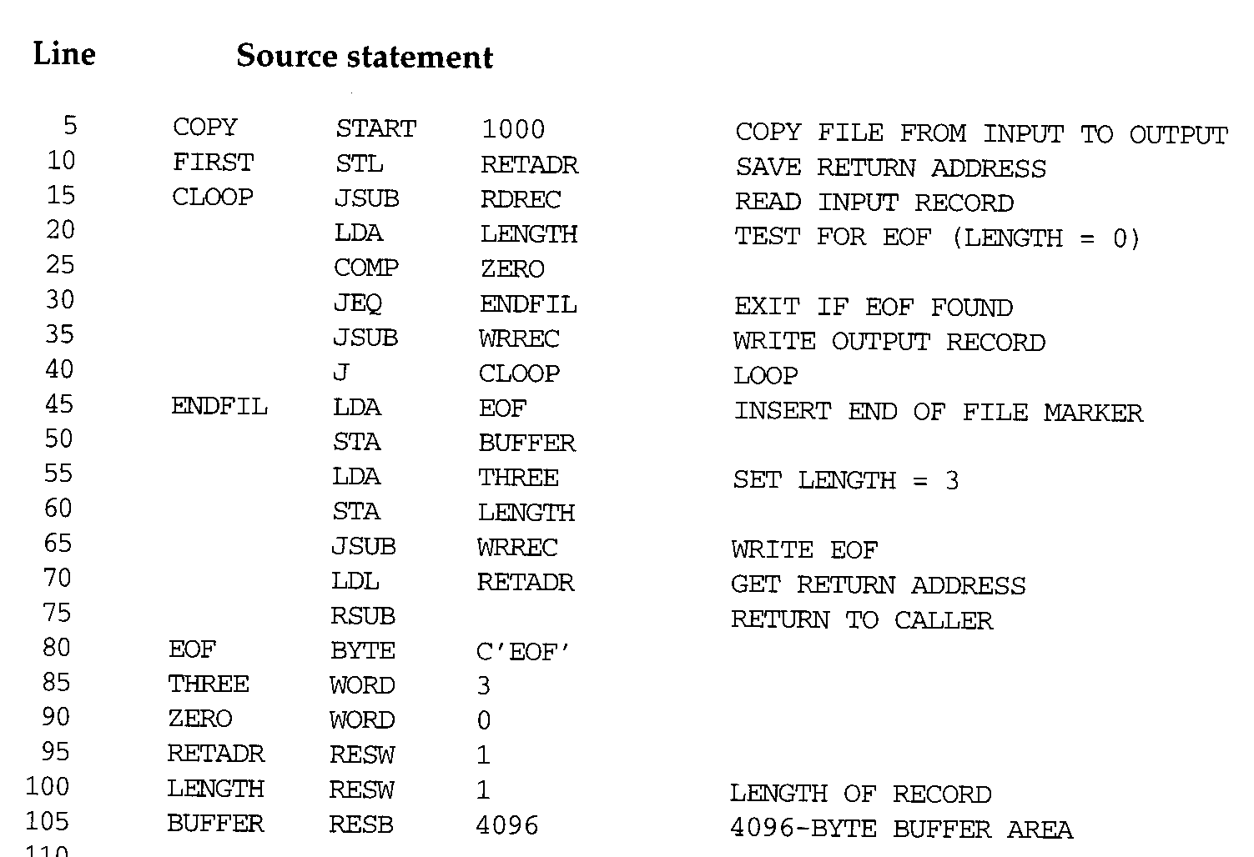
4

Slide 5
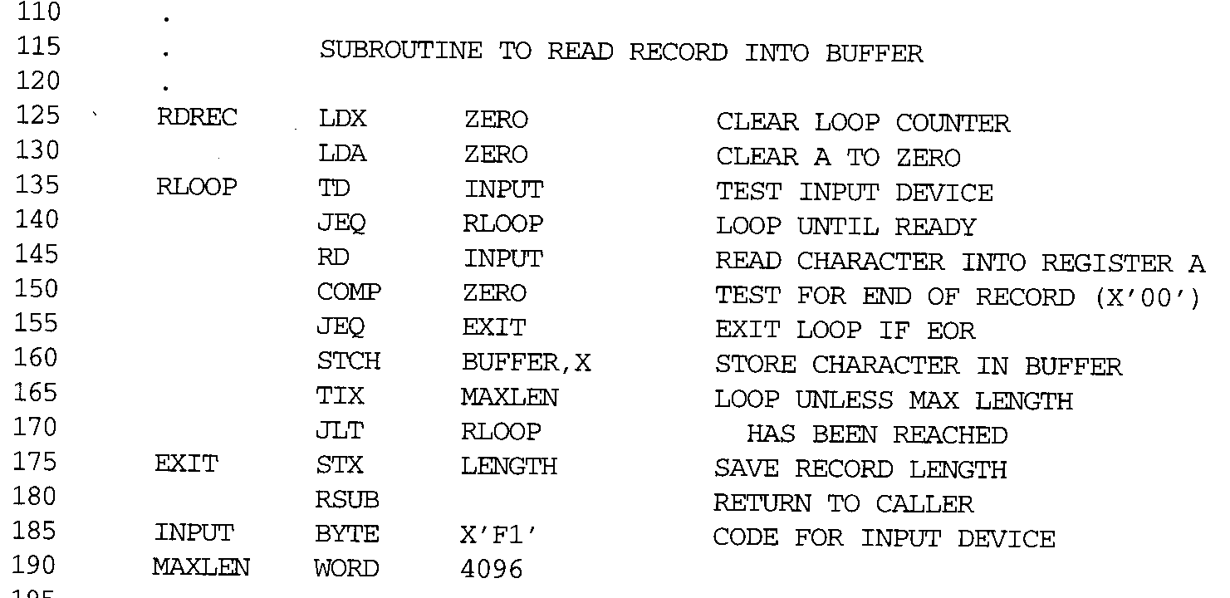
5

Slide 6
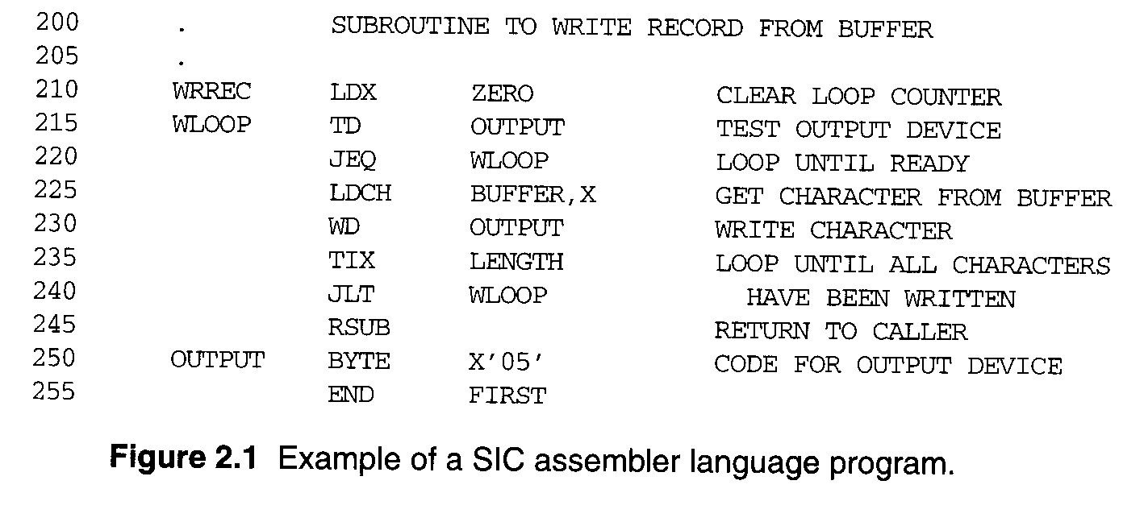
6

Slide 7
2.1 Basic Assembler Functions
Assembler directives (pseudo-instructions)
 START, END, BYTE, WORD, RESB, RESW.
 These statements are not translated into machine instructions.
 Instead, they provide instructions to the assembler itself.
7

Slide 8
2.1 Basic Assembler Functions
Data transfer (RD, WD)
 A buffer is used to store record
 Buffering is necessary for different I/O rates
 The end of each record is marked with a null character (00₁₆)
 Buffer length is 4096 Bytes
 The end of the file is indicated by a zero-length record
 When the end of file is detected, the program writes EOF on the output device and terminates by RSUB.
Subroutines (JSUB, RSUB)
 RDREC, WRREC
 Save link (L) register first before nested jump
8

Slide 9
2.1.1 A simple SIC Assembler
Figure 2.2 shows the generated object code for each statement.
 Loc gives the machine address in Hex.
 Assume the program starting at address 1000.
Translation functions
 Translate STL to 14.
 Translate RETADR to 1033.
 Build the machine instructions in the proper format (,X).
 Translate EOF to 454F46.
 Write the object program and assembly listing.
9

Slide 10
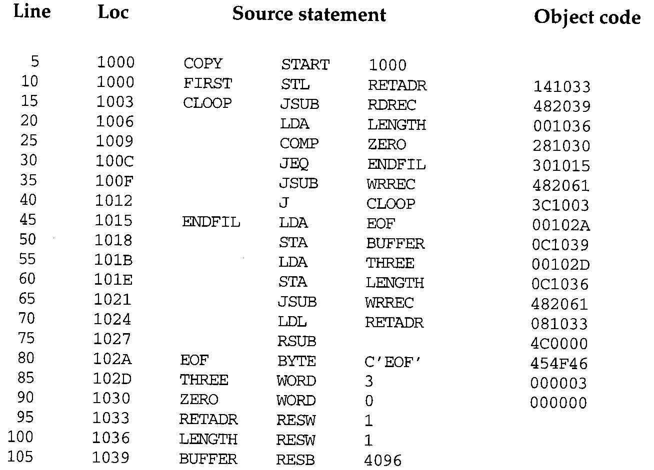
10

Slide 11
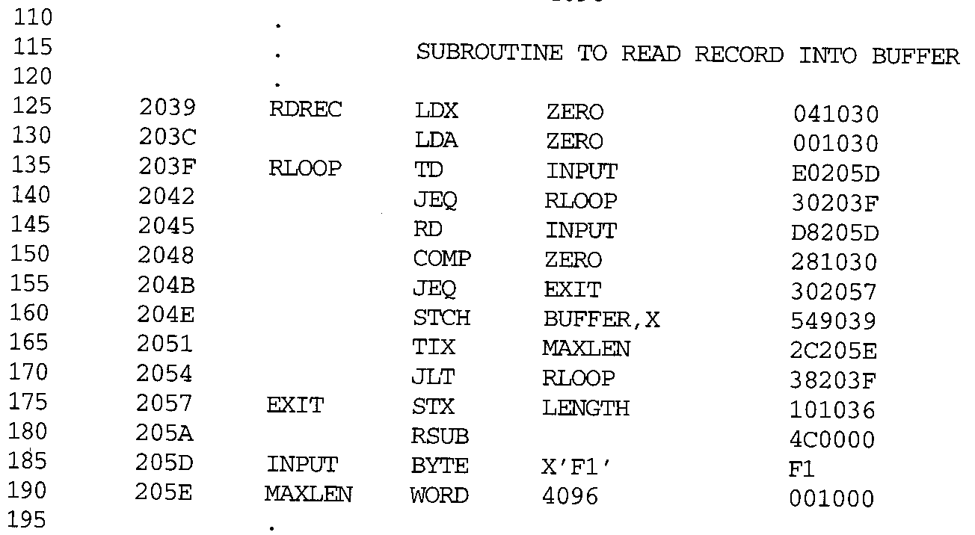

Slide 12
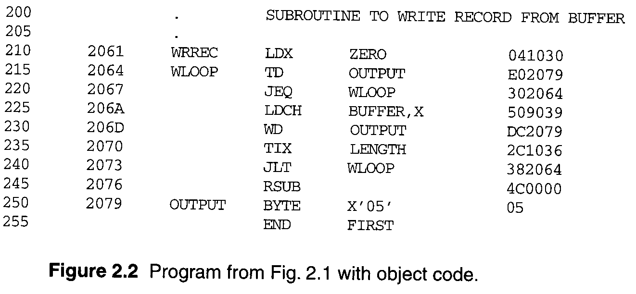

Slide 13
2.1.1 A simple SIC Assembler
A forward reference
 10 1000 FIRST STL RETADR 141033
 A reference to a label (RETADR) that is defined later in the program
 Most assemblers make two passes over the source program
Most assemblers make two passes over source program.
 Pass 1 scans the source for label definitions and assigns address (Loc).
 Pass 2 performs most of the actual translation.

Slide 14
2.1.1 A simple SIC Assembler
Example of Instruction Assemble
 Forward reference
 STCH BUFFER, X
549039
8
1
15
opcode
x
address
m
(54)₁₆
1 (001)₂
(039)₁₆

Slide 15
2.1.1 A simple SIC Assembler
Forward reference
 Reference to a label that is defined later in the program.
Loc 1000 | Label FIRST | OP Code STL | Operand RETADR
1003 … 1012 … 1033 | CLOOP … … RETADR | JSUB … J … RESW | RDREC … CLOOP … 1

Slide 16
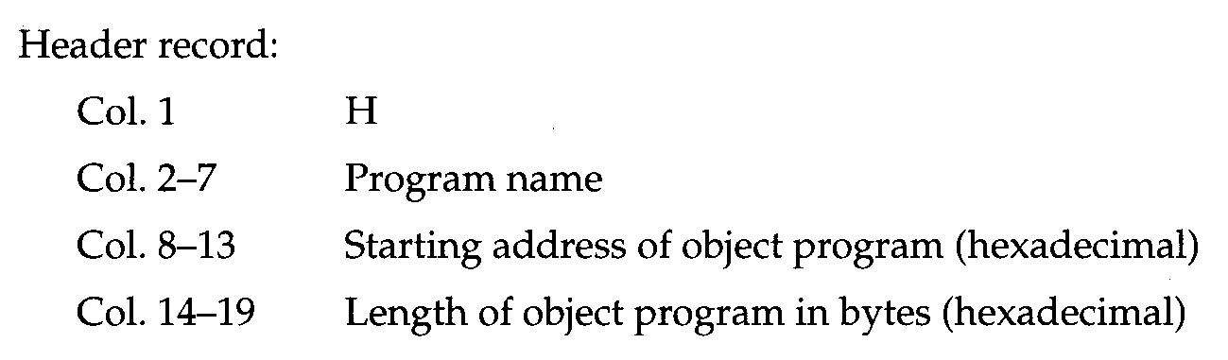
2.1.1 A simple SIC Assembler
The object program (OP) will be loaded into memory for execution.
Three types of records
 Header: program name, starting address, length.
 Text: starting address, length, object code.
 End: address of first executable instruction.

Slide 17
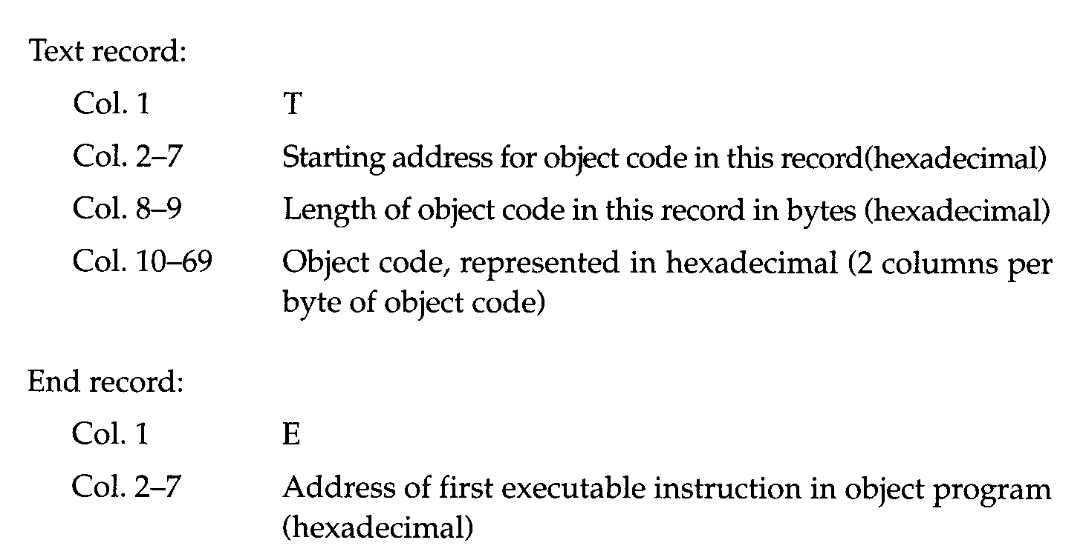
2.1.1 A simple SIC Assembler

Slide 18
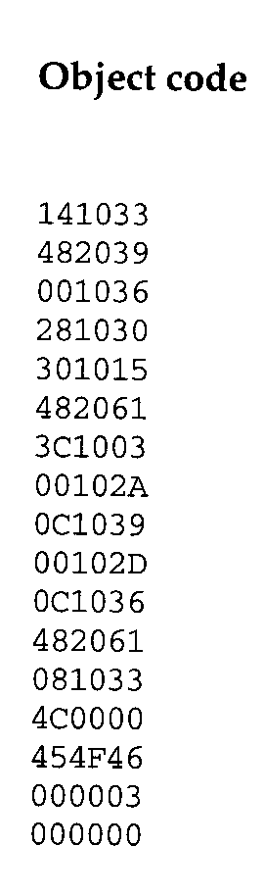
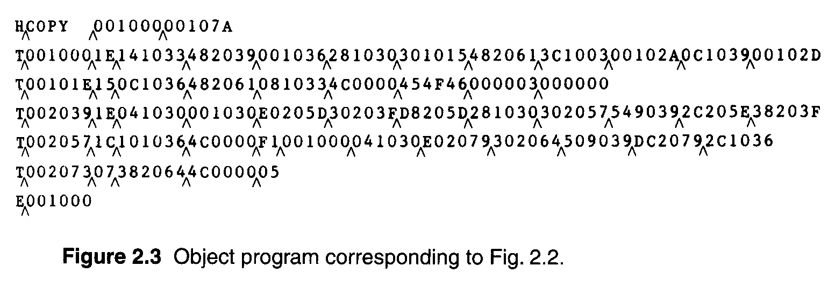
2.1.1 A simple SIC Assembler
The symbol ^ is used to separate fields.
 Figure 2.3 1E(H)=30(D)=16(D)+14(D)

Slide 19
2.1.1 A simple SIC Assembler
Assembler’s Functions
 Convert mnemonic operation codes to their machine language equivalents
STL to 14
 Convert symbolic operands (referred label) to their equivalent machine addresses
RETADR to 1033
 Build the machine instructions in the proper format
 Convert the data constants to internal machine representations
 Write the object program and the assembly listing

Slide 20
2.1.1 A simple SIC Assembler
The functions of the two passes assembler.
Pass 1 (define symbol)
 Assign addresses to all statements (generate LOC).
 Check the correctness of Instruction (check with OP table).
 Save the values (address) assigned to all labels into SYMBOL table for Pass 2.
 Perform some processing of assembler directives.
Pass 2
 Assemble instructions (op code from OP table, address from SYMBOL table).
 Generate data values defined by BYTE, WORD.
 Perform processing of assembler directives not done during Pass 1.
20
 Write the OP (Fig. 2.3) and the assembly listing (Fig. 2.2).

Slide 21
2.1.2 Assembler Tables and Logic
Our simple assembler uses two internal tables: The OPTAB and SYMTAB.
 OPTAB is used to look up mnemonic operation codes and translate them to their machine language equivalents.
 LDA→00, STL→14, …
 SYMTAB is used to store values (addresses) assigned to labels.
 COPY→1000, FIRST→1000 …
Location Counter LOCCTR
 LOCCTR is a variable for assignment addresses.
 LOCCTR is initialized to address specified in START.
 When reach a label, the current value of LOCCTR gives the address to be associated with that label.

Slide 22
2.1.2 Assembler Tables and Logic
The Operation Code Table (OPTAB)
 Contain the mnemonic operation & its machine language equivalents (at least).
 Contain instruction format & length.
 Pass 1, OPTAB is used to look up and validate operation codes.
 Pass 2, OPTAB is used to translate the operation codes to machine language.
 In SIC/XE, assembler search OPTAB in Pass 1 to find the instruction length for incrementing LOCCTR.
 Organize as a hash table (static table).

Slide 23
2.1.2 Assembler Tables and Logic
The Symbol Table (SYMTAB)
 Include the name and value (address) for each label.
 Include flags to indicate error conditions
 Contain type, length.
 Pass 1, labels are entered into SYMTAB, along with assigned addresses (from LOCCTR).
 Pass 2, symbols used as operands are look up in SYMTAB to obtain the addresses.
 Organize as a hash table (static table).
 The entries are rarely deleted from table.
COPY 1000
FIRST 1000
CLOOP 1003
ENDFIL 1015 EOF 1024 THREE 102D ZERO 1030 RETADR 1033
LENGTH 1036
BUFFER 1039
RDREC 2039

Slide 24
2.1.2 Assembler Tables and Logic
Pass 1 usually writes an intermediate file.
 Contain source statement together with its assigned address, error indicators.
 This file is used as input to Pass 2.
Figure 2.4 shows the two passes of assembler.
 Format with fields LABEL, OPCODE, and OPERAND.
 Denote numeric value with the prefix #.
#[OPERAND]

Slide 25
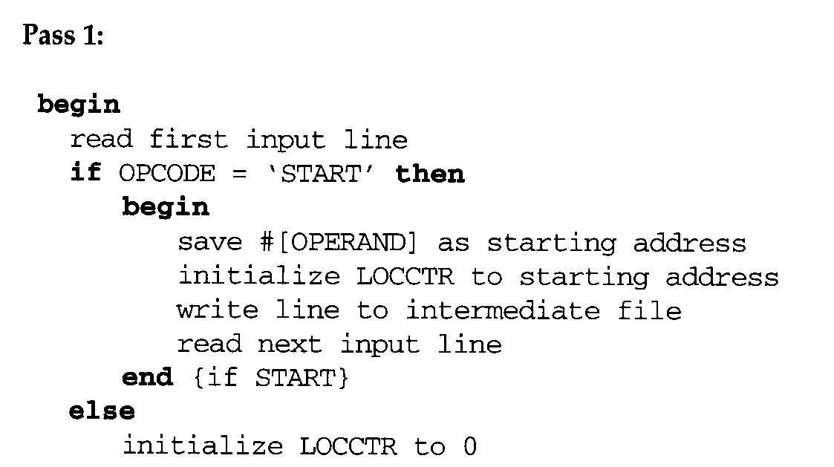

Pass 1

Slide 26
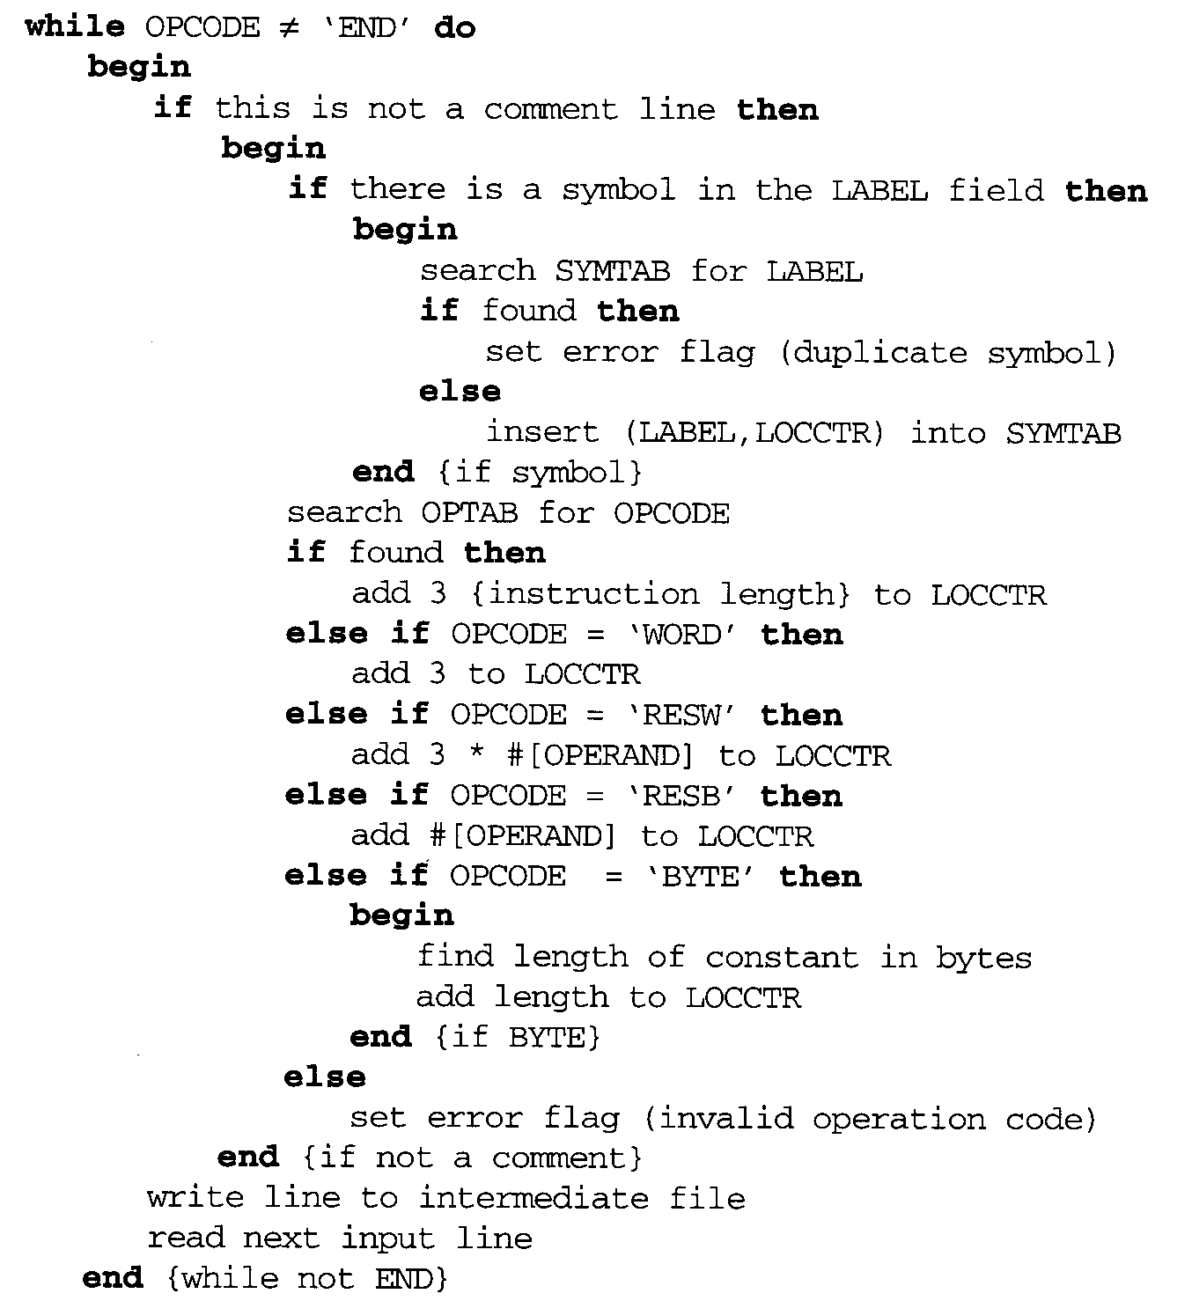

Slide 27
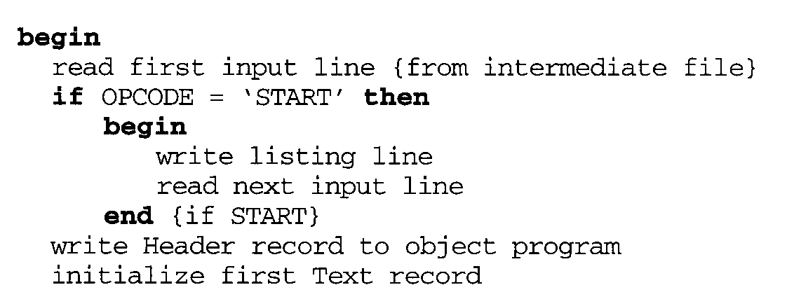
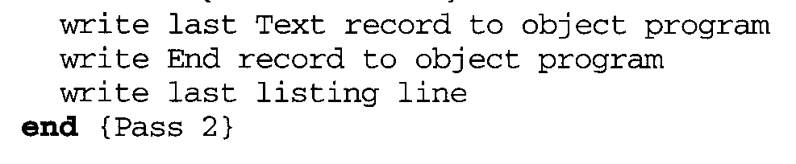
Pass 2

Slide 28
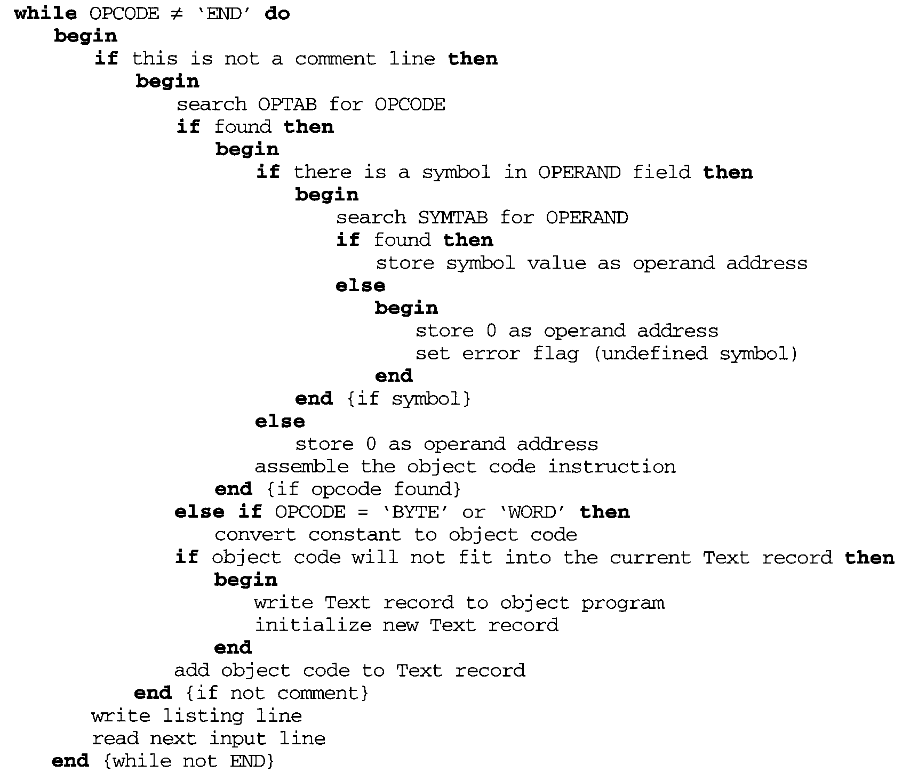
else
if (found symbol==RSUB|| found symbol== …|| found symbol==…)
store 0 as operand address else
store 0 as operand address set error flag
assemble the object code inst.

Slide 29
2.2 Machine-Dependent Assembler Features
Indirect addressing
 Adding the prefix @ to operand (line 70).
Immediate operands
 Adding the prefix # to operand (lines 12, 25, 55, 133).
Base relative addressing
 Assembler directive BASE (lines 12 and 13).
Extended format
 Adding the prefix + to OP code (lines 15, 35, 65).
The use of register-register instructions.
 Faster and don’t require another memory reference.

Slide 30
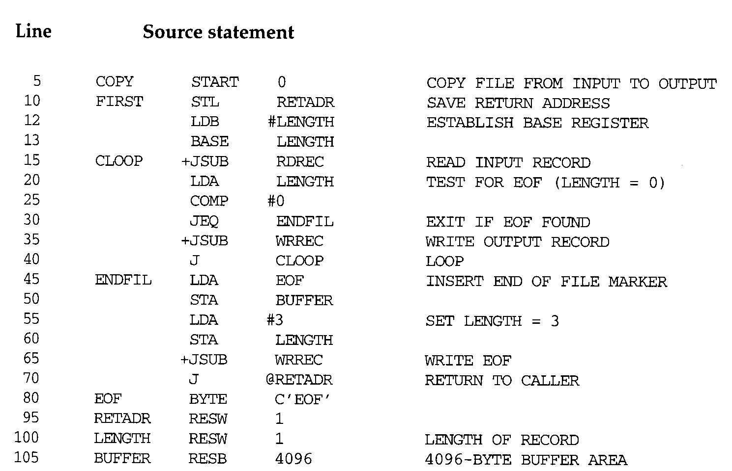
Figure 2.5: First
30

Slide 31
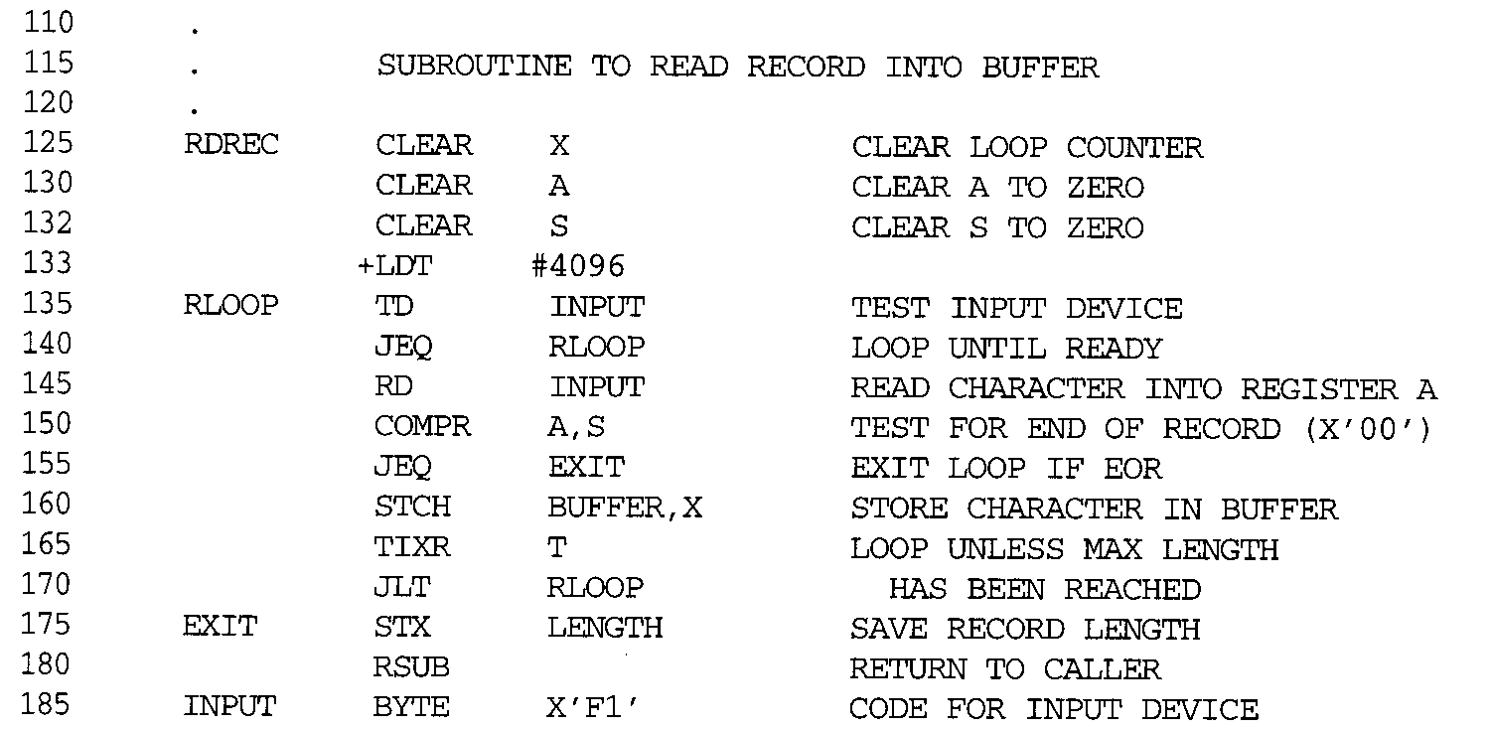
Figure 2.5: RDREC

Slide 32
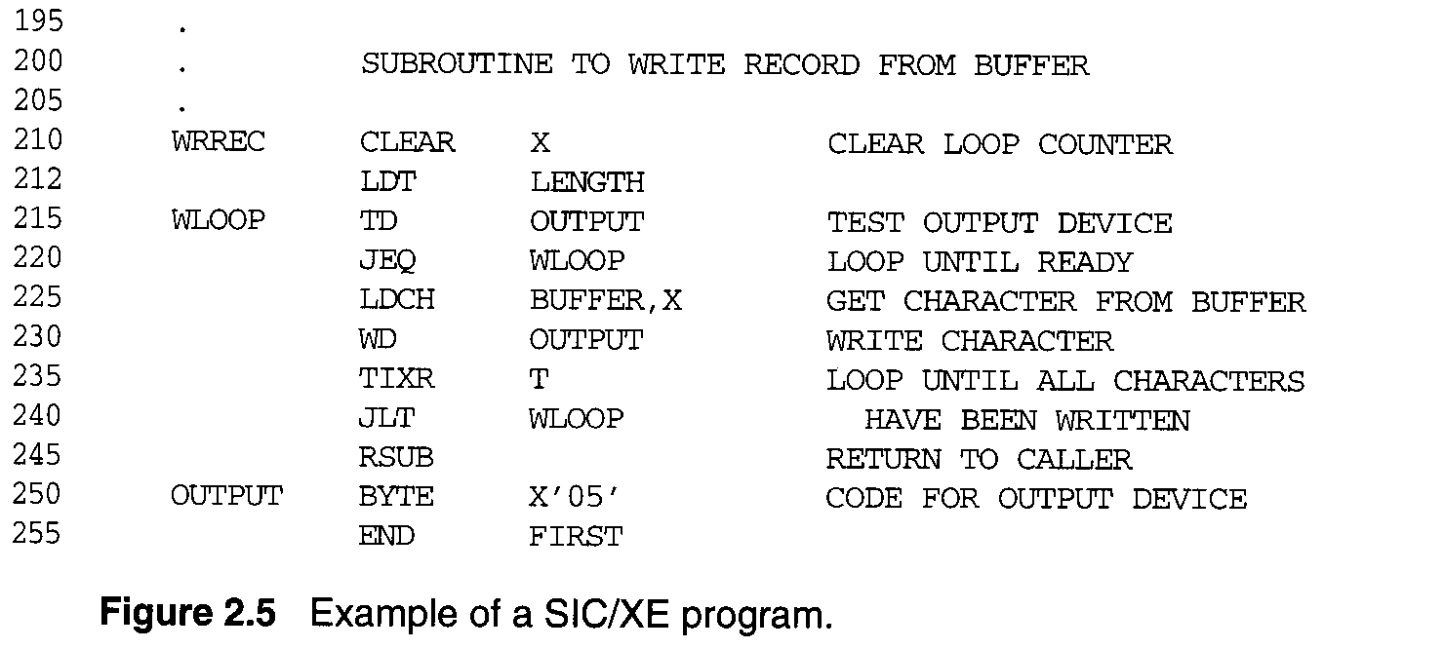
Figure 2.5: WRREC

Slide 33
2.2 Machine-Dependent Assembler
Features
SIC/XE
 PC-relative/Base-relative addressing | op | m
 Indirect addressing | op | @m
 Immediate addressing | op | #c
 Extended format | +op | m
 Index addressing | op | m, X
 register-to-register instructions COMPR
 larger memory → multi-programming (program allocation)

Slide 34
2.2 Machine-Dependent Assembler
Features
Register translation
 register name (A, X, L, B, S, T, F, PC, SW) and their values (0, 1, 2, 3, 4, 5, 6, 8, 9)
 preloaded in SYMTAB
Address translation
 Most register-memory instructions use program counter relative or base relative addressing
 Format 3: 12-bit disp (address) field
 PC-relative: -2048~2047
Base-relative: 0~4095
 Format 4: 20-bit address field (absolute addressing)

Slide 35
2.2.1 Instruction Formats & Addressing Modes
The START statement
 Specifies a beginning address of 0.
Register-register instructions
 CLEAR & TIXR, COMPR
Register-memory instructions are using
 Program-counter (PC) relative addressing
 The program counter is advanced after each instruction is fetched and before it is executed.
 PC will contain the address of the next instruction.
10 0000 FIRST STL RETADR 17202D
TA - (PC) = disp = 30H – 3H= 2D

Slide 36
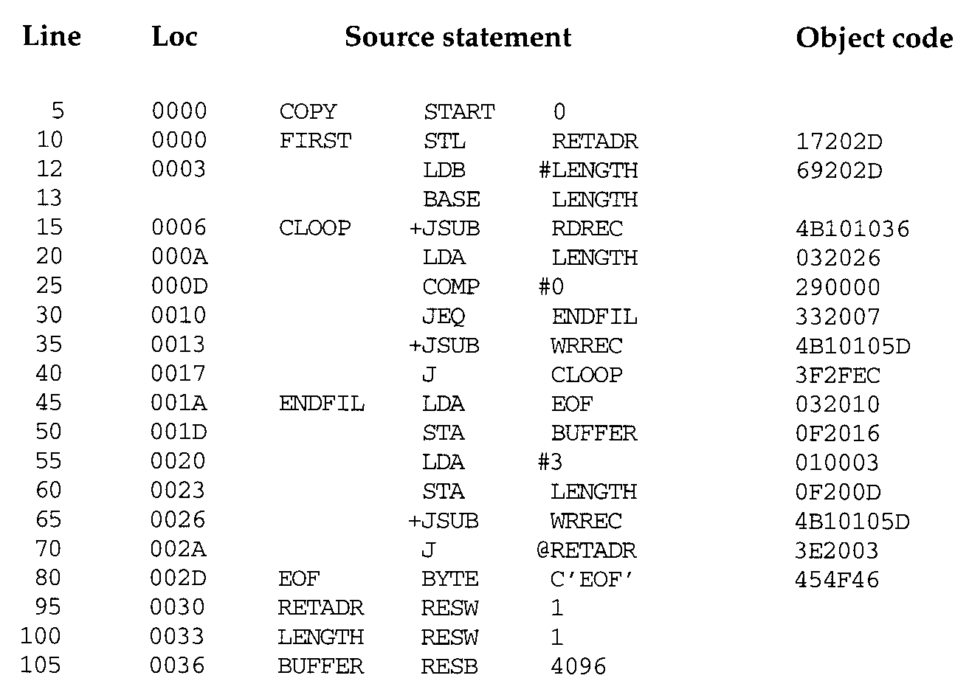

Slide 37
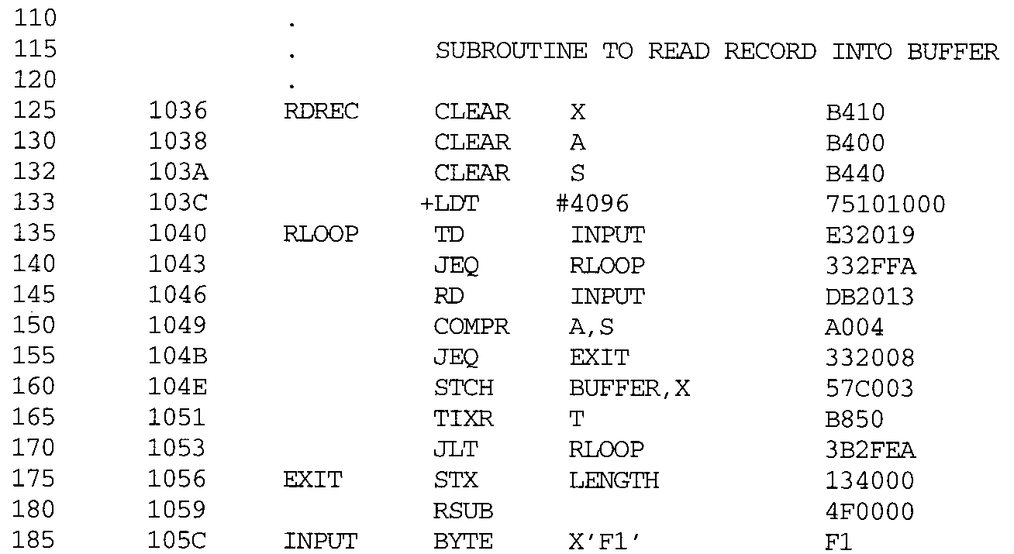

Slide 38
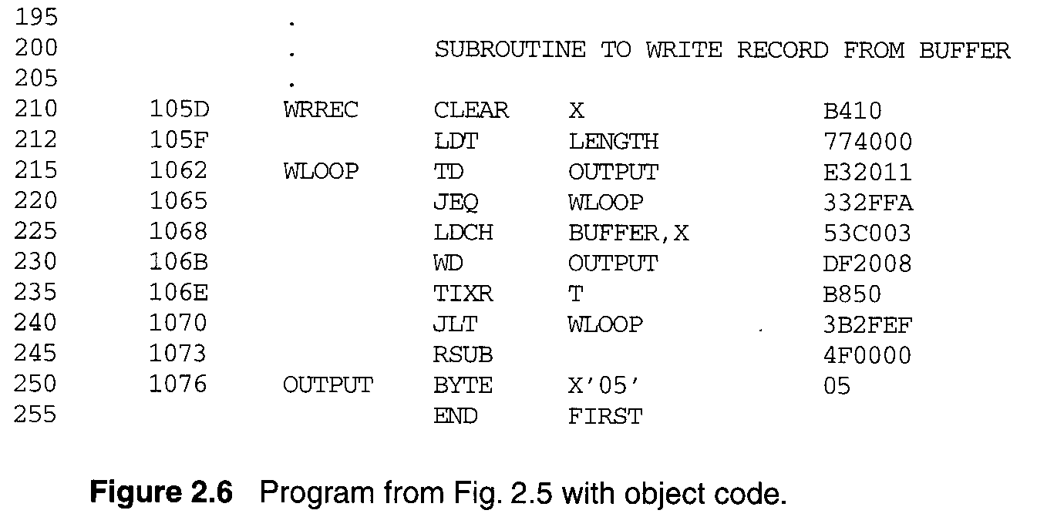

Slide 39
+OP, | e=1 |  |  | Extended
n=1, | i=1, |  | OPcode+3, | Simple
@m, | n=1, | i=0, | OPcode+2, | Indirect
#C, | n=0, | i=1, | OPcode+1, | Immediate
xbpe
2: PC-relative
4: base-relative
8: index (m,X)
1: extended

Slide 40
2.2.1 Instruction Formats & Addressing
Modes
40 0017 J CLOOP
0006 - 001A = disp = -14
 Base (B), LDB #LENGTH, BASE LENGTH
160 104E STCH BUFFER, X
3F2FEC
57C003
TA-(B) = 0036 - (B) = disp = 0036-0033 = 0003
Extended instruction
15 0006 CLOOP +JSUB RDREC 4B101036
Immediate instruction
PC relative + indirect addressing (line 70)
55 | 0020 | LDA | #3 | 010003
133 | 103C | +LDT | #4096 | 75101000
40

Slide 41
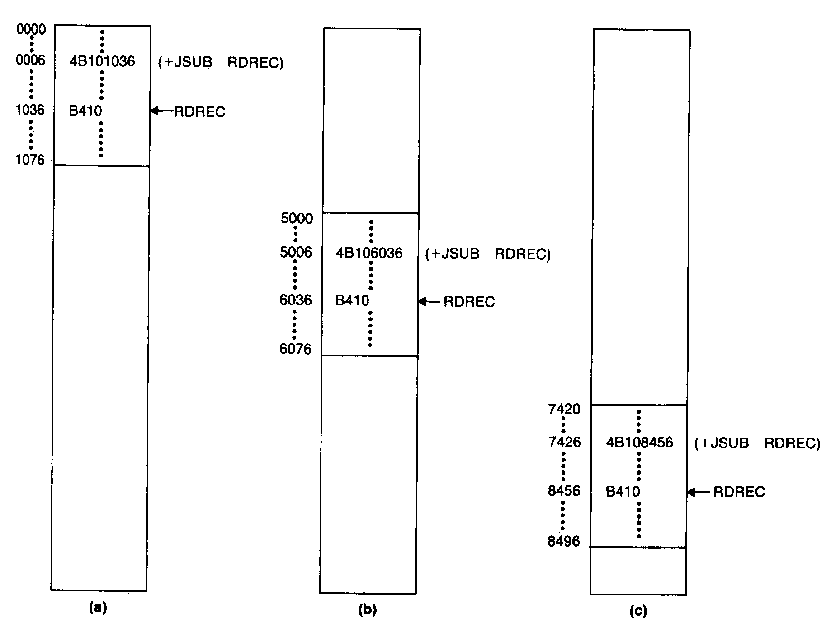
2.2.2 Program Relocation
Absolute program, relocatable program

Slide 42
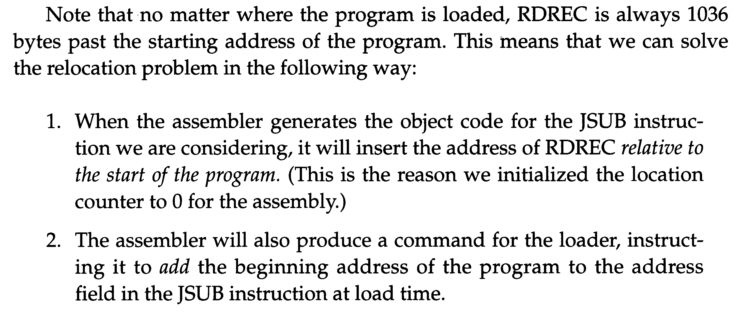
2.2.2 Program Relocation

Slide 43
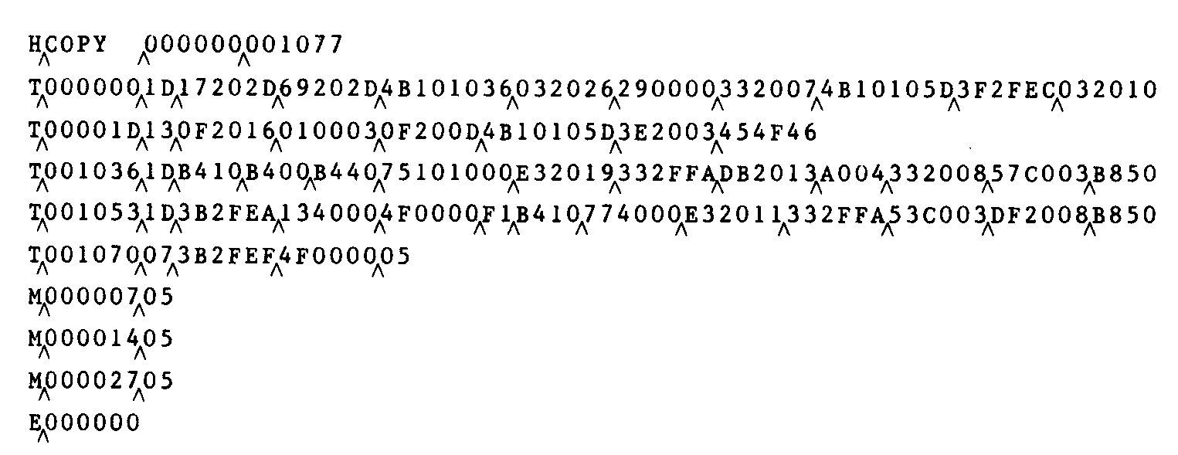

2.2.2 Program Relocation
Modification record (direct addressing)
 1 M
 2-7 Starting location of the address field to be modified, relative to the beginning of the program.
 8-9 Length of the address field to be modified, in half bytes.
M^000007^05

Slide 44
2.3 Machine-Independent Assembler
Features
Write the value of a constant operand as a part of the instruction that uses it (Fig. 2.9).
A literal is identified with the prefix =
45 001A ENDFIL LDA =C’EOF’ 032010
 Specifies a 3-byte operand whose value is the character string EOF.
215 1062 WLOOP TD =X’05’ E32011
 Specifies a 1-byte literal with the hexadecimal value 05

Slide 45
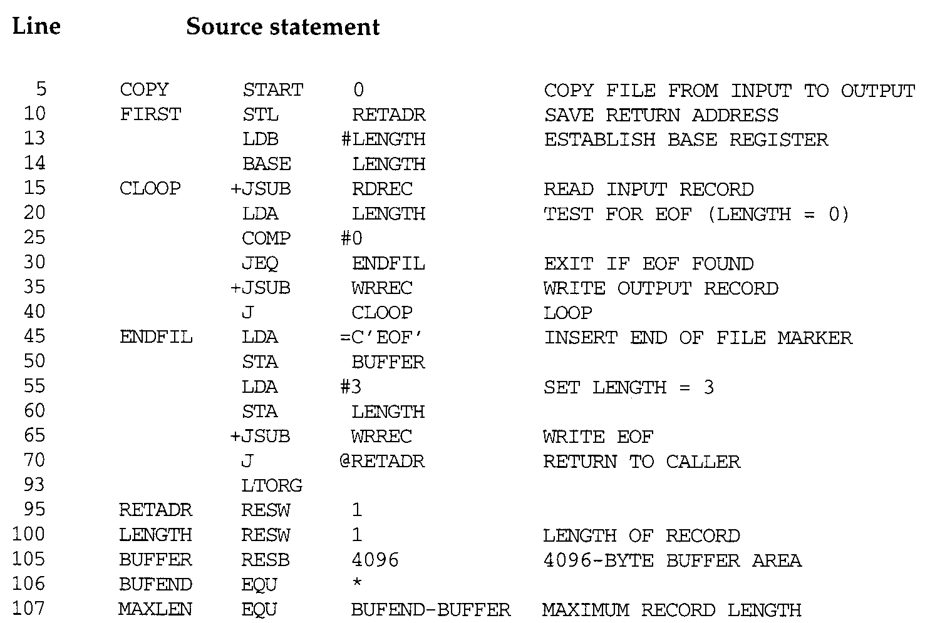

Slide 46
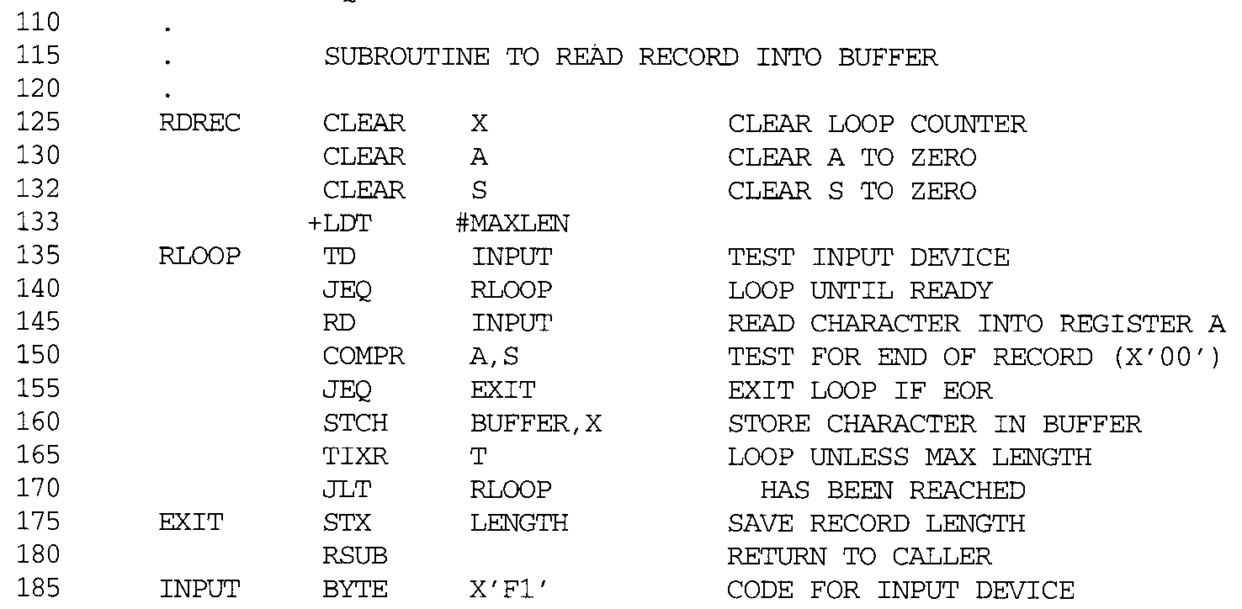
RDREC

Slide 47
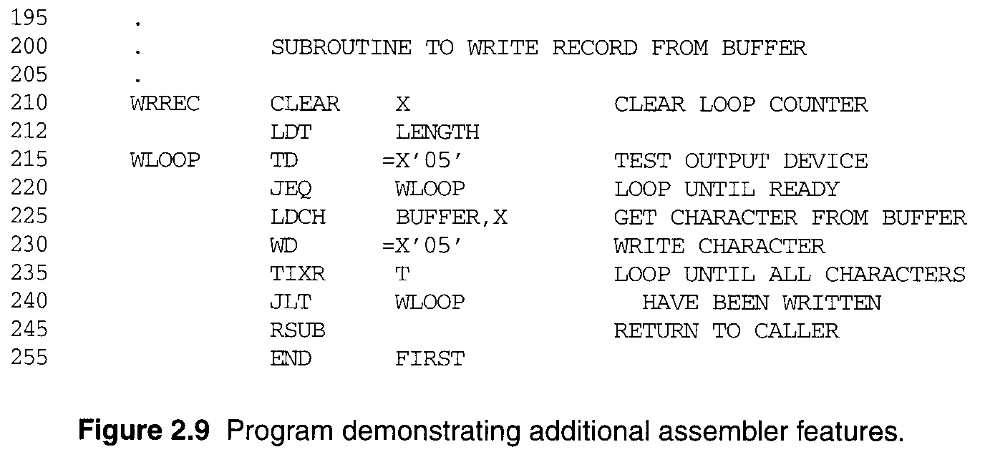
WRREC

Slide 48
2.3.1 Literals
The difference between literal operands and immediate operands
 =, #
 Immediate addressing, the operand value is assembled as part of the machine instruction, no memory reference.
 With a literal, the assembler generates the specified value as a constant at some other memory location. The address of this generated constant is used as the TA for the machine instruction, using PC-relative or base-relative addressing with memory reference.
Literal pools
 At the end of the program (Fig. 2.10).
 Assembler directive LTORG, it creates a literal pool that
contains all of the literal operands used since the previous
LTORG.
48

Slide 49
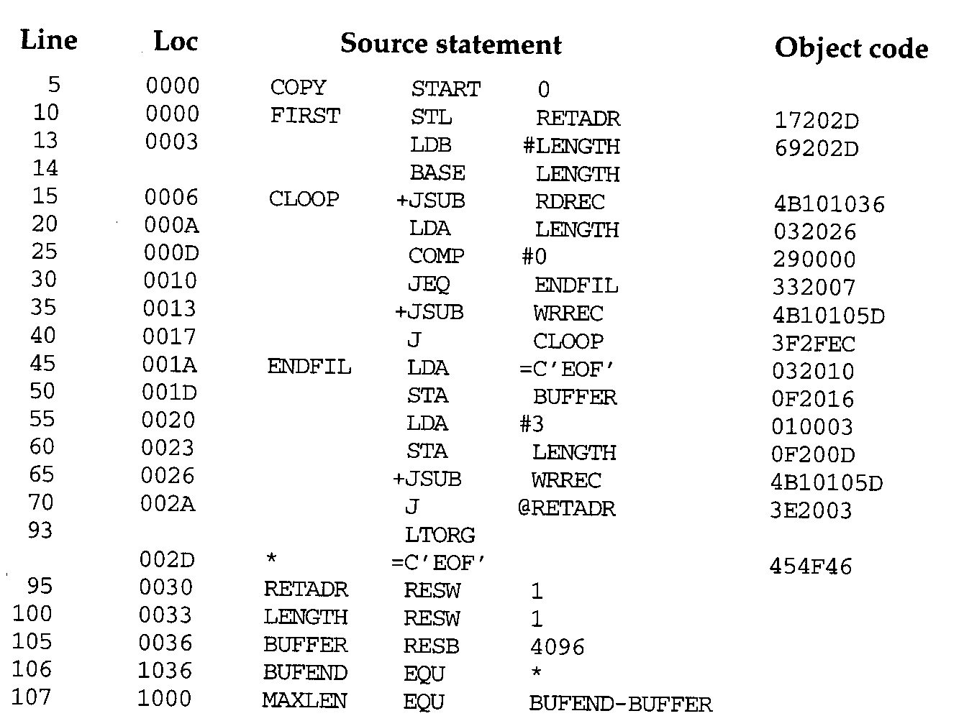

Slide 50
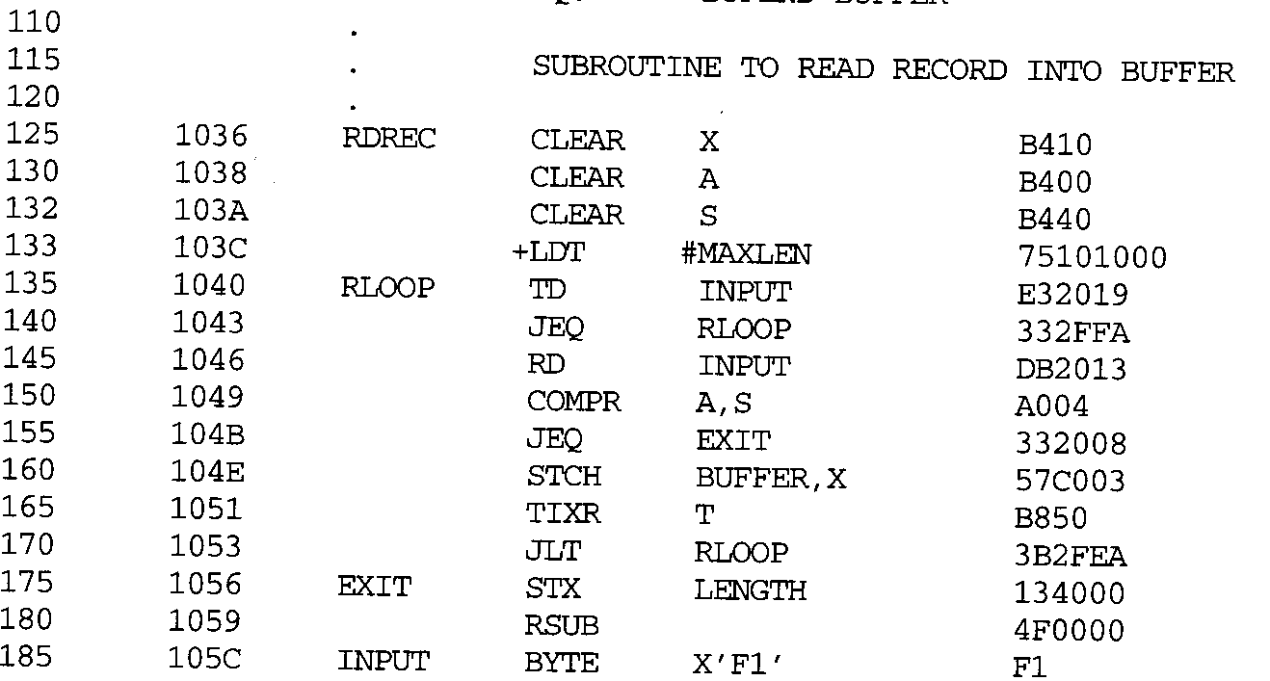
RDREC

Slide 51
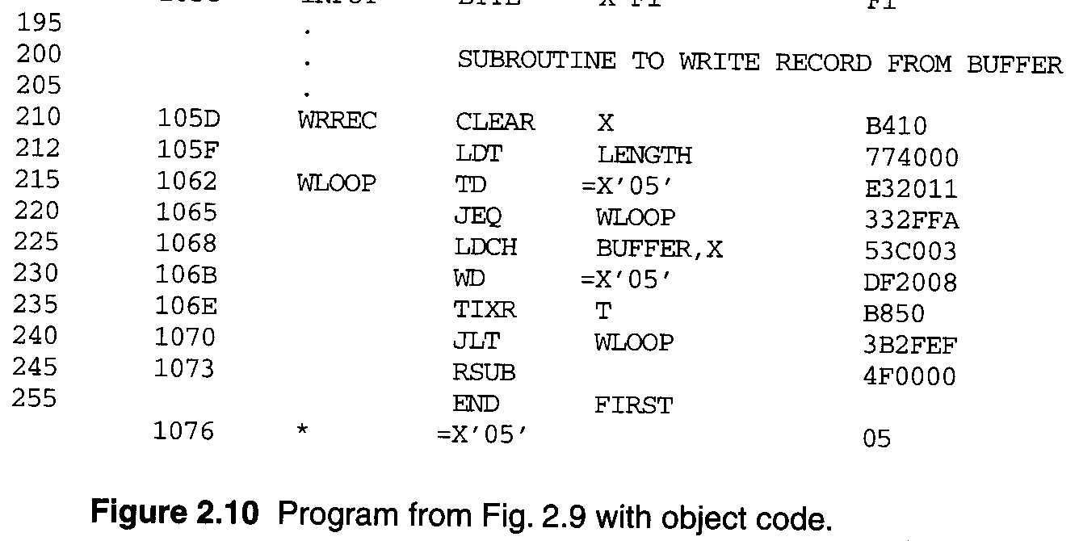
WRREC

Slide 52
2.3.1 Literals
When to use LTORG (page 69, 4th paragraph)
 The literal operand would be placed too far away from the instruction referencing.
 Cannot use PC-relative addressing or Base-relative addressing to generate Object Program.
Most assemblers recognize duplicate literals.
 By comparison of the character strings defining them.
 =C’EOF’ and =X’454F46’

Slide 53
2.3.1 Literals
Allow literals that refer to the current value of the location counter.
 Such literals are sometimes useful for loading base registers.
LDB =*
; register B=beginning address of statement=current LOC
BASE *
; for base relative addressing
If a literal =* appeared on line 13 or 55
 Specify an operand with value 0003 (Loc) or 0020 (Loc).

Slide 54
2.3.1 Literals
Literal table (LITTAB)
 Contains the literal name (=C’EOF’), the operand value (454F46) and length (3), and the address (002D).
 Organized as a hash table.
 Pass 1, the assembler creates or searches LITTAB for the specified literal name.
 Pass 1 encounters a LTORG statement or the end of the program, the assembler makes a scan of the literal table.
 Pass 2, the operand address for use in generating OC is obtained by searching LITTAB.

Slide 55
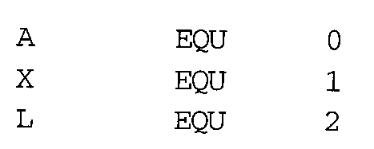
2.3.2 Symbol-Defining Statements
Allow the programmer to define symbols and specify their values.
 Assembler directive EQU.
 Improved readability in place of numeric values.
 | +LDT | #4096
MAXLEN | EQU +LDT | BUFEND-BUFFER #MAXLEN | (4096)
Use EQU in defining mnemonic names for registers.
 Registers A, X, L can be used by numbers 0, 1, 2.
RMO | 0, | 1
RMO | A, | X

Slide 56
2.3.2 Symbol-Defining Statements
The standard names reflect the usage of the registers.
BASE | EQU | R1
COUNT | EQU | R2
INDEX | EQU | R3
Assembler directive ORG
 Use to indirectly assign values to symbols.
ORG value
 The assembler resets its LOCCTR to the specified value.
 ORG can be useful in label definition.

Slide 57
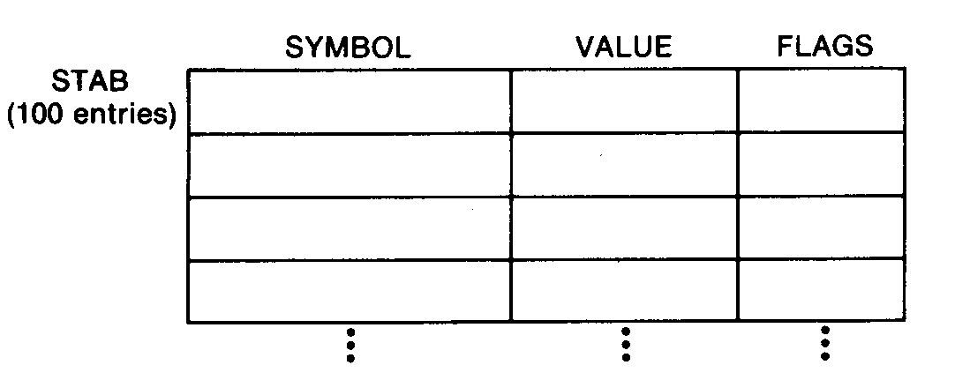
2.3.2 Symbol-Defining Statements
The location counter is used to control assignment of storage in the object program
 In most cases, altering its value would result in an incorrect assembly.
ORG is used
http://home.educities.edu.tw/wanker742126/index.html
 SYMBOL is 6-byte, VALUE is 3-byte, and FLAGS is 2-byte.
5
7

Slide 58
2.3.2 Symbol-Defining Statements
STAB | SYMBOL | VALUE | FLAGS
(100 entries) | 6 | 3 | 2
LOC 1000 STAB | RESB | 1100
1000 | SYMBOL | EQU | STAB | +0
1006 | VALUE | EQU | STAB | +6
1009 | FLAGS | EQU | STAB | +9
Use LDA VALUE, X to fetch the VALUE field form the table entry indicated by the contents of register X.
58

Slide 59
2.3.2 Symbol-Defining Statements
STAB SYMBOL (100 entries) 6 | VALUE 3 | FLAGS 2
1000 STAB RESB | 1100
ORG | STAB
1000 SYMBOL RESB | 6
1006 VALUE RESW | 1
1009 FLAGS RESB | 2
ORG STAB+1100
5
9

Slide 60
2.3.2 Symbol-Defining Statements
All terms used to specify the value of the new symbol --- must have been defined previously in the program.
...
BETA ALPHA
...
EQU ALPHA RESW 1
Need 2 passes
60

Slide 61
2.3.2 Symbol-Defining Statements
All symbols used to specify new location counter value must have been previously defined.
ORG BYTE1 | ALPHA RESB |  | 1
BYTE2 | RESB |  | 1
BYTE3 ALPHA | RESB ORG RESW |  | 1 1
Forward reference
ALPHA BETA | EQU EQU | BETA DELTA
DELTA | RESW | 1
Need 3 passes
61

Slide 62
2.3.3 Expressions
Allow arithmetic expressions formed
 Using the operators +, -, ×, /.
 Division is usually defined to produce an integer result.
 Expression may be constants, user-defined symbols, or special terms.
106 1036 BUFEND EQU *
 Gives BUFEND a value that is the address of the next byte after the buffer area.
Absolute expressions or relative expressions
 A relative term or expression represents some value (S+r), S: starting address, r: the relative value.

Slide 63
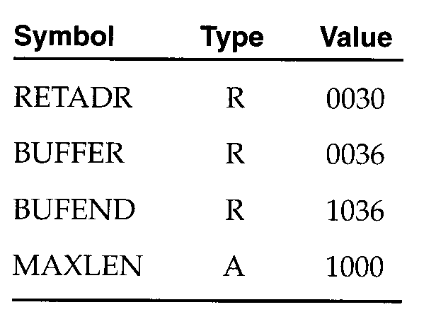
2.3.3 Expressions
107 1000 MAXLEN EQU BUFEND-BUFFER
 Both BUFEND and BUFFER are relative terms.
 The expression represents absolute value: the difference
between the two addresses.
 Loc =1000 (Hex)
 The value that is associated with the symbol that appears in the source statement.
 BUFEND+BUFFER, 100-BUFFER, 3*BUFFER represent
neither absolute values nor locations.
Symbol tables entries

Slide 64
2.3.4 Program Blocks
The source program logically contained main, subroutines, data areas.
 In a single block of object code.
More flexible (Different blocks)
 Generate machine instructions (codes) and data in a different order from the corresponding source statements.
Program blocks
 Refer to segments of code that are rearranged within a single object program unit.
Control sections
 Refer to segments of code that are translated into independent object program units.

Slide 65
2.3.4 Program Blocks
Three blocks, Figure 2.11
 Default (USE), CDATA (USE CDATA), CBLKS (USE CBLKS).
Assembler directive USE
 Indicates which portions of the source program blocks.
 At the beginning of the program, statements are assumed to be part of the default block.
 Lines 92, 103, 123, 183, 208, 252.
Each program block may contain several separate segments.
 The assembler will rearrange these segments to gather together the pieces of each block.

Slide 66
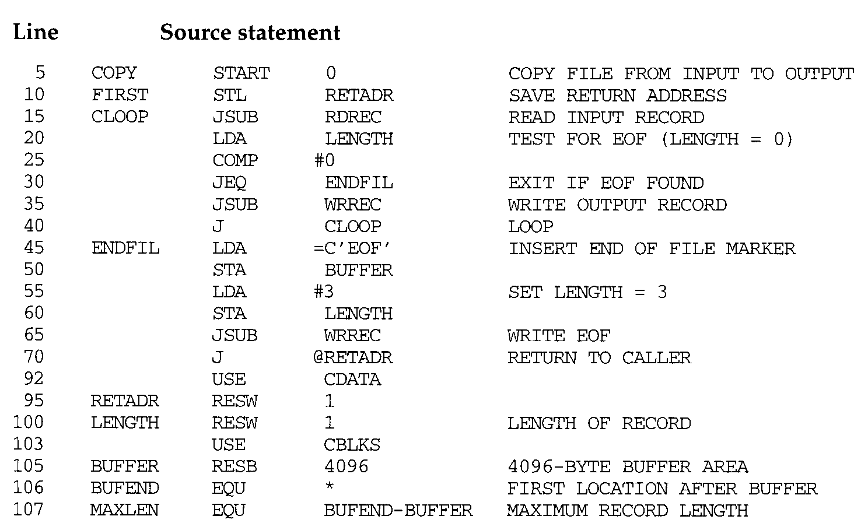
Main

Slide 67
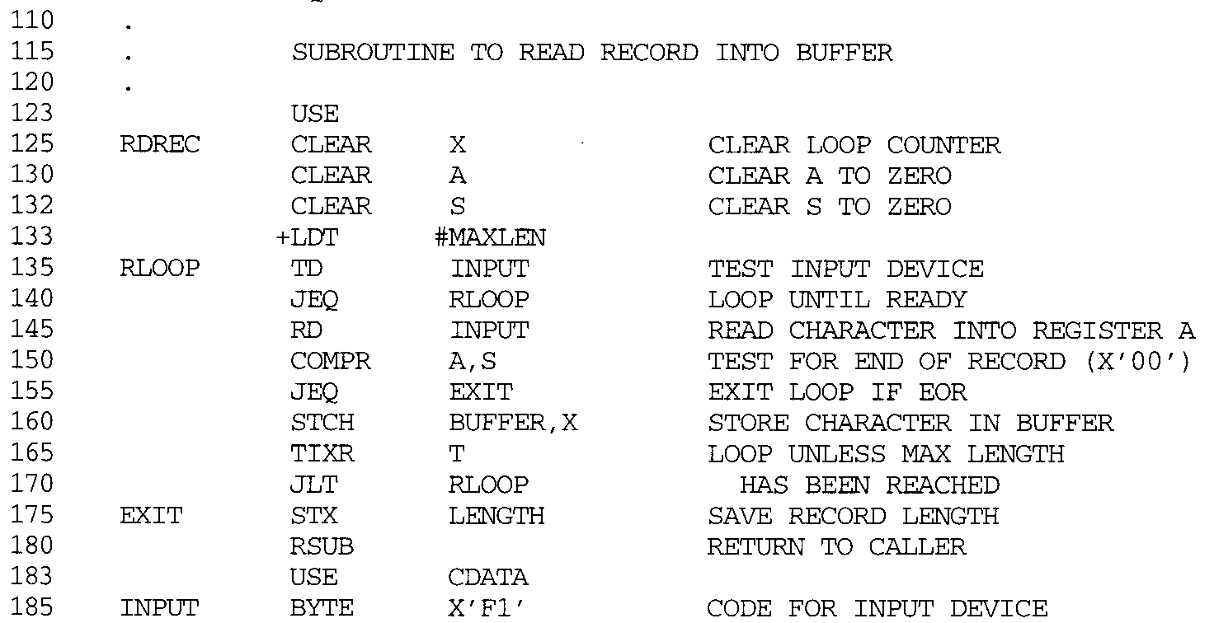
RDREC

Slide 68
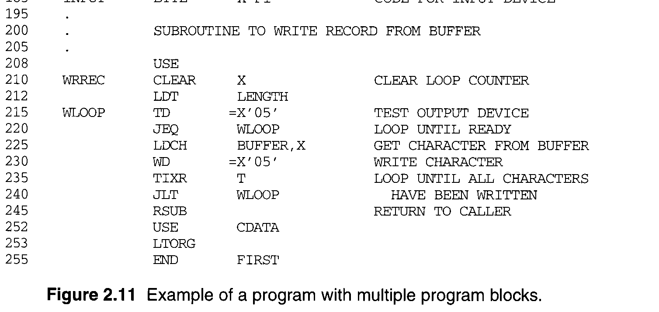
WRREC

Slide 69
2.3.4 Program Blocks
Pass 1, Figure 2.12
 The block number is started form 0.
 A separate location counter for each program block.
 The location counter for a block is initialized to 0 when the block is first begun.
 Assign each block a starting address in the object program (location 0).
 Labels, block name or block number, relative addr.
 Working table is generated
Block name | Block number | Address | End | Length
default | 0 | 0000 | 0065 | 0066 | (0~0065)
CDATA | 1 | 0066 | 0070 | 000B | (0~000A)
CBLKS | 2 | 0071 | 1070 | 1000 | (0~0FFF)

Slide 70
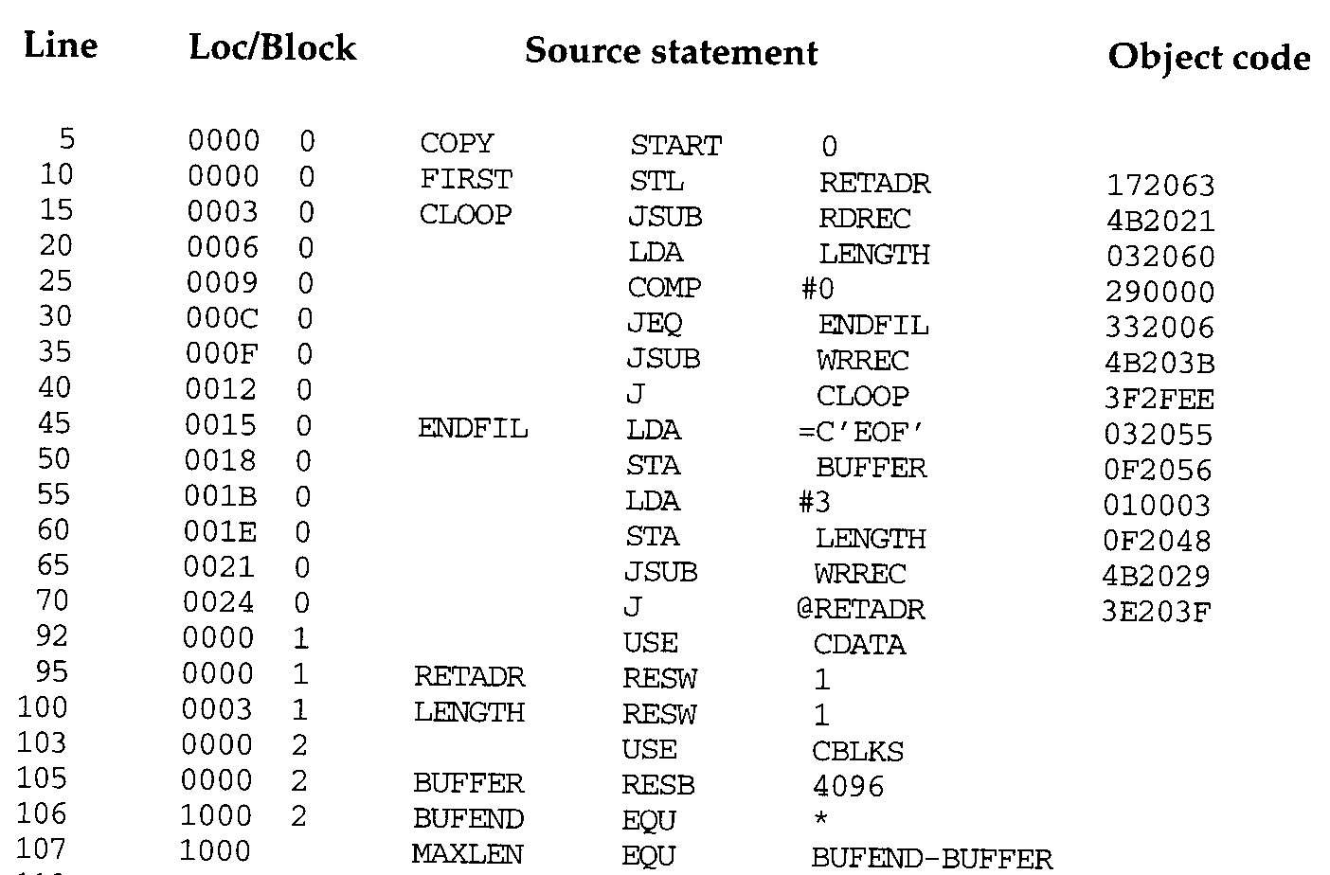
70

Slide 71
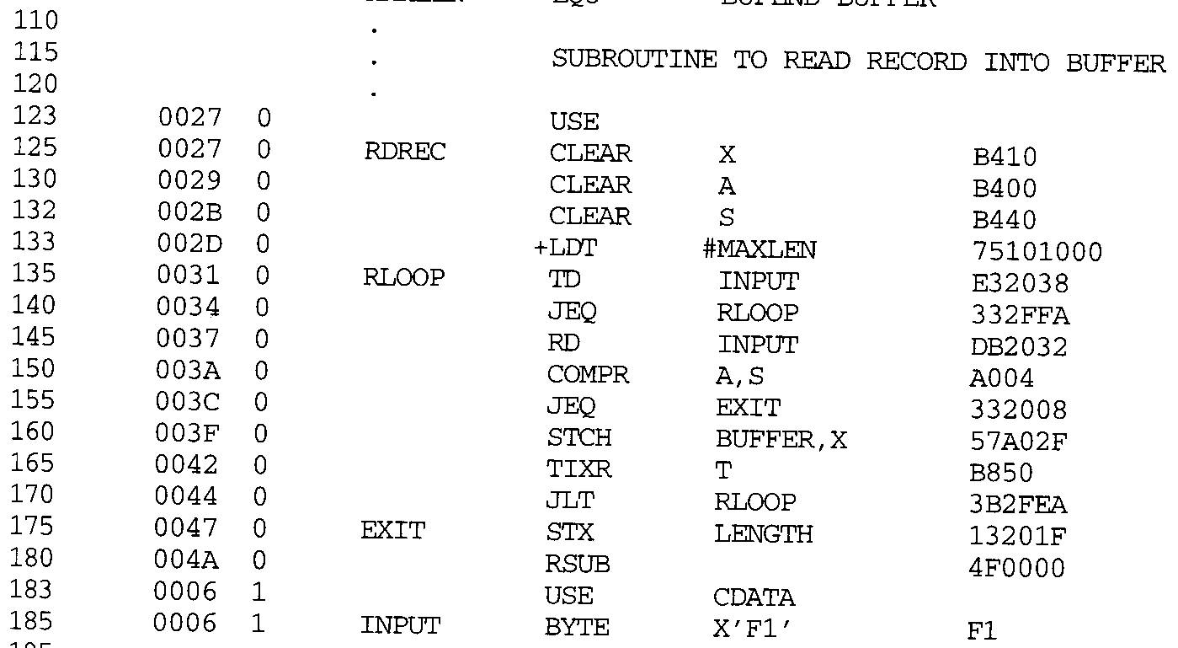

Slide 72
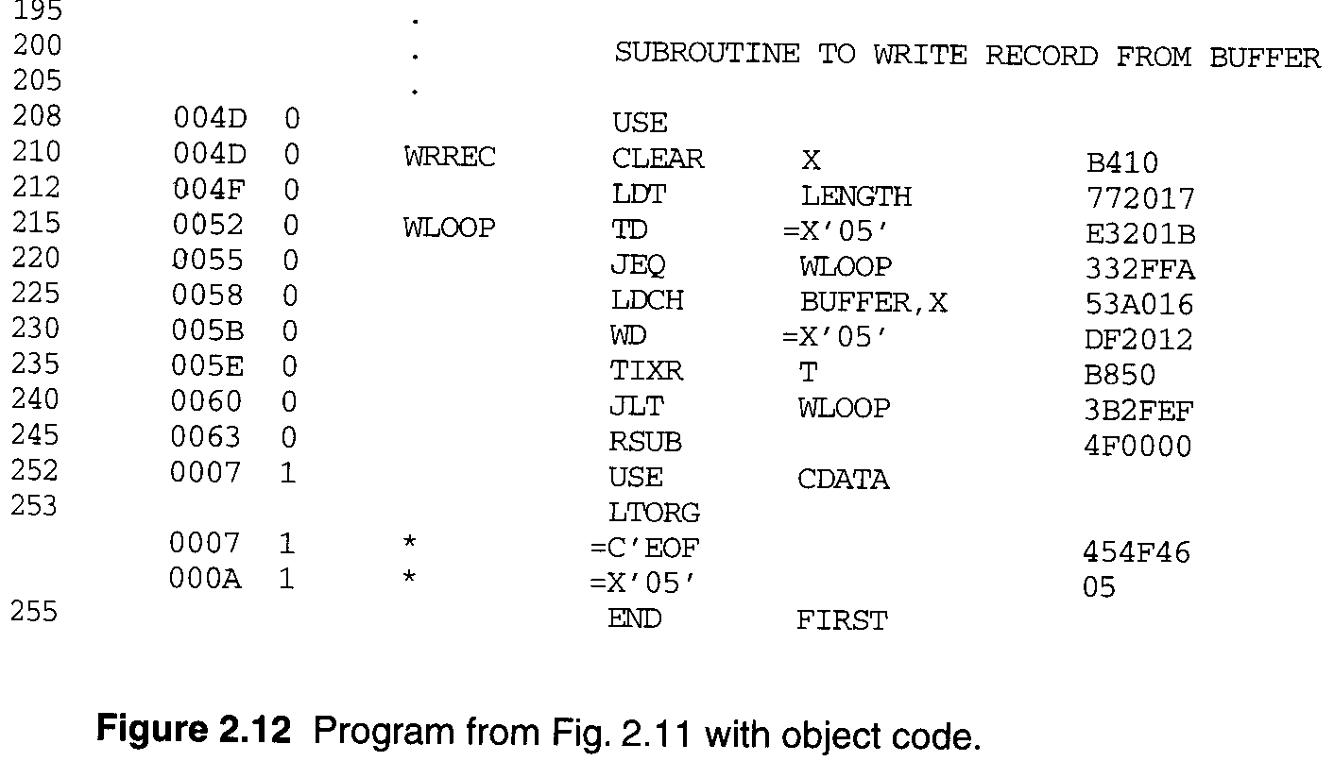

Slide 73
2.3.4 Program Blocks
Pass 2, Figure 2.12
 The assembler needs the address for each symbol relative to the start of the object program.
 Loc shows the relative address and block number.
 Notice that the value of the symbol MAXLEN (line 70) is shown without a block number.
20 0006 0 LDA LENGTH 032060
0003(CDATA) +0066 =0069 =TA
using program-counter relative addressing TA - (PC) =0069-0009 =0060 =disp

Slide 74
2.3.4 Program Blocks
Separation of the program into blocks.
 Because the large buffer (CBLKS) is moved to the end of the object program.
 No longer need extended format, base register, simply a LTORG statement.
 No need Modification records.
 Improve program readability.
Figure 2.13
 Reflect the starting address of the block as well as the relative location of the code within the block.
Figure 2.14
 Loader simply loads the object code from each record at the dictated.
 CDATA(1) & CBLKS(1) are not actually present in OP.

Slide 75
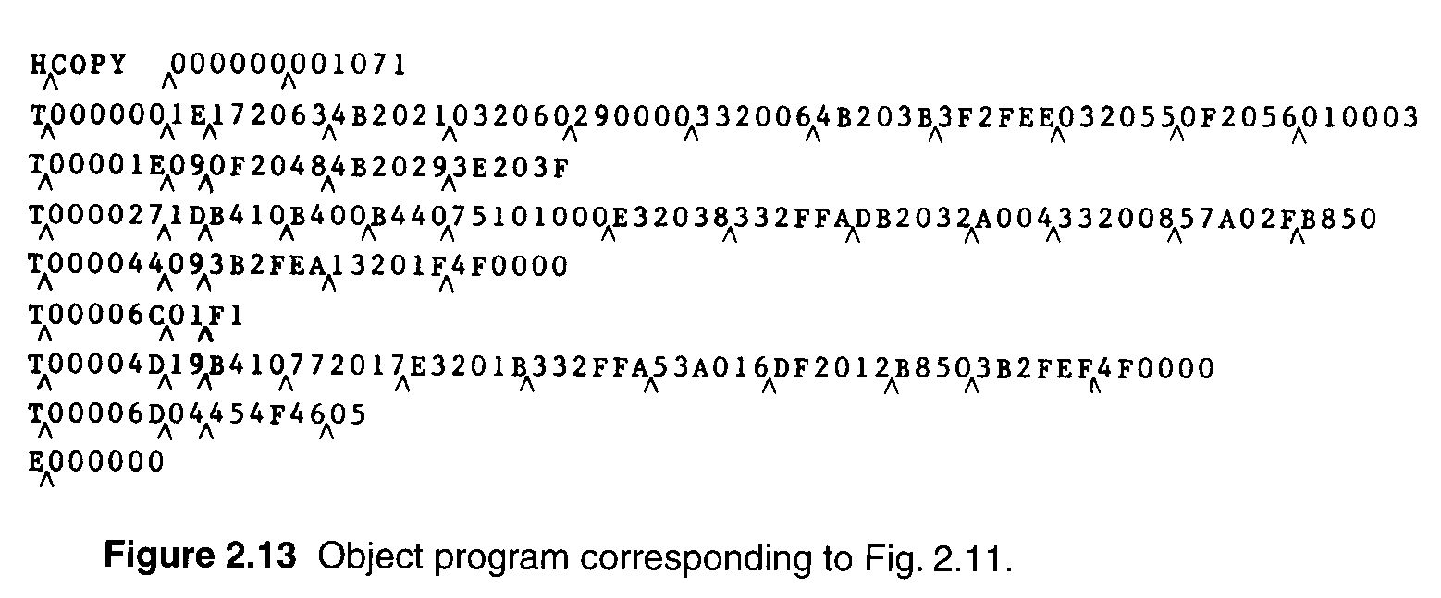
2.3.4 Program Blocks
Default 1
Default 2
CDATA 2
Default 3
CDATA 3

Slide 76
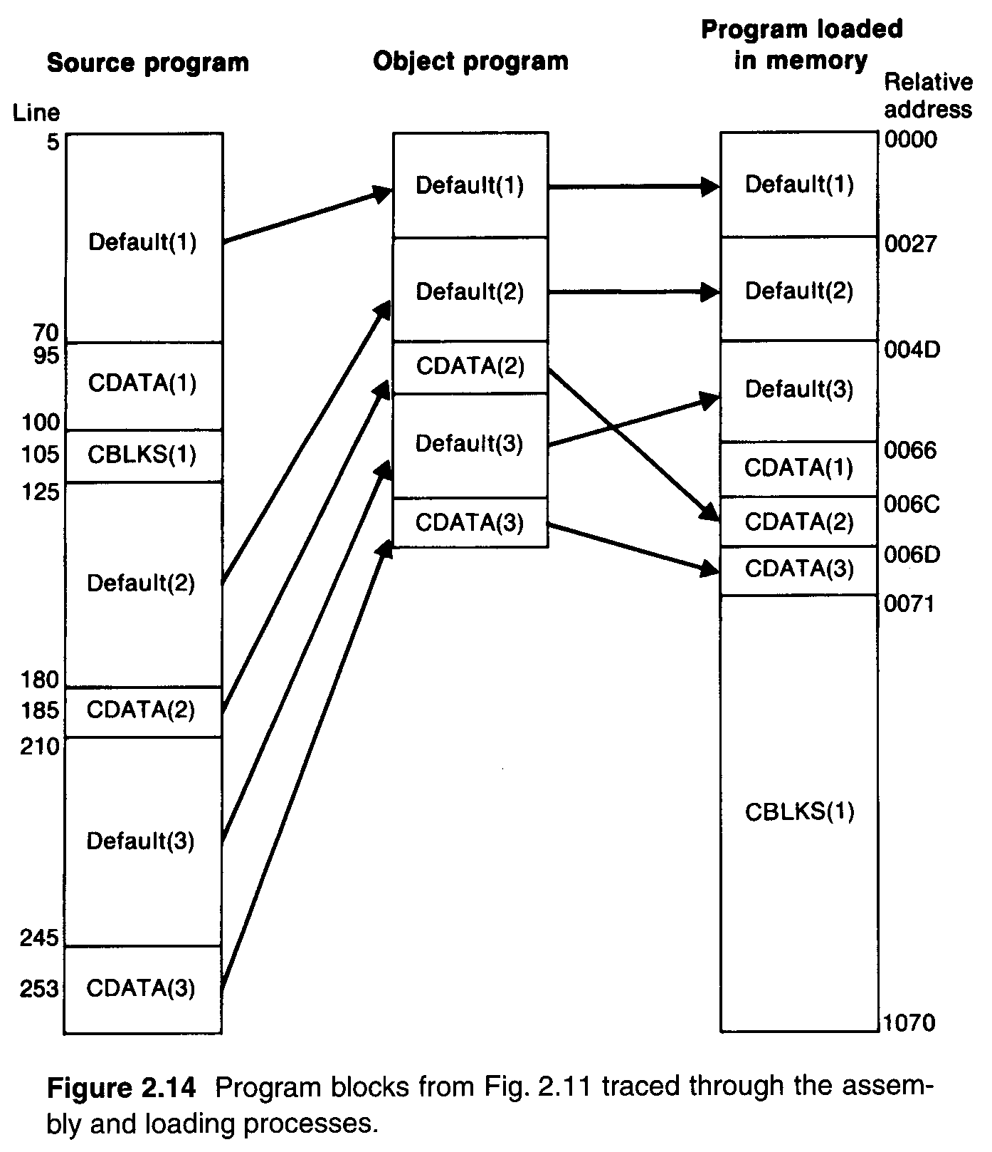

Slide 77
2.3.5 Control Sections & Program Linking
Control section
 Handling of programs that consist of multiple control sections.
 Each control section is a part of the program.
 Can be assembled, loaded and relocated independently.
 Different control sections are most often used for subroutines or other logical subdivisions of a program.
 The programmer can assemble, load, and manipulate each of these control sections separately.
 More Flexibility then the previous.
 Linking control sections together.

Slide 78
2.3.5 Control Sections & Program Linking
External references (external symbol references)
 Instructions in one control section might need to refer to instructions or data located in another section.
Figure 2.15, multiple control sections.
 Three sections, main COPY, RDREC, WRREC.
 Assembler directive CSECT.
 Assembler directives EXTDEF and EXTREF for external symbols.
 The order of symbols is not significant.
COPY | START | 0
 | EXTDEF | BUFFER, | BUFEND, LENGTH
 | EXTREF | RDREC, | WRREC (symbol name)

Slide 79
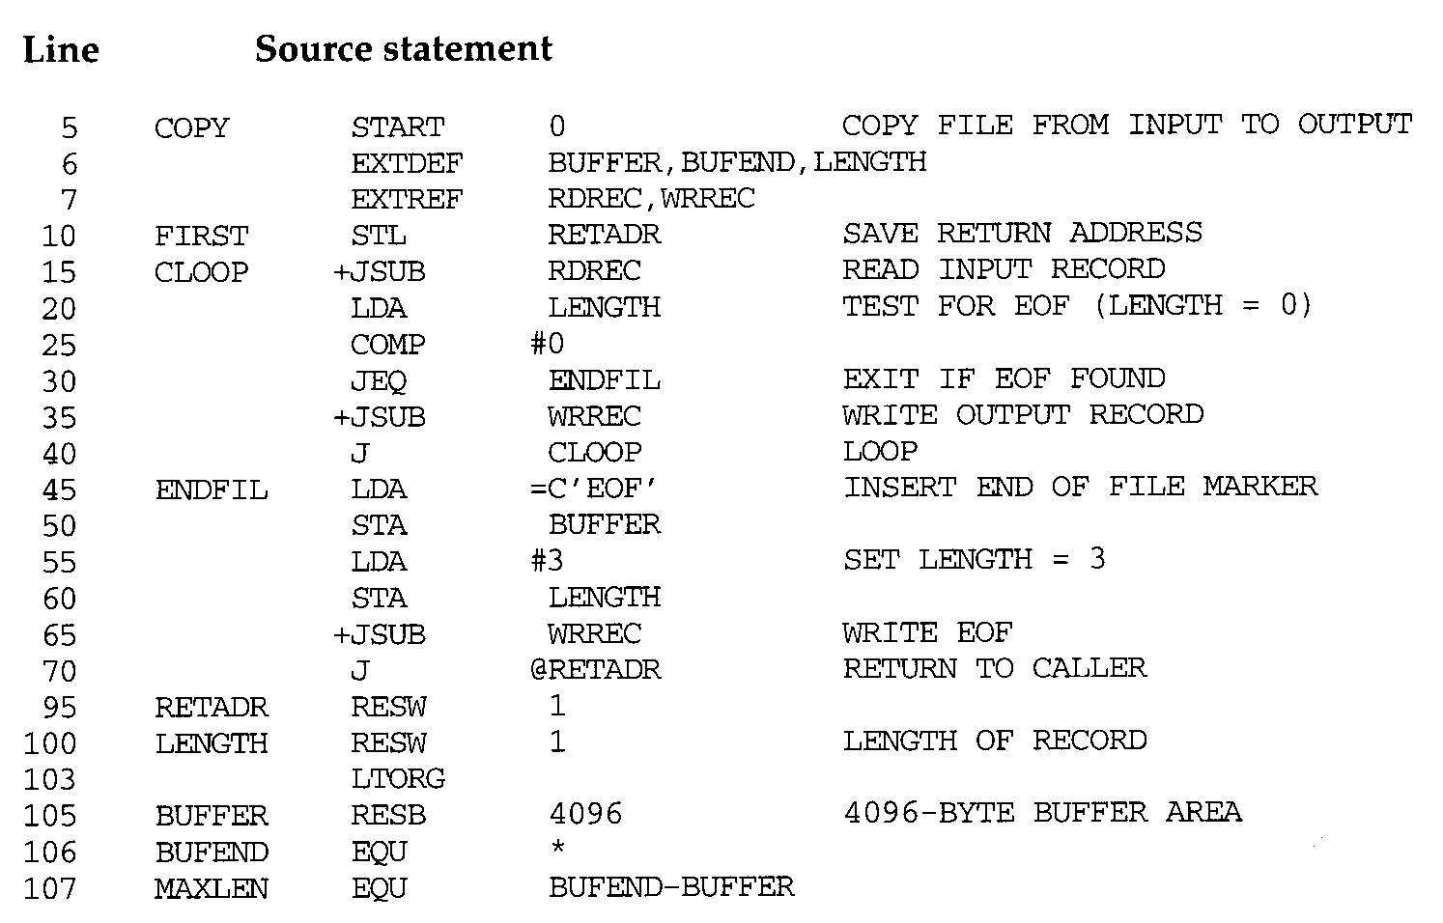

Slide 80
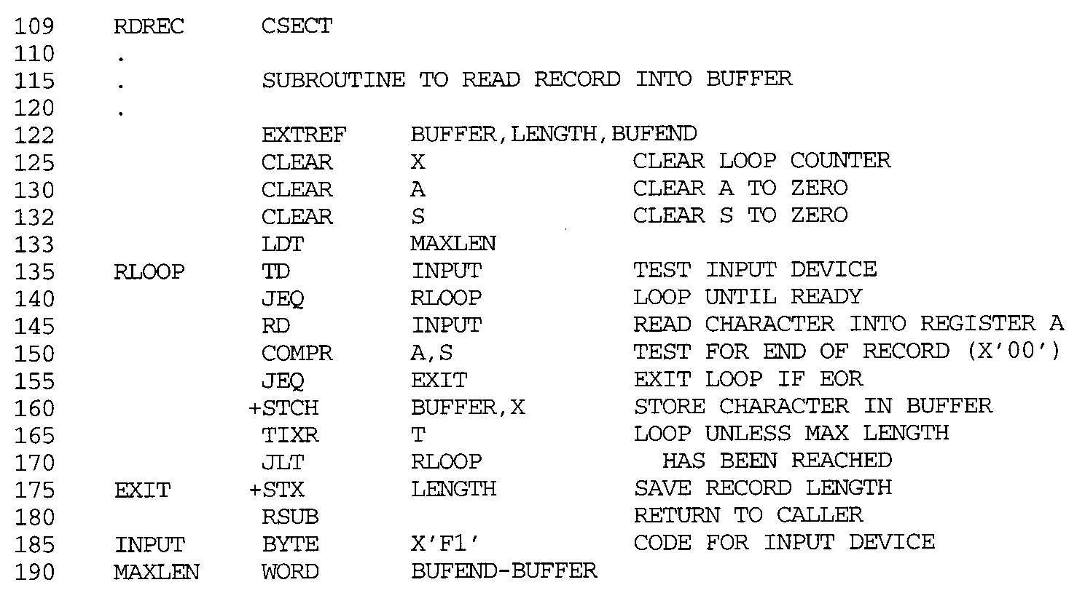
80

Slide 81
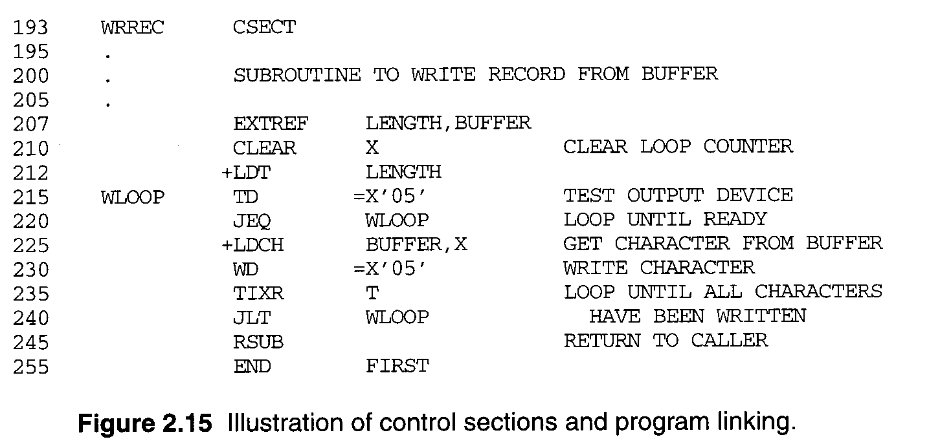

Slide 82
2.3.5 Control Sections & Program Linking
Figure 2.16, the generated object code.
15
160
0003
0017
CLOOP +JSUB RDREC
+STCH BUFFER,X
4B100000
57900000
 The LOC of all control section is started form 0
 RDREC is an external reference.
 The assembler has no idea where the control section containing RDREC will be loaded, so it cannot assemble the address.
 The proper address to be inserted at load time.
 Must use extended format instruction for external reference (M records are needed).
190 0028 MAXLEN WORD BUFEND-BUFFER
 An expression involving two external references.

Slide 83
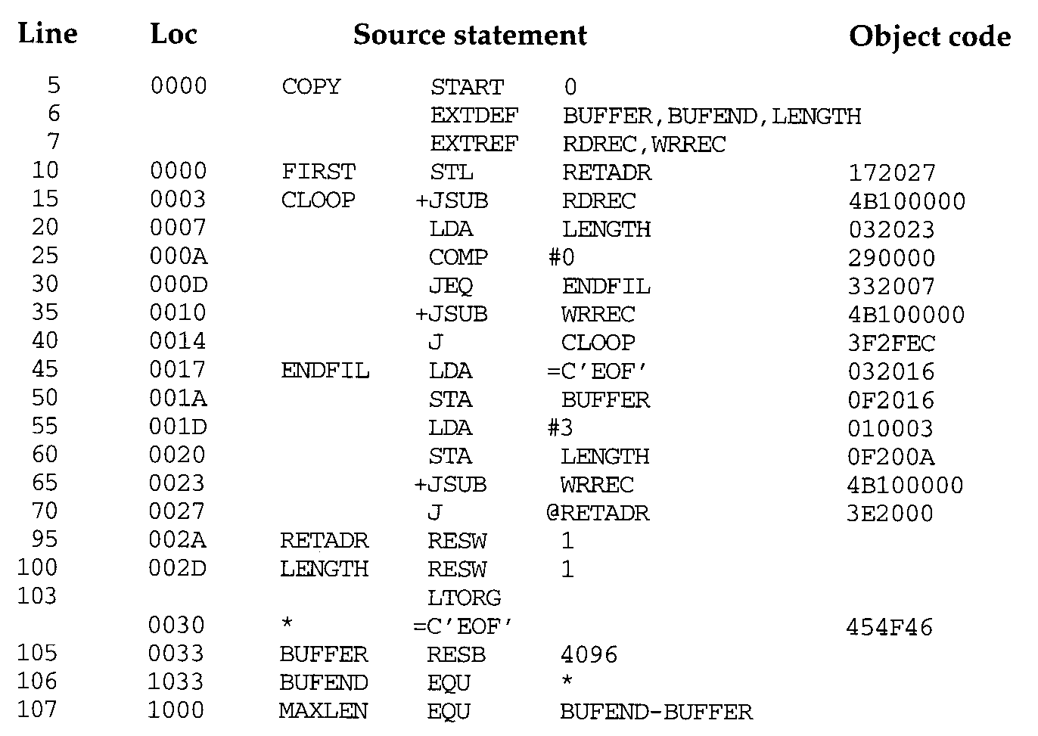

Slide 84
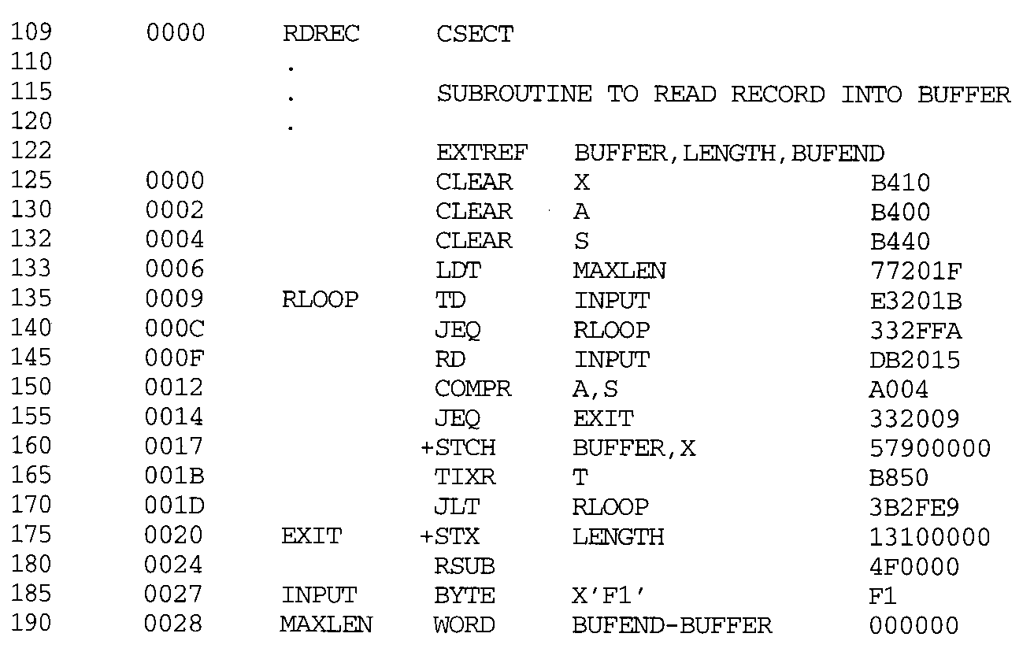

Slide 85
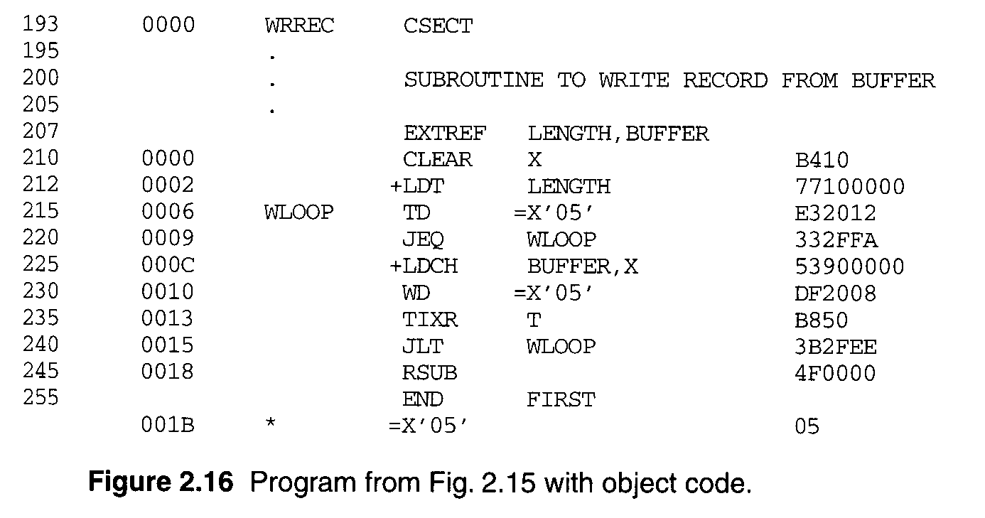

Slide 86
2.3.5 Control Sections & Program Linking
 The loader will add to this data area with the address of BUFEND and subtract from it the address of BUFFER. (COPY and RDREC for MAXLEN)
 Line 190 and 107, in 107, the symbols BUFEND and BUFFER are defined in the same section.
 The assembler must remember in which control section a symbol is defined.
 The assembler allows the same symbol to be used in different control sections, lines 107 and 190.
Figure 2.17, two new records.
 Defined record for EXTDEF, relative address.
 Refer record for EXTREF.

Slide 87
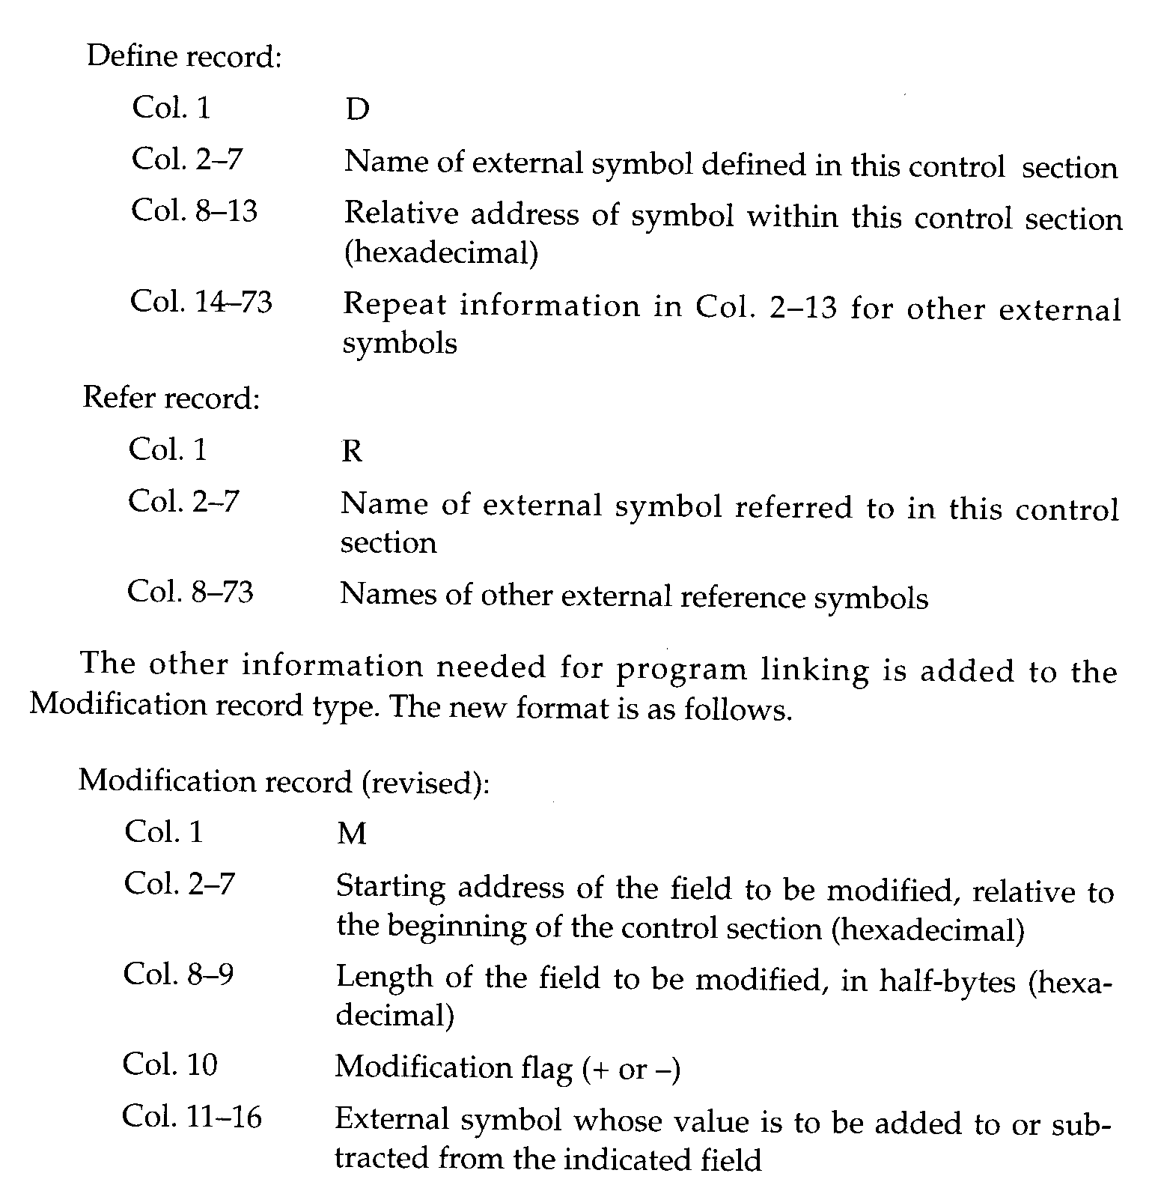

Slide 88
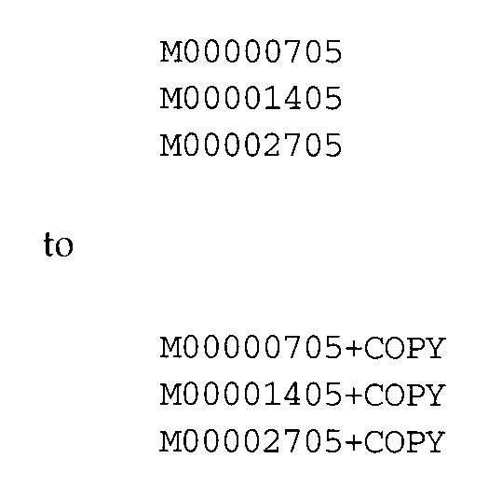
2.3.5 Control Sections & Program Linking
Modification record
 M
 Starting address of the field to be modified, relative to the beginning of the control section (Hex).
 Length of the field to be modified, in half-bytes.
 Modification flag (+ or -).
 External symbol. M^000004^05+RDREC M^000028^06+BUFEND M^000028^06-BUFFER
Use Figure 2.8 for program relocat
ion.

Slide 89
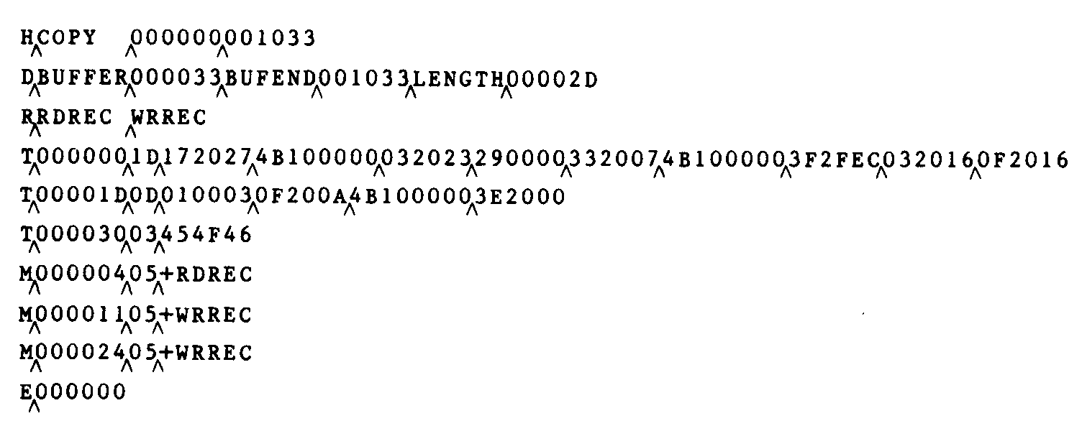


Slide 90

90

Slide 91
2.4 Assembler Design Options
2.4.1 Two-Pass Assembler
Most assemblers
 Processing the source program into two passes.
 The internal tables and subroutines that are used only during Pass 1.
 The SYMTAB, LITTAB, and OPTAB are used by both passes.
The main problems to assemble a program in one pass involves forward references.

Slide 92
2.4.2 One-Pass Assemblers
Eliminate forward references
 Data items are defined before they are referenced.
 But, forward references to labels on instructions cannot be eliminated as easily.
 Prohibit forward references to labels.
Two types of one-pass assembler. (Fig. 2.18)
 One type produces object code directly in memory for immediate execution.
 The other type produces the usual kind of object program for later execution.

Slide 93

93

Slide 94


Slide 95


Slide 96
2.4.2 One-Pass Assemblers
Load-and-go one-pass assembler
 The assembler avoids the overhead of writing the object program out and reading it back in.
 The object program is produced in memory, the handling of forward references becomes less difficult.
 Figure 2.19(a), shows the SYMTAB after scanning line 40 of the program in Figure 2.18.
 Since RDREC was not yet defined, the instruction was assembled with no value assigned as the operand address (denote by - - - -).

Slide 97


Slide 98


Slide 99
2.4.2 One-Pass Assemblers
Load-and-go one-pass assembler
 RDREC was then entered into SYMTAB as an undefined symbol, the address of the operand field of the instruction (2013) was inserted.
 Figure 2.19(b), when the symbol ENDFIL was defined (line 45), the assembler placed its value in the SYMTAB entry; it then inserted this value into the instruction operand field (201C).
 At the end of the program, all symbols must be defined without any * in SYMTAB.
 For a load-and-go assembler, the actual address must be known at assembly time.

Slide 100
2.4.2 One-Pass Assemblers
Another one-pass assembler by generating OP
 Generate another Text record with correct operand address.
 When the program is loaded, this address will be inserted into the instruction by the action of the loader.
 Figure 2.20, the operand addresses for the instructions on lines 15, 30, and 35 have been generated as 0000.
 When the definition of ENDFIL is encountered on line 45, the third Text record is generated, the value 2024 is to be loaded at location 201C.
 The loader completes forward references.
100

