Slide 1
Lecture Notes for Chapter 2
Data Mining: Data

Slide 2
What is Data?
Collection of data objects and their attributes
An attribute is a property or characteristic of an object
Examples: eye color of a person, temperature, etc.
Attribute is also known as variable, field, characteristic, or feature
A collection of attributes describe an object
Object is also known as record, point, case, sample, entity, or instance
Attributes
Objects

Slide 3
Attribute Values
Attribute values are numbers or symbols assigned to an attribute
Distinction between attributes and attribute values
Same attribute can be mapped to different attribute values
Example: height can be measured in feet or meters
Different attributes can be mapped to the same set of values
Example: Attribute values for ID and age are integers
But properties of attribute values can be different
ID has no limit but age has a maximum and minimum value

Slide 4
Measurement of Length
The way you measure an attribute is somewhat may not match the attributes properties.

Slide 5
Types of Attributes
There are different types of attributes
Nominal
Examples: ID numbers, eye color, zip codes
Ordinal
Examples: rankings (e.g., taste of potato chips on a scale from 1-10), grades, height in {tall, medium, short}
Interval
Examples: calendar dates, temperatures in Celsius or Fahrenheit.
Ratio
Examples: temperature in Kelvin, length, time, counts

Slide 6
Properties of Attribute Values
The type of an attribute depends on which of the following properties it possesses:
Distinctness: = ≠
Order: < >
Addition: + -
Multiplication: * /
Nominal attribute: distinctness
Ordinal attribute: distinctness & order
Interval attribute: distinctness, order & addition
Ratio attribute: all 4 properties

Slide 7
Attribute Type
Description
Examples
Operations
Nominal
The values of a nominal attribute are just different names, i.e., nominal attributes provide only enough information to
distinguish one object from another. (=, ≠)
zip codes, employee ID numbers, eye color, sex: {male, female}
mode, entropy, contingency correlation, χ² test
Ordinal
The values of an ordinal attriute provide enough information to order objects. (<, >)
hardness of minerals, {good, better, best}, grades, street numbers
median, percentiles, rank correlation, run tests, sign tests
Interval
For interval attributes, the differences between values are meaningful, i.e., a unit of measurement exists. (+, - )
calendar dates, temperature in Celsius or Fahrenheit
mean, standard deviation, Pearson's correlation, t and F tests
Ratio
For ratio variables, both differences and ratios are meaningful. (*, /)
temperature in Kelvin, monetary quantities, counts, age, mass, length, electrical current
geometric mean, harmonic mean, percent variation

Slide 8
Attribute Level
Transformation
Comments
Nominal
Any permutation of values
If all employee ID numbers were reassigned, would it make any difference?
Ordinal
An order preserving change of values, i.e., new_value = f(old_value) where f is a monotonic function.
An attribute encompassing the notion of good, better best can be represented equally well by the values {1, 2, 3} or by { 0.5, 1, 10}.
Interval
new_value =a * old_value + b where a and b are constants
Thus, the Fahrenheit and Celsius temperature scales differ in terms of where their zero value is and the size of a unit (degree).
Ratio
new_value = a * old_value
Length can be measured in meters or feet.

Slide 9
Discrete and Continuous Attributes
Discrete Attribute
Has only a finite or countably infinite set of values
Examples: zip codes, counts, or the set of words in a collection of documents
Often represented as integer variables.
Note: binary attributes are a special case of discrete attributes
Continuous Attribute
Has real numbers as attribute values
Examples: temperature, height, or weight.
Practically, real values can only be measured and represented using a finite number of digits.
Continuous attributes are typically represented as floating-point variables.

Slide 10
Types of data sets
Record
Data Matrix
Document Data
Transaction Data
Graph
World Wide Web
Molecular Structures
Ordered
Spatial Data
Temporal Data
Sequential Data
Genetic Sequence Data

Slide 11
Important Characteristics of Structured Data
Dimensionality
Curse of Dimensionality
Sparsity
Only presence counts
Resolution
Patterns depend on the scale

Slide 12
Record Data
Data that consists of a collection of records, each of which consists of a fixed set of attributes

Slide 13
Data Matrix
If data objects have the same fixed set of numeric attributes, then the data objects can be thought of as points in a multi-dimensional space, where each dimension represents a distinct attribute
Such data set can be represented by an m by n matrix, where there are m rows, one for each object, and n columns, one for each attribute

Slide 14
Document Data
Each document becomes a `term' vector,
each term is a component (attribute) of the vector,
the value of each component is the number of times the corresponding term occurs in the document.

Slide 15
Transaction Data
A special type of record data, where
each record (transaction) involves a set of items.
For example, consider a grocery store. The set of products purchased by a customer during one shopping trip constitute a transaction, while the individual products that were purchased are the items.

Slide 16
Graph Data
A graph can sometimes be a convenient and powerful specific cases representation for data. We consider two specific cases: 1) the graph captures relationships among data objects and 2)the data objects themselves are reppresented as graphs.
Data with Relationships among objects: The relationships among objects frequently convey important information.
The data objects are mapped to nodes of the graph, while the relationships among objects are captured by the links between objects and link properties, such as direction and weights.
Consider web pages on the World Wide Web, which contain both text and links to other pages.
In order to process search engines, Web search engines collect and process web pages to extract their contents.
It is well known, however, that the links to and from each page provide a great deal of information about the relevance of a web page to a query, and thus, must also be taken into consideration.

Slide 17
Chemical Data
Data with objects that are graphs: If objects have structure, that is, the objects contain subobjects that have relationships, then such objects are frequently represented as graphs.
For example, the structure of chemical compounds can be represented by a graph, where nodes are atoms and the links between nodes are chemical bonds.
Below figure shows a ball-and-stick diagram of the chemical compound Benzene Molecule: C₆H₆ which contains atoms of carbon (black) and hydrogen (gray).
A graph representation makes it possible to determine which substructure occur frequently in a set of compounds and to ascertain whether the presence of any of these substructures is associated with the presence or absence of certain chemical properties, such as melting point or heat of formation.
Substructure mining, which is a branch of data mining that analyzes the data.

Slide 18
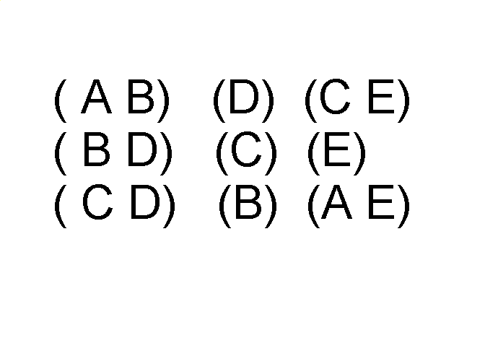
Ordered Data
Sequences of transactions
Items/Events
An element of the sequence

Slide 19
Ordered Data
Genomic sequence data

Slide 20
Ordered Data
Spatio-Temporal Data
Average Monthly Temperature of land and ocean

Slide 21
Data Quality
What kinds of data quality problems?
How can we detect problems with the data?
What can we do about these problems? Preventing data quality problems is typically not an option, data mining focuses on
the detection and correction of data quality (Data cleaning)
The use of algorithms that can tolerate poor data quality.
Examples of data quality problems:
Noise and outliers
missing values
duplicate data

Slide 22
Measurement and Data Collection Issues
It is unrealistic to expect the data to be perfect
Values or even entire data objects may be missing
Spurious or duplicate objects; i.e., multiple data objects that all correspond to a single “real” value. E.g., there might be two different records for a person who has recently lived at two different addresses
There may be inconsistencies- a person has a height of 2 meters, but weighs only 2 kilograms

Slide 23
Measurement and Data collection Errors
The measurement error refers to any problem resulting from the measurement process
A common problems is that the value recorded differs from the true value to some extent
For continuous attributes, the numerical difference of the measured and true value is called the error.
The data collection error refers to errors such as omitting data objects or attribute values or inappropriately including a data object.
Both measurement errors and data collection errors can be either systematic or random

Slide 24
Within particular domains, there are certain types of data errors that are commonplace, and there often exist well-developed techniques for detecting and/or correcting these errors.
For example, keyboard errors are common when data is entered manually, and as a result, many data entry programs have techniques for detecting and, with human intervention, correcting such errors.

Slide 25
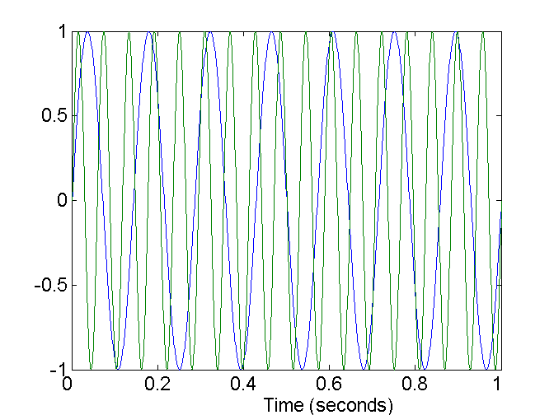
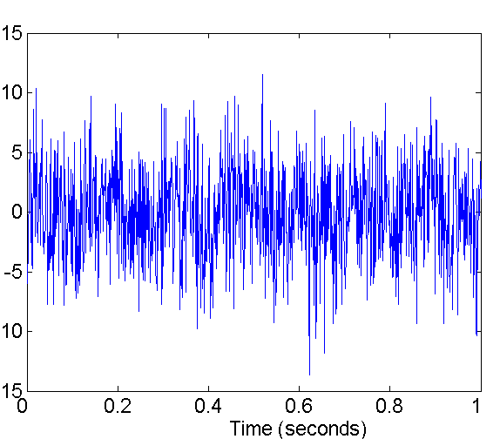
Noise
Noise refers to modification of original values
Examples: distortion of a person’s voice when talking on a poor phone and “snow” on television screen
Two Sine Waves
Two Sine Waves + Noise

Slide 26
Precision, Bias and Accuracy
In statistics and experimental science, the quality of the measurement process and the resulting data are measured by precision and bias.
Precision – the closeness of repeated measurements (of the same quantity) to one another (often measured by the standard deviation of a set of values)
Bias- A systematic variation of measurements from the quantity being measured ( measured by taking the difference between the mean of the set of values and the known value of the quantity being measured)
Accuracy- The closeness of measurements to the true value of the quantity being measured.

Slide 27
We have a standard laboratory weight with a mass of 1g and want to assess the precision and bias of our new laboratory scale.
We weigh the mass five times, and obtain the following five values :{1.015, 0.990, 1.013, 1.001, 0.986} the mean of this value is 1.001
Hence, the bias is 0.001. (1.001-1)
The precision, is measured by the standard deviation, is 0.013

Slide 28

µ is mean - mean of the values (add all the values/Total number of values) (5.005/5)= 1.001
σ is standard deivation
Variance is σ² = (1.015-1.001)² + (0.990-1.001)² + (1.013-1.001)² + (1.001- 1.001)² + (0.986 -1.001)² = 0.000686/5= 0.0001372= square root of answer= 0.012

Slide 29
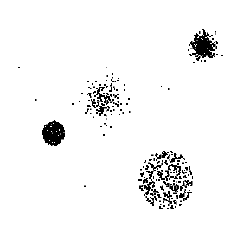
Outliers
Outliers are data objects with characteristics that are considerably different than most of the other data objects in the data set

Slide 30
Missing Values
Reasons for missing values
Information is not collected (e.g., people decline to give their age and weight)
Attributes may not be applicable to all cases (e.g., annual income is not applicable to children)
Handling missing values
Eliminate Data Objects
Estimate Missing Values
Ignore the Missing Value During Analysis
Replace with all possible values (weighted by their probabilities)

Slide 31
Duplicate Data
Data set may include data objects that are duplicates, or almost duplicates of one another
Major issue when merging data from heterogeous sources
Examples:
Same person with multiple email addresses
Data cleaning
Process of dealing with duplicate data issues

Slide 32
Issues Related to Application
Timeliness
Relevance
Knowledge about data

Slide 33
Data Preprocessing
Aggregation
Sampling
Dimensionality Reduction.
Discretization and Binarization
Attribute Transformation

Slide 34
Aggregation
Sometimes “less is more” and this is the case with aggregation, the combining of two or more objects into a single object.
Consider a data set consisting of transactions (data objects) recording the daily sales of products in various store locations(Bangalore,Dehli,Kolkata,Mumbai,..) for different days over the course of a year.
One way to aggregate transactions for this data set is to replace all the transactions of a single store with a single storewide transaction.
This reduces the hundreds or thousands of transactions that occur daily at a specific store to a single daily transaction, and the number of data objects is reduced to the number of stores.
How an aggregate transaction is created; i.e., how the values of each attribute are combined across all the records corresponding to a particular location to create the aggregate transaction that represents the sales of single store or date.
Quantitative attributes, such as price, are typically aggregated by taking a sum or an average.
A qualitative attributes, such as item, can either be omitted or summarized as the set of all the items that are sold at that location.

Slide 35
Motivations for aggregation
The smaller data sets resulting from the data reduction require less memory and processing time, aggregate may permit the use of expensive data mining algorithms.
aggregation can act as a change of scope or scale by providing a high-level view of the data instead of a low-level view.
aggregating over store locations and months gives us a monthly, per store view of the data instead of a daily, per item view.
The behaviour of groups of objects or attributes is often more stable than that of individual objects or attributes.
Averages or totals, have less variability than the individual objects being aggregated.
A Disadvantage of aggregation is the potential loss of interesting details.
In the store example aggregating over months loses information about which day of the week has the highest sales.

Slide 36
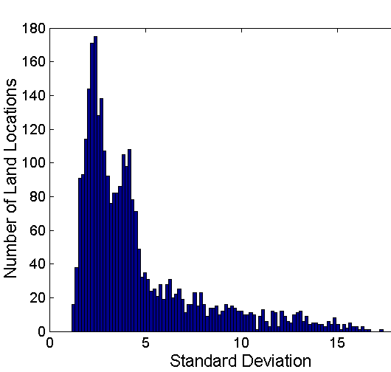
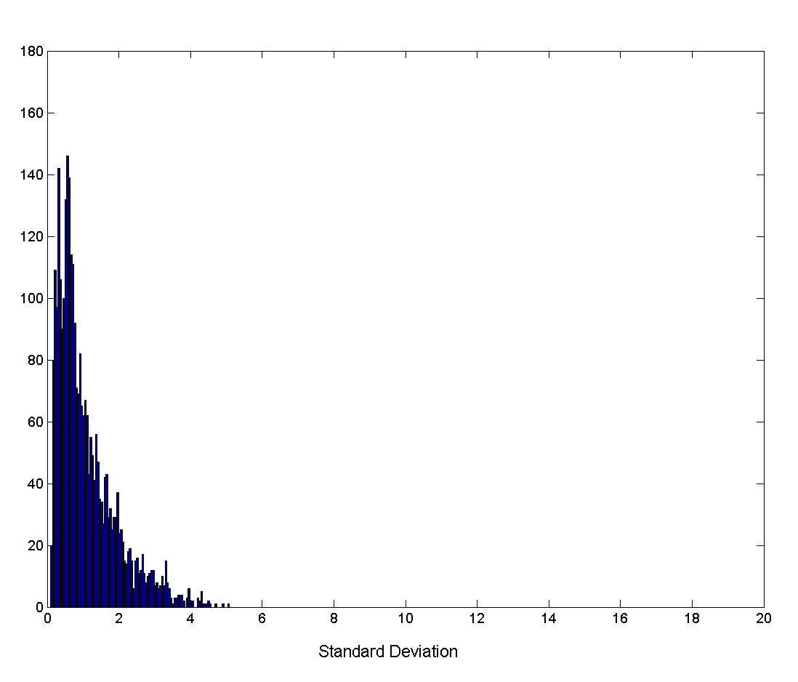
Aggregation
Variation of Precipitation in Australia
Standard Deviation of Average Monthly Precipitation
Standard Deviation of Average Yearly Precipitation

Slide 37
Sampling
Sampling is the main technique employed for data selection.
It is often used for both the preliminary investigation of the data and the final data analysis.
Statisticians sample because obtaining the entire set of data of interest is too expensive or time consuming.
Sampling is used in data mining because processing the entire set of data of interest is too expensive or time consuming.

Slide 38
Sampling …
The key principle for effective sampling is the following:
using a sample will work almost as well as using the entire data sets, if the sample is representative
A sample is representative if it has approximately the same property (of interest) as the original set of data

Slide 39
Types of Sampling
Simple Random Sampling
There is an equal probability of selecting any particular item
Sampling without replacement
As each item is selected, it is removed from the population
Sampling with replacement
Objects are not removed from the population as they are selected for the sample.
In sampling with replacement, the same object can be picked up more than once
Stratified sampling
Split the data into several partitions; then draw random samples from each partition

Slide 40
Sampling: With or without Replacement
SRSWOR
(simple random
sample without
replacement)
SRSWR
Raw Data

Slide 41
Sampling: Cluster or Stratified Sampling
Raw Data
Cluster/Stratified Sample

Slide 42

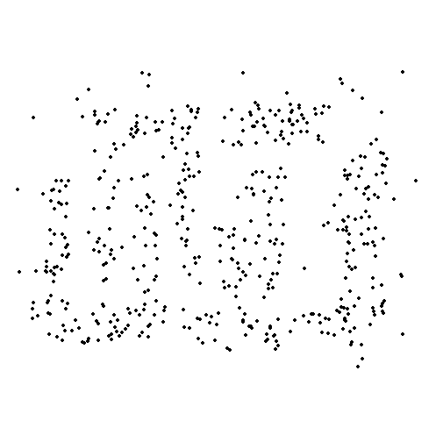
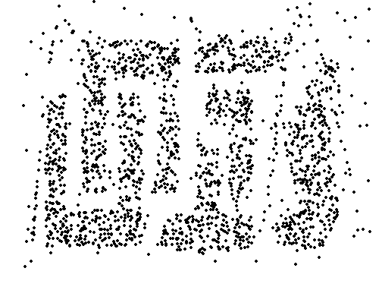
Sample Size
8000 points 2000 Points 500 Points

Slide 43
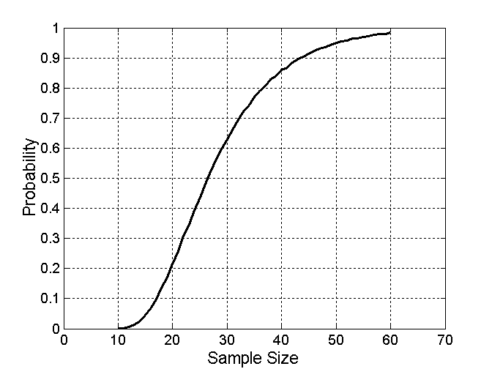

Sample Size
What sample size is necessary to get at least one object from each of 10 groups.

Slide 44
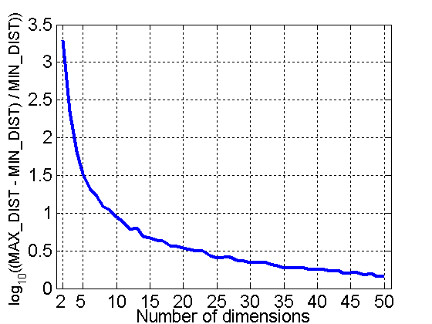
Curse of Dimensionality
When dimensionality increases, data becomes increasingly sparse in the space that it occupies
Definitions of density and distance between points, which is critical for clustering and outlier detection, become less meaningful
Randomly generate 500 points
Compute difference between max and min distance between any pair of points

Slide 45
Dimensionality Reduction
Purpose:
Avoid curse of dimensionality
Reduce amount of time and memory required by data mining algorithms
Allow data to be more easily visualized
May help to eliminate irrelevant features or reduce noise
Techniques
Principle Component Analysis
Singular Value Decomposition
Others: supervised and non-linear techniques

Slide 46
Dimensionality Reduction: PCA
Goal is to find a projection that captures the largest amount of variation in data
x₂
e
x₁

Slide 47
Dimensionality Reduction: PCA
Find the eigenvectors of the covariance matrix
The eigenvectors define the new space
x₂
e
x₁

Slide 48
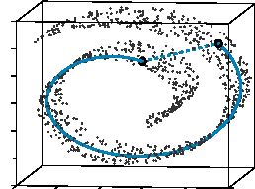
Dimensionality Reduction: ISOMAP
By: Tenenbaum, de Silva, Langford (2000)
Construct a neighbourhood graph
For each pair of points in the graph, compute the shortest path distances – geodesic distances

Slide 49
Dimensionality Reduction: PCA

Slide 50
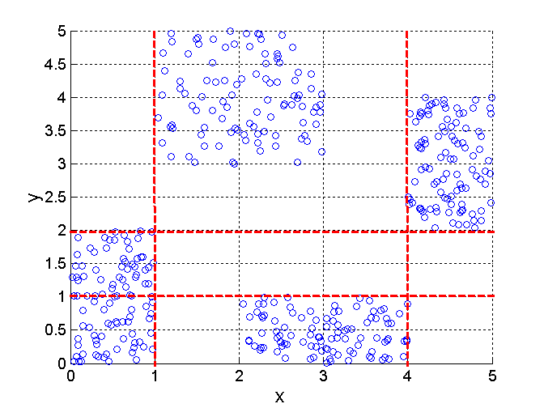
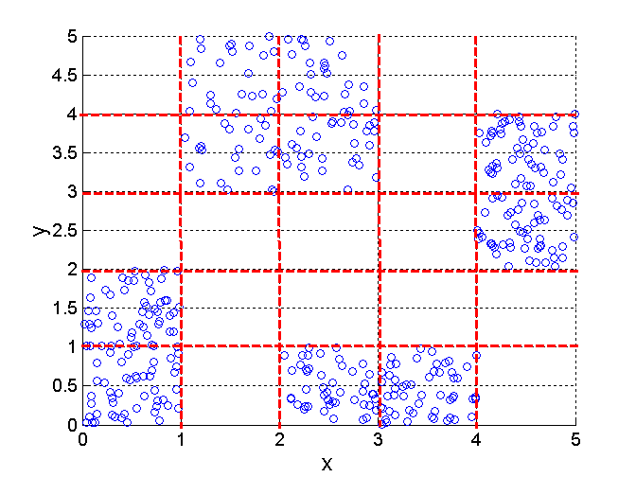
Discretization Using Class Labels
Entropy based approach
3 categories for both x and y
5 categories for both x and y

Slide 51
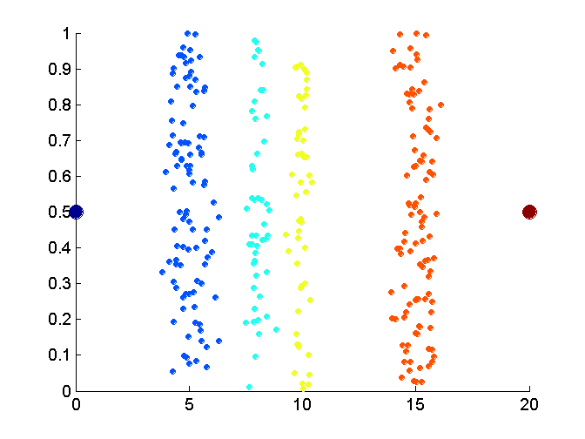
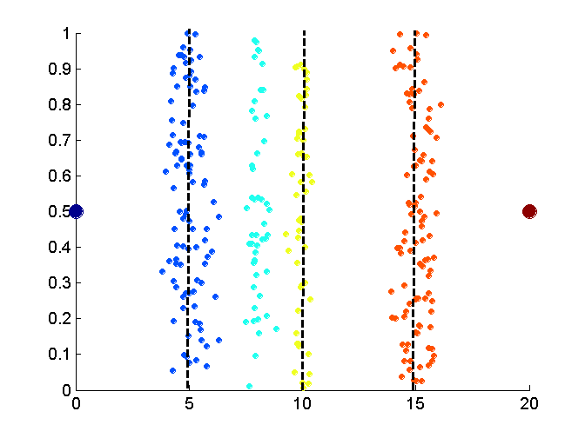
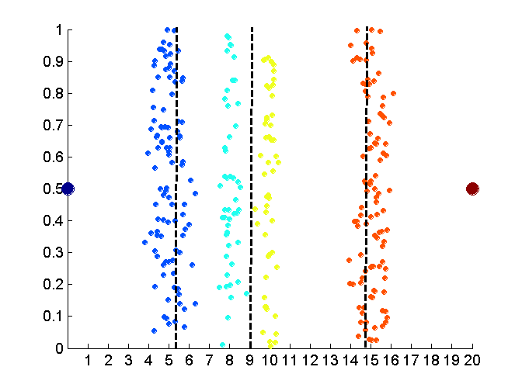
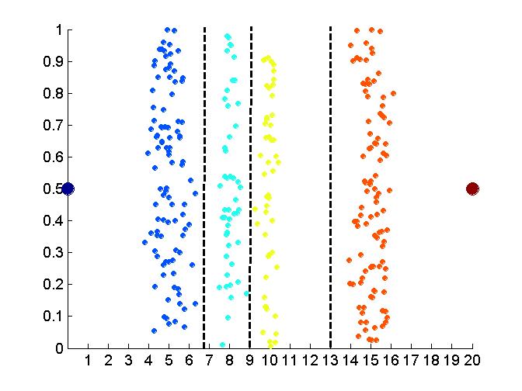
Discretization Without Using Class Labels
Data
Equal interval width
Equal frequency
K-means

Slide 52
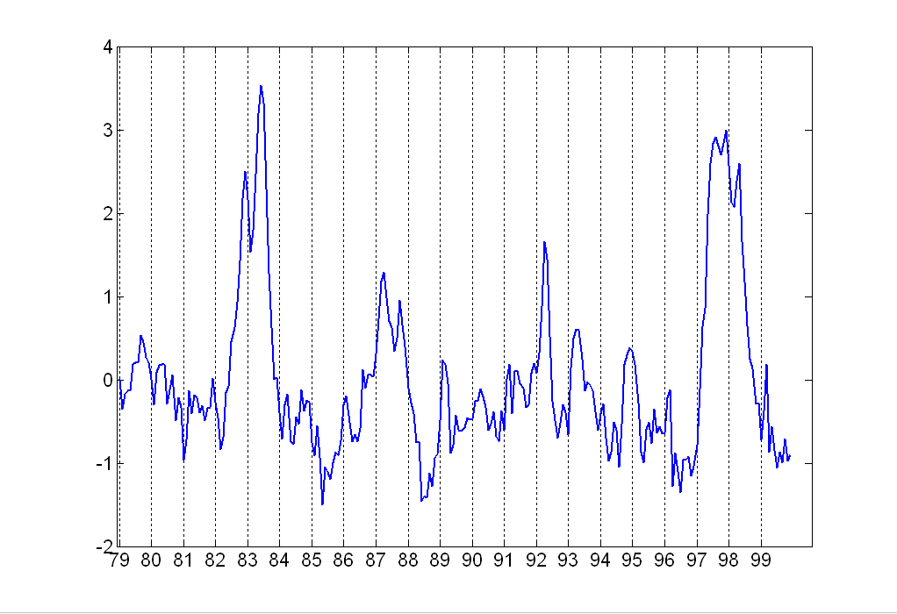
Attribute Transformation
A function that maps the entire set of values of a given attribute to a new set of replacement values such that each old value can be identified with one of the new values
Simple functions: x^{k}, log(x), e^{x}, |x|
Standardization and Normalization

